Slide 1
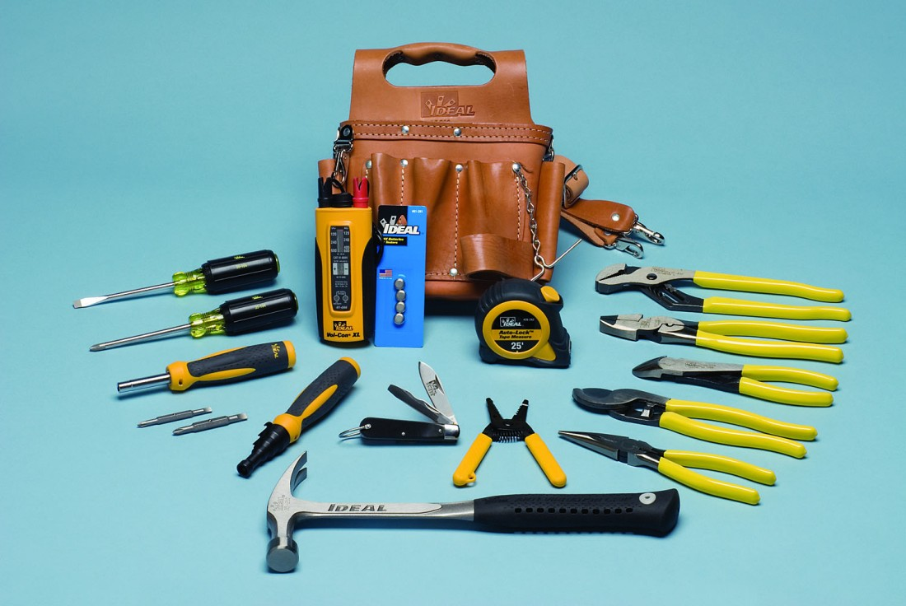
Basic Tools

Slide 2
“It is better to see one time than
to hear 100 times”

Slide 3
Code sharing & collaboration
http://jsfiddle.net/
Example:
http://jsfiddle.net/nxo9tyjj/

Slide 4
Code sharing & collaboration
http://jsbin.com/
http://codepen.io/

Slide 5
Screenshot sharing
http://clip2net.com/en/

Slide 6


Slide 7
Simple html markup
<ul class="menu-draft">
<li class="my-menu-item">menu item #1</li>
<li class="my-menu-item">menu item #2</li>
<li class="my-menu-item">menu item #3</li>
<li class="my-menu-item">menu item #4</li>
<li class="my-menu-item">menu item #5</li>
</ul>
ul.menu-draft>li.my-menu-item{menu item #$}*5

Slide 8
Emmet (IDE Plugin)
http://emmet.io/
http://jsbin.com/emmet-tips/1/edit

Slide 9
Chrome DevTools
https://developer.chrome.com/devtools
First step:
https://developer.chrome.com/devtools/docs/dom-and-styles

Slide 10
Markdown
http://en.wikipedia.org/wiki/Markdown
https://help.github.com/articles/markdown-basics/
https://help.github.com/articles/github-flavored-markdown/

