Slide 1
Lecture III

Slide 2
Scope

Slide 3
The Scope of a Variable
The scope of a variable are the locations
where it is accessible.
For example:
function foo() {
var x;
}

Slide 4
Nested Scope
function f() {
var x = 2;
function g() {
var y = 3;
alert(x + y);
}
}

Slide 5
Nested Scope
function f() {
var x = 2;
function g() {
var y = 3;
alert(x + y);
}
}
outer scope
inner scope

Slide 6
Shadowing
var scope = "global "; // A global variable
function outer() {
var scope = “outer”; // A outer variable
function inner() {
var scope = “inner";
document.write(scope); // Prints "inner"
}
inner();
}
outer();

Slide 7
Shadowing
var scope = "global "; // A global variable
function outer() {
var scope = “outer”; // A outer variable
function inner() {
document.write(scope); // Prints "outer"
}
inner();
}
outer();

Slide 8
Shadowing
var scope = "global "; // A global variable
function outer() {
function inner() {
document.write(scope); // Prints "global"
}
inner();
}
outer();

Slide 9
Hoisting
JavaScript hoists all variable declarations, it moves them to the beginning of their direct scopes.

Slide 10
Hoisting
foo(); // undefined ("foo" and "bar" exist)
function foo() {
alert(bar);
}
var bar;
function foo() {
alert(bar);
}
var bar;
foo(); // undefined

Slide 11
Hoisting
var scope = "global ";
function f( ) {
alert(scope);
var scope = "local";
alert(scope);
}
f( );
var scope = "global ";
function f( ) {
var scope;
alert(scope);
scope = "local";
alert(scope);
}
f( );

Slide 12
Only functions introduce new scopes
No block scope
function f() {
{ // block starts
var foo = 4;
} // block ends
console.log(foo); // 4
}

Slide 13
No block scope!
function test(o) {
var i = 0; // i is defined throughout function
if (typeof o == "object") {
var j = 0; // j is defined everywhere, not just block
for(var k=0; k < 10; k++) { // k is defined everywhere, not just loop
document.write(k);
}
document.write(k); // k is still defined: prints 10
}
document.write(j); // j is defined, but may not be initialized
}

Slide 14
Hoisting
var foo = 1;
function bar() {
if (!foo) {
var foo = 10;
}
alert(foo);
}
bar();

Slide 15
Code in global scope
Index.html
<!DOCTYPE html>
<html>
<head>
<title>Untitled Page</title>
<script type="text/javascript" src="script.js"></script>
</head>
<body>
<script type="text/javascript">
var a = 5;
var b = 2;
function sum(x, y) {
return x + y;
}
function mul(x, y) {
return x * y;
}
</script>
</body>
</html>
script.js
var gloabalVar = 5;
function square(x) {
return x * x;
}

Slide 16
Global namespace
Every variable is global unless it's in a function and is declared with var
window.globalVariable = “global”;
function x(){
globalVariable2 = “global2”;
}
x();
Global variables are evil

Slide 17
Global object
var x = 2;
this.x === 2;
window.x === 2;

Slide 18
Globals
// antipattern
function sum(x, y) {
// implied global
result = x + y;
return result;
}
// antipattern
function foo() {
var a = b = 0;
// ...
}
// preferred
function foo() {
var a, b;
// ...
a = b = 0; // both local
}

Slide 19
<script>
if (("a" in window) == false) {
var a = 1;
}
alert(a);
</script>

Slide 20
function declaration
VS
function expression

Slide 21
function declaration
function functionName([parameters]){
functionBody
};
add(2, 4); // works
function add(x, y) {
return x + y;
}

Slide 22
function declaration
alert(x); // function body
var x = 10;
alert(x); // 10
x = 20;
function x() { }
alert(x); // 20

Slide 23
function expression
variableName = function([parameters]){
functionBody
};
add; //undefined
add(2, 4); // this raises a TypeError
var add = function(x, y) {
return x + y;
}

Slide 24
Named function expression
variableName = function functionName([parameters]){
functionBody
};
var foo = function bar() {
bar(); // works
}
bar(); // ReferenceError

Slide 25
Function
variableName = new Function(/*parameters */, functionBody);
var add = new Function(“x”, “y”, “return x + y”);

Slide 26
Immediately-Invoked Function Expression (IIFE)

Slide 27
Lexical (Static) Scope
Static structure of a program determines the scope of a variable.
function f() {
var x = 2;
function g() {
alert(x);
}
}

Slide 28
Recap of lecture II

Slide 29


Slide 30


Slide 31
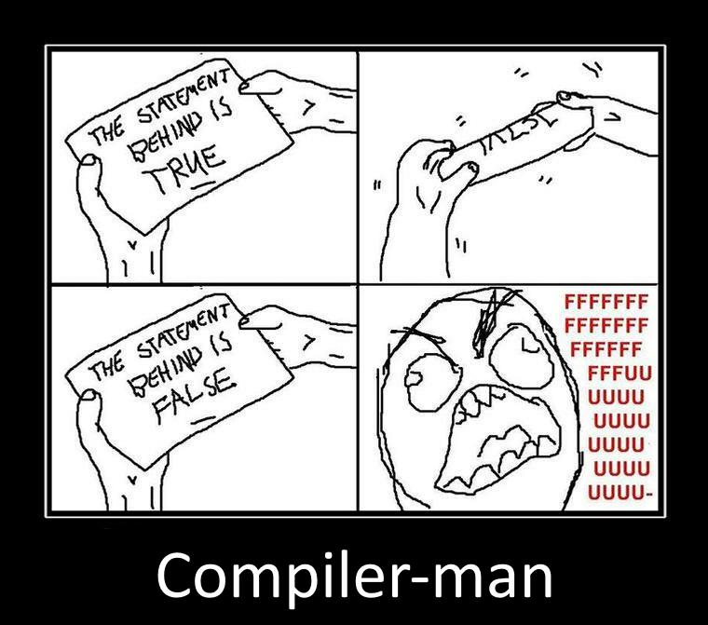

Slide 32
Example
var a = 2;
var b = 2;
console.log(a + b);

Slide 33
Evils of type coercion (recap)
'' == '0' // false
0 == '' // true
0 == '0' // true
false == 'false' // false
false == '0' // true
false == undefined // false
false == null // false
null == undefined // true
‘ \t\r\n ' == 0 // true

Slide 34
Implicit Typecasting
var zero = 0;
/* antipattern */
if (zero == false) {
// this block is executed...
}
// preferred
if (zero === false) {
// not executing because zero is 0, not false
}

Slide 35
semicolon
var a = b
//blah blah blah
(function() {alert(1)})()

Slide 36
With statement
with (obj) {
a = b;
}
a = b;
a = obj.b;
obj.a = b;
obj.a = obj.b;

Slide 37
Identifiers
Starts with a letter or _ or $
Followed by zero or more letters, digits, _ or $
By convention, all variables, parameters, members, and function names start with lower case
Except for constructors which start with upper case

Slide 38
Embedding scripts in HTML
a) Between a pair of <script> and </script> tags
<script type="text/javascript">
alert(“hello world!”);
</script>
b) From an external file specified by the src attribute of a <script> tag
<script type="text/javascript" src="script.js”></script>
c) In an event handler, specified as the value of an HTML attribute
such as onclick or onmouseover
<button onclick="sayHello();">execute function "sayHello"</button>
d) In a URL, uses the special javascript: protocol
javascript:alert(“Hello world”);

Slide 39
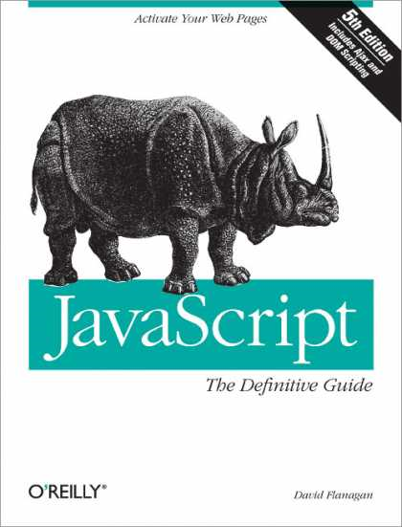
REFERENCES
JavaScript: The Definitive Guide, Six Edition
by David Flanagan
Speaking JavaScript: An In-Depth Guide for Programmers
by Dr. Axel Rauschmayer
http://dmitrysoshnikov.com
http://learn.javascript.ru

Slide 40
There are only two kinds of languages: the ones people complain about and the ones nobody uses Bjarne Stroustrup

Slide 41
ES6 In Depth: let and const

Slide 42
Problem 2 - Variable oversharing in loops

Slide 43
Static (lexical) scope
var z = 10;
function foo() {
alert(z);
}
foo();
(function () {
var z = 20;
foo();
})();
The word “static” relates to ability to determine the scope of an identifier during the parsing stage of a program.

Slide 44
function X() {
var a = 3, b = 5;
function foo () {
var b = 7, c = 11;
a += b + c;
};
foo();
alert("a = " + a + "; b = " + b);
}
X();
var x = function(){
alert(x.toString());
}
x();

Slide 45
Namespaces
if (window.myNamespace == null){
window.myNamespace = {};
}
window.myNamespace.myFunction = function(/* params*/ ) {
/* code here */
};

Slide 46
Code generation
Javascript can compile text to an executable code:
eval() - compile a string as JavaScript.
new Function() - compile a function.
setTimeout, setInterval - can both take a string as their first argument

Slide 47
eval is evil
The eval function will execute a string of JavaScript code in the current scope
var foo = 1;
function test1() {
var foo = 2;
eval("foo = 3");
}
test1();
console.log(foo); // 1

Slide 48
eval is evil
var foo = 1;
function myEval(code) {
eval(code);
}
function test2() {
var foo = 2;
myEval("foo = 3");
}
test2();
console.log(foo); //3

Slide 49
eval is evil
+ Security Issues
+ eval requires a compile and is therefore slow

