Slide 1
Strategy of passing arguments to function
Primitive types are manipulated by value.
Object types are manipulated by sharing.
function x(t){
t.a = 5;
t = {};
}
var obj = {};
x(obj)
console.log(obj)

Slide 2
Arrays
Array inherits from Object.
Indexes are converted to strings and used as names for retrieving values.
Arrays have a special length member.
var array = new Array(1, 2, 3);
var array = [1,2,3];
var array = [1, "234234", true, function() { alert("hello!"); } ];
array.length

Slide 3
Arrays
var array = new Array(3);
// [undefined, undefined, undefined]
var array = new Array(‘3’);
// ["3"]
var array = [3];

Slide 4
sort
var n = [4, 8, 15, 16, 23, 42];
n.sort();
// n is [15, 16, 23, 4, 42, 8]

Slide 5
Deleting Elements
delete array[number]
Removes the element, but leaves a hole in the numbering.
array.splice(number, 1)
Removes the element and renumbers all the following elements.

Slide 6
Deleting Elements
myArray = ['a', 'b', 'c', 'd'];
delete myArray[1];
// ['a', undefined, 'c', 'd']
myArray.splice(1, 1);
// ['a', 'c', 'd']

Slide 7
Array methods
var arrayAsString = array.join("separator");
array.reverse();
array.sort(/* options: comparison function */);//important
var newArray = array.concat("array");
var subarray = array.slice(“startIndex”,”lastIndex”);
array.splice(“startIndex”,”itemsToRemove”,/*new items*/);
var newArrayLength = array.push(“value”);
var removedValue= array.pop();
var newArrayLength = array.unshift(“value”) ;
var removedValue= array.shift();

Slide 8
WAT
2 == [[[[2]]]]

Slide 9
Unusual operators
Addition (+)
Equality (==) and Identity (===)
Comparison Operators
The in Operator
Logical OR (||)
The delete Operator

Slide 10
== !=
Equal and not equal
These operators can do type coercion
It is always better to use === and !==, which do not do type coercion.

Slide 11
Evils of type coercion
'' == '0' // false
0 == '' // true
0 == '0' // true
false == 'false' // false
false == '0' // true
false == undefined // false
false == null // false
null == undefined // true
‘ \t\r\n ' == 0 // true

Slide 12
Implicit Typecasting
var zero = 0;
/* antipattern */
if (zero == false) {
// this block is executed...
}
// preferred
if (zero === false) {
// not executing because zero is 0, not false
}

Slide 13
semicolon
var a = b
//blah blah blah
(function() {alert(1)})()

Slide 14
With statement
with (obj) {
a = b;
}
a = b;
a = obj.b;
obj.a = b;
obj.a = obj.b;

Slide 15
Identifiers
Starts with a letter or _ or $
Followed by zero or more letters, digits, _ or $
By convention, all variables, parameters, members, and function names start with lower case
Except for constructors which start with upper case

Slide 16
Constants
var COLOR_BLUE = "#00F";
var COLOR_RED = "#0F0";
var COLOR_GREEN = "#F00";
var COLOR_ORANGE = "#FF7F00";

Slide 17
Comments
/*
When I wrote this, only God and I understood what I was doing
Now, God only knows
*/
// Magic. Do not touch.

Slide 18
Example

Slide 19
Embedding scripts in HTML
a) Between a pair of <script> and </script> tags
<script type="text/javascript">
alert(“hello world!”);
</script>
b) From an external file specified by the src attribute of a <script> tag
<script type="text/javascript" src="script.js”></script>
c) In an event handler, specified as the value of an HTML attribute
such as onclick or onmouseover
<button onclick="sayHello();">execute function "sayHello"</button>
d) In a URL, uses the special javascript: protocol
javascript:alert(“Hello world”);

Slide 20
There are only two kinds of languages: the ones people complain about and the ones nobody uses Bjarne Stroustrup

Slide 21

Questions?

Slide 22
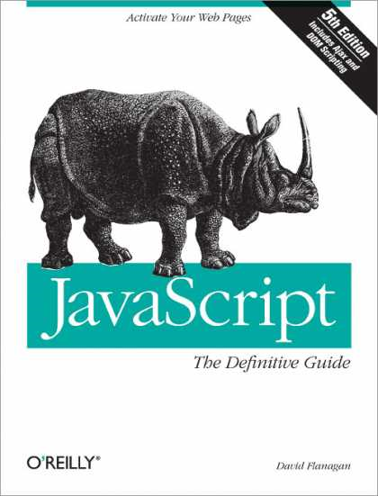
REFERENCES (TODO)
JavaScript: The Definitive Guide, Six Edition
by David Flanagan
http://javascript.crockford.com/
http://developer.yahoo.com/yui/theater/
http://dmitrysoshnikov.com
http://javascript.ru
http://www.w3schools.com
http://google-styleguide.googlecode.com/svn/trunk/javascriptguide.xml

