Slide 1
Network

Slide 2
299 792 458 m / s
~ 209 854 720 m / s

Slide 3
Alexa
http://www.alexa.com/topsites

Slide 4
Experiment
Top 1M Alexa sites
Google Chrome
Cable profile (5Mbps / 28 ms RTT)
Read more: http://developer.chrome.com/devsummit/sessions#perf-network

Slide 5


Slide 6
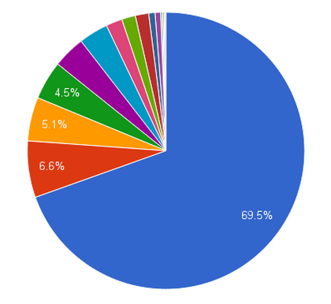
Results
69,5% of time blocked on network
6,6% of time blocked on JavaScript evaluation
5,1% blocked on Layout
4,5% blocked on Paint

Slide 7
Networking Basics

Slide 8
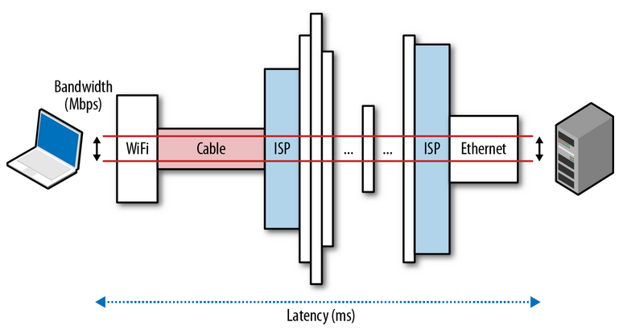
Bandwidth and Latency

Slide 9
Bandwidth
Region | Avg. Connection Speed (Mbps)
Netherlands | 12.5
France | 6.5
South Korea | 22.1 (~2.7625 Mbyte/sec)
Russia | 7.8
United States | 9.8
Australia | 5.5
China | 2.9
Latin & South America | ~3
Middle East & Africa | ~2.5
The State of the Internet by Akamai
http://www.akamai.com/dl/akamai/akamai-soti-q313.pdf?WT.mc_id=soti_Q313

Slide 10
Upstream bandwidth
usually just 20% of the total bandwidth

Slide 11
Round-trip time (RTT)
Client
Server
RTT

Slide 12
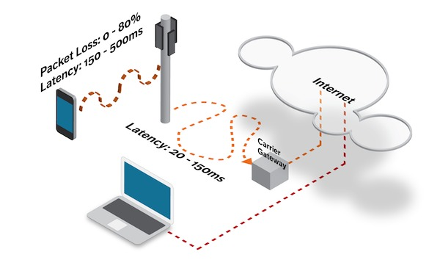
Latency
Read more: http://www.mobify.com/blog/web-performance-optimization/

Slide 13
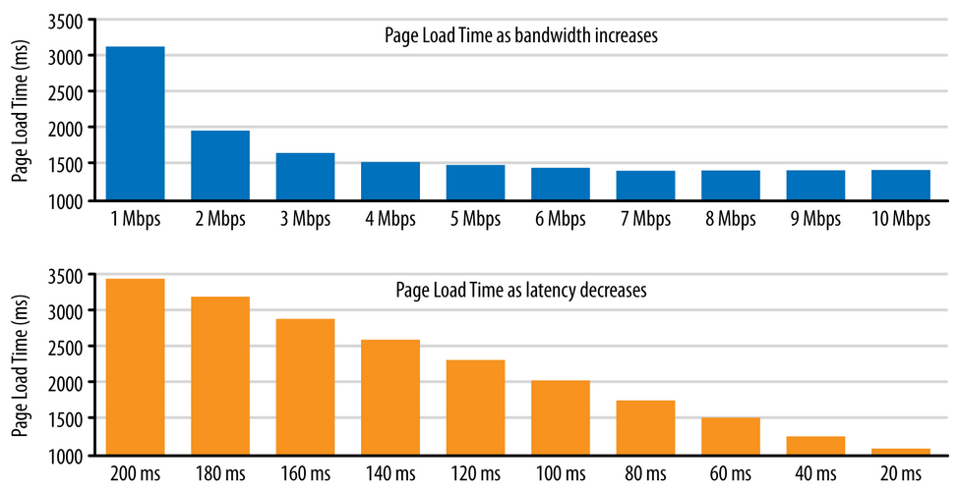
Bandwidth vs Latency
Read more: http://chimera.labs.oreilly.com/books/1230000000545/ch10.html#LATENCY_BOTTLENECK

Slide 14
In early 2011, Huawei and Hibernia Atlantic began laying a new 3,000-mile fiber-optic link ("Hibernia Express") across the Atlantic Ocean to connect London to New York, with the sole goal of saving traders 5 milliseconds of latency by taking a shorter route between the cities, as compared with all other existing transatlantic links… cost over $400M

Slide 15
Signal latencies in vacuum and fiber
Route | Distance | Time, light in vacuum | Time, light in fiber | Round-trip time (RTT) in fiber
New York to San Francisco | 4,148 km | 14 ms | 21 ms | 42 ms
New York to London | 5,585 km | 19 ms | 28 ms | 56 ms
New York to Sydney | 15,993 km | 53 ms | 80 ms | 160 ms
Equatorial circumference | 40,075 km | 133.7 ms | 200 ms | 200 ms

Slide 16
Last-Mile Latency

Slide 17
Basic Steps
App Cache
DNS
TCP
Request
Response

Slide 18
Cache
The truth is that "it's all in the cache" is another common myth. For various reasons a surprising amount of visitors will always come to your site with an empty cache.
An experiment done with the Yahoo! front-page revealed that:
40-60% of the daily visitors come with empty cache
20% of all the page views are always empty cache views
Read more: http://www.bookofspeed.com/chapter3.html

Slide 19

Three-Way Handshake
All TCP connections begin with this:
Read more: http://www.bookofspeed.com/chapter3.html
http://chimera.labs.oreilly.com/books/1230000000545/ch02.html

Slide 20
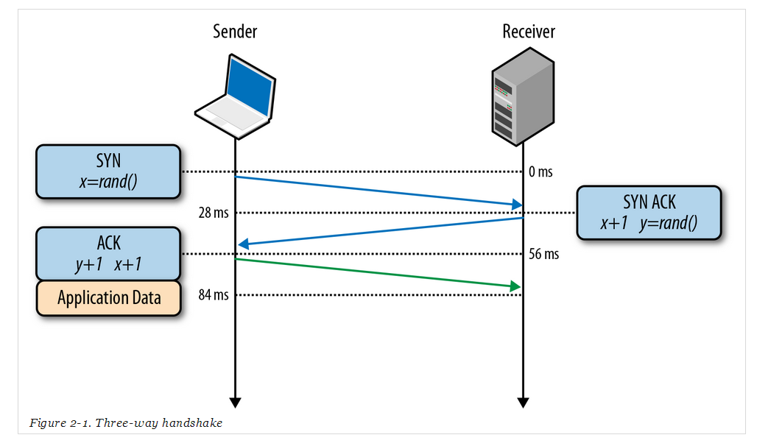
New York – London (5,585 km)

Slide 21

TCP Slow Start

Slide 22
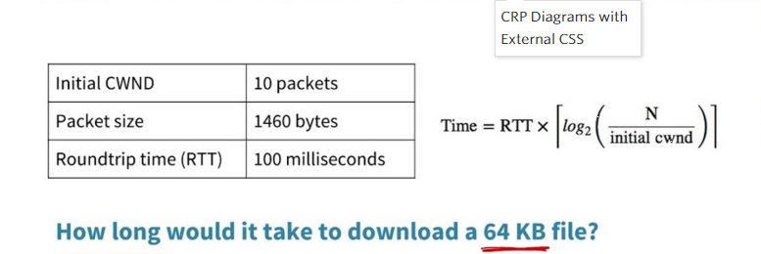

Slide 23
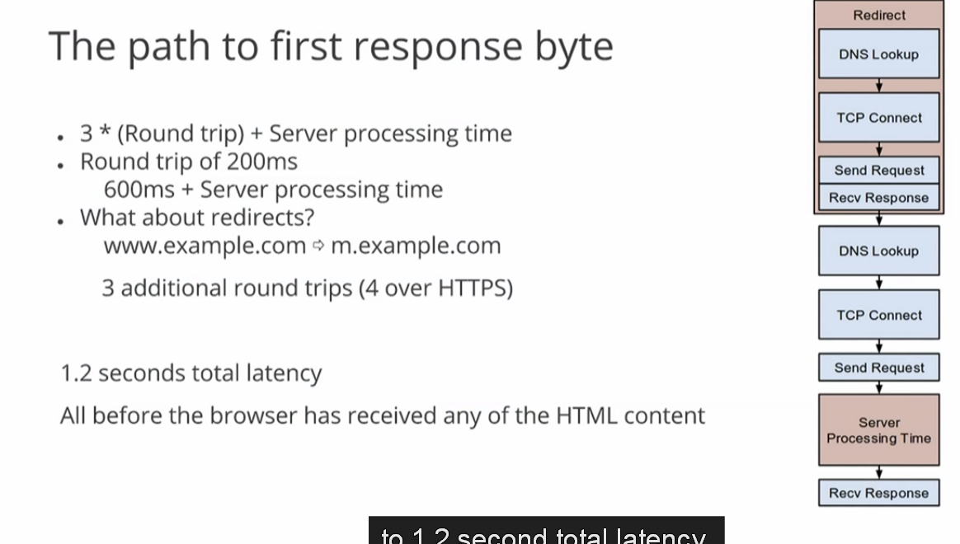

Slide 24

http://chimera.labs.oreilly.com/books/1230000000545

Slide 25
Summary
No bit is faster than one that is not sent ☺
2) We can’t make the bits travel faster, but we can move the bits closer.
3) TCP connection reuse is critical to improve performance.

Slide 26
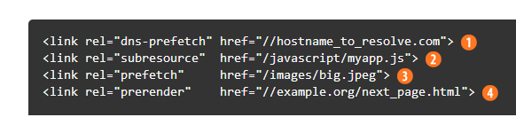
Oops! Good news
Resource pre-fetching and prioritization
DNS pre-resolve
TCP pre-connect
Page pre-rendering

Slide 27
SPDY (HTTP 2.0)
Multiplexed streams
Request prioritization
HTTP header compression
Server push
Server hint

Slide 28
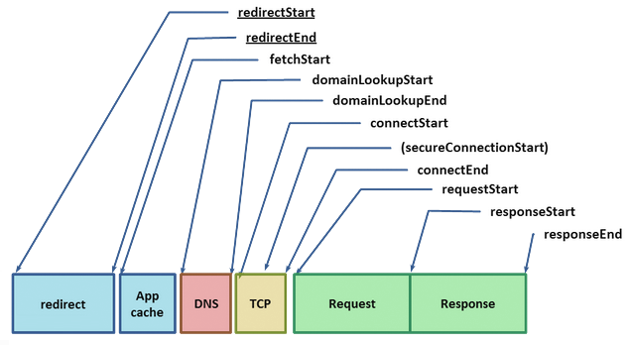
Navigation Timing
Read more: http://www.w3.org/TR/navigation-timing/
http://www.igvita.com/posa/high-performance-networking-in-google-chrome/

Slide 29
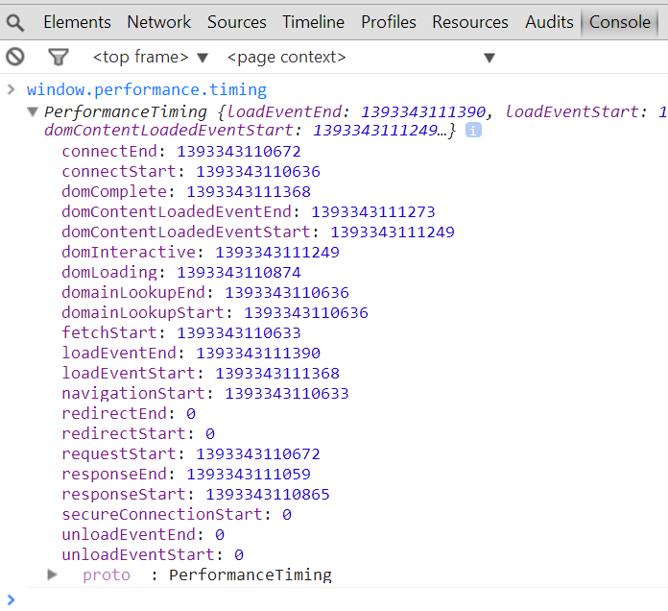

Slide 30

Page Speed

Slide 31
PageSpeed Insights
https://developers.google.com/speed/pagespeed/insights/

Slide 32
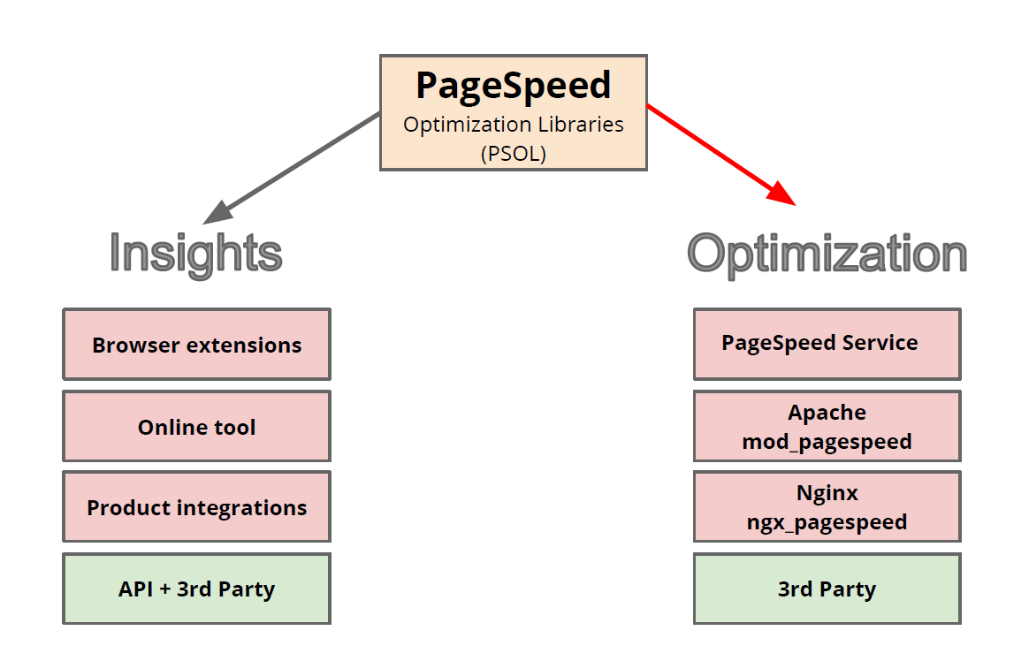
http://www.slideshare.net/igrigorik/pagespeed-what-why-and-how-it-works

Slide 33
PageSpeed Insights
URL | Mobile | Mobile UX | Desktop
http://www.epam.com/ | 59 / 100 | 2 / 5 | 77 / 100
http://www.itransition.com/ | 56 / 100 | 1 / 5 | 66 / 100
http://www.sam-solutions.com/ | 31 / 100 | 4 / 5 | 37 / 100
http://ru.wargaming.net/ | 69 / 100 | 2 / 3 | 89 / 100
http://xbsoftware.com/ | 66 / 100 | 4 / 5 | 78 / 100

Slide 34
https://developers.google.com/speed/docs/insights/rules
https://developers.google.com/speed/pagespeed/module/using
http://www.slideshare.net/igrigorik/pagespeed-what-why-and-how-it-works

Slide 35
http://www.webpagetest.org/

Slide 36
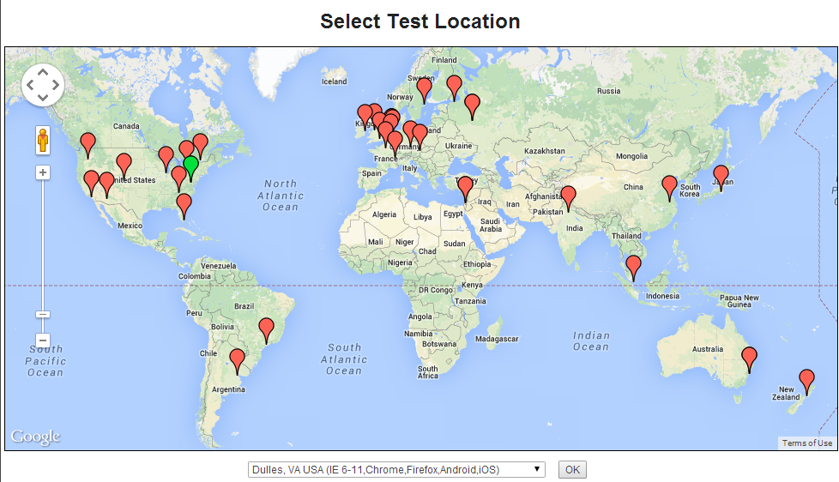

Slide 37
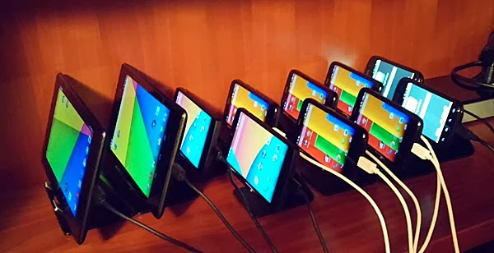
Dulles, VA USA (Android 4.4, 2.3, iOS)

Slide 38
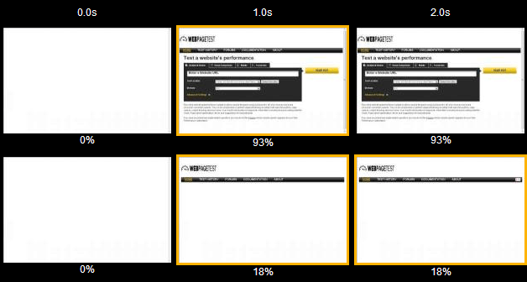
Speed Index

Slide 39
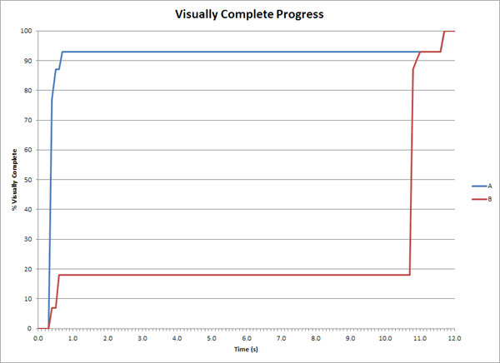
Speed Index

Slide 40
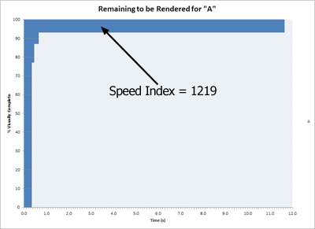
Speed Index

Slide 41
Demo

Slide 42
Keep-alive - http://www.webpagetest.org/result/140226_3K_82Z/1/details/

Slide 43
Out of Scope
SPDY
Domain Sharding
HTTP Pipelining
Compression (gzip and etc.)
Etc.

Slide 44
Want more?
http://developer.chrome.com/devsummit/sessions#perf-network
http://blog.pamelafox.org/2014/01/improving-front-page-performance.html
http://www.igvita.com/posa/high-performance-networking-in-google-chrome/
https://www.youtube.com/watch?v=4Q9e58_08E4
http://www.slideshare.net/AndyDavies/web-page-test-beyond-the-basics

Slide 45
Questions?

Slide 46
Gzip
https://www.youtube.com/watch?v=whGwm0Lky2s&feature=youtu.be
https://docs.google.com/presentation/d/1TtEKxKLi2pG3OoS8fgCpum_9nPZz_KxgO3UkBdh4bh8/edit#slide=id.p18

Slide 47
http://httpArchive.org/
The HTTP Archive tracks how the Web is built.
Trends in web technology
load times, download sizes, performance scores
Interesting stats
popular scripts, image formats, errors, redirects
Website performance specific URL screenshots, waterfall charts, HTTP headers

Slide 48
http://httpArchive.org/
Time frame: January 2013 - February 2014
Scope: ~290K URL’s from Top 1M Alexa sites
All stats: http://httparchive.org/trends.php?s=All&minlabel=Jan+1+2014&maxlabel=Feb+15+2014

Slide 49
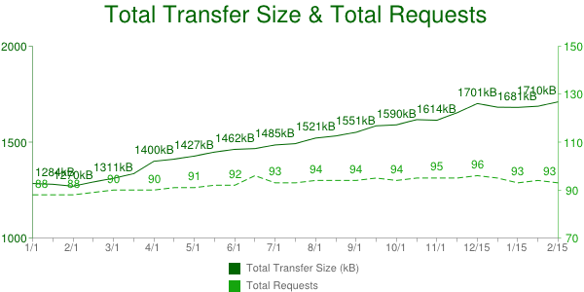

Slide 50
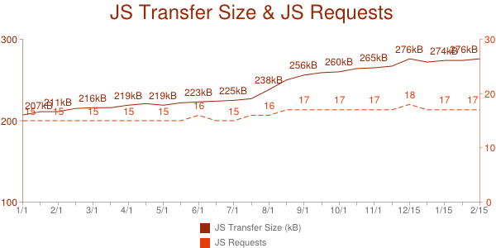

Slide 51
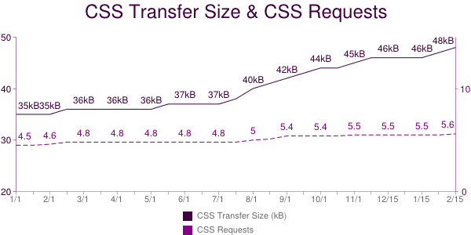

Slide 52
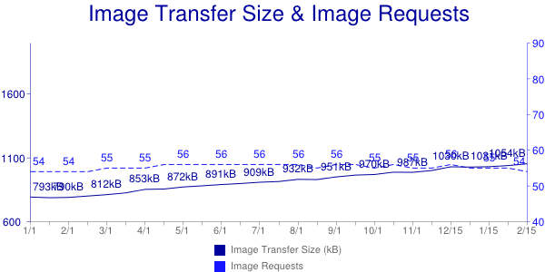

Slide 53
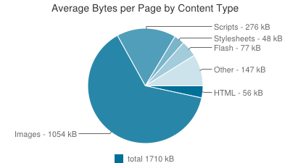

Slide 54
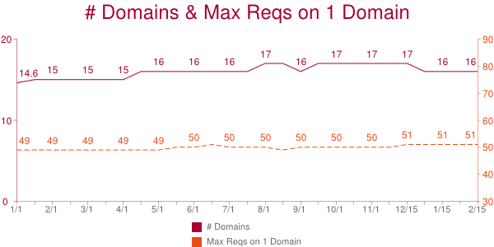

Slide 55
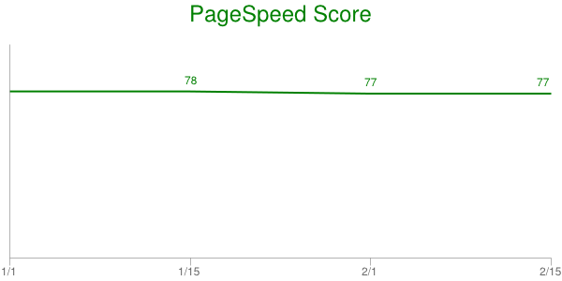

Slide 56
gzip
http://www.infoq.com/presentations/zip-code

Slide 57
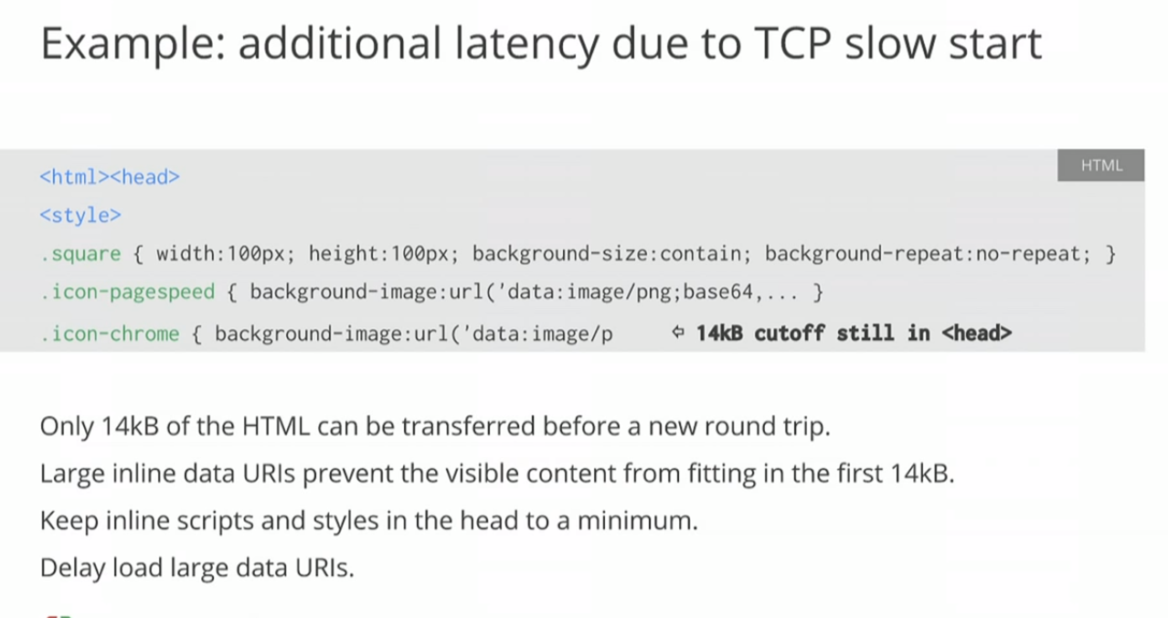
+gzip
https://developers.google.com/events/io/sessions/325128936

Slide 61
Исследования yandex
http://habrahabr.ru/company/yandex/blog/222951/

Slide 62
http://www.slideshare.net/patrickmeenan/webpagetest-power-users-velocity-2014

Slide 63
http://blog.catchpoint.com/2014/04/29/understanding-rtt-impact-on-tcp-retransmissions/
+ wireshark + three way handshake

Slide 64
Dial Up Modem Handshake Sound - Spectrogram
https://www.youtube.com/watch?v=vvr9AMWEU-c
http://i.imgur.com/5Dq6K2U.png

Slide 65
Nice presentation
http://mattandrews.info/talks/port80-2013/#/11
https://speakerdeck.com/patrickhamann/css-and-the-critical-path

Slide 66
SPDY
https://developers.google.com/speed/spdy/
http://dev.chromium.org/spdy/spdy-best-practices
http://googlecode.blogspot.com/2012/01/making-web-speedier-and-safer-with-spdy.html

Slide 67
http://blog.catchpoint.com/2014/04/29/understanding-rtt-impact-on-tcp-retransmissions/

Slide 68
Paul Irish, Fluent 2014 Keynote, "Delivering the goods"
https://docs.google.com/presentation/d/1MtDBNTH1g7CZzhwlJ1raEJagA8qM3uoV7ta6i66bO2M/present#slide=id.g17390f7c5_2_114
https://www.youtube.com/watch?v=R8W_6xWphtw&feature=youtu.be&t=9m24s

Slide 69
Inspired by
High Performance Browser Networking (Ilya Grigorik)
Even Faster Web Sites (Steve Souders)
Book of Speed (Stoyan Stefanov)

