Slide 1
Prototype
Every function has a prototype property and it contains an object.
function Rectangle(w, h) { … }
Rectangle
prototype length
{}

Slide 2
Prototype
prototype is a property that gets created as soon as you define the function. Its initial value is an object with a single constructor property.
Rectangle
prototype length
Rectangle.prototype
constructor
Assert(Rectangle.prototype.constructor === Rectangle);

Slide 3
Prototype vs [[Prototype]]
The value of the prototype property is used to initialize the [[Prototype]] property of a newly created object.
The [[Prototype]] property is an internal reference to prototype object.

Slide 4
function Rectangle(w, h) {
this.width = w;
this.height = h;
}
var rect1 = new Rectangle(2, 4);
Assert(rect1 instanceof Rectangle);
var rect2 = new Rectangle(8, 11);
Rectangle
prototype length
[[prototype]]
rect1
width = 2 height = 4
[[prototype]]
{}
constructor
[[prototype]]
rect2
width = 8 height = 11
[[prototype]]

Slide 5
{}
constructor
[[prototype]]
Function
prototype length
[[prototype]]
Rectangle
prototype length
[[prototype]]
{}
constructor
toString() apply() call()
[[prototype]]
{}
constructor
toString()
[[prototype]]

Slide 6
Constructor function
var rectangle = new Rectangle(2, 4);
function Rectangle(w, h) {
this.width = w;
this.height = h;
}
function Rectangle(w, h) {
this.width = w;
this.height = h;
return;
}
function Rectangle(w, h) {
this.width = w;
this.height = h;
}
function Rectangle(w, h) {
this.width = w;
this.height = h;
return {};
}

Slide 7
new operator
The new operator creates a new object and invokes a constructor function to initialize it.
var obj = new Object();
var date = new Date( );
var rectangle = new Rectangle(2, 4);

Slide 8
var rect1 =
new
Rectangle
(2, 4);
function Rectangle(w, h) {
this.width = w;
this.height = h;
}
{}
{}
[[prototype]]
{}
width = 2 height = 4
[[prototype]]

Slide 9
How new work?
function newOperator(Constr, args) {
var thisValue = Object.create(Constr.prototype); // (1)
var result = Constr.apply(thisValue, args);
if (typeof result === 'object' && result !== null) {
return result; // (2)
}
return thisValue;
}

Slide 10
Methods
var rect1 = new Rectangle(2, 4);
var rect2 = new Rectangle(8, 11);
rect1.area = function() {
return this.width * this.height;
}
rect1
width = 2 height = 4
area()
[[prototype]]
rect2
width = 8 height = 11
[[prototype]]
{}
constructor
[[prototype]]

Slide 11
var rect1 = new Rectangle(2, 4);
var rect2 = new Rectangle(8, 11);
function Rectangle(w, h) {
this.width = w;
this.height = h;
this.area = function() {
return this.width * this.height;
}
}
rect1
width = 2 height = 4
area()
[[prototype]]
rect2
width = 8 height = 11
area()
[[prototype]]
{}
constructor
[[prototype]]

Slide 12
var rect1 = new Rectangle(2, 4);
var rect2 = new Rectangle(8, 11);
function Rectangle(w, h) {
this.width = w;
this.height = h;
}
Rectangle.prototype.area = function() {
return this.width * this.height;
}
rect1
width = 2 height = 4
[[prototype]]
rect2
width = 8 height = 11
[[prototype]]
{}
constructor
area()
[[prototype]]

Slide 13
Using the Prototype's Methods
var rect1 = new Rectangle(2, 4);
Assert(rect1.area() == 8);
Assert(rect1.hasOwnProperty(“width") == true);
Assert(rect1.hasOwnProperty("area") == false);
Assert(Rectangle.prototype.hasOwnProperty("area") == true);
rect1
width = 2 height = 4
[[prototype]]
{}
constructor
area()
[[prototype]]

Slide 14
Inheritance features
function Rectangle(w, h) {
this.width = w;
this.height = h;
}
var rect1 = new Rectangle(2, 4);
function Rect() { };
Rect.prototype = rect1;
var newRect = new Rect();
Assert(newRect.width == 2);
Assert(newRect.height == 4);

Slide 15
var rect1 = new Rectangle(2, 4);
function Rect() { };
Rect.prototype = rect1;
var newRect = new Rect();
Assert(newRect.width == 2);
Assert(newRect.height == 4);
Rectangle
prototype length
[[prototype]]
rect1
width = 2 height = 4
[[prototype]]
{}
constructor
[[prototype]]
newRect
[[prototype]]
Rect
prototype length
[[prototype]]
{}
constructor
[[prototype]]

Slide 16
Inheritance features
If access of a member of newRect fails, then search for the member in rect1.
If that fails, then search for the member in Rectangle.prototype.
{}
constructor
toString() toLocaleString() valueOf() hasOwnProperty() isPrototypeOf() propertyIsEnumerable()
[[prototype]]
newRect
[[prototype]]
rect1
width = 2 height = 4
[[prototype]]
{}
constructor
[[prototype]]

Slide 17
Inheritance features
Changes in rect1 may be immediately visible in newRect.
Changes to newRect have no effect on rect1.
newRect
[[prototype]]
rect1
width = 2 height = 4
[[prototype]]

Slide 18
Setting and Deleting Affects Only Own Properties
var proto = { foo: 'a' };
var obj = Object.create(proto);
obj.hasOwnProperty('foo') // false
obj.foo = 'b';
obj.hasOwnProperty('foo') // true
delete obj.foo;
delete obj.foo;
obj.hasOwnProperty('foo') // ???

Slide 19
Getters and Setters
var obj = { get foo() { console.log('function call'); } }; obj.foo; // call a function without parenthesis

Slide 20
Example

Slide 21
instanceof
The instanceof operator tests whether an object has in its prototype chain the prototype property of a constructor.
function Car(make, model, year)
{
this.make = make;
this.model = model;
this.year = year;
}
var mycar = new Car("Honda", "Accord", 1998);
var a = mycar instanceof Car; // returns true
var b = mycar instanceof Object; // returns true

Slide 22
WAT
function A(){};
var x = new A();
x instanceof A; //true
A.prototype = {};
x instanceof A; //false
//A.prototype = {constructor: A};

Slide 23
Prototypal Inheritance
function object(o) {
function f() {}
f.prototype = o;
return new f();
}
JS EC5
var obj = {
key1: "value1",
key2: "value2"
}
var obj2 = object(obj);
console.log(obj2.key1);
var obj = {
key1: "value1",
key2: "value2"
}
var obj2 = Object.create(obj);
console.log(obj2.key1);

Slide 24
Checklist
What is the difference between this:
var Foo = function () { this.prop = 10; }; Foo.prototype.method = function () { return this.prop; };
And this one:
var Foo = function () { this.prop = 10; this.method = function () { return this.prop; }; };
Notes:
Есть ли разница между этими двумя объявлениями класса?
На первый взгляд может показаться, что разницы нет. На самом деле – это не так. В первом случае мы выносим метод в прототип, и каждый объект класса Foo будет иметь ссылку на один и тот же метод.
Во втором случае мы каждый раз, при создании нового объекта, будем делать копию этого метода, что приведет к ненужному расходу памяти.

Slide 25
Checklist
What is the difference between this:
var Foo = function () { this.prop = 10; this.method = function () { return this.prop; }; };
And this one:
var Foo = function () { this.prop = 10; }; Foo.method = function () { return this.prop; };
Notes:
Есть ли разница между этими двумя объявлениями класса?
В первом случае метод будет принадлежать объекту, во втором случае метод будет принадлежать самой функции Foo и он не будет доступен из объекта.

Slide 26
Checklist
var Foo = function () { this.prop = 10; }; Foo.prototype.method = function () { return this.prop; };
What is the difference between this:
var foo = Foo ();
And this one:
var foo = new Foo ();
Notes:
Есть ли разница?
Да, есть.
В первом случае происходит вызов функции Foo, и в foo будет содержаться undefined, т.к. сама функция Foo ничего не возвращает.
Во втором случае создается объект класса Foo.

Slide 27
Checklist
var Foo = function () { var prop = 10; return { prop: 10 }; }; Foo.prototype.method = function () { // do something };
What is the difference between this:
var foo = Foo ();
And this one:
var foo = new Foo ();
Notes:
Есть ли разница?
Разницы нет. И в первом и во втором случае мы получим в foo объект класса Object с одним свойством prop. Как мы помним, если функция конструктор имеет return, то она не возвращает созданный инстанс.

Slide 28
memory usage example

Slide 29
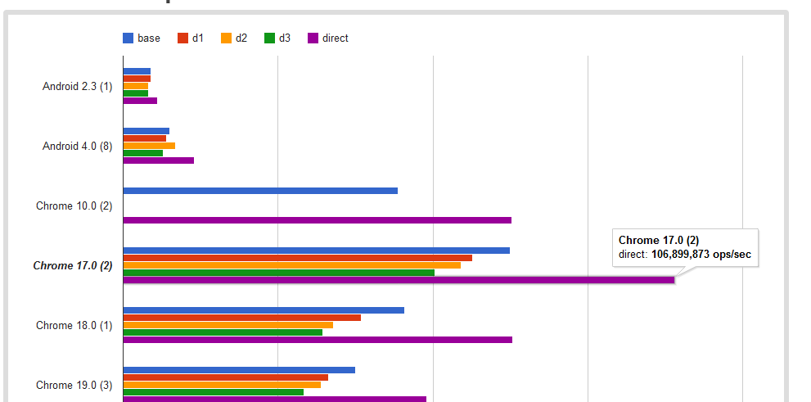
prototype lookup

Slide 30
http://habrahabr.ru/blogs/javascript/108915/

Slide 31
Pseudoclassical inheritance

Slide 32
Pseudoclassical inheritance
function Phone(model, color) {
this.model = model;
this.color = color;
}
Phone.prototype.makeCall = function() {…}
Phone.prototype.answer = function() {…}
function MobilePhone(model, color, ringtone) {
…
}
MobilePhone.prototype = new Phone(???); //wrong
MobilePhone.prototype = Phone.prototype; //wrong
extend(MobilePhone, Phone); //old school

Slide 33
Extend function
function extend(MobilePhone, Phone) {
var TempFunction = function() { };
TempFunction.prototype = Phone.prototype;
MobilePhone.prototype = new TempFunction();
MobilePhone.prototype.constructor = MobilePhone;
MobilePhone.superclass = Phone.prototype;
}
extend(MobilePhone, Phone);

Slide 34
Extend function
function extend(MobilePhone, Phone) {
var TempFunction = function() { };
…
}
TempFunction
prototype length
[[prototype]]
{}
constructor
[[prototype]]

Slide 35
function extend(MobilePhone, Phone) {
var TempFunction = function() { };
TempFunction.prototype = Phone.prototype;
…
}
TempFunction
prototype length
[[prototype]]
{}
constructor
[[prototype]]
Phone
prototype length
[[prototype]]
{}
constructor
[[prototype]]

Slide 36
function extend(MobilePhone, Phone) {
var TempFunction = function() { };
TempFunction.prototype = Phone.prototype;
MobilePhone.prototype = new TempFunction();
…
}
TempFunction
prototype length
[[prototype]]
MPhone.prototype
prototype length
[[prototype]]
Phone
prototype length
[[prototype]]
Phone.prototype
constructor
[[prototype]]
MPhone.prototype
[[prototype]]

Slide 37
function extend(MobilePhone, Phone) {
var TempFunction = function() { };
TempFunction.prototype = Phone.prototype;
MobilePhone.prototype = new TempFunction();
MobilePhone.prototype.constructor = MobilePhone;
MobilePhone.superclass = Phone.prototype;
}
TempFunction
prototype length
[[prototype]]
MobilePhone
prototype length
[[prototype]]
superclass
Phone
prototype length
[[prototype]]
Phone.prototype
constructor
[[prototype]]
MPhone.prototype
[[prototype]]
constructor

Slide 38
ES5 Extend function
function extend(MobilePhone, Phone) {
MobilePhone.prototype = Object.create(Phone.prototype);
MobilePhone.prototype.constructor = MobilePhone;
MobilePhone.superclass = Phone.prototype;
}

Slide 39
Pseudoclassical inheritance
function Phone(model, color) {
this.model = model;
this.color = color;
}
Phone.prototype.makeCall = function() {…}
Phone.prototype.increaseVolume= function() {…}
function MobilePhone(model, color, ringtone) {
MobilePhone.superclass.constructor.call(this, color, ringtone);
this. ringtone = ringtone;
}
MobilePhone.prototype.increaseVolume = function(newVolume) {
MobilePhone.superclass.increaseVolume.call(this, newVolume);
//…
}
extend(MobilePhone, Phone);

Slide 40
Phone
prototype length
[[prototype]]
Phone.prototype
constructor
makeCall() answer()
[[prototype]]
MobilePhone.prototype
makeCall() sendSMS() constructor
[[prototype]]
MobilePhone
prototype length superclass
[[prototype]]

Slide 41
Private members
function Phone(model, color) {
this.model = model;
this.color = color;
var volume ;
this.getVolume = function() {return volume;}
this.setVolume = function(v) {volume = v;}
}

Slide 42
Extending Without Inheriting
function borrowMethods(borrowFrom, addTo) {
var from = borrowFrom.prototype;
var to = addTo.prototype;
for (m in from) {
if (typeof from[m] != "function") continue;
to[m] = from[m];
}
}
borrowMethods(Stopwatch , MobilePhone);

Slide 43
Mixins

Slide 44
Parasitic inheritance (functional pattern)

Slide 45
Parasitic inheritance
new
constructor
prototype
instanceof

Slide 46
Example

Slide 47

Questions?

Slide 48
Prefer containment (composition) over inheritance?
Think of containment as a has a relationship. A car "has an" engine, a person "has a" name, etc.
Think of inheritance as an is a relationship. A car "is a" vehicle, a person "is a" mammal, etc.
http://stackoverflow.com/questions/49002/prefer-composition-over-inheritance
http://en.wikipedia.org/wiki/Composition_over_inheritance

