Slide 1

Chrome Internals:
Paint and Composition
by Dzmitry Varabei

Slide 2
Demo

Slide 3
Page Rendering Cycle
Request a page from server
Parse HTML and CSS files
Construct DOM tree

Slide 4
Nodes and the DOM tree
<html>
<body>
<div>
Hello
</div>
</body>
</html>
HTMLDocument
HTMLHTMLElement
HTMLBodyElement
HTMLDivElement
Text("Hello")

Slide 5
Page Rendering Cycle
Request a page from server
Parse HTML and CSS files
Construct DOM tree
Construct CSSOM (from user agent and style sheets)
Combine DOM and CSSOM (aka recalculate styles)
Build the rendering tree

Slide 6
RenderObject Tree
This is a data structure that helps the browser perform layout tasks.
display:none
<head>
<script>
<style>
anonymous line box
:before

Slide 7

Page Rendering Cycle
Build the rendering tree
Calculate layout (or calculate how many space is needed for each renderTree element )
Rasterization
Paint

Slide 8
Page Rendering Cycle
Build the rendering tree
Calculate layout (or calculate how many space is needed for each renderTree element )
Paint
Composite
Draw the final screen image onto the screen

Slide 9
Display refresh rate
~ 60Hz or 60 FPS
or
~16.6ms (10) to make a frame

Slide 10

Google Chrome Canary
console> chrome.exe
--enable-threaded-compositing
--force-compositing-mode
--enable-impl-side-painting
--enable-skia-benchmarking
--allow-webui-compositing

Slide 11
Trace Event Profiling Tool
about://tracing/
Read more: http://dev.chromium.org/developers/how-tos/trace-event-profiling-tool

Slide 12
Demo – CSS Paint Order

Slide 13
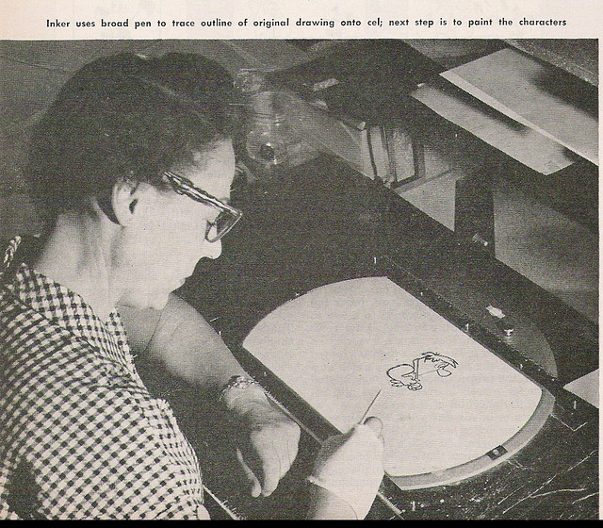
Paint
The phase of rendering where RenderObjects make calls into the GraphicsContext API to make a visual representation of themselves

Slide 14
Skia Graphics Engine
Skia is the open source C++ graphics library for drawing Text, Geometries, and Images.
https://code.google.com/p/skia/

Slide 15




Skia is currently used in
Google Chrome | Mozilla Firefox | Chrome OS | Android | Sublime Text 3

Slide 16
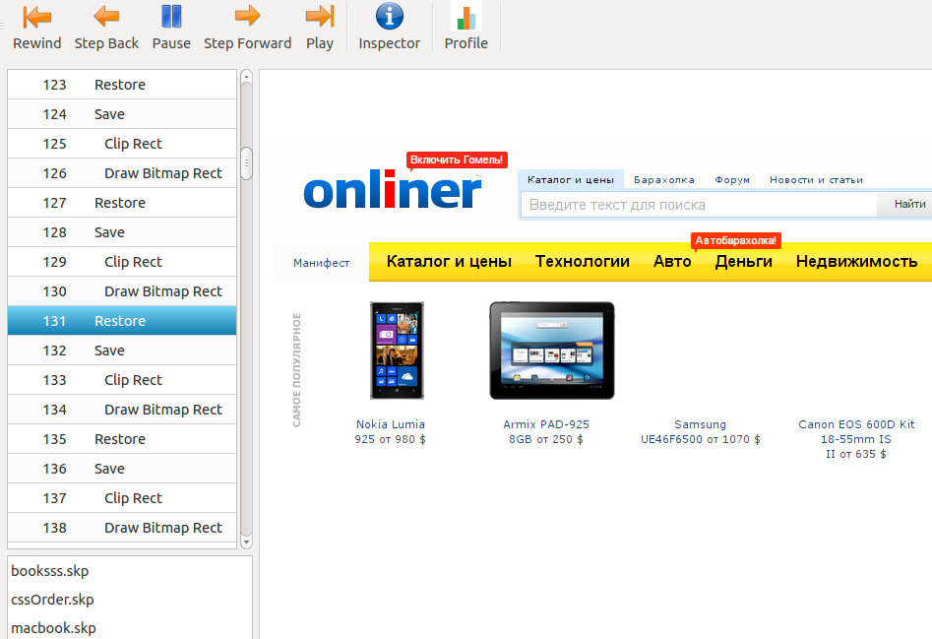
Skia Debugger
- Demo

Slide 17
How to save .skp files from Chromium?
http://www.chromium.org/developers/how-tos/trace-event-profiling-tool/saving-skp-s-from-chromium

Slide 18
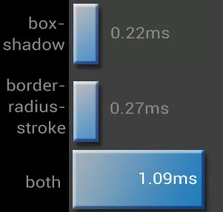
What cause complex painting?
image decodes/resizes
box-shadow (essentially
improved over
the past 2 years)
border-radius
border-radius + box-shadow
Read more: CSS Paint Times and Page Render Weight

Slide 19
Software mode VS Accelerated compositing mode

Slide 20
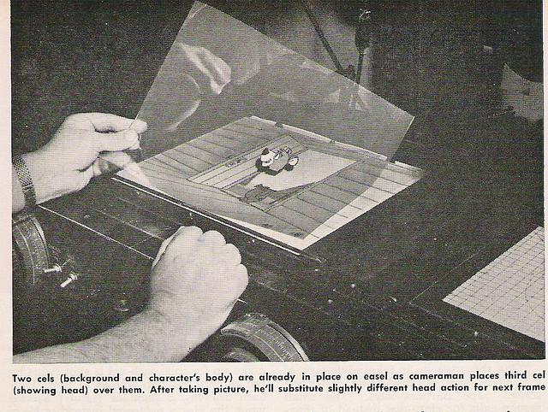
Composition

Slide 21
Accelerated compositing mode
Layer bitmaps are transferred to the GPU, combined ("composited"), and drawn on the screen.

Slide 22
Layer
Layer: section of the page, subtree of the DOM. Painted independently, composited on the GPU, and can stretch, move, and fade without repainting.

Slide 23
Which elements have their own layer?
Root page object
Canvas
Video element
plugins (flash and etc)
Elements with CSS properties: TranslateZ, Translate3d, Opacity, ScaleZ, RotateZ...
2D Transforms do not create layer

Slide 24
The cost of too many layers:
Additional GPU and memory usage

Slide 25
Render profiling tools
Show FPS
Show paint rectangles
Continuous page repainting
Show composited layer borders
Timeline -> Frames

Slide 26
Recommendation
Keep the DOM as small as possible.

Slide 27
Questions?

Slide 28
Resources
How Browsers Work
http://jankfree.org/
Jank Free: Chrome Rendering Performance
Compositing in Blink and WebKit
Trace Event Profiling Tool (about:tracing)
GPU Accelerated Compositing in Chrome
CSS Paint Times and Page Render Weight
http://dev.chromium.org/developers/tech-talk-videos

Slide 29
Layout boundaries
http://wilsonpage.co.uk/introducing-layout-boundaries/

Slide 30
CSS Triggers
http://csstriggers.com/

Slide 31
FLIP
https://aerotwist.com/blog/flip-your-animations/

Slide 32
Thanks!
Dzmitry.Varabei@gmail.com

