Slide 1

Duck typing

Slide 2
“When I see a bird that walks like a duck and swims like a duck and quacks like a duck, I call that bird a duck.”
@ James Whitcomb Riley

Slide 3
“When I see a bird that walks like a duck and swims like a duck and quacks like a duck, I call that bird a duck.”
@ James Whitcomb Riley

Slide 4
Duck typing is a style of dynamic typing in which an object's current set of methods and properties determines the valid semantic,
rather than its inheritance from a particular class or implementation of a specific interface.

Slide 5
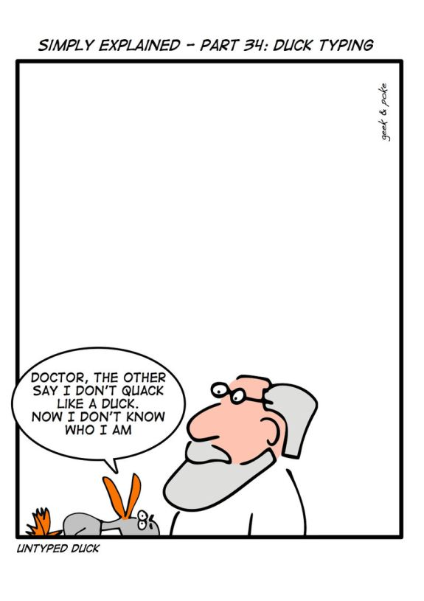

Slide 6
Duck typing
var t = {
"0": "a",
"1": "ab",
"2": "abc",
length: 3
};
[ ].push.call(t, "abcd");
[ ].join.call(t, " -- ");

Slide 7
Closures
var inner;
function outer(){
var local = 1;
inner = function(){
return local;
};
}
inner();
outer();
inner();

Slide 8
Closures
function sayHello() {
var text = "Hello #1";
var sayAlert = function() { alert(text); }
text = "Hello #2";
sayAlert();
}

Slide 9
Example

Slide 10
function makeDIVs() {
for (var i = 0; i < 10; i++) {
var div = document.createElement("div");
div.innerHTML = "div #" + i;
div.style.backgroundColor = "#DBE89A";
div.onclick =
document.body.appendChild(div);
}
}
function() {
alert(i);
}

Slide 11
function makeDIVsFixed() {
for (var i = 0; i < 10; i++) {
var div = document.createElement("div");
div.innerHTML = "div #" + i;
div.style.backgroundColor = "#DBE89A";
div.onclick =
document.body.appendChild(div);
}
}
function(x) {
return
} (i);
function() {
alert(x);
}

Slide 12
Private Members
function makeProperty(obj, name, predicate) {
var value;
obj["get" + name] = function() { return value; };
obj["set" + name] = function(v) {
if (predicate && !predicate(v)) return;
value = v;
};
}
var obj = {};
makeProperty(obj, "Name", function(x) { return typeof x == "string"; });
obj.setName("Dima");
Assert(obj.getName() == "Dima");

Slide 13
Example

Slide 14
Timers
var timeoutId = window.setTimeout(/* function or JavaScript code */, "number of milliseconds");
window.clearTimeout(timeoutId);
var intervalId = window.setInterval(/* function or JavaScript code */,
"number of milliseconds")
window.clearInterval(intervalId);

Slide 15
Timers
function log(msg){
var newNode = document.createElement("div");
newNode.innerHTML = msg;
document.body.appendChild(newNode);
}
var x = function(){
var start = (new Date).getTime();
log("start = " + new Date());
window.setTimeout(function(){
log("timeout = " + new Date());
},1000);
while (start + 2000 > (new Date).getTime()){
var c = 3 + 3+ 3;
}
log("end = " + new Date());
}
x();

Slide 16
Example

Slide 17
“setName” example

Slide 18
Returning functions
function setup() {
var count = 0;
return function() {
return ++count;
}
}
var next = setup();
next(); // 1
next(); // 2

Slide 19
Self-executable function
(function (a, b){
var c = a + b;
alert(c);
})(1, 2);

Slide 20
Self-overwriting functions
function next() {
var count = 1;
next = function() {
return ++count;
};
return count;
}
next(); // 1
next(); // 2

Slide 21
Lazy function definition
function lazy(){
var result = 2 + 2;
lazy = function() {
return result;
}
return lazy();
}
lazy(); // 4
lazy(); // 4

Slide 22
Chaining
var o = {
v:1,
increment: function() {
this.v++;
return this;
},
add: function (v){
this.v += v;
return this;
},
shout: function() {
alert(this.v);
}
};
o.increment().add(3).shout() // 5

Slide 23
Chaining
//DOM api
var headers = document.getElementsByTagName("h1");
for (var i = 0, l = headers.length; i < l; i++) {
headers[i].className = "title";
headers[i].innerHTML = "Hello World";
}
//jQuery
$("h1").addClass("title").html("Hello World");

Slide 25
Singleton
function Single () {
var instance = this;
//add more to this...
Single = function () {
return instance;
};
}

Slide 26
Decorator
function logArgs(f){
return function(){
console.dir(arguments);
return f.apply(this, arguments);
}
}
function sum(x, y){
return x + y;
}
sum = logArgs(sum);
sum(2, 7);

Slide 27
Memoization

Slide 28
Private members
var obj = new function () {
var privateVariable;
function privateFunction(x) {
// privateVariable
}
return {
firstMethod: function (a, b) {
// privateVariable
},
secondMethod: function (c) {
// privateFunction()
}
};
};

Slide 29
mixin
function Car(props){
this.color = props.color || "Black";
this.model = props.model || "X1";
//....
}
function Car(props){
this.color = "Black";
this.model = "X1";
//....
mixin(this,props);
}

Slide 30
bind
var x = {
name: “dima”,
sayName: function() {
alert(this.name);
}
}
window.setTimeout(bind(x, x.sayName), 1000);

Slide 31
bind
function bind(obj, fn){
return function(){
return fn.apply(obj, arguments);
}
}

Slide 32
currying
function curry(obj, fn/*, args */) {
var slice = Array.prototype.slice,
args = slice.call(arguments, 2);
return function () {
return fn.apply(obj || this, args.concat(slice.call(arguments)));
}
}
setTimeout(curry(obj, obj.show, "hello"), 100);

Slide 33
function add(x, y) { return x + y; }
function mul(x, y) { return x * y; }
function make(/*???*/) { /* ??? */ }
var s = make(1)(2)(3)(4)(5);
Assert(s(add) == 15);
Assert(s(mul) == 120);
var x = make(5)(10)(15);
Assert(x(add) == 30);
Assert(x(mul) == 750);

Slide 34

Questions?

Slide 35
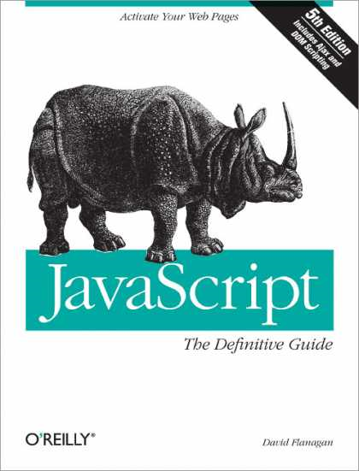
REFERENCES
JavaScript: The Definitive Guide, Six Edition
by David Flanagan
Speaking JavaScript: An In-Depth Guide for Programmers
by Dr. Axel Rauschmayer
http://dmitrysoshnikov.com
http://learn.javascript.ru

Slide 36
Function bind
function add(x, y) { return x + y; } var plus1 = add.bind(null, 1); console.log(plus1(5)); // 6

