Slide 1
Lecture III

Slide 2
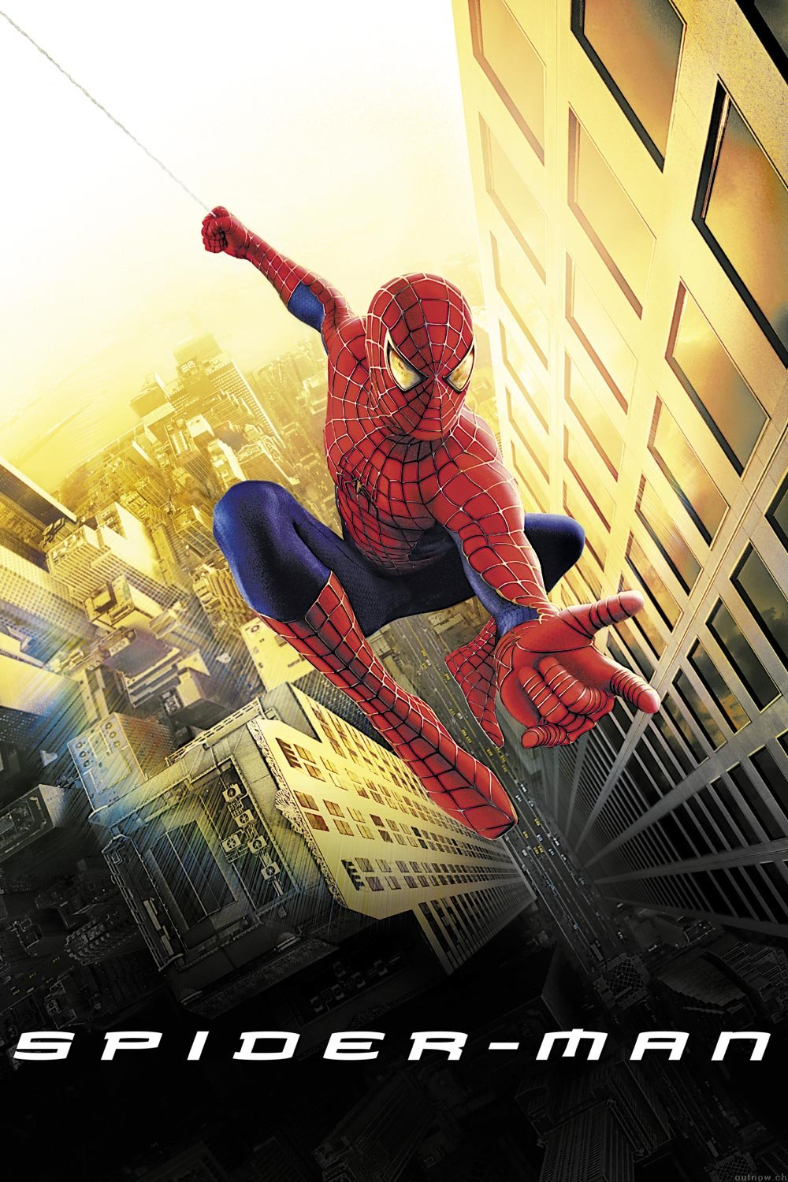

Slide 3
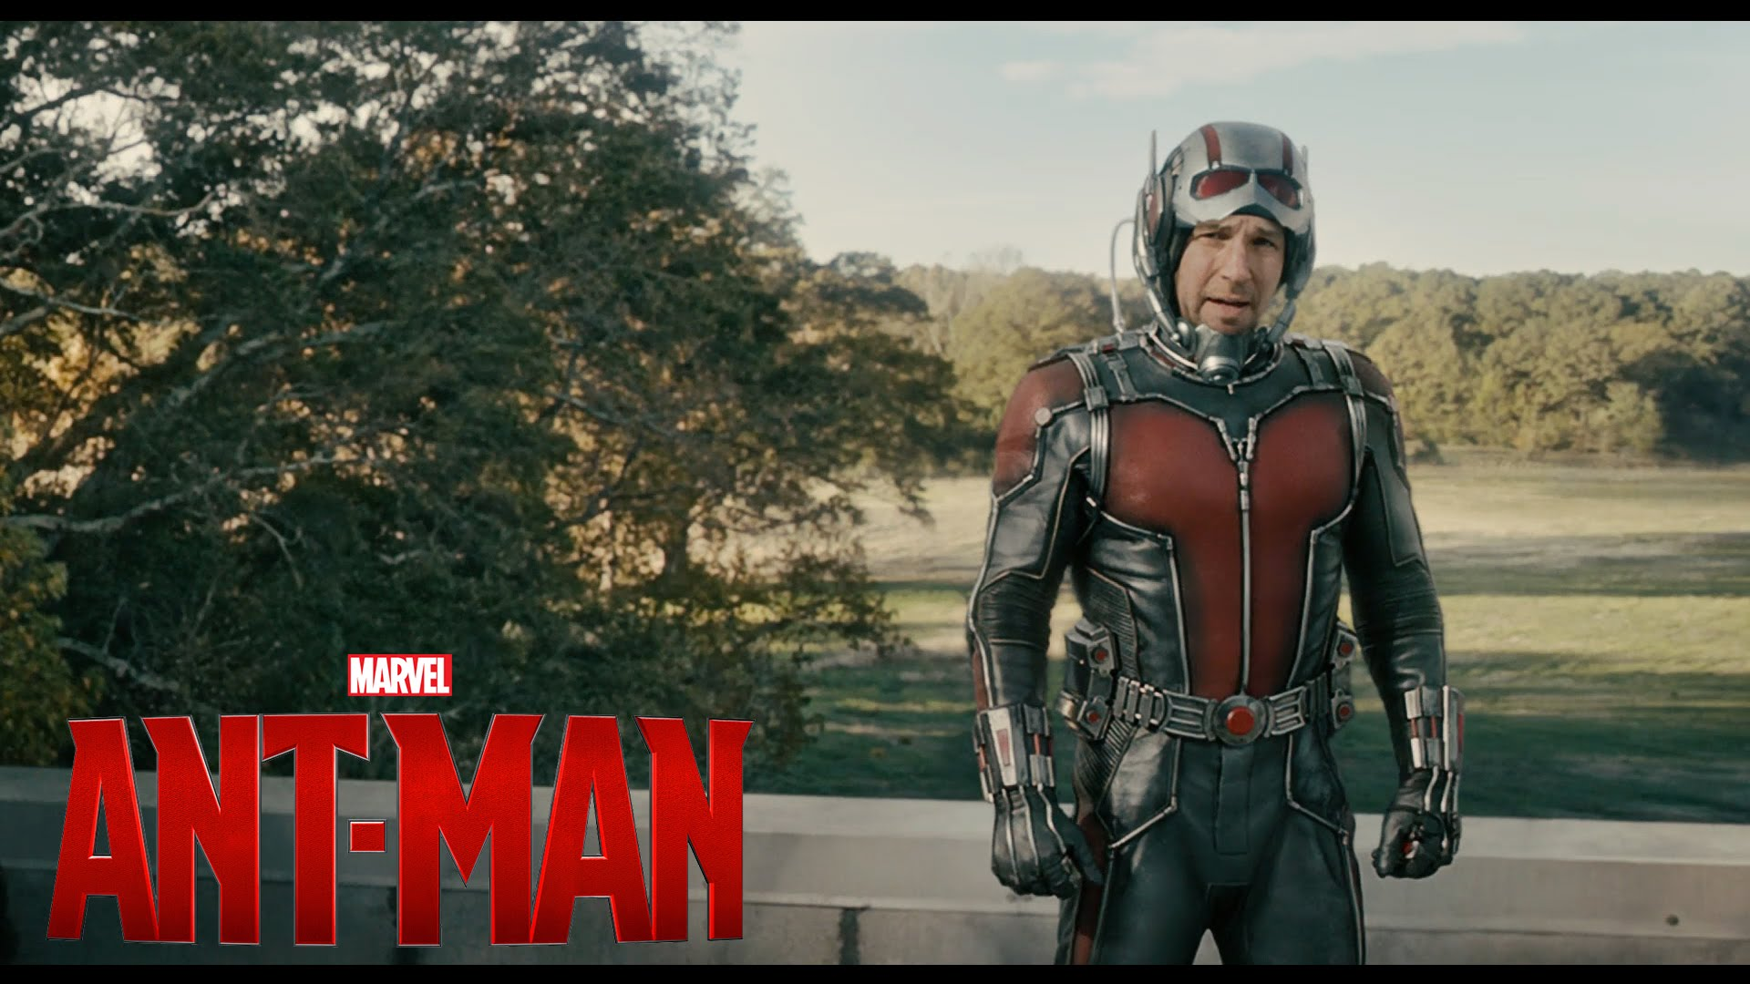

Slide 4
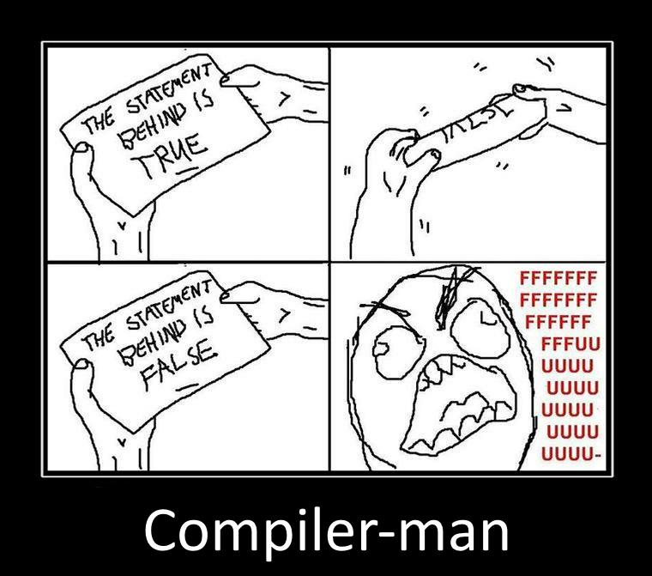

Slide 5
Example
var a = 2;
var b = 2;
console.log(a + b);

Slide 6
Recap of lecture II

Slide 7
Evils of type coercion (recap)
'' == '0' // false
0 == '' // true
0 == '0' // true
false == 'false' // false
false == '0' // true
false == undefined // false
false == null // false
null == undefined // true
‘ \t\r\n ' == 0 // true

Slide 8
Implicit Typecasting
var zero = 0;
/* antipattern */
if (zero == false) {
// this block is executed...
}
// preferred
if (zero === false) {
// not executing because zero is 0, not false
}

Slide 9
semicolon
var a = b
//blah blah blah
(function() {alert(1)})()

Slide 10
With statement
with (obj) {
a = b;
}
a = b;
a = obj.b;
obj.a = b;
obj.a = obj.b;

Slide 11
Identifiers
Starts with a letter or _ or $
Followed by zero or more letters, digits, _ or $
By convention, all variables, parameters, members, and function names start with lower case
Except for constructors which start with upper case

Slide 12
Example

Slide 13
Embedding scripts in HTML
a) Between a pair of <script> and </script> tags
<script type="text/javascript">
alert(“hello world!”);
</script>
b) From an external file specified by the src attribute of a <script> tag
<script type="text/javascript" src="script.js”></script>
c) In an event handler, specified as the value of an HTML attribute
such as onclick or onmouseover
<button onclick="sayHello();">execute function "sayHello"</button>
d) In a URL, uses the special javascript: protocol
javascript:alert(“Hello world”);

Slide 14
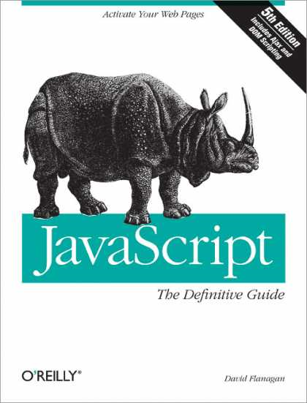
REFERENCES
JavaScript: The Definitive Guide, Six Edition
by David Flanagan
Speaking JavaScript: An In-Depth Guide for Programmers
by Dr. Axel Rauschmayer
http://dmitrysoshnikov.com
http://learn.javascript.ru

