Slide 1
Lecture III

Slide 2
Recap of lecture II

Slide 3


Slide 4


Slide 5
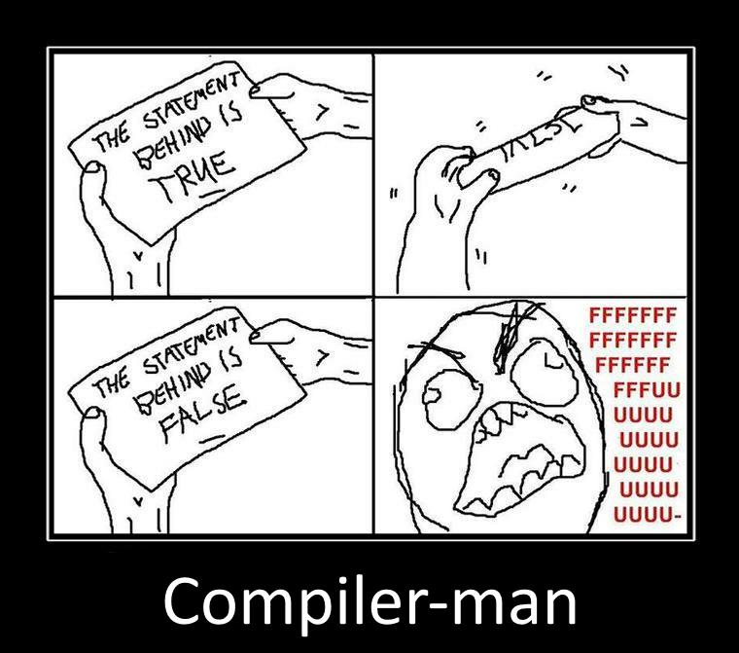

Slide 6
Example
var a = 2;
var b = 2;
console.log(a + b);

Slide 7
Scope

Slide 8
ES 3

Slide 9
The Scope of a Variable
The scope of a variable are the locations
where it is accessible.
For example:
function foo() {
var x;
}

Slide 10
Nested Scope
function f() {
var x = 2;
function g() {
var y = 3;
alert(x + y);
}
}

Slide 11
Nested Scope
function f() {
var x = 2;
function g() {
var y = 3;
alert(x + y);
}
}
outer scope
inner scope

Slide 12
Shadowing
var scope = "global "; // A global variable
function outer() {
var scope = “outer”; // A outer variable
function inner() {
var scope = “inner";
document.write(scope); // Prints "inner"
}
inner();
}
outer();

Slide 13
Shadowing
var scope = "global "; // A global variable
function outer() {
var scope = “outer”; // A outer variable
function inner() {
document.write(scope); // Prints "outer"
}
inner();
}
outer();

Slide 14
Shadowing
var scope = "global "; // A global variable
function outer() {
function inner() {
document.write(scope); // Prints "global"
}
inner();
}
outer();

Slide 15
function X() {
var a = 3, b = 5;
function foo () {
var b = 7, c = 11;
a += b + c;
};
foo();
alert("a = " + a + "; b = " + b);
}
X();
var x = function(){
alert(x.toString());
}
x();

Slide 16
Hoisting
JavaScript hoists all variable declarations, it moves them to the beginning of their direct scopes.

Slide 17
Hoisting
foo(); // undefined ("foo" and "bar" exist)
function foo() {
alert(bar);
}
var bar;
function foo() {
alert(bar);
}
var bar;
foo(); // undefined

Slide 18
Hoisting
var scope = "global ";
function f( ) {
alert(scope);
var scope = "local";
alert(scope);
}
f( );
var scope = "global ";
function f( ) {
var scope;
alert(scope);
scope = "local";
alert(scope);
}
f( );

Slide 19
Only functions introduce new scopes
No block scope
function f() {
{ // block starts
var foo = 4;
} // block ends
console.log(foo); // 4
}

Slide 20
No block scope!
function test(o) {
var i = 0; // i is defined throughout function
if (typeof o == "object") {
var j = 0; // j is defined everywhere, not just block
for(var k=0; k < 10; k++) { // k is defined everywhere, not just loop
document.write(k);
}
document.write(k); // k is still defined: prints 10
}
document.write(j); // j is defined, but may not be initialized
}

Slide 21
Hoisting
var foo = 1;
function bar() {
if (!foo) {
var foo = 10;
}
alert(foo);
}
bar();

Slide 22
Code in global scope
Index.html
<!DOCTYPE html>
<html>
<head>
<title>Untitled Page</title>
<script type="text/javascript" src="script.js"></script>
</head>
<body>
<script type="text/javascript">
var a = 5;
var b = 2;
function sum(x, y) {
return x + y;
}
function mul(x, y) {
return x * y;
}
</script>
</body>
</html>
script.js
var gloabalVar = 5;
function square(x) {
return x * x;
}

Slide 23
Global namespace
Every variable is global unless it's in a function and is declared with var
function f(){
x = “global variable”;
}
f();

Slide 24
Global object (WAT)
function f(){
x = “global variable”; // var is missed
}
f();
this.x === “global variable”;
window.x === “global variable”; // true for browsers
Global variables are evil

Slide 25
Globals
// antipattern
function sum(x, y) {
// implied global
result = x + y;
return result;
}
// antipattern
function foo() {
var a = b = 0;
// ...
}
// preferred
function foo() {
var a, b;
// ...
a = b = 0; // both local
}

Slide 26
<script>
if (("a" in window) == false) {
var a = 1;
}
alert(a);
</script>

Slide 27
Working with global
window.foo
if (window.foo) { … }
if (“foo” in window) { … }
if (typeof “foo” !== “undefined”) { … }

Slide 28
Namespaces
if (window.myNamespace == null){
window.myNamespace = {};
}
window.myNamespace.myFunction = function(/* params*/ ) {
/* code here */
};

Slide 29
function declaration
VS
function expression

Slide 30
function declaration
function functionName([parameters]){
functionBody
};
add(2, 4); // works
function add(x, y) {
return x + y;
}

Slide 31
function declaration
alert(x); // function body
var x = 10;
alert(x); // 10
x = 20;
function x() { }
alert(x); // 20

Slide 32
function expression
variableName = function([parameters]){
functionBody
};
add; //undefined
add(2, 4); // this raises a TypeError
var add = function(x, y) {
return x + y;
}

Slide 33
Named function expression
variableName = function functionName([parameters]){
functionBody
};
var foo = function bar() {
bar(); // works
}
bar(); // ReferenceError

Slide 34
Function
variableName = new Function(/*parameters */, functionBody);
var add = new Function(“x”, “y”, “return x + y”);

Slide 35
Immediately-Invoked Function Expression (IIFE)

Slide 36
Immediately-Invoked Function Expression
(function () { // open IIFE
// inside IIFE
}()); // close IIFE
OR
(function (x, y) {
console.log(x + y);
}(2,4));

Slide 37
Why IIFE ?

Slide 38
Avoiding global variable or hiding variables from global scope.
(function () {
var x = 2;
var y = 4;
}());
typeof window.x === “undefined”;
typeof window.y === “undefined”;

Slide 39
2. Avoiding variable sharing.
function f() {
var result = [];
for (var i=0; i<3; i++) {
var func = function () { return i; };
result.push(func);
}
return result;
}
console.log(f()[0]()); // 3
console.log(f()[1]()); // 3
console.log(f()[2]()); // 3

Slide 40
2. Avoiding variable sharing.
function f() {
var result = [];
for (var i=0; i<3; i++) {
(function () { // step 1: IIFE
var pos = i; // step 2: copy
var func = function () { return pos; };
result.push(func);
}()); }
return result;
}
console.log(f()[0]()); // 0
console.log(f()[1]()); // 1
console.log(f()[2]()); // 2

Slide 41
3. Keeping data private to all of a constructor
var StringBuilder = function () { // open IIFE
var KEY_BUFFER = '_StringBuilder_buffer_' + uuid.v4();
function StringBuilder() {
this[KEY_BUFFER] = [];
}
StringBuilder.prototype = { // Omitted: methods accessing this[KEY_BUFFER]
//….
};
return StringBuilder;
}(); // close IIFE

Slide 42
4. Attaching data to a method
var obj = {
method: function () { // open IIFE
// method-private data
var invocCount = 0;
return function () {
invocCount++;
console.log('Invocation #'+invocCount);
return 'result'; };
}() // close IIFE
};

Slide 43
Lexical (Static) Scope
Static structure of a program determines the scope of a variable.
function f() {
var x = 2;
function g() {
alert(x);
}
}

Slide 44
Lexical (Static) Scope
var z = 10;
function foo() {
alert(z);
}
foo();
(function () {
var z = 20;
foo();
})();
The word “static” relates to ability to determine the scope of an identifier during the parsing stage of a program.

Slide 45
There are only two kinds of languages: the ones people complain about and the ones nobody uses Bjarne Stroustrup

Slide 46
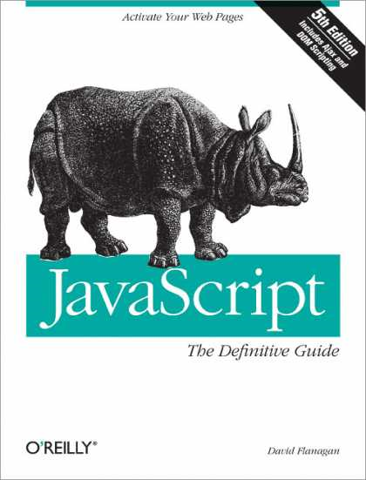
REFERENCES
JavaScript: The Definitive Guide, Six Edition
by David Flanagan
Speaking JavaScript: An In-Depth Guide for Programmers
by Dr. Axel Rauschmayer
http://dmitrysoshnikov.com
http://learn.javascript.ru

