Slide 1
Functions
Lecture #4

Slide 2
What is common between Johnny Depp and JS Function?

Slide 3
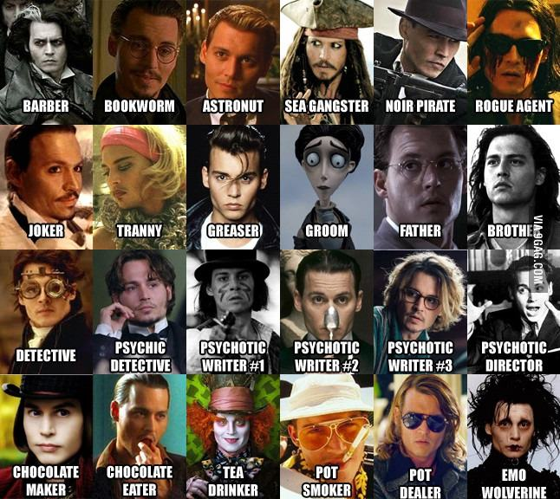

Slide 4
They play a lot of different roles

Slide 5
Function as normal function
function add(a, b) {
return a + b;
}

Slide 6
Function as method
var Rectangle = {
x: 2,
y: 4,
perimeter : function() {
return (this.x+this.y)*2;
}
}
Math.add(2, 4);

Slide 7
Function as constructor
function Rectangle(x, y) {
this.x = x;
this.y = y;
}
var rect = new Rectangle();

Slide 8
function declaration
VS
function expression

Slide 9
function declaration
function functionName([parameters]){
functionBody
};
add(2, 4); // works
function add(x, y) {
return x + y;
}

Slide 10
function declaration
alert(x); // prints function body
var x = 10;
alert(x); // 10
x = 20;
function x() { }
alert(x); // 20

Slide 11
anonymous function expression
variableName = function([parameters]){
functionBody
};
add; //undefined
add(2, 4); // this raises a TypeError
var add = function(x, y) {
return x + y;
}

Slide 12
Named function expression
variableName = function functionName([parameters]){
functionBody
};
var foo = function bar() {
bar(); // works
}
bar(); // ReferenceError

Slide 13
Function
variableName = new Function(/*parameters */, functionBody);
var add = new Function(“x”, “y”, “return x + y”);

Slide 14
Strategy of passing arguments to function
Primitive types are manipulated by value.
Object types are manipulated by sharing.
function func(obj){
obj.prop1 = 5;
obj = {};
}
var data = {};
func(data);
console.log(data); // {prop1: 5}

Slide 15
Function as data
function square(x) { return x * x; }
var pointerToSquare = square;
Assert(pointerToSquare(3) == 9);
var newArray = ["a", "b", "c", pointerToSquare];
Assert(newArray[3](4) == 16);
var obj = { "square": square };
Assert(obj.square(5) == 25);

Slide 16
Static members
function MyMath() {
//math here...
}
MyMath.Pi = 3.14;
function getNewId() {
if (!getNewId.lastId) getNewId.lastId = 0;
return ++getNewId.lastId;
}

Slide 17
Return statement
return expression;
or
return;
If there is no expression, then the return value is undefined.
Except for constructors, whose default return value is this.

Slide 18
Function Arguments
1) If a function is called with too many arguments, the extra arguments are ignored.
2) If a function is called with too few arguments, the missing values will be undefined.

Slide 19
Function Arguments
Optional Arguments and Argument Types
function NodeText(/*domNode|String*/ node, /*String?*/ text) {
if (typeof node == “string”){
node = document.getElementById(node);
if (!node) return;
}
if(text != null) {
node.innerHTML = text;
} else {
return node.innerHTML ;
}
}

Slide 20
Configuration objects
var printEmployeeInformation = function (info) {
var firstName = info.firstName || "";
var lastName = info.lastName || "";
var position = info.position || "";
var office = info.office || "K1";
var phone = info.phone || "911";
var internalPhone = info.internalPhone || "";
var manager = info.manager || "";
…
}
var info = { firstName: “Bruce", lastName: "Wayne", internalPhone: “111" };
info.office = "R40";
printEmployeeInformation(info);
info.office = "K1";
printEmployeeInformation(info);

Slide 21
Pseudo parameters
arguments
this

Slide 22
The “arguments” object
arguments contains the following properties:
callee – reference to the current function
length – quantity of real passed arguments
properties-indexes – parameters from the invocation
It is an array-like object.

Slide 23
foo(10, 20);
function foo(x, y, z) {
// quantity of defined function arguments (x, y, z)
alert(foo.length); // 3
// quantity of really passed arguments (only x, y)
alert(arguments.length); // 2
// reference of a function to itself
alert(arguments.callee === foo);
// parameters sharing
alert(x === arguments[0]); // true
alert(x); // 10
alert(arguments[2]); // undefined
}

Slide 24
The “arguments” object
function sum() {
var n = arguments.length;
var total = 0;
for (var i = 0; i < n; i++) {
total += arguments[i];
}
return total;
}
var ten = sum(1, 2, 3, 4);

Slide 25
THIS

Slide 26
this
function Car(model, color) {
this.model = model;
this.color = color;
this.changeGear = function (value) {
this.currentGear = value;
//....
}
}

Slide 27
this
this is determined on entering the context and is immutable while the code is running in the context.

Slide 28
this in the global context
var x = 20;
console.log(x == window.x);
console.log(this.x == x);
console.log(this.x == window.x);

Slide 29
this in the function context
Value of this in function context is determined by the form on invocation but not context of definition.
function foo() {
console.log(this.bar);
}
var x = { bar: 1 };
var y = { bar: 2 };
x.foo = foo;
y.foo = foo;
x.foo(); // 1
y.foo(); // 2
var bar = 3;
foo(); //3
new foo(); // undefined

Slide 30
Function form
foo();
function foo(){
this === window; // Fixed in ES5/Strict
}

Slide 31
Method form
var test = {
“name”: “Max”,
“foo”: function(){
alert(this.name);
}
};
test.foo(); //this === test
test[“foo”](); // this === test
var foo = test.foo;
foo(); // this === window

Slide 32
Constructor form
function Car(model, color) {
this.model = model;
this.color = color;
this.changeGear = function () {
//…
}
}
var bmw1 = new Car(“z1", “black")
bmw1.changeGear();

Slide 33
Constructor form
function Car(model, color) {
this.model = model; // this === window
this.color = color;
this.changeGear = function () {
//…
}
}
var bmw1 = new Car(“z1", “black")
bmw1.changeGear();

Slide 34
Constructor form
function Car(model, color) {
var that = {};
that.model = model;
that.color = color;
that.changeGear = function () {
//…
}
return that;
}
var bmw1 = new Car(“z1", “black")
bmw1.changeGear();

Slide 35
Enforcing new
function Car(model, color) {
if (!(this instanceof Car)) {
return new Car(model, color);
}
this.model = "model";
//...........
}
var lada = Car("kalina", "gray");

Slide 36
Inner form
function Car(model, color) {
this.model = model;
this.color = color;
this.changeGear = function () {
var that = this;
var inner = function(){
//this === window
// Use that instead of this here
}
inner();
}
}

Slide 37
Explicit Setting of this
foo.apply(thisObject,[arguments])
foo.call(thisObject, / *arguments */);
A function’s apply or call method allows for calling the function, explicitly specifying this.

Slide 38
Arguments / apply
var array = [1,2,368,10,45];
Math.max.apply(Math,array); //368

Slide 39
Solid type-checking function
function type(v) { if (v === null) { return 'null'; } if (typeof v === undefined) { return 'undefined'; } return Object.prototype.toString.call(v). slice(8, -1).toLowerCase(); }
type({}); // 'object' type([]); // 'array' type(333); // 'number'
type(new String(“str”)); //’string’

Slide 40
Borrowing methods
notmyobj.doStuff.call(myobj, param1, p2, p3);
notmyobj.doStuff.apply(myobj, [param1, p2, p3]);
function f() {
var args = [].slice.call(arguments, 1, 3);
return args;
}
f(1,2,3,4,5,6); // [2, 3]

Slide 41
Immediately-Invoked Function Expression (IIFE)

Slide 42
Immediately-Invoked Function Expression
(function () { // open IIFE
// inside IIFE
}()); // close IIFE
OR
(function (x, y) {
console.log(x + y);
}(2,4));

Slide 43
Why IIFE ?

Slide 44
Avoiding global variable or hiding variables from global scope.
(function () {
var x = 2;
var y = 4;
}());
typeof window.x === “undefined”;
typeof window.y === “undefined”;

Slide 45
2. Avoiding variable sharing.
function f() {
var result = [];
for (var i=0; i<3; i++) {
var func = function () { return i; };
result.push(func);
}
return result;
}
console.log(f()[0]()); // 3
console.log(f()[1]()); // 3
console.log(f()[2]()); // 3

Slide 46
2. Avoiding variable sharing.
function f() {
var result = [];
for (var i=0; i<3; i++) {
(function () { // step 1: IIFE
var pos = i; // step 2: copy
var func = function () { return pos; };
result.push(func);
}()); }
return result;
}
console.log(f()[0]()); // 0
console.log(f()[1]()); // 1
console.log(f()[2]()); // 2

Slide 47
3. Keeping data private to all of a constructor
var StringBuilder = function () { // open IIFE
var KEY_BUFFER = '_StringBuilder_buffer_' + uuid.v4();
function StringBuilder() {
this[KEY_BUFFER] = [];
}
StringBuilder.prototype = { // Omitted: methods accessing this[KEY_BUFFER]
//….
};
return StringBuilder;
}(); // close IIFE

Slide 48
4. Attaching data to a method
var obj = {
method: function () { // open IIFE
// method-private data
var invocCount = 0;
return function () {
invocCount++;
console.log('Invocation #'+invocCount);
return 'result'; };
}() // close IIFE
};

Slide 49
Lexical (Static) Scope
Static structure of a program determines the scope of a variable.
function f() {
var x = 2;
function g() {
alert(x);
}
}

Slide 50
Lexical (Static) Scope
var z = 10;
function foo() {
alert(z);
}
foo();
(function () {
var z = 20;
foo();
})();
The word “static” relates to ability to determine the scope of an identifier during the parsing stage of a program.

Slide 51
There are only two kinds of languages: the ones people complain about and the ones nobody uses Bjarne Stroustrup

Slide 52

Duck typing

Slide 53
“When I see a bird that walks like a duck and swims like a duck and quacks like a duck, I call that bird a duck.”
@ James Whitcomb Riley

Slide 54
“When I see a bird that walks like a duck and swims like a duck and quacks like a duck, I call that bird a duck.”
@ James Whitcomb Riley

Slide 55
Duck typing is a style of dynamic typing in which an object's current set of methods and properties determines the valid semantic,
rather than its inheritance from a particular class or implementation of a specific interface.

Slide 56
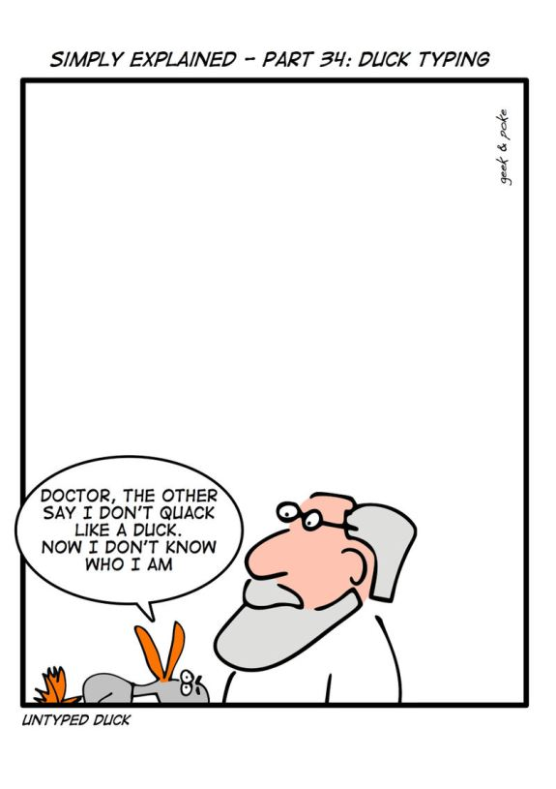

Slide 57
Duck typing
var t = {
"0": "a",
"1": "ab",
"2": "abc",
length: 3
};
[ ].push.call(t, "abcd");
[ ].join.call(t, " -- ");

Slide 58
Closures
var inner;
function outer(){
var local = 1;
inner = function(){
return local;
};
}
inner();
outer();
inner();

Slide 59
Closures
function sayHello() {
var text = "Hello #1";
var sayAlert = function() { alert(text); }
text = "Hello #2";
sayAlert();
}

Slide 60
Example

Slide 61
function makeDIVs() {
for (var i = 0; i < 10; i++) {
var div = document.createElement("div");
div.innerHTML = "div #" + i;
div.style.backgroundColor = "#DBE89A";
div.onclick =
document.body.appendChild(div);
}
}
function() {
alert(i);
}

Slide 62
function makeDIVsFixed() {
for (var i = 0; i < 10; i++) {
var div = document.createElement("div");
div.innerHTML = "div #" + i;
div.style.backgroundColor = "#DBE89A";
div.onclick =
document.body.appendChild(div);
}
}
function(x) {
return
} (i);
function() {
alert(x);
}

Slide 63
Private Members
function makeProperty(obj, name, predicate) {
var value;
obj["get" + name] = function() { return value; };
obj["set" + name] = function(v) {
if (predicate && !predicate(v)) return;
value = v;
};
}
var obj = {};
makeProperty(obj, "Name", function(x) { return typeof x == "string"; });
obj.setName("Dima");
Assert(obj.getName() == "Dima");

Slide 64
Example

Slide 65
Timers
var timeoutId = window.setTimeout(/* function or JavaScript code */, "number of milliseconds");
window.clearTimeout(timeoutId);
var intervalId = window.setInterval(/* function or JavaScript code */,
"number of milliseconds")
window.clearInterval(intervalId);

Slide 66
Timers
function log(msg){
var newNode = document.createElement("div");
newNode.innerHTML = msg;
document.body.appendChild(newNode);
}
var x = function(){
var start = (new Date).getTime();
log("start = " + new Date());
window.setTimeout(function(){
log("timeout = " + new Date());
},1000);
while (start + 2000 > (new Date).getTime()){
var c = 3 + 3+ 3;
}
log("end = " + new Date());
}
x();

Slide 67
Example

Slide 68
“setName” example

Slide 69
Returning functions
function setup() {
var count = 0;
return function() {
return ++count;
}
}
var next = setup();
next(); // 1
next(); // 2

Slide 70
Self-executable function
(function (a, b){
var c = a + b;
alert(c);
})(1, 2);

Slide 71
Self-overwriting functions
function next() {
var count = 1;
next = function() {
return ++count;
};
return count;
}
next(); // 1
next(); // 2

Slide 72
Lazy function definition
function lazy(){
var result = 2 + 2;
lazy = function() {
return result;
}
return lazy();
}
lazy(); // 4
lazy(); // 4

Slide 73
Chaining
var o = {
v:1,
increment: function() {
this.v++;
return this;
},
add: function (v){
this.v += v;
return this;
},
shout: function() {
alert(this.v);
}
};
o.increment().add(3).shout() // 5

Slide 74
Chaining
//DOM api
var headers = document.getElementsByTagName("h1");
for (var i = 0, l = headers.length; i < l; i++) {
headers[i].className = "title";
headers[i].innerHTML = "Hello World";
}
//jQuery
$("h1").addClass("title").html("Hello World");

Slide 76
Singleton
function Single () {
var instance = this;
//add more to this...
Single = function () {
return instance;
};
}

Slide 77
Decorator
function logArgs(f){
return function(){
console.dir(arguments);
return f.apply(this, arguments);
}
}
function sum(x, y){
return x + y;
}
sum = logArgs(sum);
sum(2, 7);

Slide 78
Memoization

Slide 79
Private members
var obj = new function () {
var privateVariable;
function privateFunction(x) {
// privateVariable
}
return {
firstMethod: function (a, b) {
// privateVariable
},
secondMethod: function (c) {
// privateFunction()
}
};
};

Slide 80
mixin
function Car(props){
this.color = props.color || "Black";
this.model = props.model || "X1";
//....
}
function Car(props){
this.color = "Black";
this.model = "X1";
//....
mixin(this,props);
}

Slide 81
bind
var x = {
name: “dima”,
sayName: function() {
alert(this.name);
}
}
window.setTimeout(bind(x, x.sayName), 1000);

Slide 82
bind
function bind(obj, fn){
return function(){
return fn.apply(obj, arguments);
}
}

Slide 83
currying
function curry(obj, fn/*, args */) {
var slice = Array.prototype.slice,
args = slice.call(arguments, 2);
return function () {
return fn.apply(obj || this, args.concat(slice.call(arguments)));
}
}
setTimeout(curry(obj, obj.show, "hello"), 100);

Slide 84
function add(x, y) { return x + y; }
function mul(x, y) { return x * y; }
function make(/*???*/) { /* ??? */ }
var s = make(1)(2)(3)(4)(5);
Assert(s(add) == 15);
Assert(s(mul) == 120);
var x = make(5)(10)(15);
Assert(x(add) == 30);
Assert(x(mul) == 750);

Slide 85

Questions?

Slide 86
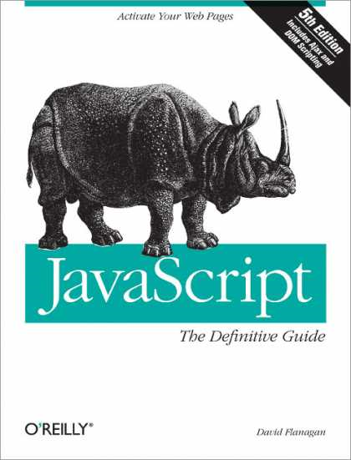
REFERENCES
JavaScript: The Definitive Guide, Six Edition
by David Flanagan
Speaking JavaScript: An In-Depth Guide for Programmers
by Dr. Axel Rauschmayer
http://dmitrysoshnikov.com
http://learn.javascript.ru

Slide 87
Function bind
function add(x, y) { return x + y; } var plus1 = add.bind(null, 1); console.log(plus1(5)); // 6

