Slide 1
Git, commit and code review

Slide 2
Часть первая: Git

Slide 3
Git
Simple but powerful

Slide 4
Сообщения Git’а могут испугать:
“You are in detached HEAD state…”

Slide 5
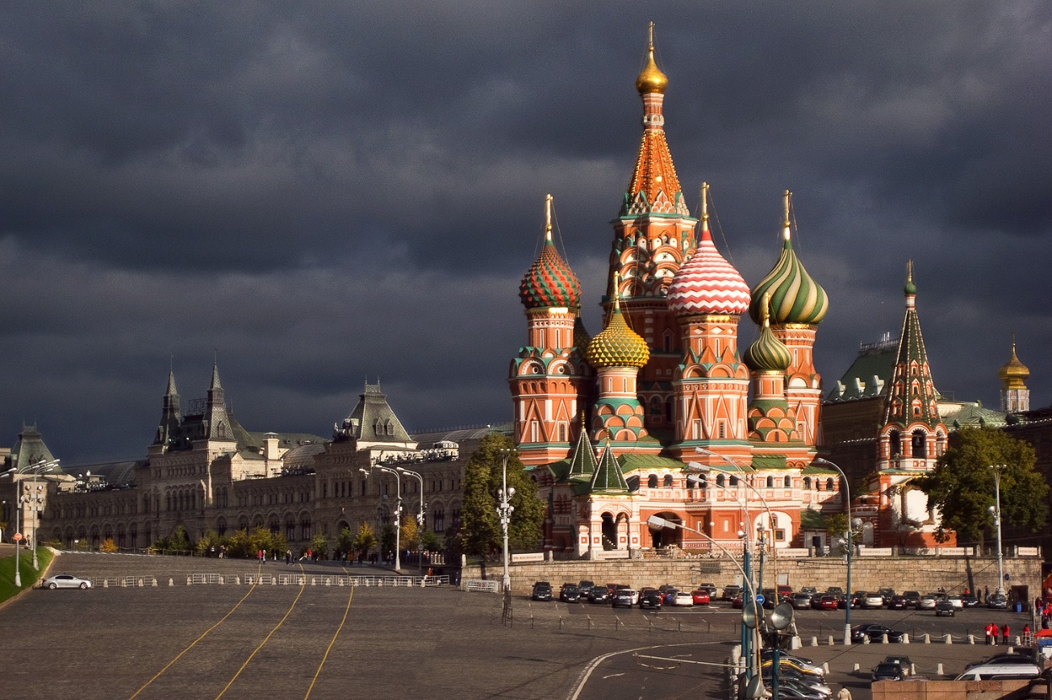
Внезапно…

Slide 6
А теперь будет притча o git
По мотивам: http://tom.preston-werner.com/2009/05/19/the-git-parable.html

Slide 7
Представьте мир без систем контроля версий
Унылое место

Slide 8
Как выглядел бы день обычного разработчика?

Slide 9
Нет гита, нет проблем

Slide 10
Будем хранить код проекта, например, тут
С:\\dev\working

Slide 11
Ну совсем без версий плохо
И после завершения каждой фичи будем делать копию папки:
С:\\dev\working
Вот таким образом:
С:\\dev\archive\snapshot-0

Slide 12
Ну совсем без версий плохо
И после завершения каждой фичи будем делать копию папки:
С:\\dev\working
Вот таким образом:
С:\\dev\archive\snapshot-0
И еще и еще
С:\\dev\archive\snapshot-1
С:\\dev\archive\snapshot-2
С:\\dev\archive\snapshot-3
С:\\dev\archive\snapshot-4

Slide 13
А теперь пришло время изобрести commit message

Slide 14
В каждый snapshot архив будем добавлять message.txt вида:
Я, Иванов Иван Иванович, прикрутил новую версию tauСharts.
20 августа 2042 - [digital signature]

Slide 15
Теперь структура папок выглядит так
С:\\dev\working
С:\\dev\archive\snapshot-0\message.txt
С:\\dev\archive\snapshot-1\message.txt
С:\\dev\archive\snapshot-2\message.txt
…..

Slide 16
Прошла пара недель…

Slide 17
Первый релиз:
…
С:\\dev\archive\snapshot-97
С:\\dev\archive\snapshot-98
С:\\dev\archive\snapshot-99 (aka release-1.0)
…

Slide 18
Но мы девелопим дальше:
…
С:\\dev\archive\snapshot-97
С:\\dev\archive\snapshot-98
С:\\dev\archive\snapshot-99 (aka release-1.0)
С:\\dev\archive\snapshot-100
С:\\dev\archive\snapshot-101
С:\\dev\archive\snapshot-102
С:\\dev\archive\snapshot-103
С:\\dev\archive\snapshot-104
…

Slide 19
Плохие новости:
“Критикал баг в продакшене” ☹

Slide 20
Поправили, но куда теперь сохранить fix?
…
С:\\dev\archive\snapshot-97
С:\\dev\archive\snapshot-98
С:\\dev\archive\snapshot-99 (aka release-1.0)
С:\\dev\archive\snapshot-100
С:\\dev\archive\snapshot-101
С:\\dev\archive\snapshot-102
С:\\dev\archive\snapshot-103
С:\\dev\archive\snapshot-104
…

Slide 21
Линейная организация не подходит ☹

Slide 22
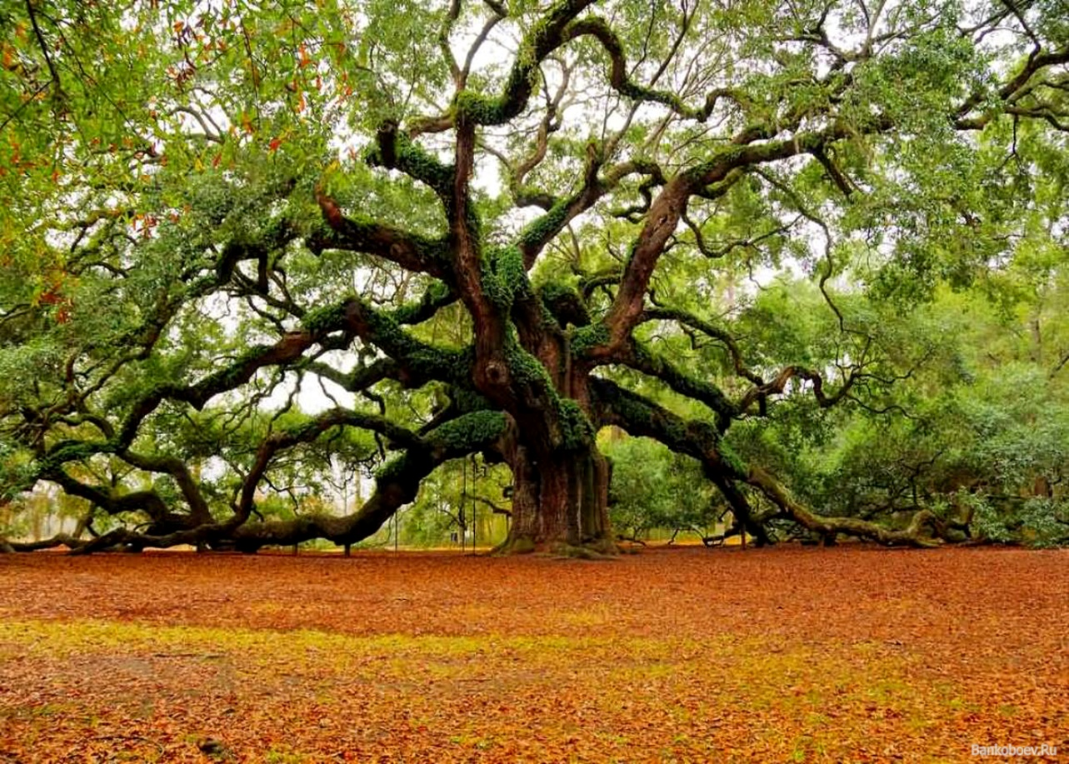
Есть свежая идея!

Slide 23
Как преобразовать список в дерево?
С:\\dev\archive\snapshot-97
С:\\dev\archive\snapshot-98
С:\\dev\archive\snapshot-99 (aka release-1.0.0)
С:\\dev\archive\snapshot-100
С:\\dev\archive\snapshot-101
С:\\dev\archive\snapshot-102
С:\\dev\archive\snapshot-103
С:\\dev\archive\snapshot-104
С:\\dev\archive\snapshot-105 (aka release-1.0.1)
С:\\dev\archive\snapshot-106
С:\\dev\archive\snapshot-107
С:\\dev\archive\snapshot-108
С:\\dev\archive\snapshot-109 (aka release-1.0.2)
С:\\dev\archive\snapshot-110
С:\\dev\archive\snapshot-111

Slide 24
Добавим к каждому сообщению ссылку на родителя
Я, Иванов Иван Иванович, исправил аццкий баг в продакшене
20 августа 2042 - [digital signature]
Предыдущий коммит - С:\\dev\archive\snapshot-99

Slide 25
Получилось такая логическая стуруктура
snapshot-97
С:\\dev\archive\snapshot-97
С:\\dev\archive\snapshot-98
С:\\dev\archive\snapshot-99 (aka release-1.0.0)
С:\\dev\archive\snapshot-100
С:\\dev\archive\snapshot-101
С:\\dev\archive\snapshot-102
С:\\dev\archive\snapshot-103
С:\\dev\archive\snapshot-104
С:\\dev\archive\snapshot-105 (aka release-1.0.1)
С:\\dev\archive\snapshot-106
С:\\dev\archive\snapshot-107
С:\\dev\archive\snapshot-108
С:\\dev\archive\snapshot-109 (aka release-1.0.2)
С:\\dev\archive\snapshot-110
С:\\dev\archive\snapshot-111
snapshot-98
snapshot-99
snapshot-102
snapshot-100
snapshot-107
snapshot-101
snapshot-102
snapshot-103

Slide 26
Но как это обычно бывает появилась другая проблема – нет возможности определить последний коммит в ветке по номеру
С:\\dev\archive\snapshot-97
С:\\dev\archive\snapshot-98
С:\\dev\archive\snapshot-99
С:\\dev\archive\snapshot-100
С:\\dev\archive\snapshot-101
С:\\dev\archive\snapshot-102
С:\\dev\archive\snapshot-103
С:\\dev\archive\snapshot-104
С:\\dev\archive\snapshot-105
С:\\dev\archive\snapshot-106
С:\\dev\archive\snapshot-107
С:\\dev\archive\snapshot-108
С:\\dev\archive\snapshot-109
С:\\dev\archive\snapshot-110
С:\\dev\archive\snapshot-111

Slide 27
Нам нужны ссылки на последние коммиты
С:\\dev\working
С:\\dev\archive\snapshot-0
С:\\dev\archive\snapshot-1
С:\\dev\archive\snapshot-2\message.txt
….
С:\\dev\archive\references\heads\master.txt
С:\\dev\archive\references\heads\release-1.0.txt
С:\\dev\archive\references\heads\new-help-page.txt
….

Slide 28
snapshot-97
snapshot-98
snapshot-99
snapshot-102
snapshot-100
Release-0.1
snapshot-107
snapshot-101
snapshot-102
snapshot-103
master

Slide 29
snapshot-97
snapshot-98
snapshot-99
snapshot-102
snapshot-100
snapshot-107
snapshot-101
snapshot-109
snapshot-102
Release-0.1
snapshot-110
snapshot-103
snapshot-104
snapshot-106
snapshot-106
master

Slide 30
Бранчи офигенная вещь!
Но указатели постоянно , меняются при новых коммитах
Давайте изобретем теги

Slide 31
Теперь у нас есть теги
С:\\dev\working
С:\\dev\archive\snapshot-1
С:\\dev\archive\snapshot-2\message.txt
….
С:\\dev\archive\references\heads\master.txt
С:\\dev\archive\references\heads\release-1.0.txt
С:\\dev\archive\references\tags\v1.0.1.txt
С:\\dev\archive\references\tags\v1.0.2.txt
….

Slide 32
snapshot-97
snapshot-98
snapshot-99
V1.0.0
V1.0.1
snapshot-102
snapshot-100
snapshot-107
snapshot-101
snapshot-109
snapshot-102
Release-0.1
snapshot-110
snapshot-103
snapshot-104
snapshot-106
snapshot-106
master

Slide 33
Git - distributed version control system
Берем копируем все файлы и отправляем другому разработчику.
Можно работать в разное время, оффлайн, быстро смотреть историю и тд.

Slide 34
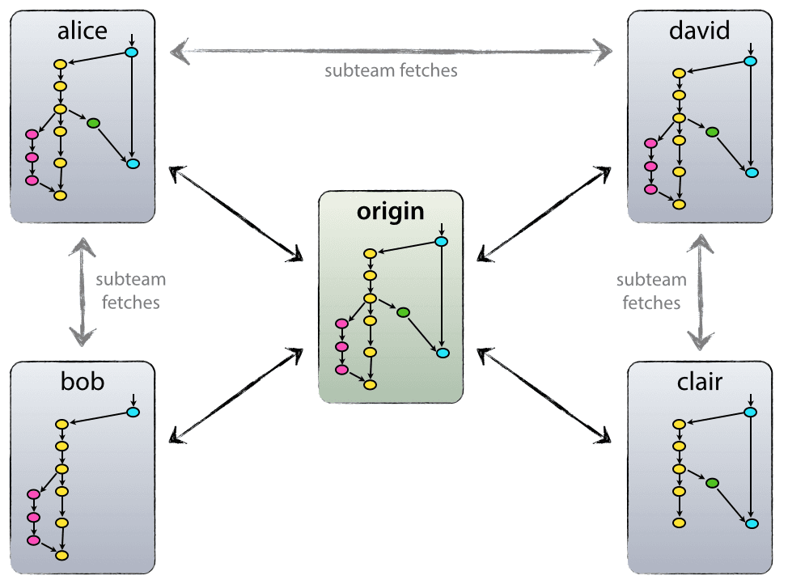
Decentralized but centralized
no such thing as a central repo at a technical level
But one repo is only considered to be the central one (origin)

Slide 35
Новая проблема
Единая нумерация и коллизия имен
…
С:\\dev\archive\snapshot-97
С:\\dev\archive\snapshot-98
С:\\dev\archive\snapshot-99 (aka release-1.0)
С:\\dev\archive\snapshot-100
С:\\dev\archive\snapshot-101
С:\\dev\archive\snapshot-102
С:\\dev\archive\snapshot-103
С:\\dev\archive\snapshot-104
…

Slide 36
Решение
Берем сообщение коммита
С:\\dev\archive\snapshot-2\message.txt
Я, Иванов Иван Иванович, исправил аццкий баг в продакшене
20 августа 2042 - [digital signature]
Мой предыдущий коммит - С:\\dev\archive\snapshot-99

Slide 37
SHA1 hash algorithm
И используя SHA1 получаем вот такую строку
8ba3441b6b89cad23387ee875f2ae55069291f4b
Это и будет новым именем

Slide 38
Теперь директория выглядит так
С:\\dev\working
С:\\dev\archive\8ecefd0b596fe2f95d91e4b914dc8b7b45eebd
С:\\dev\archive\11c52114047683224149cf2d48f0752e548b0c\message.txt
….
С:\\dev\archive\references\heads\master.txt
С:\\dev\archive\references\heads\release-1.0.txt
С:\\dev\archive\references\tags\v1.0.1.txt
С:\\dev\archive\references\tags\v1.0.2.txt
….

Slide 39
5aefd3c
e742533
7a6c97e
V1.0.0
V1.0.1
e690abb
8ca90af
fba1609
b843a0e
df6215a
2a5e81e
Release-0.1
c211f7f
172af80
5b38360
7be20f0
2521386
master

Slide 40
Мержи
Придется создать отдельный снапшот и сообщение
Я, Иванов Иван Иванович, вмержил фичу разработанную Петровым А.В.
20 августа 2042 - [digital signature]
предыдущие коммиты
8ba3441b6b89cad23387ee875f2ae55069291f4b
db9ecb5b5a6294a8733503ab57577db96ff2249e

Slide 41
История и её переписывание TODODDODODO
HEAD
HEAD ^^
Detached snapshot and so on

Slide 42
Что еще
Staging Area
Diffs

Slide 43
Eliminating Duplication
С:\\dev\working
С:\\dev\archive\8ecefd0b596fe2f95d91e4b914dc8b7b45eebd
С:\\dev\archive\11c52114047683224149cf2d48f0752e548b0c\message.txt
….
С:\\dev\archive\references\heads\master.txt
С:\\dev\archive\references\tags\v1.0.2.txt
С:\\dev\archive\objects\
….

Slide 44
А теперь для каждого файла в каждой snapshot директории
Step 1: Calculate the SHA1 of the contents.
Step 2: Add an entry into the temp file that contains the word ‘blob’ (binary large object), the SHA1 from the first step, and the filename. Step 3: Copy the file to the objects directory and rename it to the SHA1 from step 1. Once finished with all the files, find the SHA1 of the temp file contents and use that to name the temp file, also placing it in the objects directory.
If at any time the objects directory already contains a file with a given name, then you have already stored that file’s contents and there is no need to do so again.

Slide 45
Compressing Blobs
Text can be very efficiently compressed using something like the LZW or DEFLATE compression algorithms. If you compress every blob before computing its SHA1 and saving it to disk you can reduce the total storage size of the project history by another very admirable quantity.

Slide 46
Git
remember that it is almost impossible to lose work that has been committed.
Even when you delete a branch, all that’s really happened is that the pointer to that commit has been removed.
All of the snapshots are still in the objects directory, you just need to dig up the commit SHA. In these cases, look up git reflog.
It contains a history of what each branch pointed to and in times of crisis, it will save the day.

Slide 47
Теперь смотрим реальную папку .git

Slide 48
Stash – по сути обычный коммит

Slide 49
Вставить картинку
https://octodex.github.com/

Slide 50
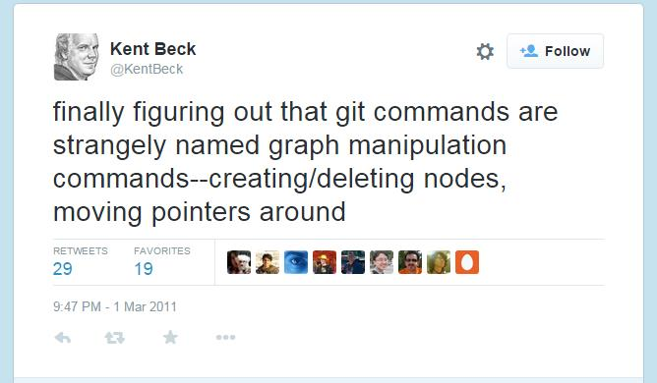

Slide 51
Полезные линки

Slide 52
Git overview

Slide 53
Начали использовать гит около 3х лет назад, до этого subversion
Использовали в лучших традициях SVN
В последние полгода задумались о том правильно ли мы его используем ☺

Slide 54
Commit message
AngularJS Git Commit Message Conventions
https://docs.google.com/document/d/1QrDFcIiPjSLDn3EL15IJygNPiHORgU1_OOAqWjiDU5Y/mobilebasic
emoji on commits

Slide 55
Git Flow

Slide 56


Slide 57
The main branches
origin/master – production ready
origin/develop – latest development (or integration branch)
Merge from dev to master == new production release

Slide 58
Supporting branches (limited life time)
Feature branches
Release branches
Hotfix branches

Slide 59
Feature branches
May branch off from:
develop
Must merge back into:
develop
Branch naming convention:
anything except master, develop, release-*, or hotfix-*
Feature branches typically exist in developer repos only, not in origin.
$ git checkout -b myfeature develop Switched to a new branch "myfeature"
$ git checkout develop Switched to branch 'develop'
$ git merge --no-ff myfeature Updating ea1b82a..05e9557 (Summary of changes)
$ git branch -d myfeature Deleted branch myfeature (was 05e9557).
$ git push origin develop

Slide 60
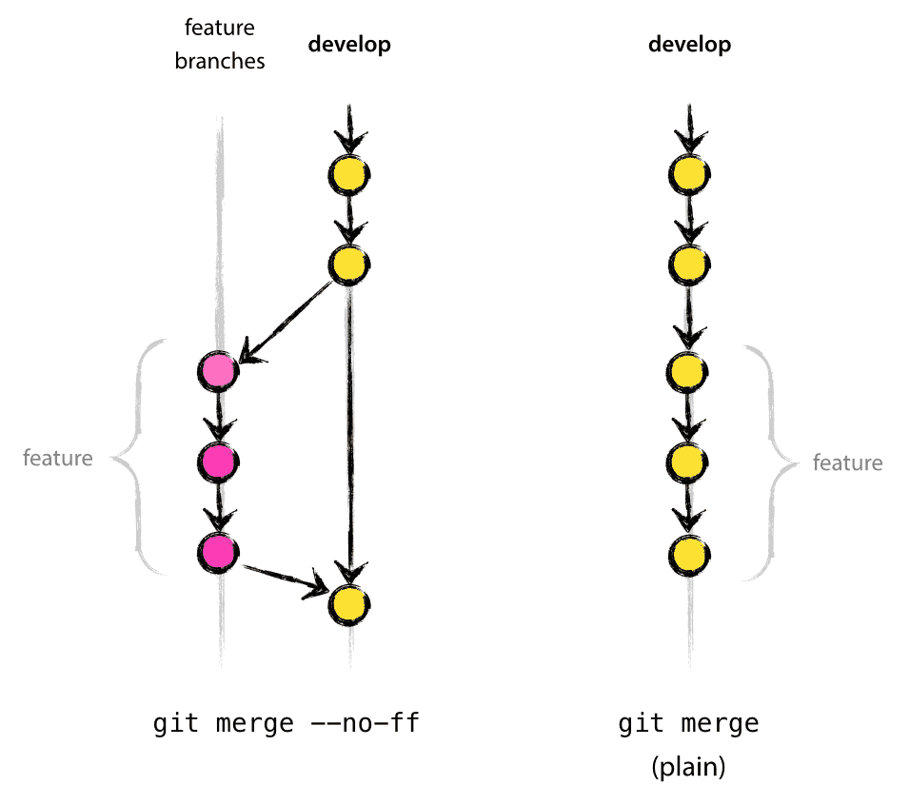
The --no-ff flag
The --no-ff flag causes the merge to always create a new commit object,
even if the merge could be performed with a fast-forward.
This avoids losing information about the historical existence of a
feature branch and groups together all commits that together added the feature
In the latter case, it is impossible to see from the
Git history which of the commit objects together have implemented a feature—you would have to manually read all the log messages. Reverting a whole feature (i.e. a group of commits), is a true headache in the latter situation, whereas it is easily done if the --no-ff flag was used.
Yes, it will create a few more (empty) commit objects, but the gain is much bigger that that cost.
Unfortunately, I have not found a way to make --no-ff the default behaviour of git merge yet, but it really should be.

Slide 61
Release branches
Release branches support preparation of a new production release.
They allow for last-minute dotting of i’s and crossing t’s
bug fixes may be applied in this branch
Adding large new features here is strictly prohibited.
May branch off from:
develop
Must merge back into:
develop and master
Branch naming convention:
release-*
$ git checkout -b release-1.2 develop Switched to a new branch "release-1.2"
$ ./bump-version.sh 1.2 Files modified successfully, version bumped to 1.2.
$ git commit -a -m "Bumped version number to 1.2" [release-1.2 74d9424]
Bumped version number to 1.2 1
files changed, 1 insertions(+), 1 deletions(-)
$ git checkout master Switched to branch 'master'
$ git merge --no-ff release-1.2 Merge made by recursive. (Summary of changes)
$ git tag -a 1.2

Slide 62
Release branches
$ git checkout develop Switched to branch 'develop‘
$ git merge --no-ff release-1.2 Merge made by recursive.
(Summary of changes)
Merge conflicts
Now we are really done and the release branch may be removed, since we don’t need it anymore:
$ git branch -d release-1.2 Deleted branch release-1.2 (was ff452fe).

Slide 63
Hotfix branches
May branch off from:
master
Must merge back into:
develop and master
Branch naming convention:
hotfix-*
$ git checkout -b hotfix-1.2.1 master Switched to a new branch "hotfix-1.2.1"
$ ./bump-version.sh 1.2.1 Files modified successfully, version bumped to 1.2.1.
$ git commit -a -m "Bumped version number to 1.2.1" [hotfix-1.2.1 41e61bb] Bumped version number to 1.2.1 1 files changed, 1 insertions(+), 1 deletions(-)
$ git commit -m "Fixed severe production problem" [hotfix-1.2.1 abbe5d6] Fixed severe production problem 5 files changed, 32 insertions(+), 17 deletions(-)
$ git checkout master Switched to branch 'master'
$ git merge --no-ff hotfix-1.2.1 Merge made by recursive. (Summary of changes)
$ git tag -a 1.2.1
$ git checkout develop Switched to branch 'develop'
$ git merge --no-ff hotfix-1.2.1 Merge made by recursive. (Summary of changes)
$ git branch -d hotfix-1.2.1 Deleted branch hotfix-1.2.1 (was abbe5d6).

Slide 64
Git Flow Docs
https://github.com/nvie/gitflow
https://github.com/nvie/gitflow

Slide 65


Slide 66

GitHub Team

Slide 67
(картинка что все очень просто ☺)
По сравнению с git flow

Slide 68
Особенности
Нет develop бранча
simplicity
Есть Continuous Deployment (Delivery)
Little issues can be introduced, but then they can be fixed and redeployed very quickly. Normally you would have to do a ‘hotfix’ or something outside of the normal process, but it’s simply part of our normal process - there is no difference in the GitHub flow between a hotfix and a very small feature.
We can respond to security issues that are brought to our attention or implement small but interesting feature requests incredibly quickly, yet we can use the exact same process to address those changes as we do to handle normal or even large feature development.

Slide 69
Master
Feature branches / remote branches
Pull request
Code review & communication
---

Slide 70
PULL REQUEST!!!
Code discussion
Feature discussion
Strategy discussion
Discussion

Slide 71
Rules
#1 - anything in the master branch is deployable
Every branch we push has tests run on it
#2 - create descriptive branches off of master
(t’s almost like a list of upcoming features with current rough status.)
#3 - push to named branches constantly
#4 - open a pull request at any time (communication, code review, обновление из мастера)
#5 - merge only after pull request review
#6 - deploy immediately after review

Slide 72
GitHub Flow Docs
https://guides.github.com/introduction/flow/
http://scottchacon.com/2011/08/31/github-flow.html
* http://zachholman.com/talk/how-github-uses-github-to-build-github/
http://haacked.com/archive/2014/07/28/github-flow-aliases/

Slide 73
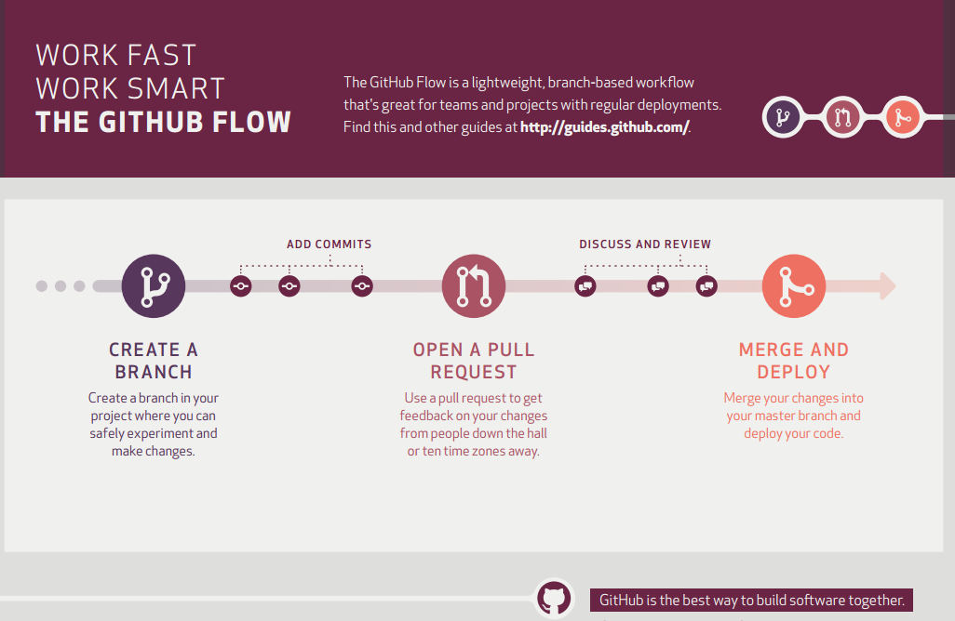

Slide 74
Continuous Integration
“Everyone Commits To the Mainline Every Day” @Martin Fowler

Slide 75
Code review (задачи)
командообразование
разные скилы у коллег (+ bus fuctor)
обучение коллег и студентов

Slide 76
Internals
http://wildlyinaccurate.com/a-hackers-guide-to-git/

Slide 77
feature branching vs CI
feature branching and how it fits in with CI.

Slide 78
http://martinfowler.com/bliki/FeatureBranch.html
Feature Branching is a poor man's modular architecture, instead of building systems with the ability to easy swap in and out features at runtime/deploytime they couple themselves to the source control providing this mechanism through manual merging.
-- Dan Bodart

Slide 79
FeatureToggle
http://martinfowler.com/bliki/FeatureToggle.html
http://stackoverflow.com/questions/19434222/feature-toggles-vs-feature-branches

Slide 80
BranchByAbstraction
http://martinfowler.com/bliki/BranchByAbstraction.html
http://continuousdelivery.com/2011/05/make-large-scale-changes-incrementally-with-branch-by-abstraction/
Thus one of the more controversial statements in Continuous Delivery is that you can’t do continuous integration and use branches. By definition, if you have code sitting on a branch, it isn’t integrated. One common case when it seems obvious to use branches in version control is when making a large-scale change to your application. However there is an alternative to using branches: a technique called branch by abstraction.

Slide 81
http://martinfowler.com/
http://martinfowler.com/tags/version%20control.html
http://martinfowler.com/tags/continuous%20integration.html

Slide 82
https://groups.google.com/forum/#!topic/continuousdelivery/9_5xpiHJZUc

Slide 83
CI, CD and Code Review
https://groups.google.com/forum/#!searchin/continuousdelivery/code$20review/continuousdelivery/LIJ1nva9Oas/Rn991jRQIEwJ
I am currently writing a blog post on this topic. The short answer is this: * The best way to review code is through pair programming * It's a bad idea to gate merge to mainline - by creating a separate branch, for example - on a formal review process. This inhibits continuous integration (the best way of reducing the risk of bad changes, which is what you are really aiming to achieve). * I think Gerrit is a nice tool, but it should be used *after* check- in (that's how it's designed, in fact). Part of the job of the senior developers is to review all check-ins. They could, for example, subscribe to a feed. To summarize: code review is good. So good, we should be doing it continuously, through pair programming and reviewing commits. If a senior dev finds a bad commit, she should pair with the person who committed it to help them fix the problem. Gating merge to mainline on a formal review is bad, and creating branches to do so is extra bad, for the same reason that feature branches are bad. Thanks,

Slide 84
I'm not clear what you want as a result of a more systematic process. I assume you mean you want to have higher quality code.
There is no magic formula for the correct % of code that needs to be reviewed. If you are measuring too many bugs per release, why do you think are you having so many bugs? You need to answer that question. Are your tests not catching things? Are your developers less experienced and need more training?
IMHO code reviews are a sign that the reviewer doesn't trust the coder, so it is the organization's job to increase trust in the developer, through education (pair programming, code reviews, etc.) until you trust them. And trust needs to be measured by something like how many bugs a person introduces. Trust removes process, removing process speeds up development.

Slide 85
Hi Frederic
I definitely advocate a systematic approach. All check-ins should be systematically reviewed by the dev lead as soon as possible after the check-ins occur. Gerrit is a nice tool for this.
Furthermore, all code that is to be checked in must have been reviewed by one other person before check-in (as part of pair programming). This should also be systematic, i.e. built into the system.
So 100% of commits should be reviewed, both before and after check-in (i.e. twice).
What I don't recommend is creating gated processes that try to enforce this, either by using branches in version control, or by adding stages to the pipeline. I say this for two reasons:
1. it inhibits continuous integration
2. it assumes that people are going to be stupid and that your process must correct for this, rather than that people will overall try to do the right thing, but that we must put something in place to manage the exceptions. Basically, your process should follow theory Y not theory X: http://en.wikipedia.org/wiki/Theory_X_and_theory_Y
In general, managers spend too much time trying to create complex processes to try and enforce "good behaviour" rather than building systems in which good behaviour naturally emerges. I like to call this kind of Theory X thinking "risk management theatre" because it provides the impression that risk is being managed effectively, while actually producing lower quality results.
Thanks,

Slide 86
Высокая культура ☺
Если у нас баг в продакшене значит у нас баг в хайринге

Slide 87
With respect to your assumption of "under-reviewed code," I would say there are many cases where we deploy code, even publicly, that you would consider to be "under-reviewed." The relative degree of testing that we apply is proportional to the amount of risk involved. We are decent at assessing and socializing risk. :) Our Payments team, for example, is much more rigid about their review process than teams that, say, are running experiments at the UI level. It's not one-size-fits-all.

Slide 88
In terms of development process, we don't use feature branches in the traditional sense—especially if you think of branches existing for more than a day. In practice, there are certainly cases where individuals will use a short-lived branch to isolate a couple of things they're working on at a time, much like you might use git stash—such as to switch context to work on an immediate bug fix that needs to go to production.
Our review process does utilize branches. But that's only comes into play to support the review process. As an engineer prepares to commit a change set, they create a (short-lived) review branch in git. This allows us to look at the review in GitHub Enterprise and use their commenting and visual diff'ing. It also allows other engineers to checkout the branch and put it through its paces, when necessary.
Once the code review is complete, the branch is typically auto-merged in GitHub when the engineer is prepared to deploy it.

Slide 89
Code Review
http://blog.mattcallanan.net/2014/02/how-etsy-do-code-reviews-with.html
имена комитов (скриншот)
требования к именованию комитов

Slide 90
GitLab Flow
https://about.gitlab.com/2014/09/29/gitlab-flow/

Slide 91
Разные проекты – разные задачи
Иногда надо выкатывать новые фичи как можно быстрее
И некогда ждать

Slide 92
1) Я люблю гит
2) git flow - все сложно и формально
3) github flow - все проше, но крутые тесты, тестеры не нужны (10 - 40 деплоев в день) Необходимо очень хорошее тестировени, не боятся выкатить баг в продакшен
и мониторинг твиттера
4) про сборку - webpack
5) используют github enterprise, запуск тестов для фича бранчей и тд
6) после мержа, тестирование на отдельном сервере
7) пше

Slide 93


Slide 94
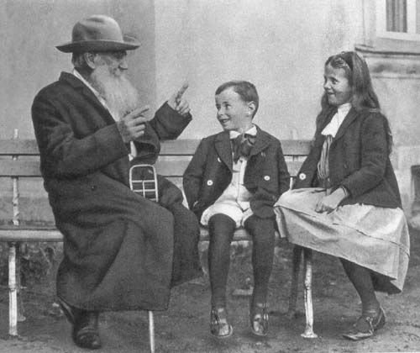
Лев Толстой рассказывает внукам сказку об огурце. 1909 г
Вот такой коммит на продакшен

Slide 95
Проблемы с git flow
“add feature X”
“fix jshint errors”
“fix tests”

Slide 96
Что осталось за бортом
Diff и его инструменты

Slide 97
Git Alias
[alias]
s = status -s
lg = log --oneline --decorate --all --graph
co = checkout
cob = checkout -b
ec = config --global -e
cm = !git add -A && git commit -m
up = !git pull --rebase --prune $@ && git submodule update --init --recursive
save = !git add -A && git commit -m 'SAVEPOINT'
wip = commit -am "WIP"
undo = reset HEAD~1 --mixed
amend = commit -a --amend
wipe = !git add -A && git commit -qm 'WIPE SAVEPOINT' && git reset HEAD~1 –hard
…..
http://haacked.com/archive/2014/07/28/github-flow-aliases/

Slide 98
Code review

Slide 99
Полезные ссылки
Git Magic
http://www-cs-students.stanford.edu/~blynn/gitmagic/
Притча
http://tom.preston-werner.com/2009/05/19/the-git-parable.html
How GitHub Uses GitHub to Build GitHub
https://www.youtube.com/watch?v=qyz3jkOBbQY
Всё о правильной номерации версий приложения
http://semver.org/

Slide 100
Полезные ссылки
Big ball of mud
http://www.laputan.org/mud/

Slide 101
Не гитом единым
tfs, commitы в несколько веток и тд
Разные подходы
Кроме самых простых

Slide 102
Код ревью?

Slide 103
Картинка с виноватыми парнями
Нужна фотка – мужики (или дети) стоят виноватые
повесив головы

