Slide 1
Lecture III

Slide 2
ECMAScript Philosophy
“don’t break the web”
Which means:
No version like python 2 and 3.
No breaking changes
Fully backwards-compatibility.

Slide 3
ECMAScript versions and our course
ES3 (1999)
ES4 (2008) ES5 or ES3.1 (2009)
ES6 (2015)

Slide 4
ECMAScript Harmony ECMAScript.next ECMAScript 6 (or ES6) ECMAScript 2015

Slide 5
Current state
http://kangax.github.io/compat-table/es5/
http://kangax.github.io/compat-table/es6/
http://caniuse.com/

Slide 6
Recap of lecture II

Slide 7


Slide 8


Slide 9
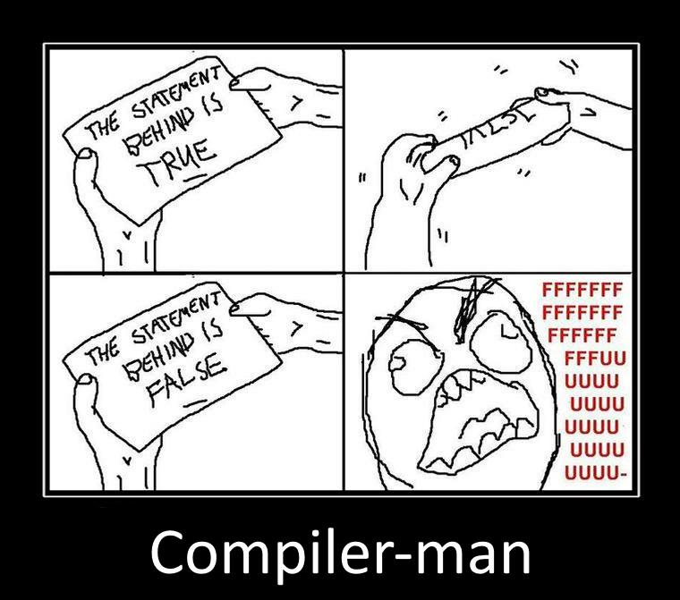

Slide 10
Example
var a = 2;
var b = 2;
console.log(a + b);

Slide 11
Scope

Slide 12
ES 3

Slide 13
The Scope of a Variable
The scope of a variable are the locations
where it is accessible.
For example:
function foo() {
var x;
}

Slide 14
Scope - is a logical boundaries in which a variable (or expression) has its meaning.
For example, a global variable, a local variable, etc, which generally reflects a logical range of a variable lifetime.

Slide 15
Scope can be nested
function f() {
var x = 2;
function g() {
var y = 3;
alert(x + y);
}
}

Slide 16
Nested Scope
function f() {
var x = 2;
function g() {
var y = 3;
alert(x + y);
}
}
outer scope
inner scope

Slide 17
Shadowing
var scope = "global "; // A global variable
function outer() {
var scope = “outer”; // A outer variable
function inner() {
var scope = “inner";
document.write(scope); // Prints "inner"
}
inner();
}
outer();

Slide 18
Shadowing
var scope = "global "; // A global variable
function outer() {
var scope = “outer”; // A outer variable
function inner() {
document.write(scope); // Prints "outer"
}
inner();
}
outer();

Slide 19
Shadowing
var scope = "global "; // A global variable
function outer() {
function inner() {
document.write(scope); // Prints "global"
}
inner();
}
outer();

Slide 20
function X() {
var a = 3, b = 5;
function foo () {
var b = 7, c = 11;
a += b + c;
};
foo();
alert("a = " + a + "; b = " + b);
}
X();
var x = function(){
alert(x.toString());
}
x();

Slide 21
Hoisting
JavaScript hoists all variable declarations, it moves them to the beginning of their direct scopes.

Slide 22
Hoisting
foo(); // undefined ("foo" and "bar" exist)
function foo() {
alert(bar);
}
var bar;
function foo() {
alert(bar);
}
var bar;
foo(); // undefined

Slide 23
Hoisting
var scope = "global ";
function f( ) {
alert(scope);
var scope = "local";
alert(scope);
}
f( );
var scope = "global ";
function f( ) {
var scope;
alert(scope);
scope = "local";
alert(scope);
}
f( );

Slide 24
Only functions introduce new scopes
No block scope
function f() {
{ // block starts
var foo = 4;
} // block ends
console.log(foo); // 4
}

Slide 25
No block scope!
function test(o) {
var i = 0; // i is defined throughout function
if (typeof o == "object") {
var j = 0; // j is defined everywhere, not just block
for(var k=0; k < 10; k++) { // k is defined everywhere, not just loop
document.write(k);
}
document.write(k); // k is still defined: prints 10
}
document.write(j); // j is defined, but may not be initialized
}

Slide 26
Hoisting
var foo = 1;
function bar() {
if (!foo) {
var foo = 10;
}
alert(foo);
}
bar();

Slide 27
Code in global scope
Index.html
<!DOCTYPE html>
<html>
<head>
<title>Untitled Page</title>
<script type="text/javascript" src="script.js"></script>
</head>
<body>
<script type="text/javascript">
var a = 5;
var b = 2;
function sum(x, y) {
return x + y;
}
function mul(x, y) {
return x * y;
}
</script>
</body>
</html>
script.js
var gloabalVar = 5;
function square(x) {
return x * x;
}

Slide 28
Global namespace
Every variable is global unless it's in a function and is declared with var
function f(){
x = “global variable”;
}
f();

Slide 29
Global object (WAT)
function f(){
x = “global variable”; // var is missed
}
f();
this.x === “global variable”;
window.x === “global variable”; // true for browsers

Slide 30
window vs global
(function (glob) {
// glob points to global object
}(typeof window !== 'undefined' ? window : global));

Slide 31
Global variables are evil
They are less robust, behave less predictably, and are less reusable.
Name clashes. Your code, built-ins, analytics code, social media buttons use the same global scope.

Slide 32
Globals
// antipattern
function sum(x, y) {
// implied global
result = x + y;
return result;
}
// antipattern
function foo() {
var a = b = 0;
// ...
}
// preferred
function foo() {
var a, b;
// ...
a = b = 0; // both local
}

Slide 33
<script>
if (("a" in window) == false) {
var a = 1;
}
alert(a);
</script>

Slide 34
Working with global
window.foo
if (window.foo) { … }
if (“foo” in window) { … }
if (typeof “foo” !== “undefined”) { … }

Slide 35
Namespaces
if (window.myNamespace == null){
window.myNamespace = {};
}
window.myNamespace.myFunction = function(/* params*/ ) {
/* code here */
};

Slide 36
immediately invoked function expression in next lecture

Slide 37

REFERENCES
JavaScript: The Definitive Guide, Six Edition
by David Flanagan
Speaking JavaScript: An In-Depth Guide for Programmers
by Dr. Axel Rauschmayer
http://dmitrysoshnikov.com
http://learn.javascript.ru

