Slide 1
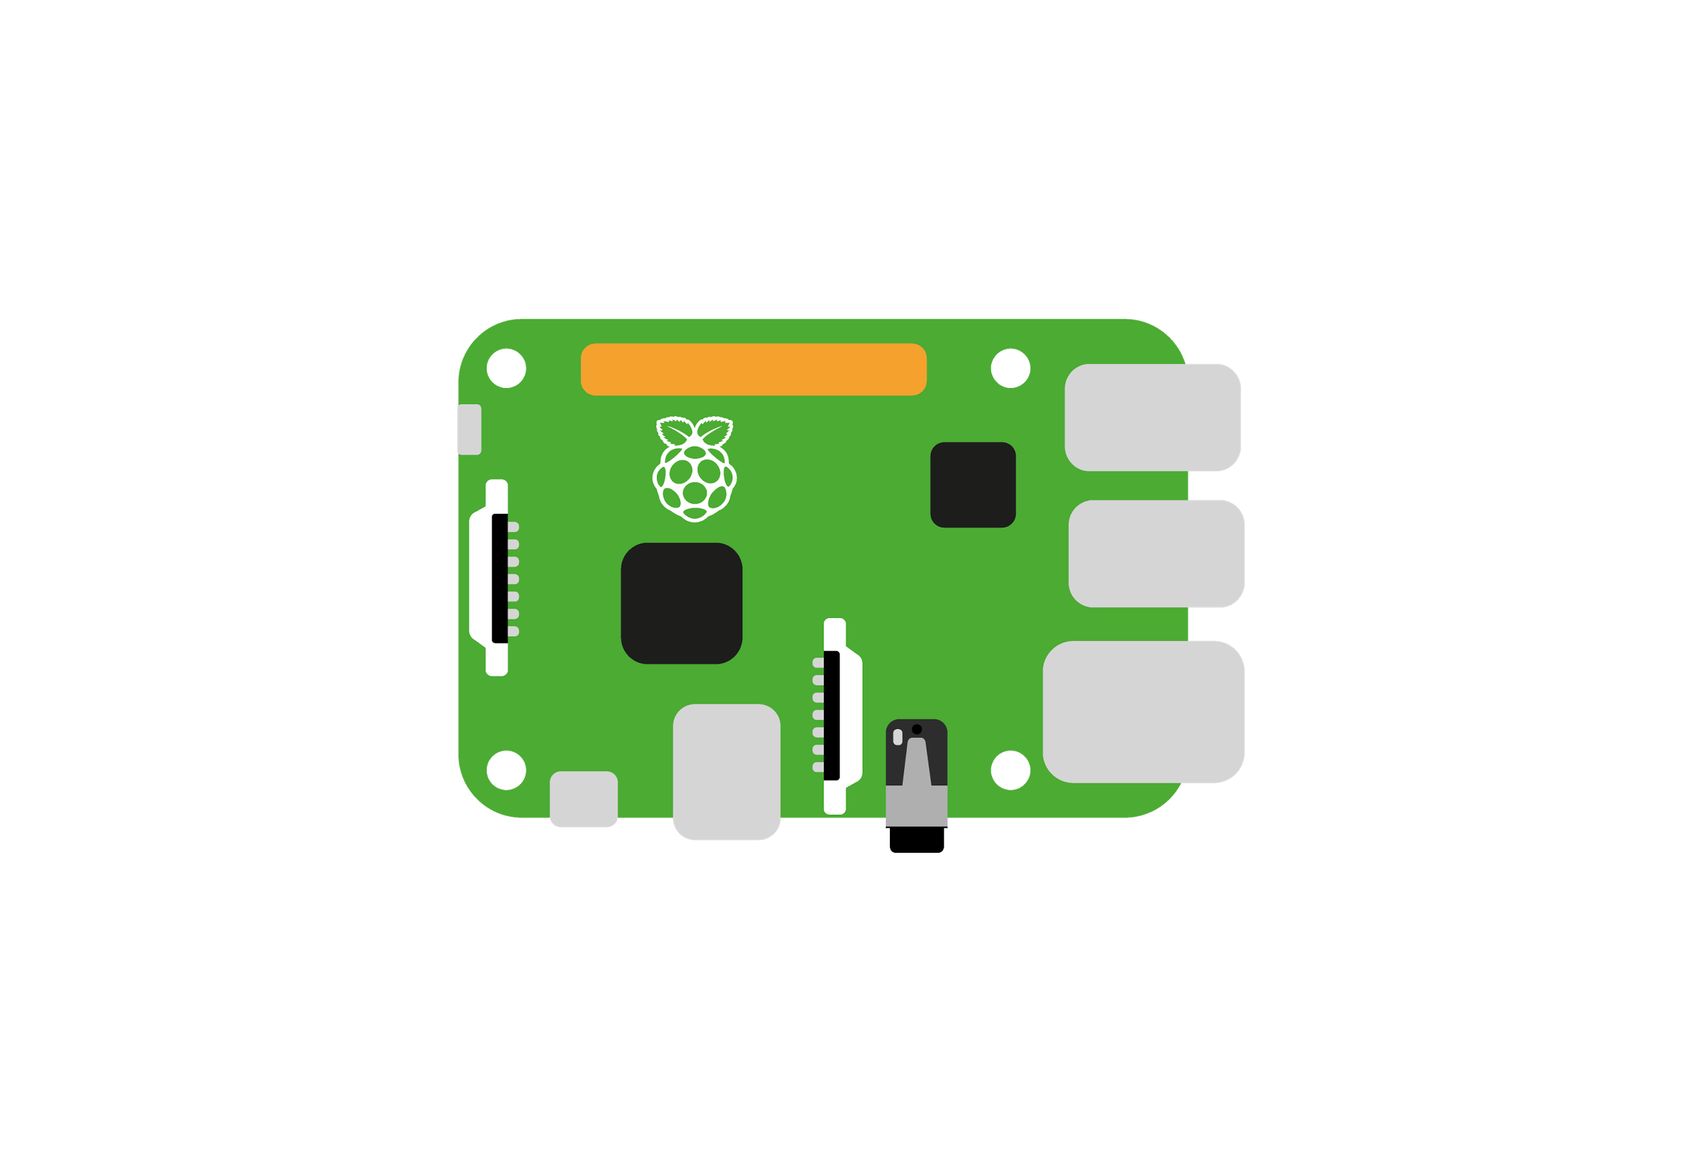


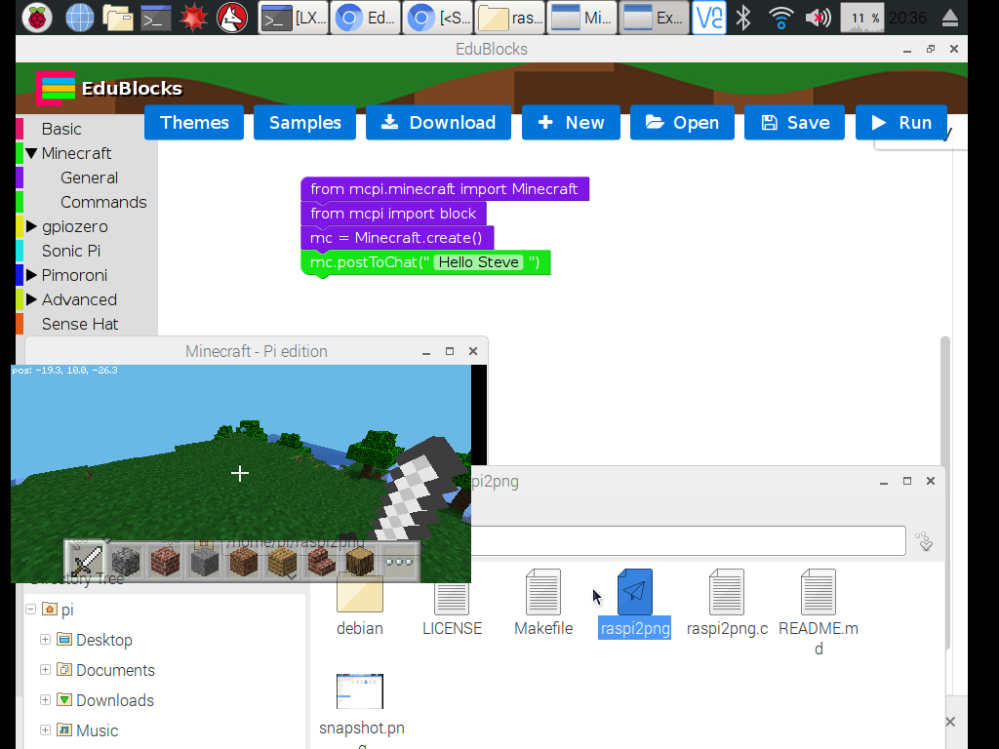
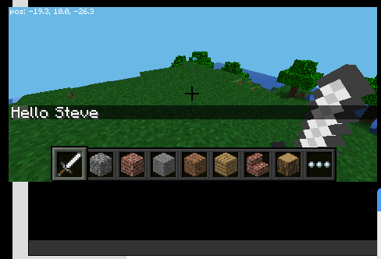
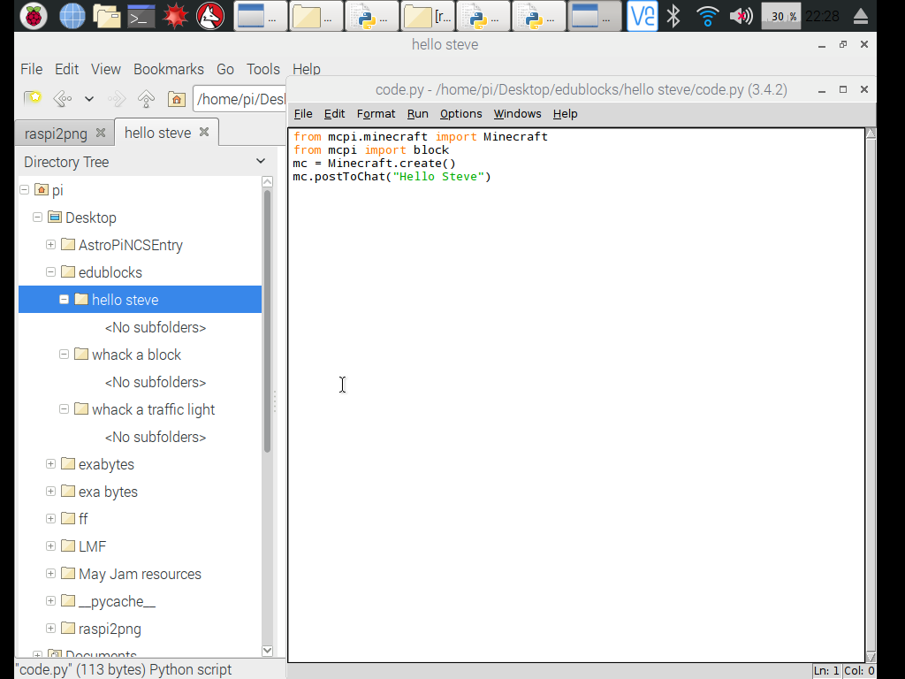
1
2
3
Coding
Get a Pi
Master visual Python with EduBlocks on side one
Try your hand at text based programming with Python 3 on side 2
Hello Steve
123 coding cards v1

Slide 2
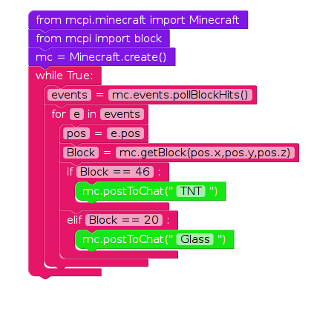
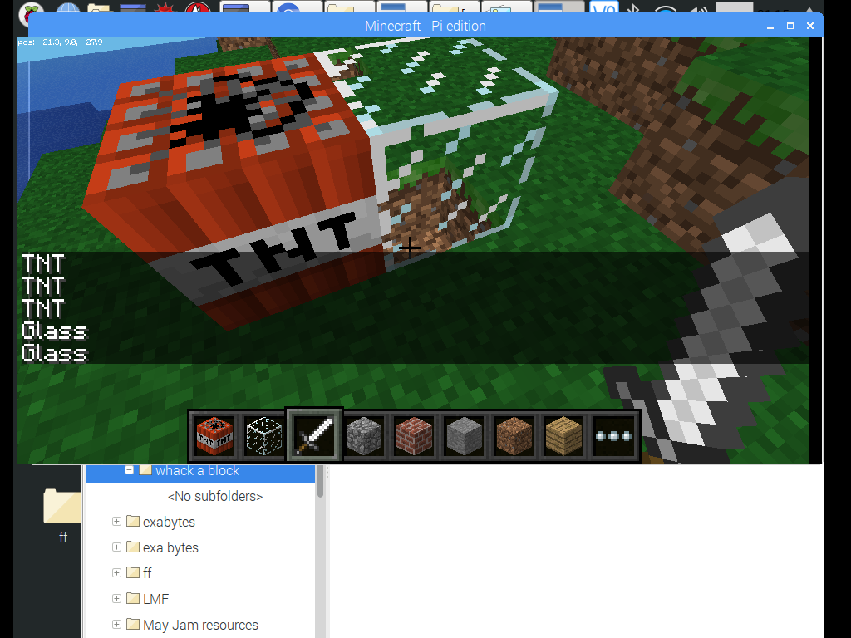
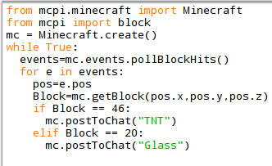
1
2
3
Coding
Get a Pi
Master visual Python with EduBlocks on side one
Try your hand at text based programming with Python 3 on side 2
Whack a block, postToChat
123 coding cards v1

Slide 3
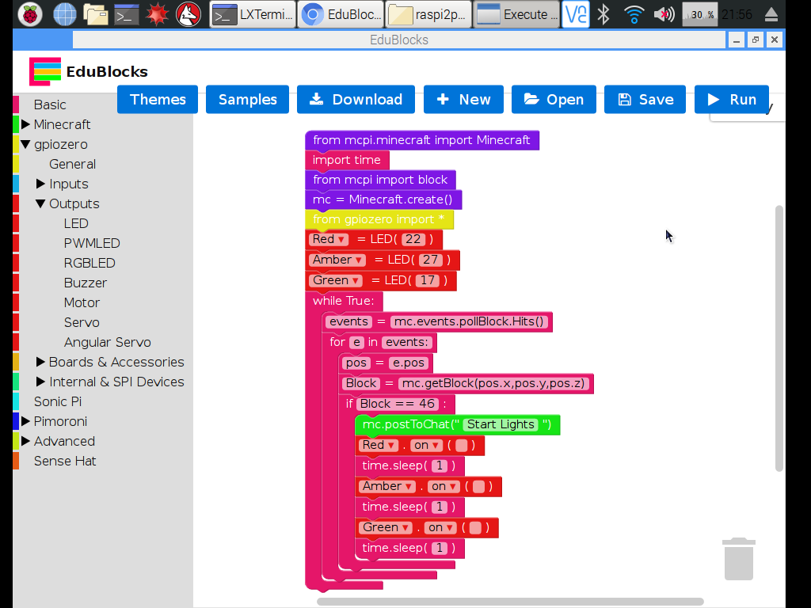
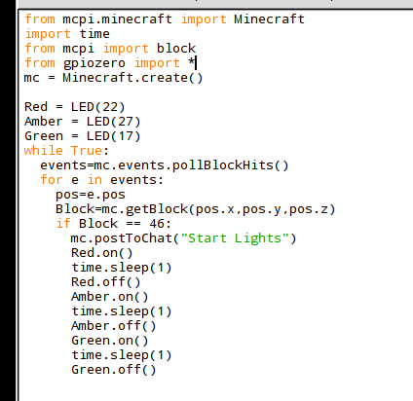
1
2
3
Coding
Get a Pi
Master visual Python with EduBlocks on side one
Try your hand at text based programming with Python 3 on side 2
Whack a block, control Traffic lights
123 coding cards v1

