Slide 1

SUPER MARIO
PROJECT GAME INTRODUCTION
CS TEAM

Slide 2

Team Members
Đặng Vĩnh Bảo
Team Leader
Programmer
Tester
Cao Thanh Bình
Programmer
Sound Designer
Tester
Nguyễn Ngọc Hoan
Programmer
AI Designer
Tester
Nguyễn Minh Châu
Programmer
Graphics Designer
Tester

Slide 3
Project Introduction
The final project of GameLoft internship
Recreate one of the greatest Super Nintendo games of all time, Super Mario, on Mobile
Genre: Adventure – Single player game
MIDP 2.0 / CLDC 1.1 Mobile Java game

Slide 4
Game Introduction
The player takes the role of Mario
The object is to race through the Mushroom Kingdom, evade or battle enemies, and save Princess Peach from the evil Bowser, king of the Koopas
Many obstacles stand in your way, such as enemy creatures and bottemless pits

Slide 5



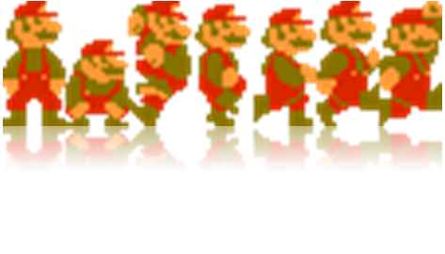
Mario Levels
Small Mario (beginning level)‏
Super Mario (when collect a grow-up mushroom)

Slide 6

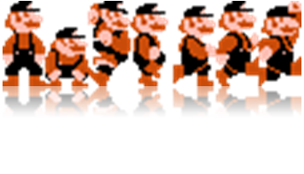

Mario Levels
Fiery Mario (when collect a fire flower)‏
Invincible Mario (when collect a starman)

Slide 7






Enemies
Goombas
Buzzy Beetles

Slide 8



Enemies
Koopa Troopas

Slide 9

Enemies
Bowser - King of the Koopas

Slide 10
Bonus Items
Extra life mushroom
Coin
Secret item (bonus brick, question box, hidden bonus)‏

Slide 11
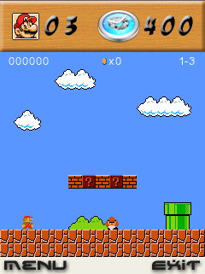
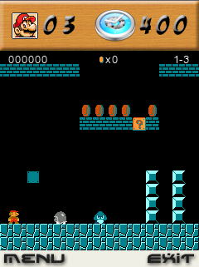
World Levels

Slide 12
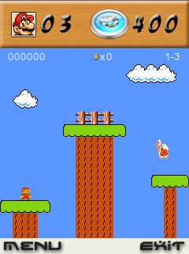
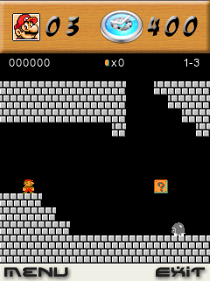
World Levels

Slide 13
Disadvantages
Use large memory
Missing some enemies
Lack of world

Slide 14
Advantages
Variety of motion and sound effects
Simple control
Fun to play
Many secrets to discover

Slide 15
Our achivements
Knowledge about mobile game development process
How to make a J2ME game
Subversion and coding convention
Be familiar with many open source and freeware tools
Team work and communication skills

Slide 16
Demonstration

Slide 17
Question & Answer

