Slide 1
Introduction to Express.js

Slide 2
Table of content
What is Express.js
Setting up an Express.js application
Understanding routing in Express.js
Handling HTTP requests and responses using Express.js
Serving static files
Understanding middleware in Express.js
Conclusion

Slide 3
What is Express.js
Express.js is a web framework for Node.js that simplifies the process of building server-side applications.
It provides a set of HTTP utility methods and middleware for handling requests, responses, routing, and more.
Express.js follows the middleware architecture, where each middleware function can handle a specific task in the request-response cycle.
It allows developers to create routes, handle HTTP methods (GET, POST, PUT, DELETE, etc.), and implement middleware functions for various purposes.
Express.js also integrates with other popular Node.js modules and libraries, making it a powerful tool for building web applications.

Slide 4
Setting Up Express.js
To use Express.js, you first need to install it in your Node.js project using npm (Node Package Manager). Open your terminal and run the following command:
npm install express
Once installed, you can require Express.js in your Node.js application and create an instance of the Express application as follows:
const express = require('express’);
const app = express();
The app variable represent the express application and you can use it to configure routes, middleware and other settings

Slide 5

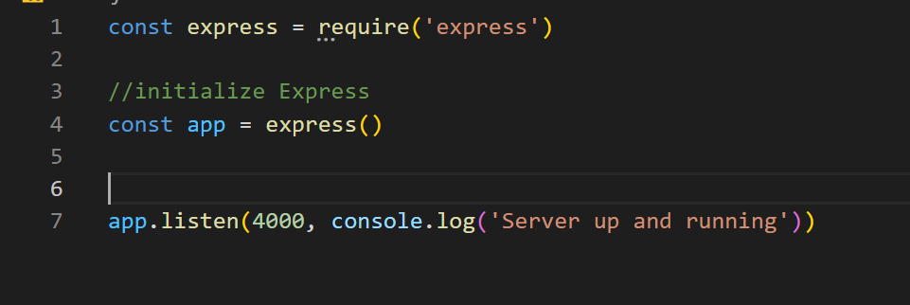
Continuation of setting up express
To run your express app, you will use the listen method provided by express in the app variable created. It listens on a port and also execute a call back function or logs a message to the console. Below is a wider representation of the code

Slide 6
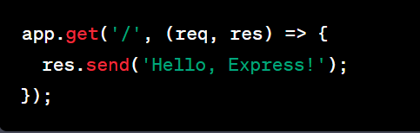
Understanding routing in Express.js
Routes define how the application responds to different URLs and HTTP methods. You can create routes in Express.js using the app object and specifying the URL pattern, HTTP method, and callback function that handles the request.
In the above example, we define a route for the root URL ("/") and the HTTP GET method. The callback function takes two parameters: req (request) and res (response). The res object is used to send the response to the client

Slide 7

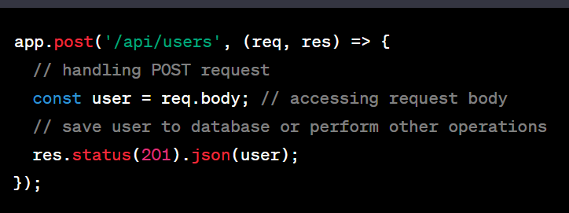
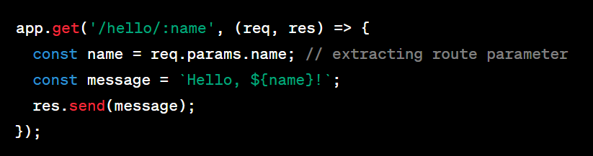
Handling HTTP requests and responses using Express.js
In the above example, we define a route for the HTTP POST method and use the req.body property to access the request body. This is commonly used for handling form submissions or API requests.
In the above example, we define a route with a URL pattern "/hello/:name", where :name is a route parameter that can capture a value from the URL. The req.params object is used to access the captured parameter value.

Slide 8
Serving Static Files:
Express.js allows you to serve static files, such as HTML, CSS, images, and JavaScript, from a directory using the express.static() middleware
app.use(express.static('public'));
In the above example, we configure the Express app to serve static files from the "public" directory. This means that any file located in the "public" directory will be directly accessible from the browser using the URL path.
If you need to serve the about page, you type http://localhost:4000/about.html

Slide 9
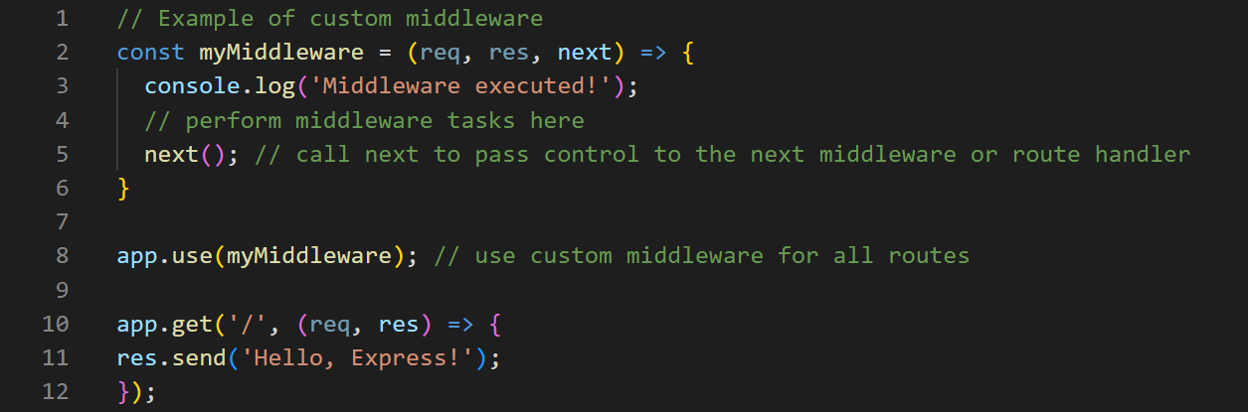
Understanding middleware in Express.js
DEFINITION
Middleware functions are functions that can handle tasks in the request-response cycle before the final response is sent to the client. They can perform operations such as authentication, logging, data validation, and more.
In the above example, we define a custom middleware function myMiddleware that logs a message to the console. We then use app.use() to register this middleware function, which will be executed for every incoming request before reaching the route handler for the root URL ("/"). The next() function is called to pass control to the next middleware or route handler in the chain.

Slide 10
conclusion
Express.js is a powerful web framework for Node.js that simplifies the process of building server-side applications.
It provides a set of features such as routing, middleware, error handling, and static file serving that make it easy to build robust and scalable web applications.
Express.js integrates well with other Node.js modules and libraries, making it a popular choice among developers for building web applications.

