Slide 1
Software engineering: Stocks n Stuff
Paul Fears
Frank Firicano
Mitchell Taylor

Slide 2
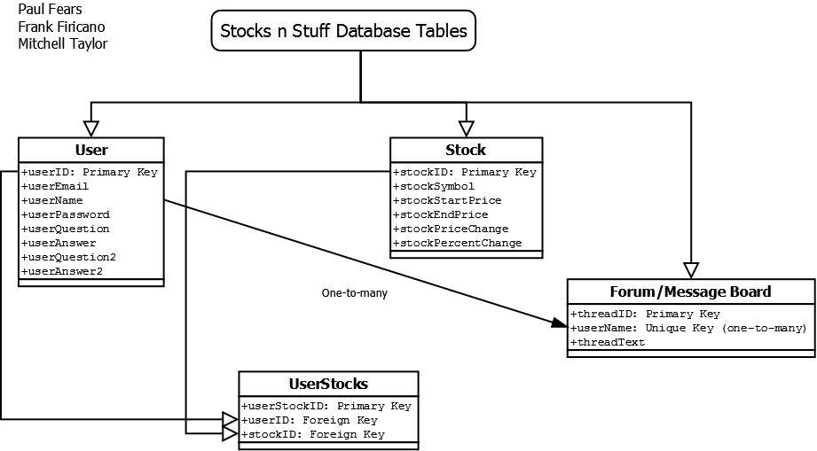
Er diagram

Slide 3
Tables
4 different tables: User, Stock, UserStock, and Forum
User contains user information—email/password, username, status (banned/unbanned/suspended) and security questions/answers
Stock contains stock information retrieved and filtered from website—includes stock symbol, start/end price, and change ($ and %)
Forum contains message board posts/comments
Includes userID (each post belongs to a single user)

Slide 4
Tables (cont.)
The table UserStock makes connections to users and stocks they wish to ‘track’ which they can view on a separate page
A UserStock table is created for each user upon registration
Stocks are added/removed from individual tables by users ‘tracking’/’untracking’ them

