Slide 1
CUSTOMER BOOKING PREDICTION PIPELINE
End-to-End Machine Learning Workflow
Costas Antony Pinto
British Airways • 2025

Slide 2
PROJECT OVERVIEW
End-to-end pipeline to predict customer bookings using a Random Forest Classifier.
Covers environment setup, data preparation, modeling, evaluation, and deployment.

Slide 3
PHASE 1: ENVIRONMENT SETUP
Imported data science libraries, logging, and visualization tools
Configured Rose Pine and Trading View themes for consistent plots
Set global random seed and logging format

Slide 4
PHASE 2: DATA LOADING & INSPECTION
Loaded customer booking dataset with multiple encoding fallbacks
Standardized column names and checked for missing values
Visualized booking status, origins, and passenger counts

Slide 5
PHASE 3: DATA OVERVIEW & VISUALIZATION
Generated statistical summaries and checked nulls
Visualized key distributions (booking origin, sales channel, etc.)
Ensured balanced representation of the target variable

Slide 6
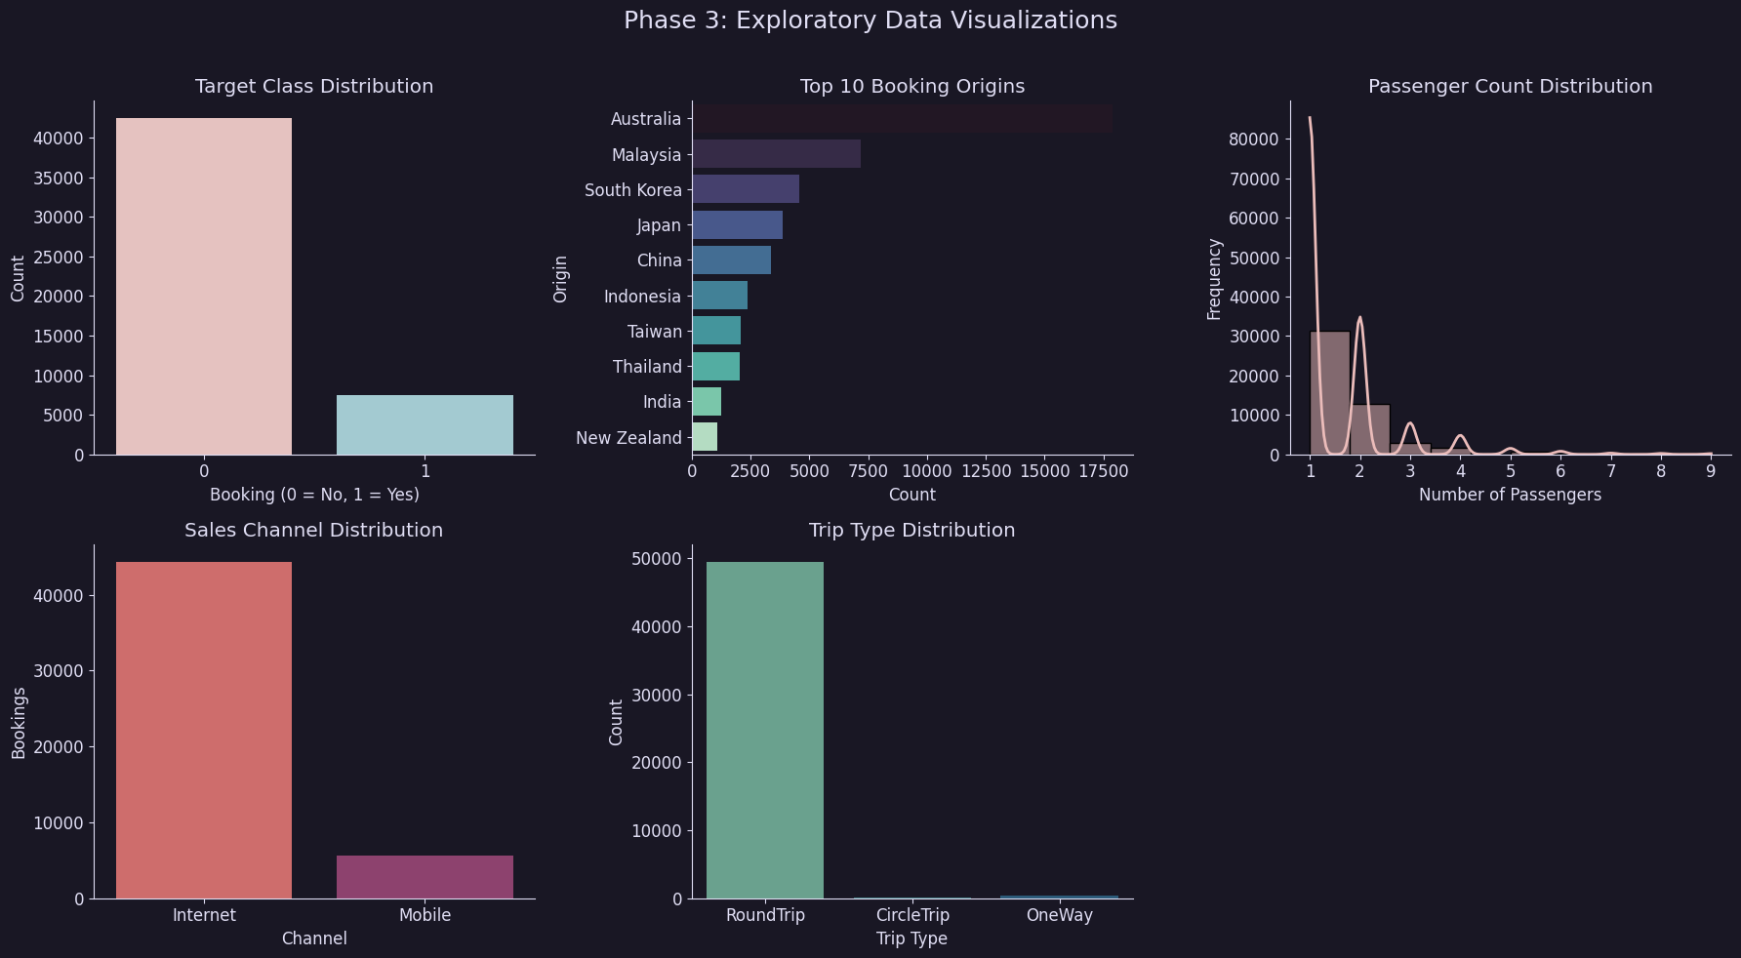

Slide 7
PHASE 4: DATA CLEANING, BALANCING & SPLIT
Handled missing data and applied one-hot encoding
Balanced target class using SMOTE
Split dataset into stratified train-test sets

Slide 8
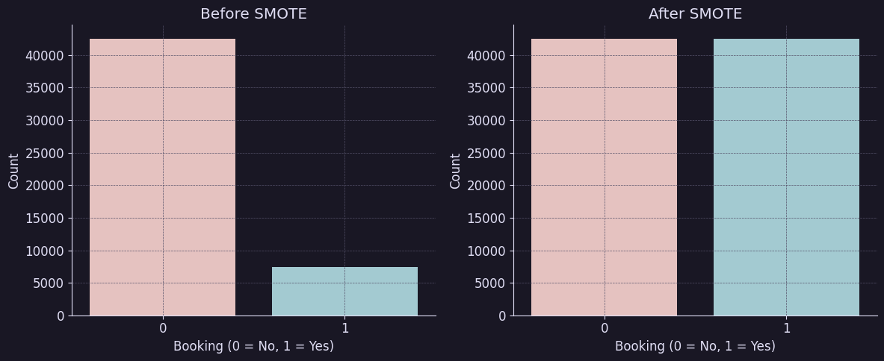

Slide 9
PHASE 5: FEATURE ENGINEERING – LEAD TIME
Engineered 'leadtime' from 'purchase lead' column
Handled missing/negative values and visualized distributions
Feature ready for model training

Slide 10
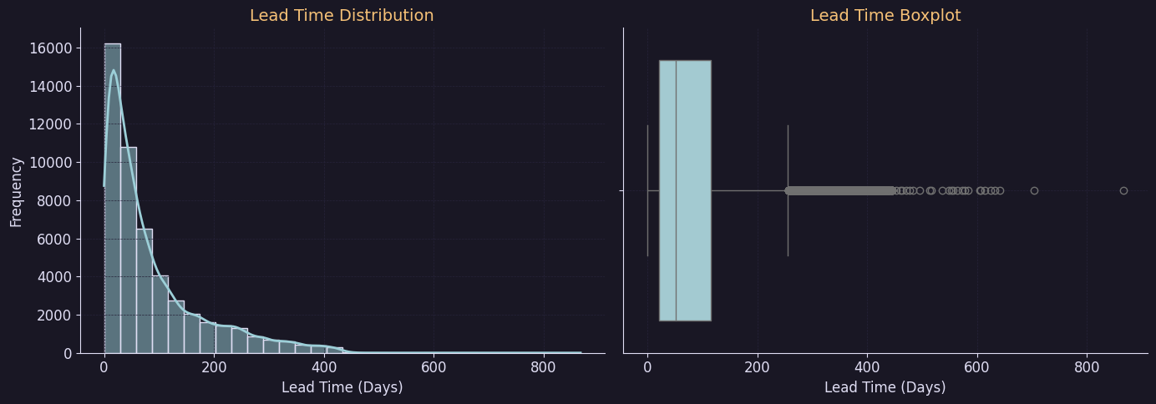

Slide 11
PHASE 6–7: TRAINING & CROSS-VALIDATION
Trained Random Forest with class weights
Used 5-fold Stratified Fold with ROC-AUC scoring
Visualized fold-wise ROC and mean AUC: 0.9671

Slide 12
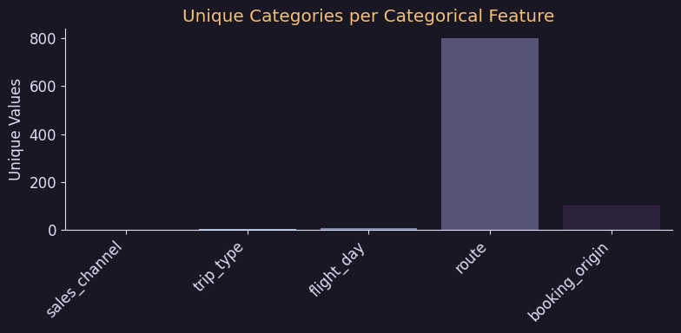


Slide 13
PHASE 8: MODEL EVALUATION
Assessed accuracy, precision, recall, F1-score
Plotted confusion matrix and classification report
Identified model strengths on unseen data

Slide 14
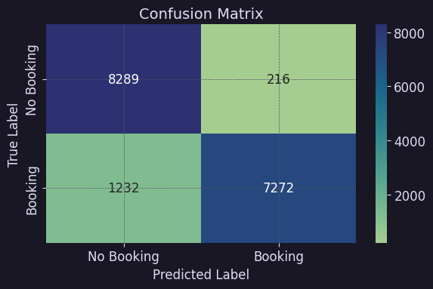

Slide 15
PHASE 9–10: SAVE & EXPLAIN MODEL
Serialized trained model using Joblib
Visualized top 20 feature importances
Model ready for deployment

Slide 16
KEY FEATURES & HIGHLIGHTS
Dark-themed plots with Rose Pine color scheme
Robust logging, modularized code blocks
Supports reproducibility, auditability, and reuse for other pipelines

Slide 17
