Slide 1


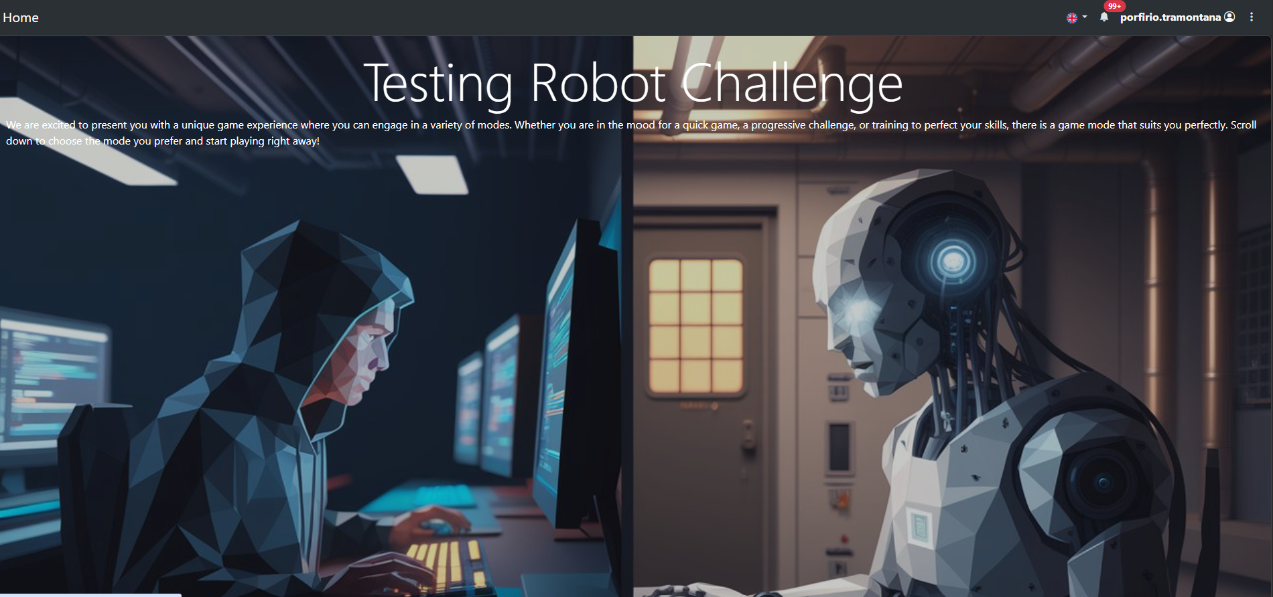
Testing Robot Challenge Game
-Player Guide-
1
Notes:
1

Slide 2
Summary
Goal of the Play
Player Features overview
Player Registration and Login
Main Page- GameMode selection
Single Match game playing
Configuring the match
Entering the Game Arena

Slide 3
Goal of the Game
The objective of the game is to develop a code class capable of competing against classes created by other players.
Each match evaluates the performance of the code based on specific criteria (such as correctness, efficiency, or strategy), and the winner is determined by the test results.
Players earn experience points and unlock achievements by winning different matches.

Slide 4
Player Features Overview
Players have access to several features that enhance gameplay and code development, including:
Match Participation: Join competitive matches or practice in Training Mode
Code Management: Create, upload, download, and edit test classes
Match History: View past matches and track performance
Statistics: Access detailed player stats, including games played, experience points, and achievements earned
Search & Replace: Use built-in tools to quickly find and modify code
Resume Matches: Interrupt and resume Single Matches at any time

Slide 5
Player Registration and Login
Before start playing, the player has to register and create a «Student account»

Slide 6
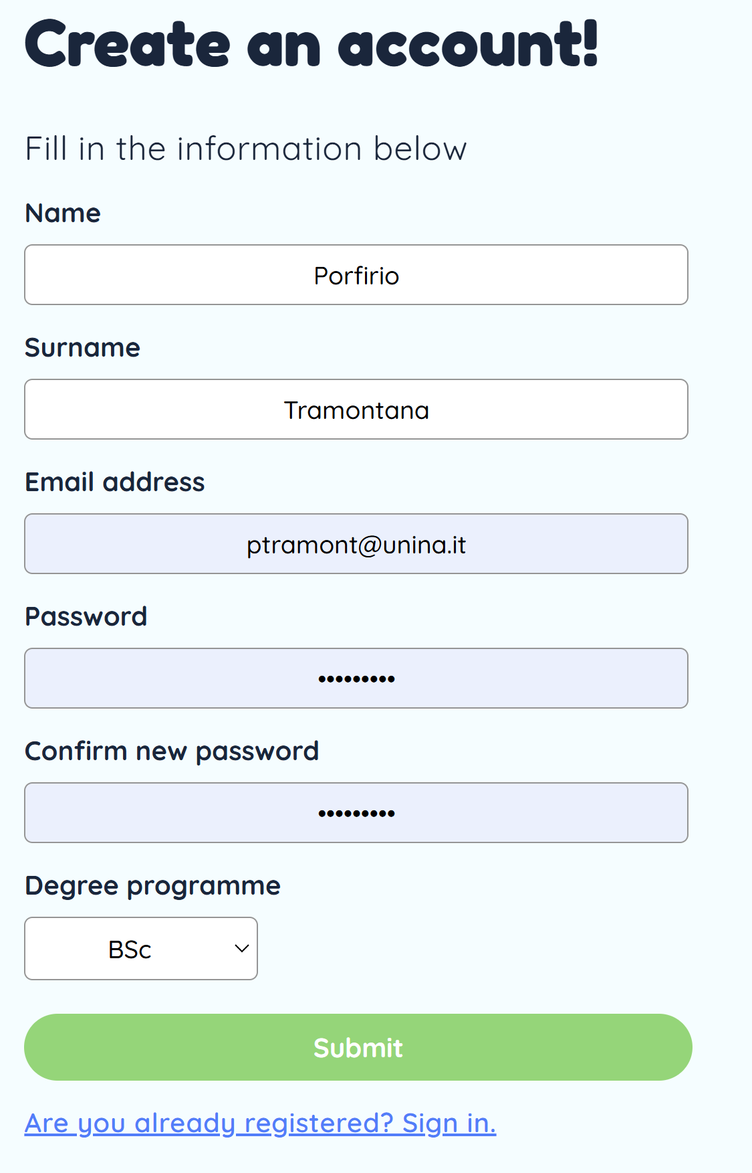
Registration
The player has to provide a few personal information by filling in the registration form

Slide 7
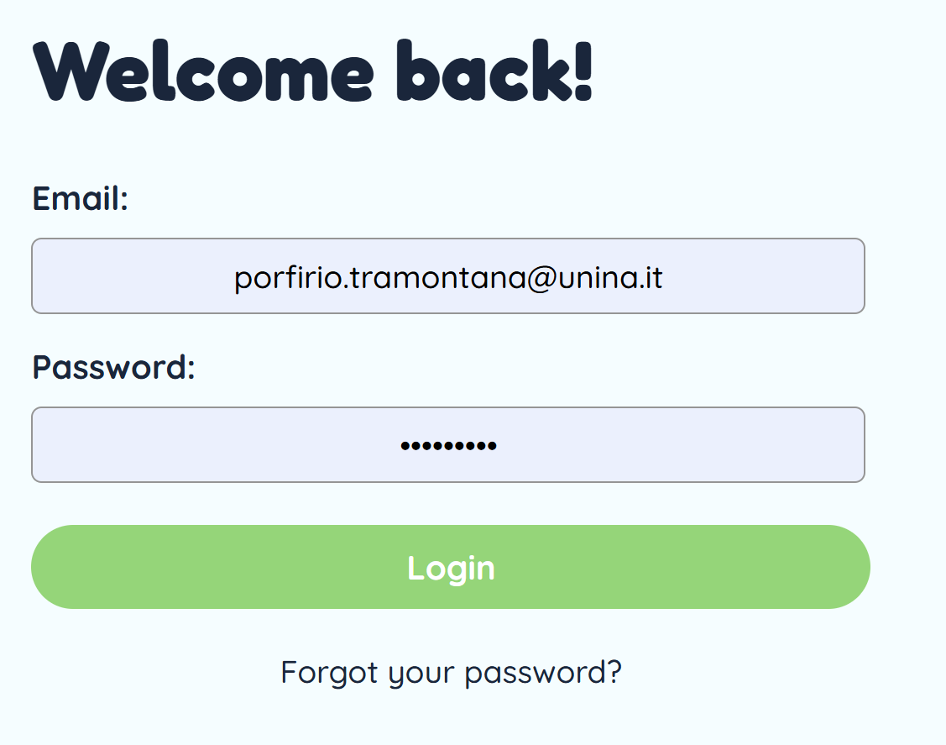
Login
Once registered, the Login is required to enter the app:

Slide 8
Entering the Main Page

Slide 9
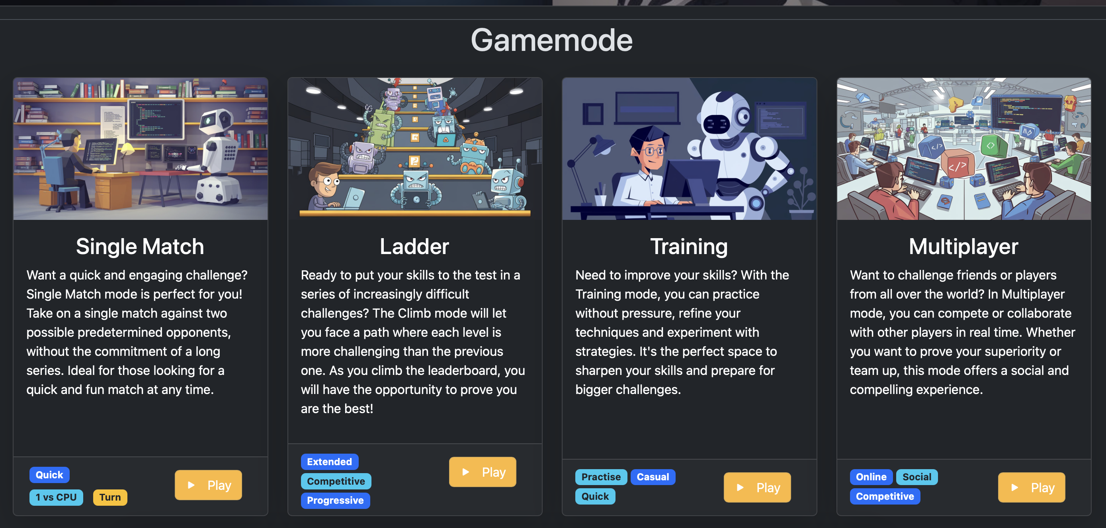
Main Page – GameMode selection
The player can choose between four game modes:

Slide 10
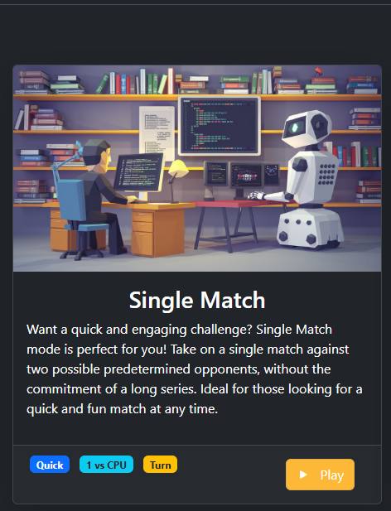
Starting a Single Match Game
The Single Match Game Mode allows to play a challenge against a single opponent.
The goal of the challenge is to outperform the opponent by achieving higher test coverage of a Java Class

Slide 11
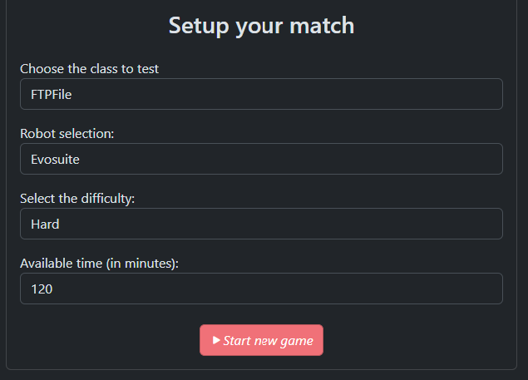
Configuring the Single Match
The player has to choose:
A class to be tested
An Opponent to challenge
Randoop / Evosuite / LLM / Other Students
The difficulty level :
Easy / Medium / Hard
The Time available for the challenge

Slide 12
Choice of Class, Opponent, Difficulty Level
Java Class:
It can be selected from a predefined list established by the Game Administrator
The Opponent can be chosen among:
Randoop, i.e. a random-based test case generator (usually easy to beat)
LLM, i.e. test cases generated by different LLMs including ChatGPT, Gemini, Llama (usually, not so easy to beat)
Evosuite, i.e. a search-based test case generator (usually hard to beat)
Student, i.e. a sample of test cases written by students from different courses (usually very hard to beat)
Difficulty Level:
For each opponent, different test suites with increasing level of coverage may be available (i.e. Easy / Medium / Hard)

Slide 13
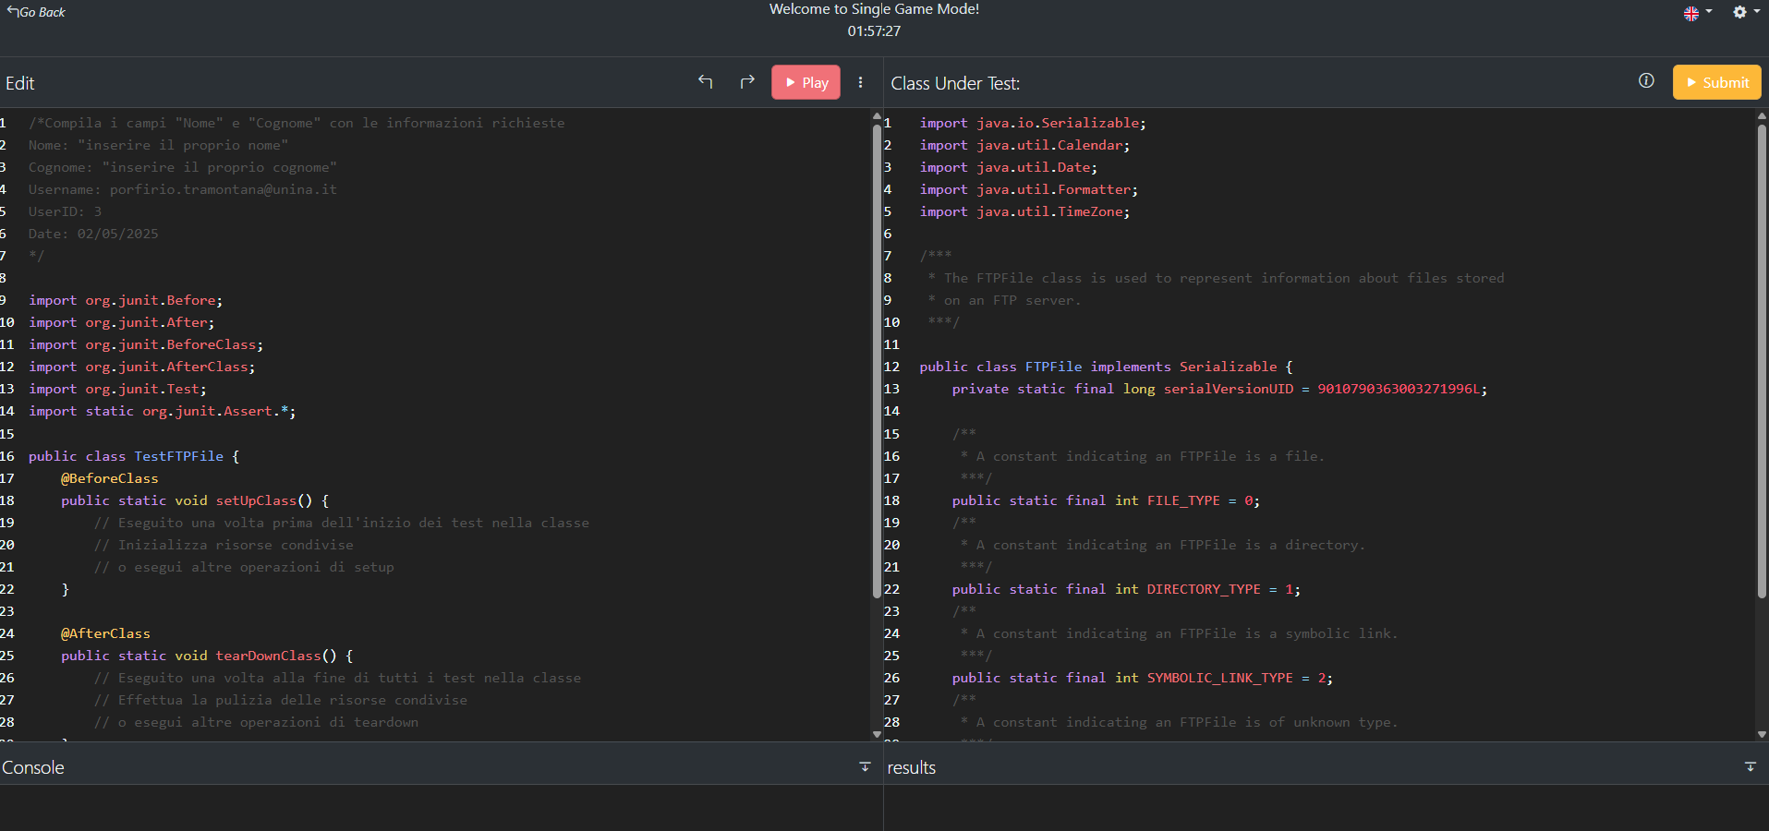
Game Play- Entering the Game Arena

Slide 14
Game Arena- explanation
In the left side, a partially pre-compiled JUnit test class is shown
The class includes empty setup and tearDown methods and possible test methods
In the right side, the class under test code is reported (but cannot be modified)
It is an independent class that can be tested without dependencies on other classes of the project
The Console frame at the bottom left will display the results of each compilation
The Results frame at the bottom right will show the results of the match

Slide 15
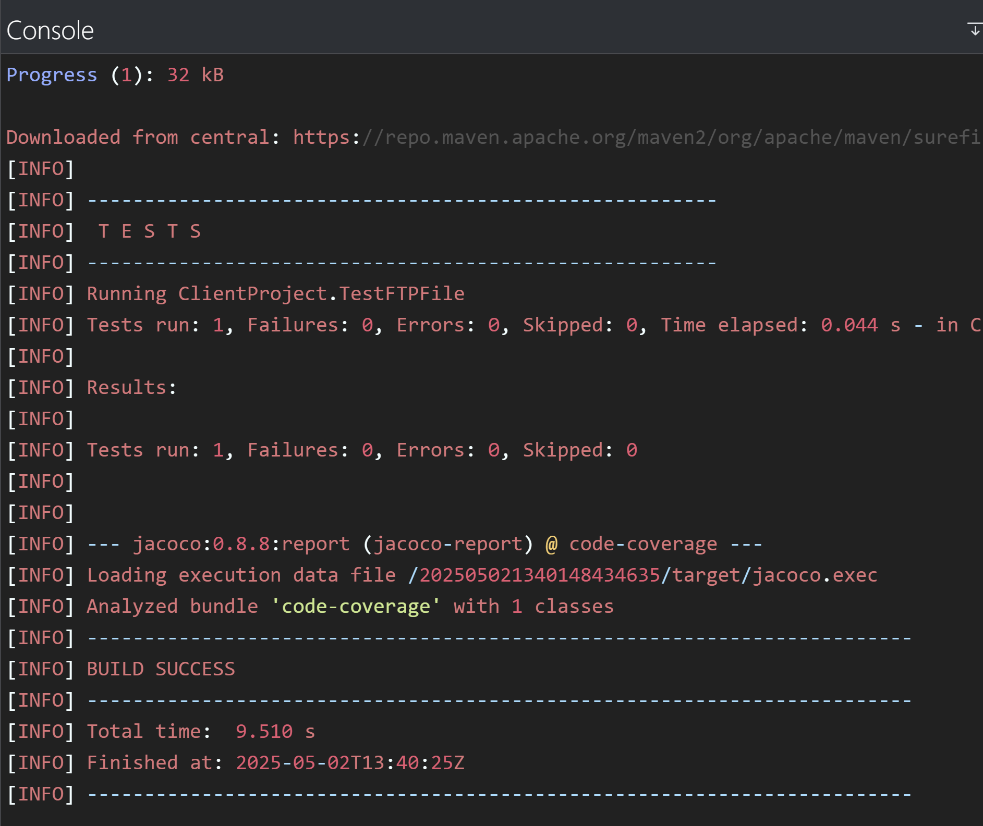
Game Play : Compiling the test code
The player can edit the test case code on the left frame
By clicking the red Play button (in the left frame), the test class will be compiled
Any compilation errors that occur will be shown in the Console frame

Slide 16
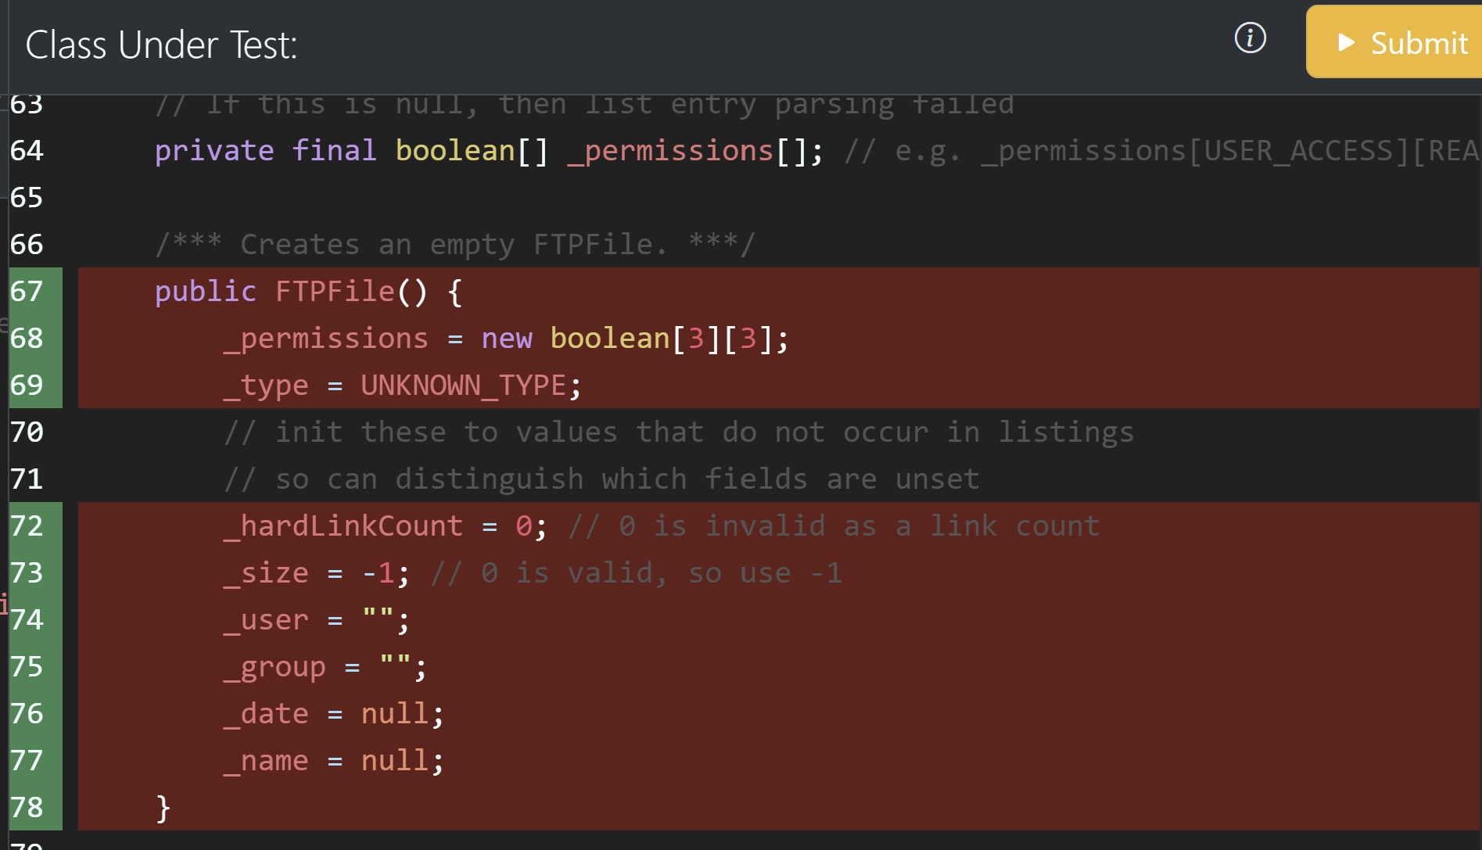
Game Play : Analysing Coverage results
Once the test cases are compiled and executed without errors, code coverage is evaluated, compared with the opponent’s, and displayed in the right Class Under Test frame
The code lines shown with red / yellow / green background indicate that they have been not covered/ partially covered/ fully covered by the Player's test cases, respectively
Code with black background represents code that is not executable (it has not to be covered)
The colors (red / yellow / green) of the listing line numbers on the left indicate lines of code that have been: not covered / partially covered / covered by the Opponent’s test cases, respectively

Slide 17
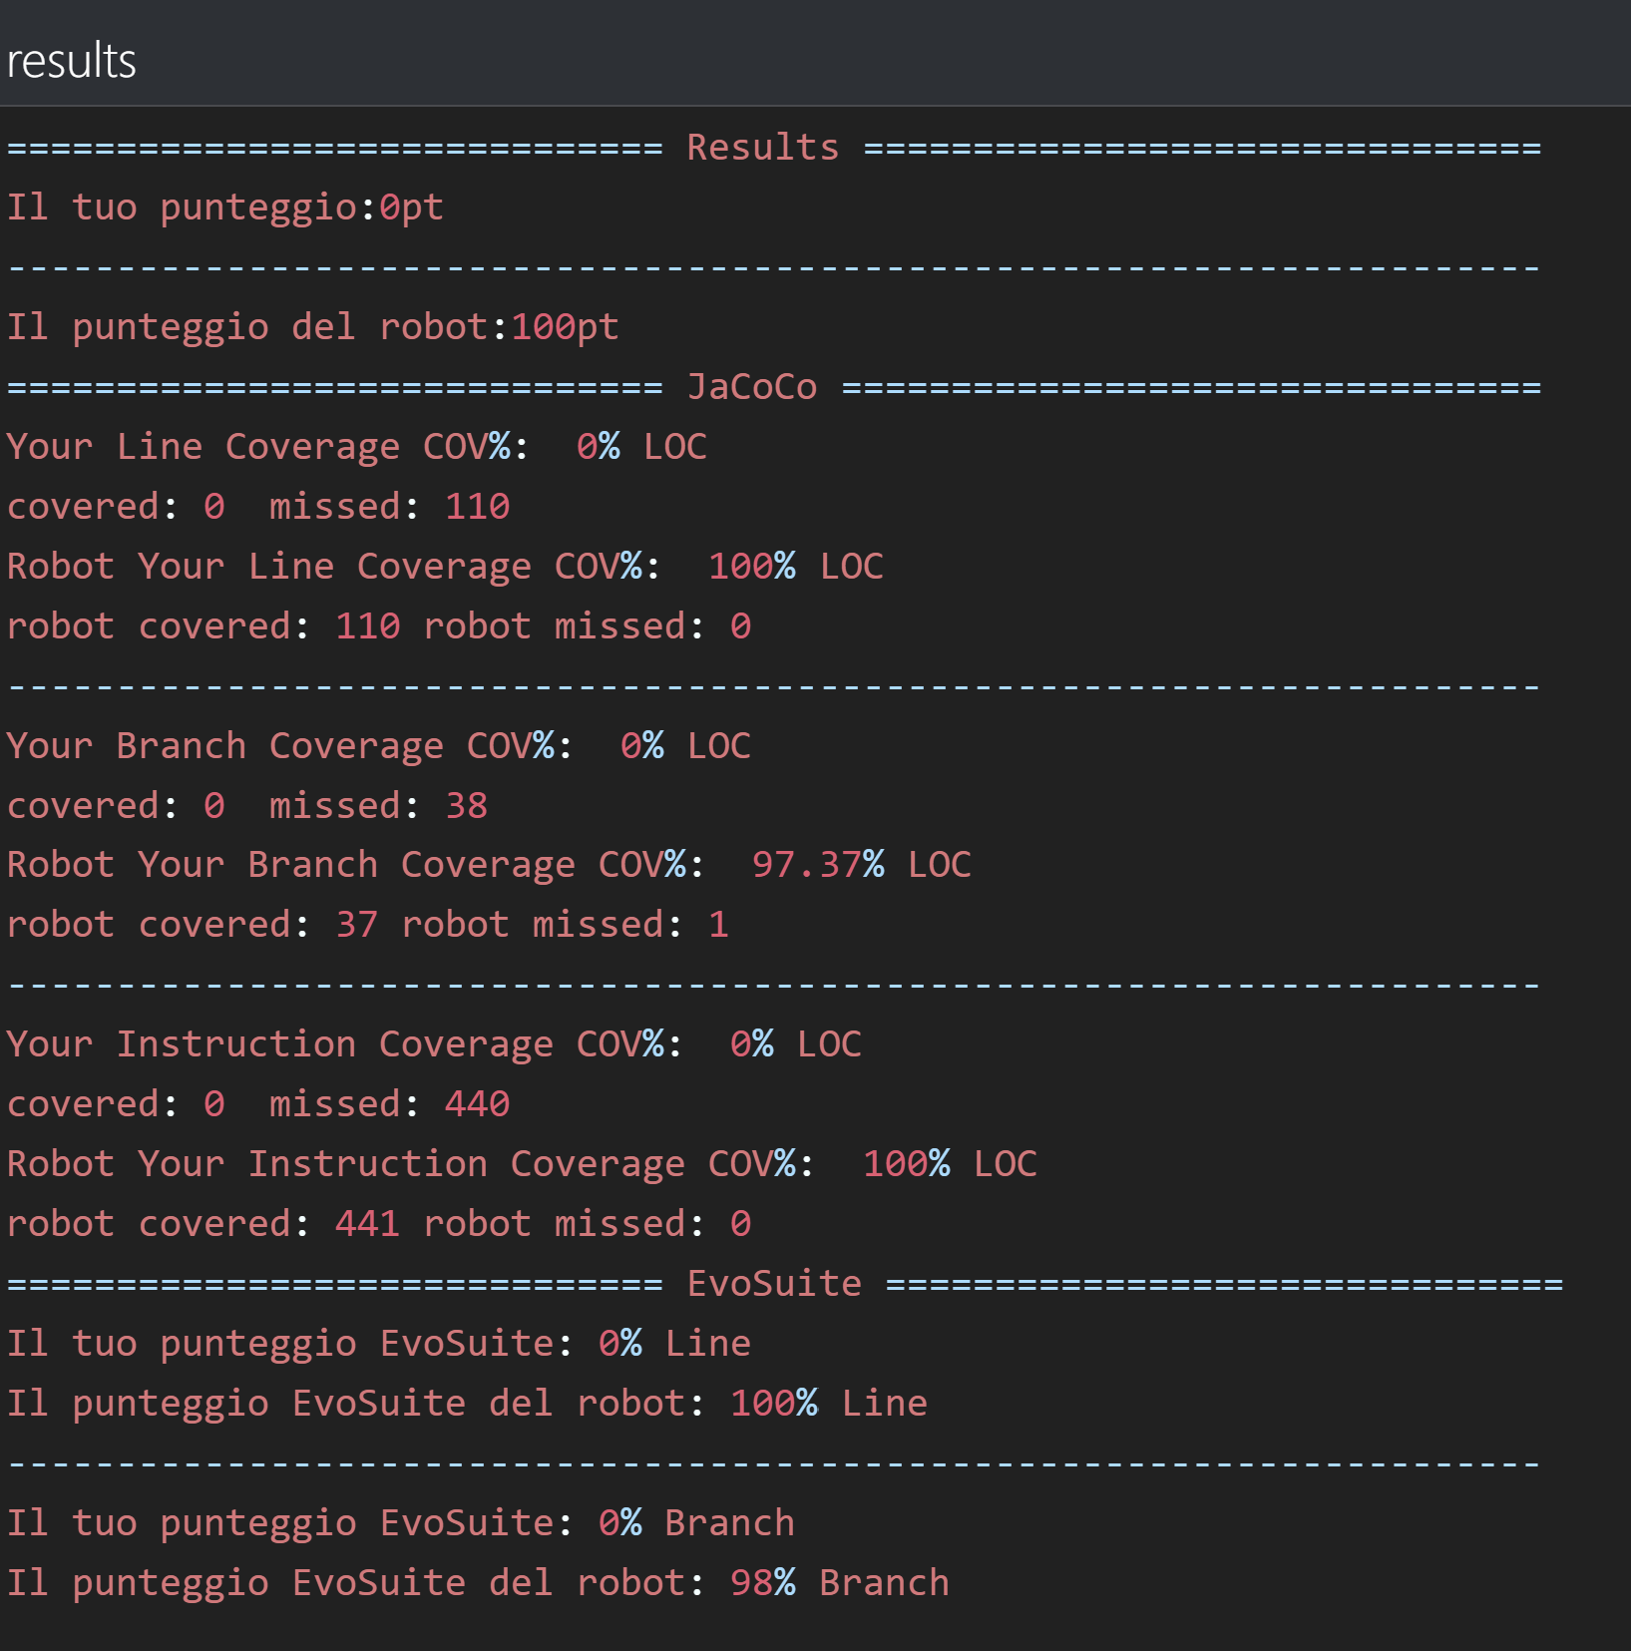
Game Play : Coverage results
The bottom right Results frame will show aggregate coverage statistics related to player’s test cases and opponent’s test cases

Slide 18
Game Play: Results evaluation
Based on the evaluation of the coverage achieved, the Player should add new test cases until his coverage will beat the one achieved by the opponent’s test cases
The Play command can be executed without limitations
However, due to the time required to compile, execute, and evaluate test cases, it is recommended to limit the number of Play requests.

Slide 19
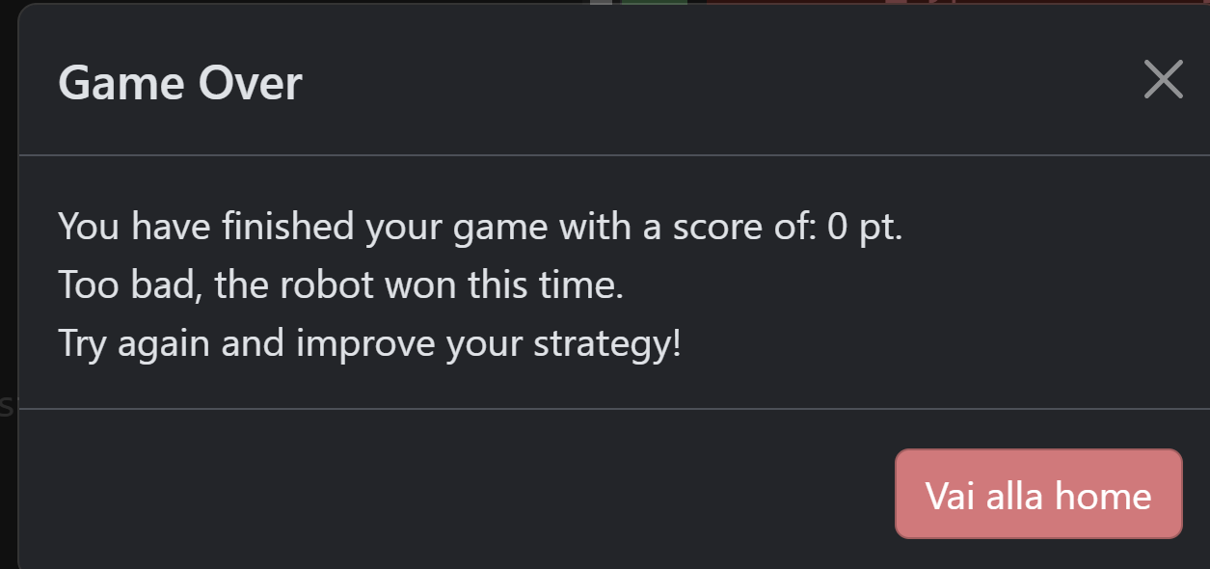
Ending the Game
The Player can conclude the match by clicking on the Submit button
The system will provide a message about match result
By closing the message it is possible to review (and save) the test class, otherwise it is possibile to return to the home
The Match terminates only in two cases:
when the player clicks Submit or
when the time is over

Slide 20
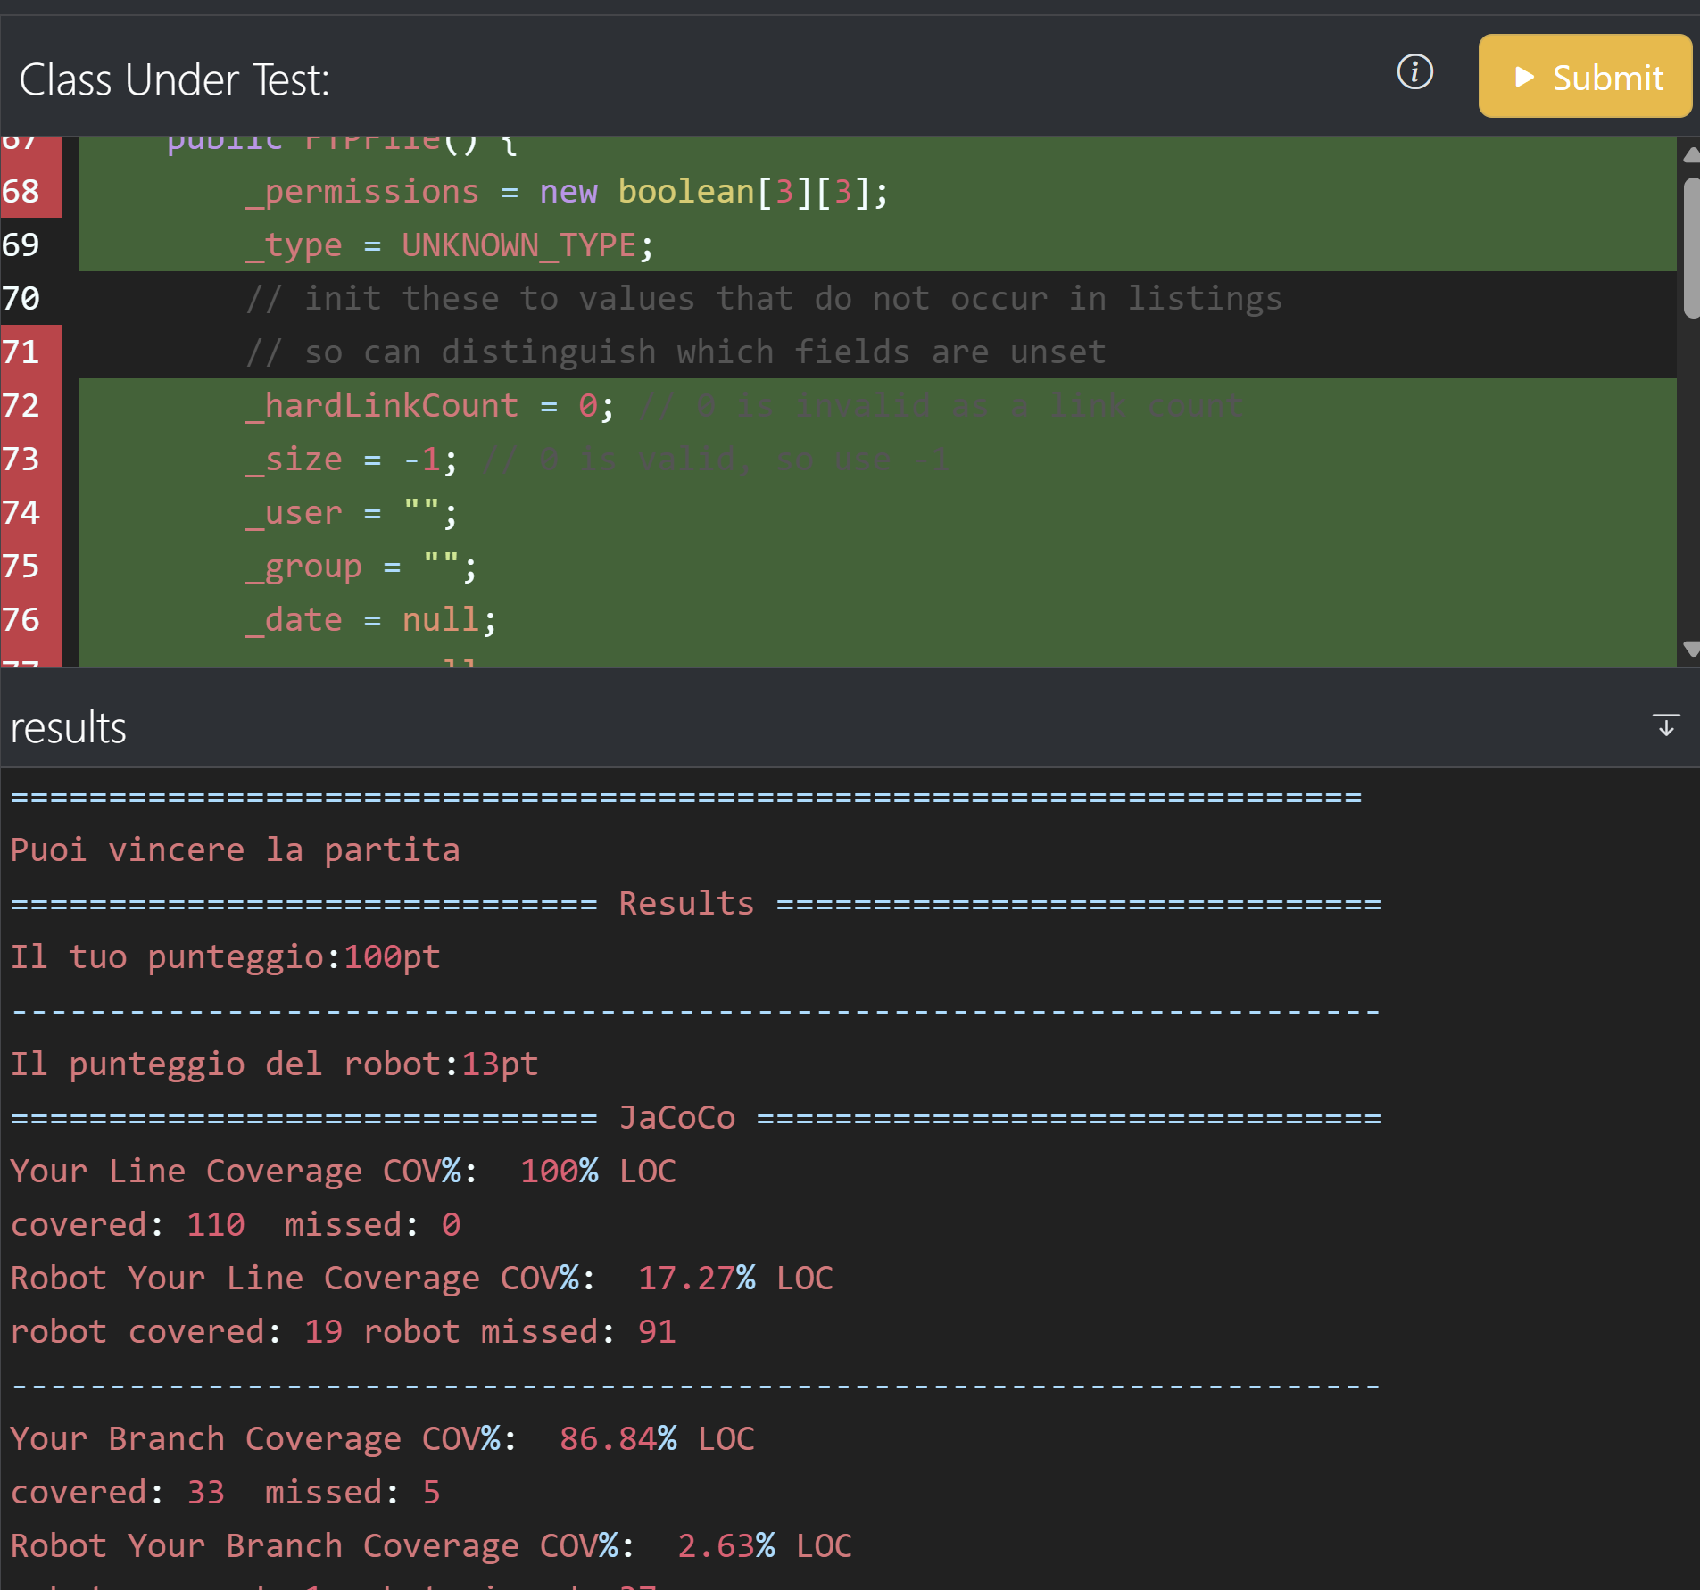
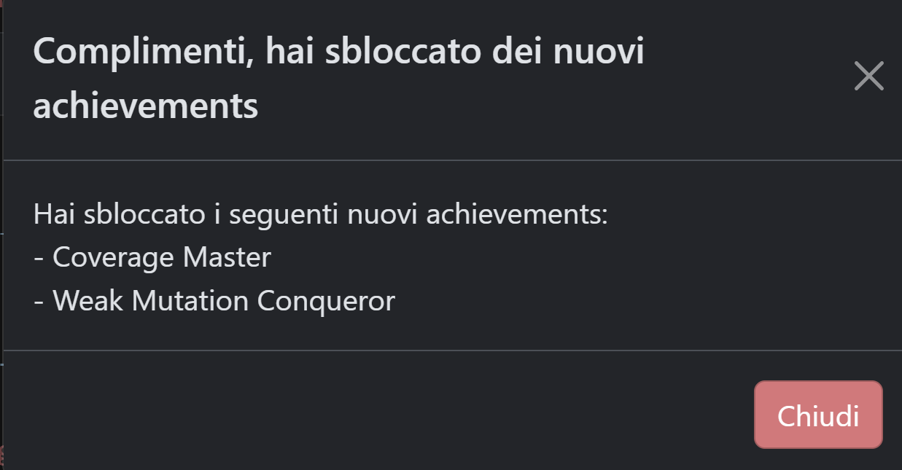
Winning a Game
When he will beat the opponent, he may obtain new achievements
Even after winning the game, the player can continue to improve his test cases

Slide 21
End game : Warning
Warning
In order to definitevely conclude a match, submit the results and achieve the experience points the player MUST click on Submit
A match without a submission is not considered completed, even if the opponent has already been beaten

Slide 22
Match Time
A match will also end when the time limit is reached.
The maximum testing time (in minutes) can be configured at the start of the match.
When the match window is closed, the timer is paused.
If the time runs out, the result from the last executed Play will be considered final.

Slide 23
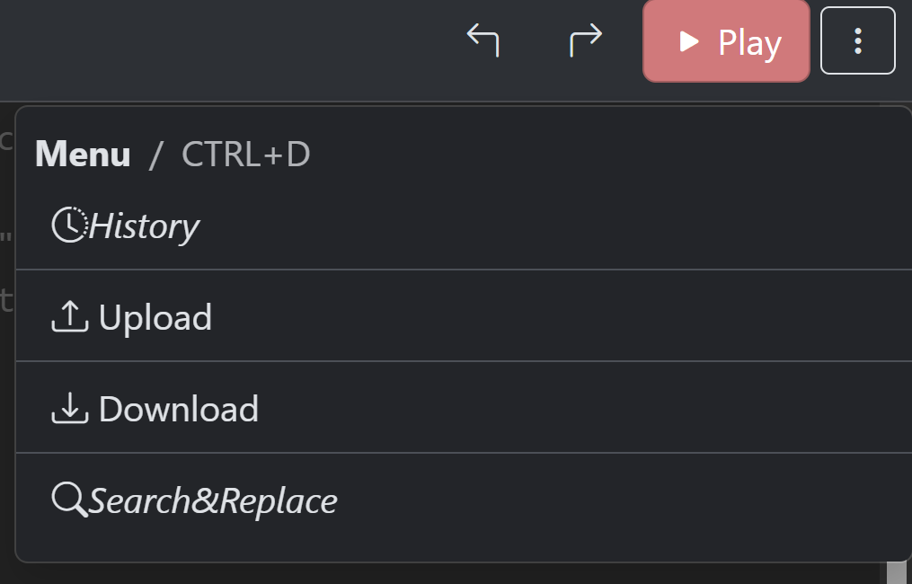
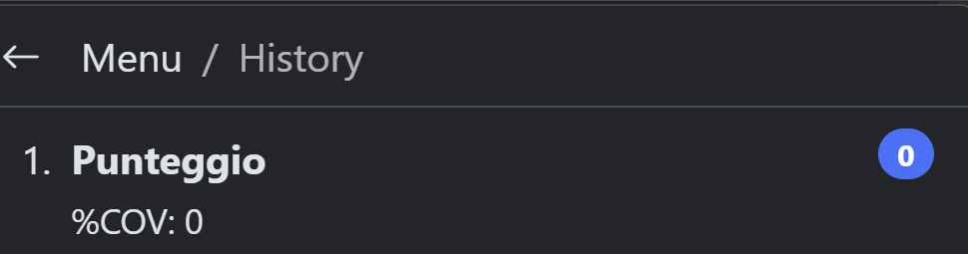
Other options available during gameplay
During gameplay, the player can:
View the history of executed test classes
Upload test class code from the local machine
Download a copy of the implemented test class
Search for and replace text within the code

Slide 24
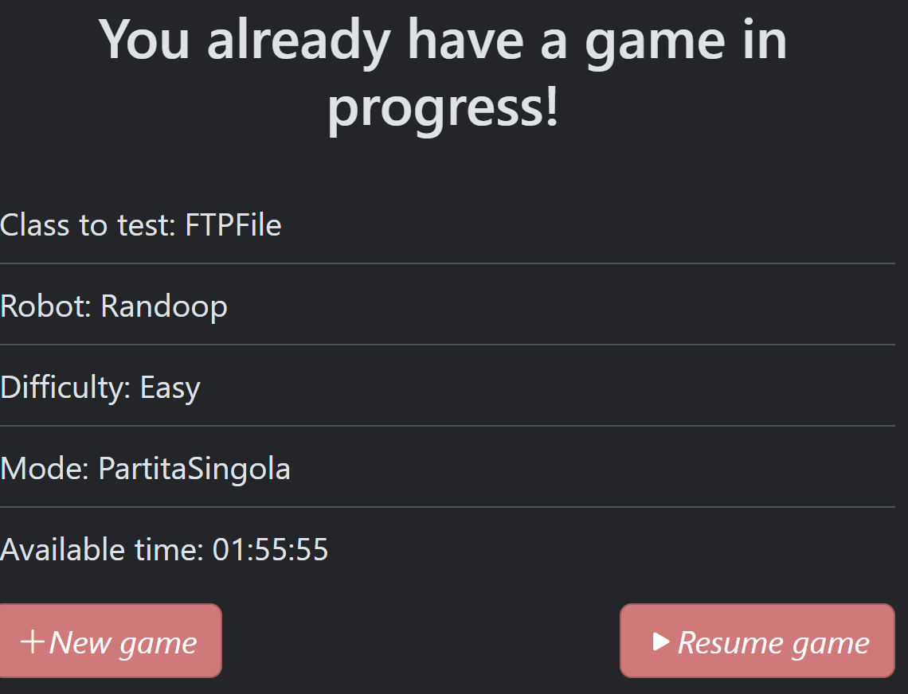
Other Features : Match resume
A match can be interrupted (e.g., by closing the browser) and later resumed by selecting the Resume Game option

Slide 25
Other features
On the upper right of the edit window, it is possible to change :
The color combination (black or white theme)
The language (English, Italian and Spanish are supported)
The font size (16 by default)
It is also possible to return to Home (the match is paused)

Slide 26
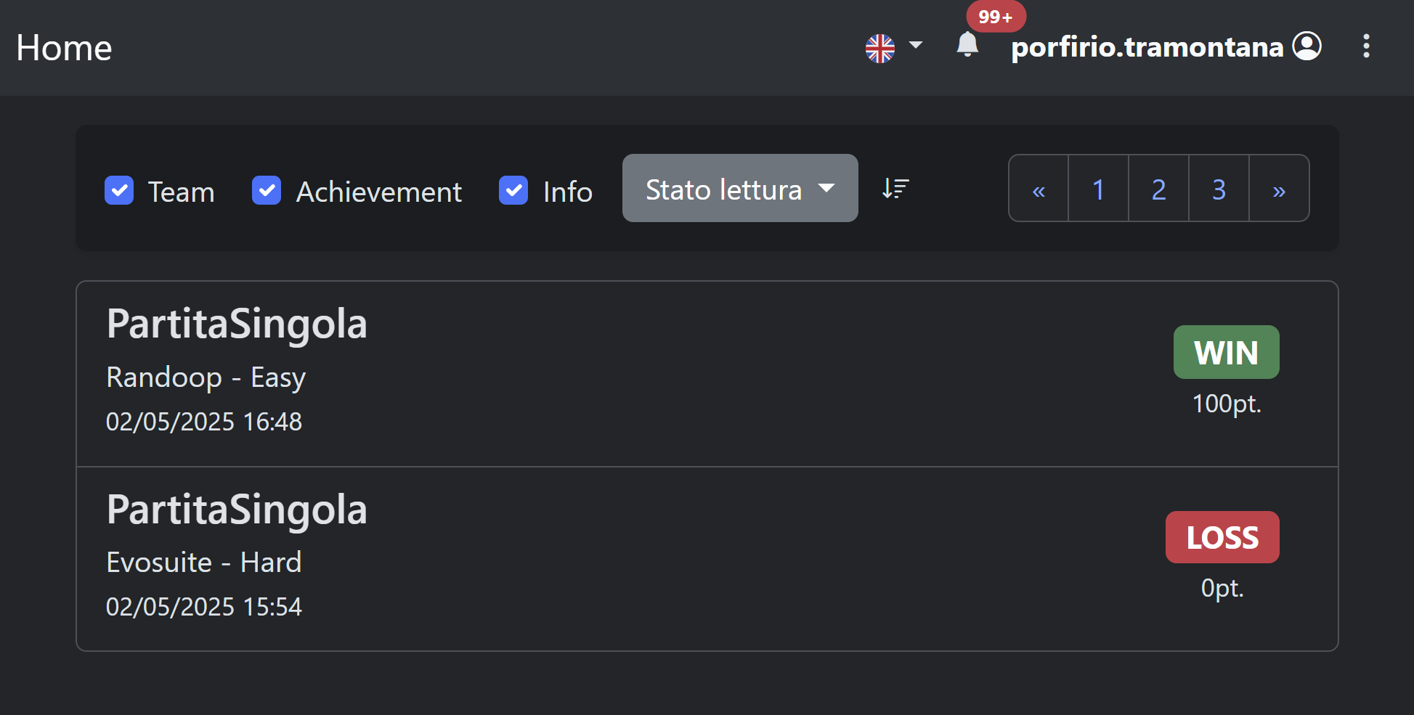
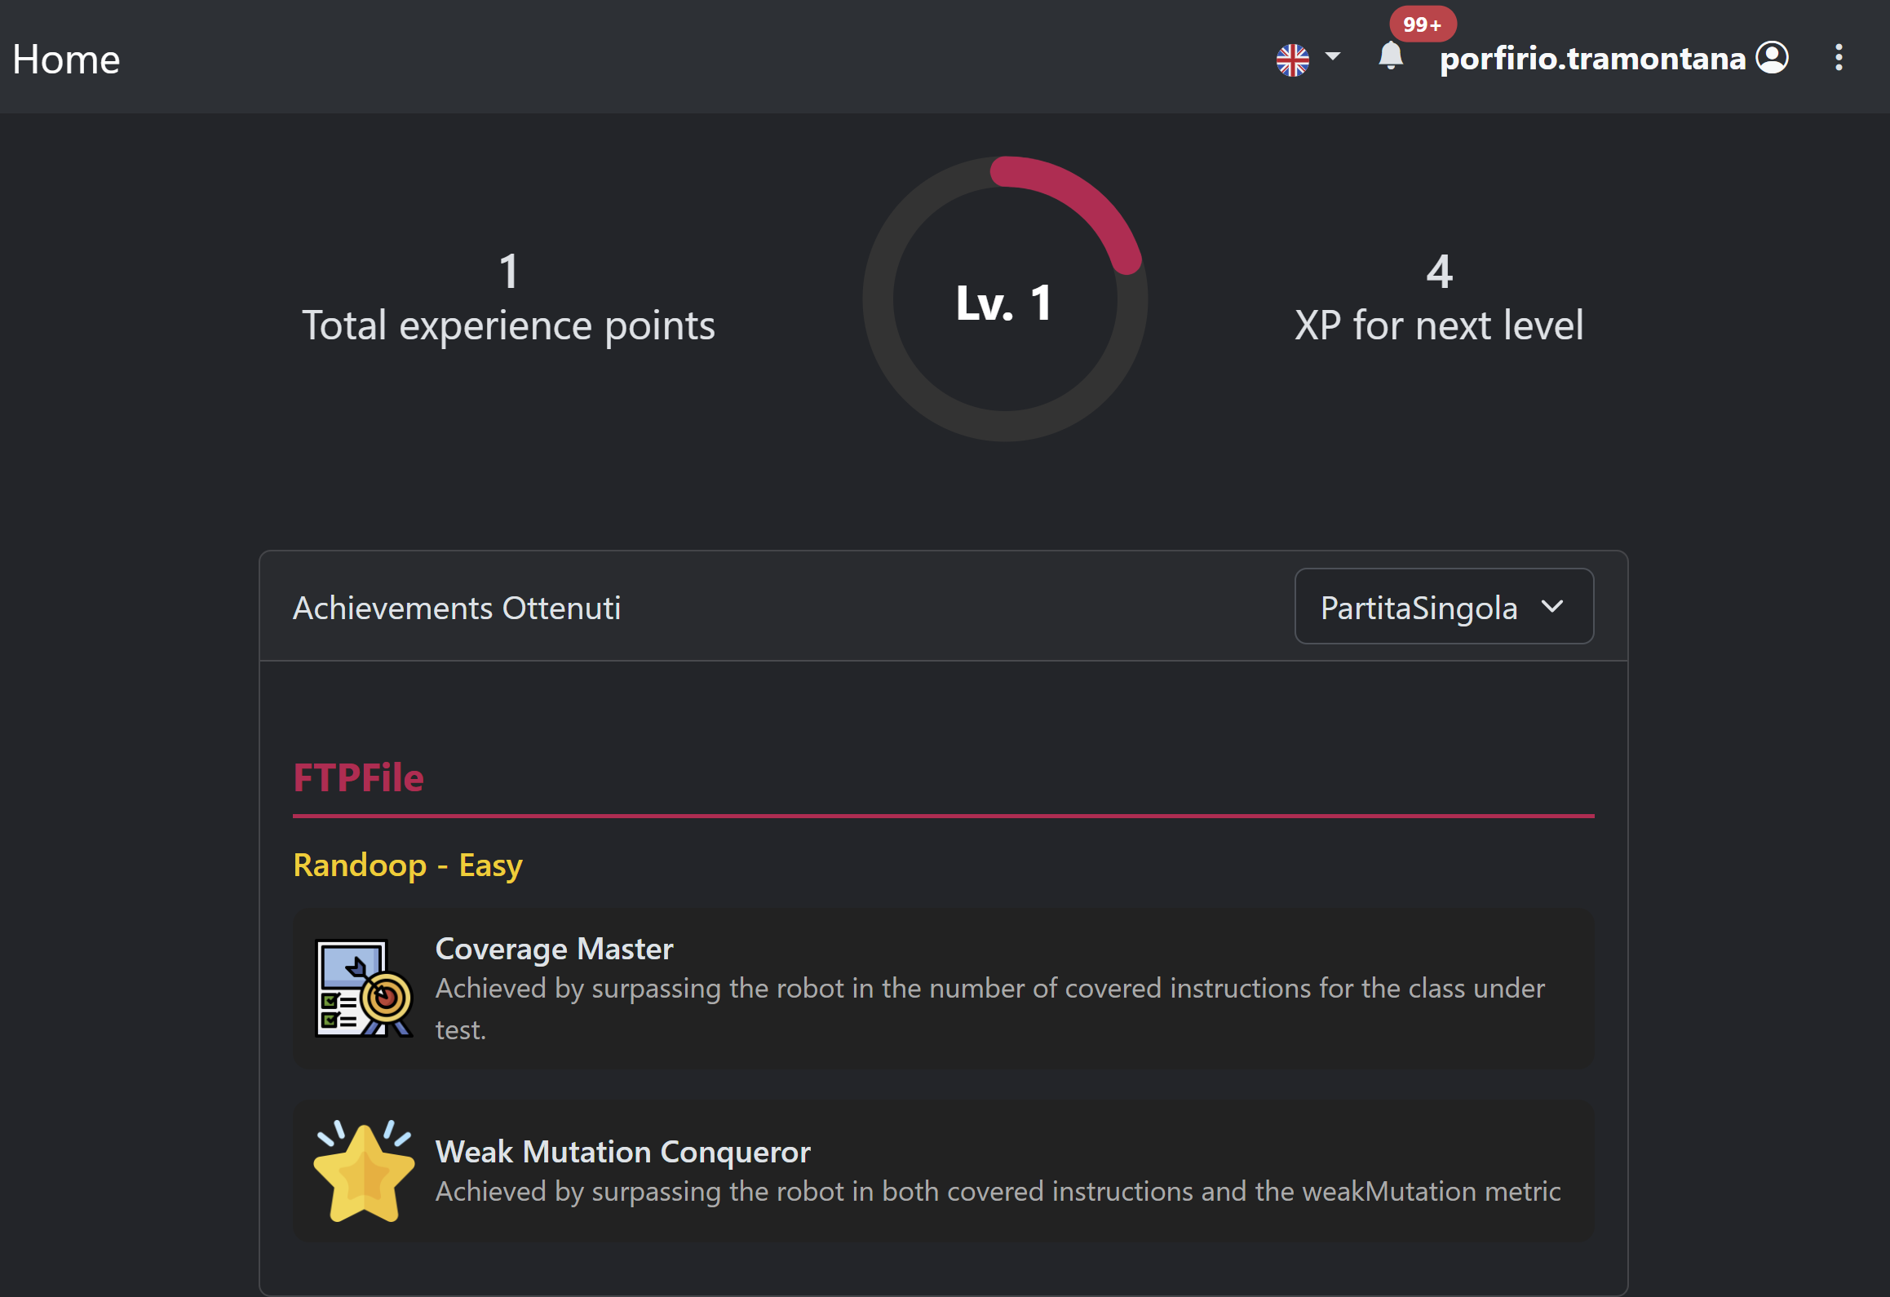
Other Features : Player Profile
By clicking on a player's name, you can view a range of player statistics (note: some are still under development), including:
A list of played games
Experience points (awarded as one point for each unique match won)
Achievements earned

Slide 27
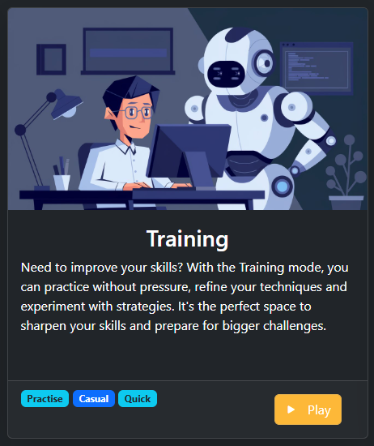
Additional Game Modes: Training Mode
A Training Mode is also available, allowing the user to test a class without any opponents to play against.

Slide 28
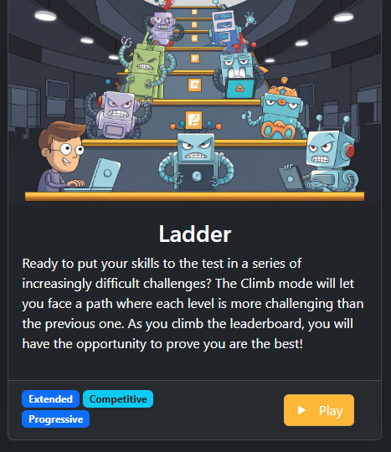
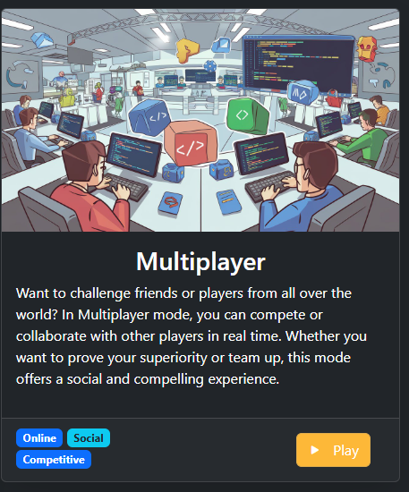
Additional Game Modes - under development
Other Game Modes are currently under development
Ladder,in which the user plays different games at increasing difficulties
Multiplayer, in which different players can compare their solutions

