Slide 1
Project NFM
A Journey to the cloud

Slide 2
REQUIREMENTS
Customer facing nodeJS application with OS level access behind a NGINX reverse proxy
MongoDB – no change in DB technology
3 environments
The solution must be highly available, scalable and flexible and must use AWS products
Minimum amount of modifications
Finance team must have FTP access to the produced files
IaC project using AWS CDK

Slide 3
ASSUMPIONS
No mutual authentication on the load balancer
DocumentDB with mongo compatibility does not affect the query optimization
The files produced by the application can be stored in a private S3 bucket with server-side encryption
The client must provide a docker image of the BE application, and the image will be pushed on AWS ECR

Slide 4
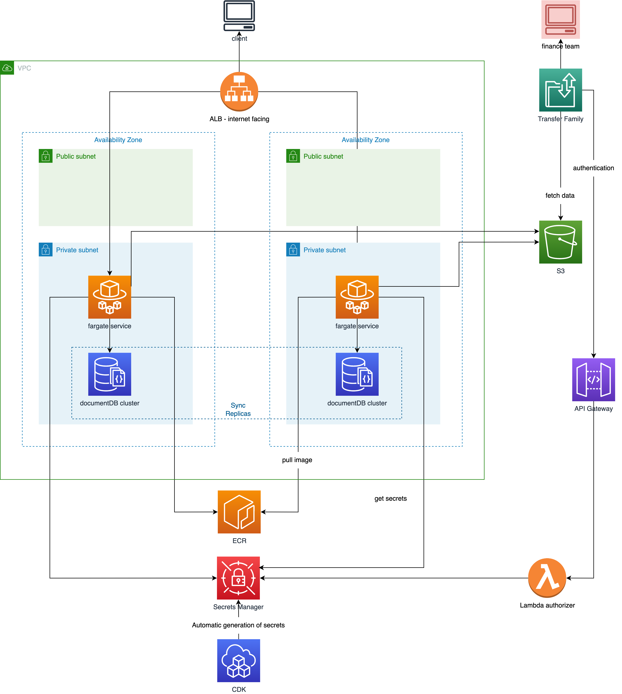
ARCHITECTURE
The application is managed through Fargate services on an ECS cluster.
The DB consist on a documentDB cluster
Both the application and the DB are inside the VPC and they talk with AWS services outside the VPC through VPCendpoints (preferred to a NAT Gateway solution to reduce costs)
An internet facing load balancer will handle the client request with the possibiliy to perform health checks
To obtain high availability the system is deployed on 2 AZs (3 if needed) with documentDB synch replica enabled.

Slide 5
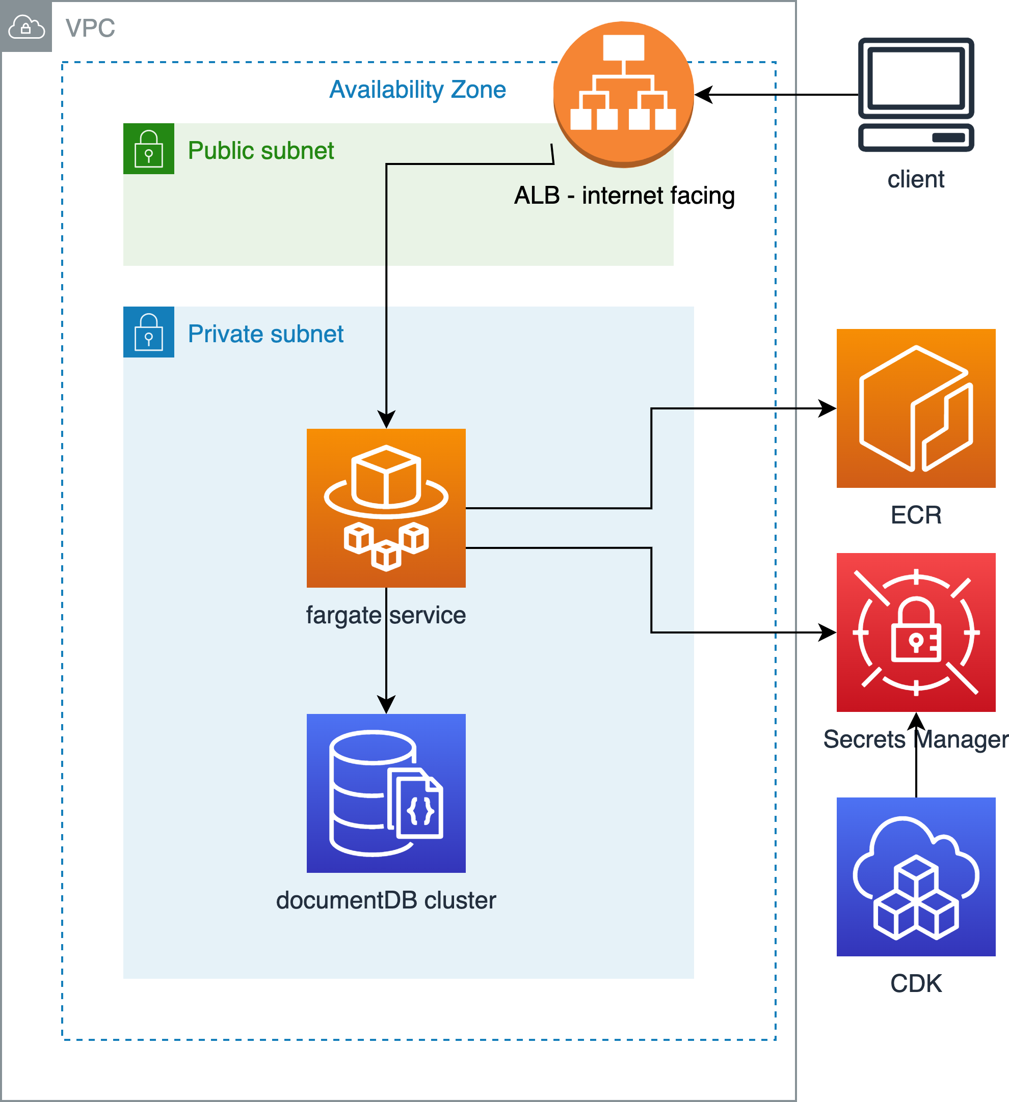
APPLICATION ARCHITECTURE
The application is pulled from a private ECR repository. Fargate will handle automatically eventual load spikes by running more containers
Application Load Balancer, fargate service and DocumentDB cluster are all attached to customise security groups
The Application Load Balancer will automatically switch private IP to the correct service IP
DocumentDB is encrypted at Rest
In order to isolate resources, all the applications have the environment name included in their IDs

Slide 6
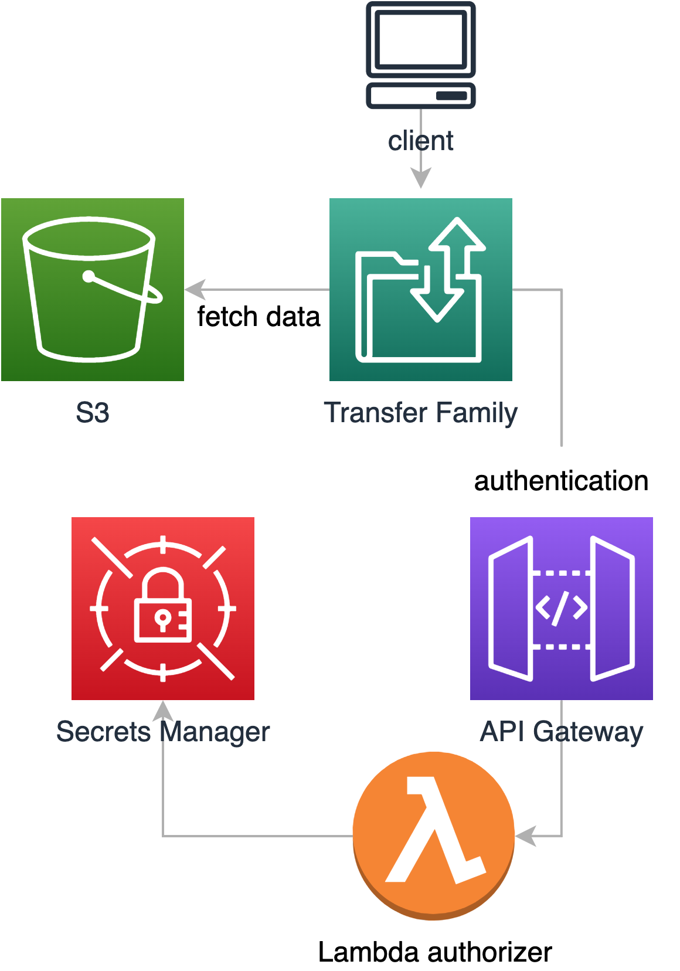
FTP SERVER ARCHITECTURE
Using AWS Transfer Family an FTP server is deployed.
In order to authenticate the user a lambda is called through an API gateway endpoint. The lambda will check the provided credentials on secrets manager

Slide 7
ENHANCEMENTS
In order to increase security a AWS WAF could be attached to the application load balancer
A disaster recovery strategy could be implemented

