Slide 1
Logbook-June

Slide 2
Procedure
Load Data
Add Noise
Pre-processing
Mean Subtraction
Spike Emphasis
Thresholding
Evaluation

Slide 3
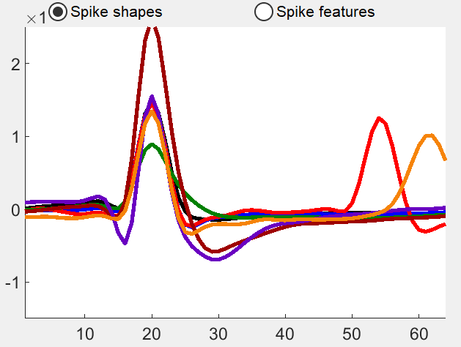
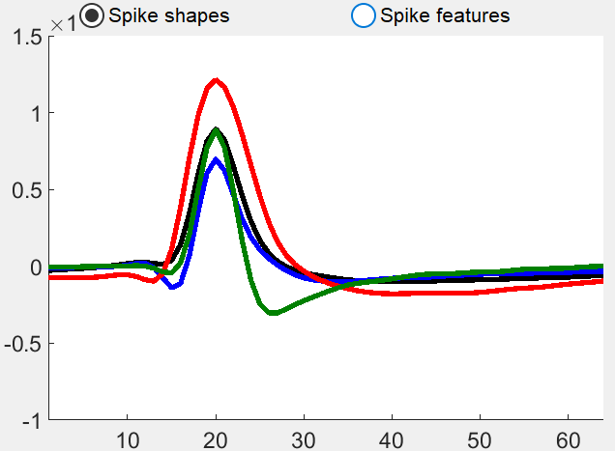
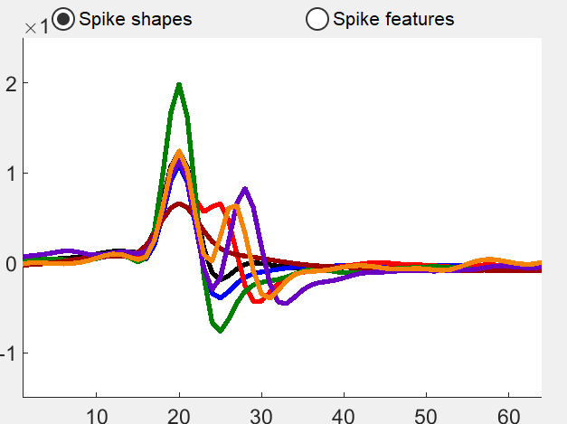
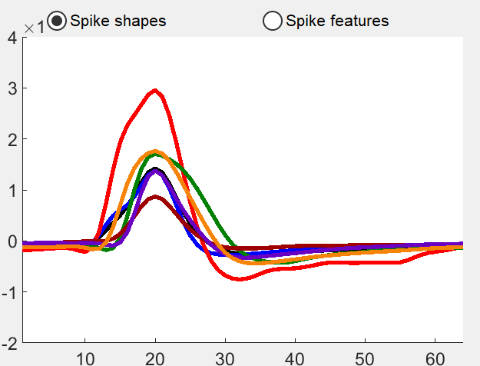
Data fs=24414Hz, typical spike duration 11~15 data points, i.e.~0.6ms
Data 1
Data 2
For Setting Parameters
Real Data 4 from Ukiah_DelayA-13 ch12
For Test:
Real Data 1 from Ukiah_DelayA-9 ch3
Real Data 2 from Ukiah_DelayA-11 ch7
Real Data 3 from Ukiah_DelayA-12 ch6
For Simulate Noise
Noise Base Extracted from Real Data 4 (1000 different spikes)
Data 3
Data 4

Slide 4
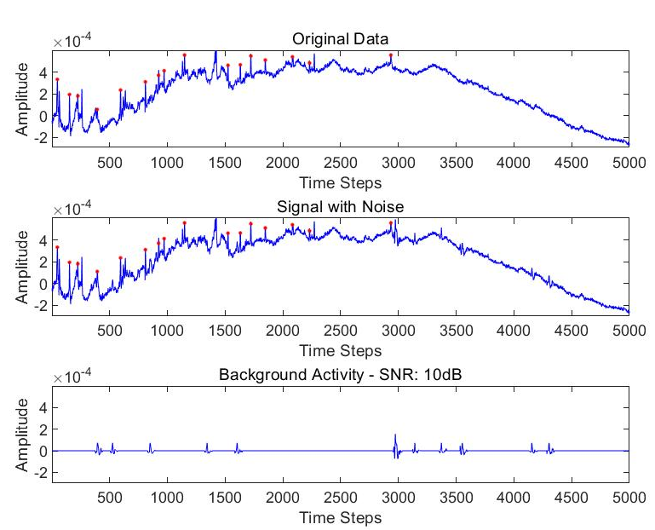
Add Noise
Number of arrivals follow Poisson Distribution.
Average number of arrivals per sec : 20Hz.
3 cells simulated.
Implementation:
For: number of cells
Generate Exponential RV with lambda = 20.
Accumulation of the random variables
is the time of arrival for one cell.
Cut at the desired duration.
End
Normalise the noise peak to be 1. Then amplified with desired noise power.
*Upgraded to inhomogeneous Poisson Distribution?

Slide 5
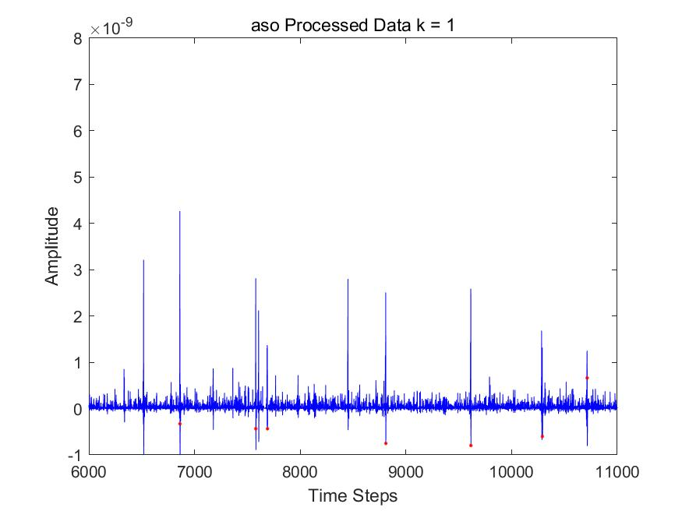
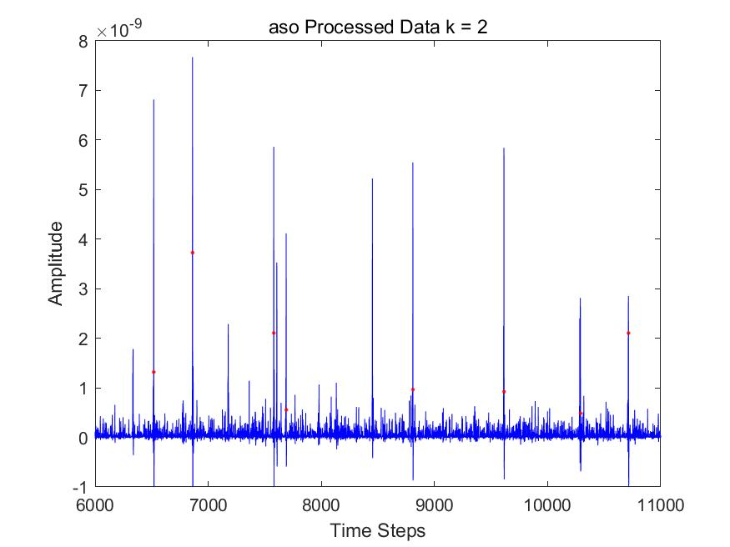

Pre-processing
Subtract Mean-> Nothing New.
Spike Emphasis ->Multiresolution Implementation (k=2)
MNEO: $y\left(n\right)=x^{2}\left(n\right)−x(n−k)x(n+k)$
MASO: $y\left(n\right)=x(n)(x\left(n\right)−x(n−k)$)
Gradient is increased, so that spikes can be more resolvable when random background noise is large (not background activity).

Slide 6
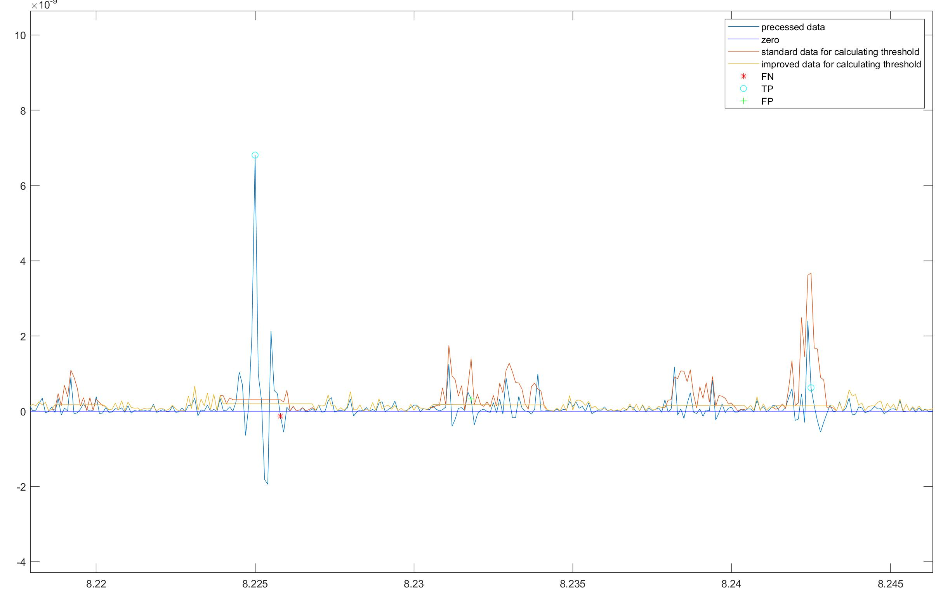
Thresholding
Metrics:
Median: c*median(|x|)
Mean: c*mean(|x|)
RMS： c*RMS(x)
Tricks
None - naive
Spike time holding – standard
When spikes are detected, threshold is not upgraded. Spikes will be replaced with the current result of median/mean/RMS.
Hold time: 5 sample before spikes, 10 samples after spikes. (fs=24414Hz)
None spike outlier avoiding – improved
A subthreshold is setting, if one value is between subthreshold and threshold, it will be replaced with the current result of median/mean/RMS, but will not be regarded as a spike.
Subthreshold is set to be a half of the threshold. Easy to calculation
-> to overcome interference resulting from the fluctuation before and after a spike & background activity
The Standard does not find this spike,
but the Improved does.

Slide 7
Testing Cases
{none, neo, aso}x{median, mean, rms}x{naïve, standard, improved}
Raw x {median, mean, rms} x naive
27 +3 case
SNR levels are tested from 5dB to 20dB and the case with no background activity
*Tests on raw data can only achieve about accuracy 0.3, therefore not discussed
*None means only mean subtracted.

Slide 8
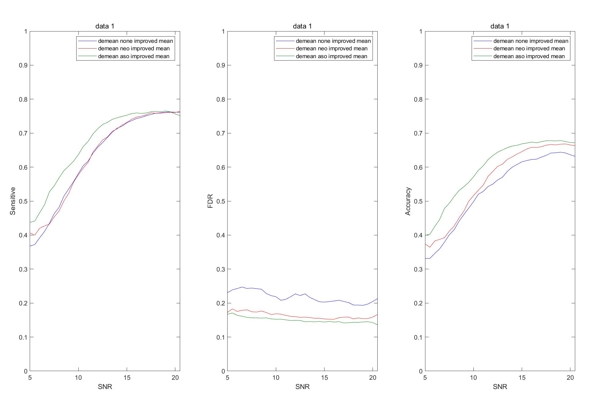
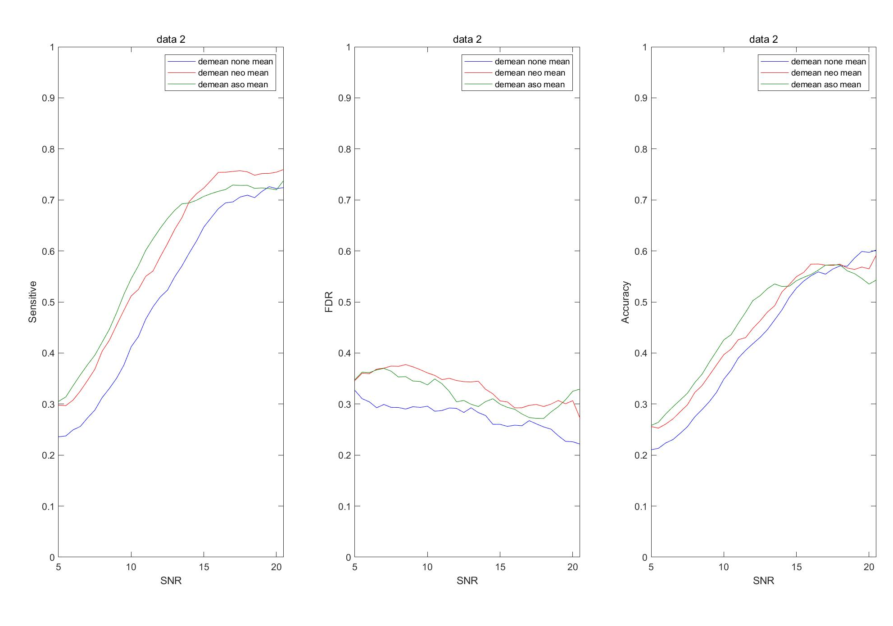
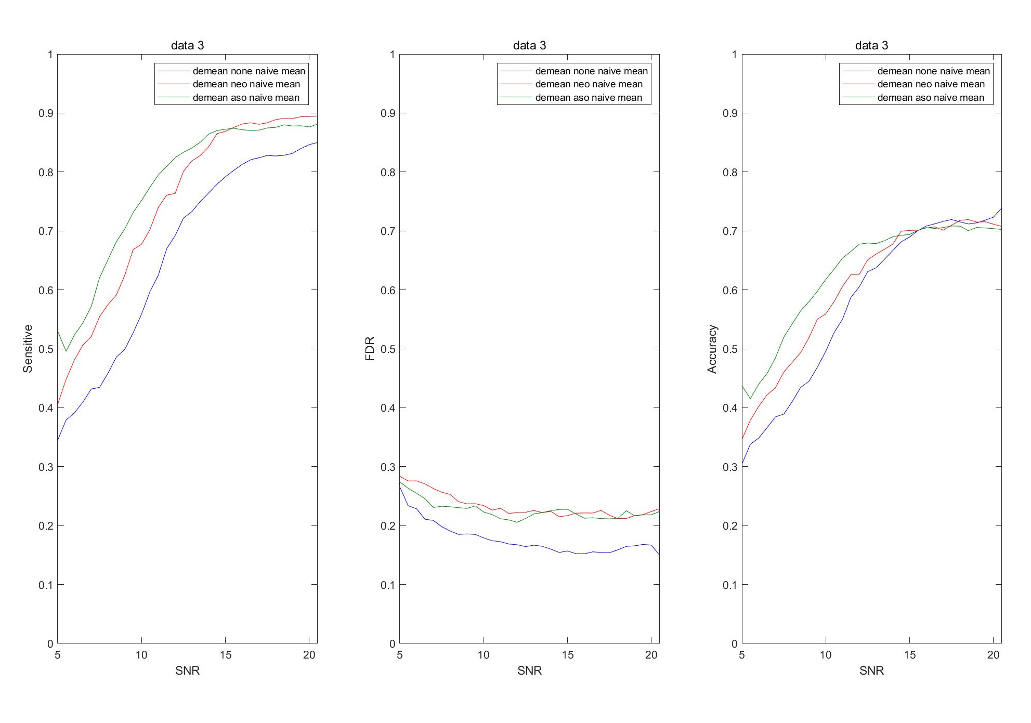
Results – Comparison on Pre-processing Methods
Some sample results are shown below: (the green one is ASO)
Conclusion:
For six different combinations of thresholding scheme, ASO is the best in nearly all cases.

Slide 9
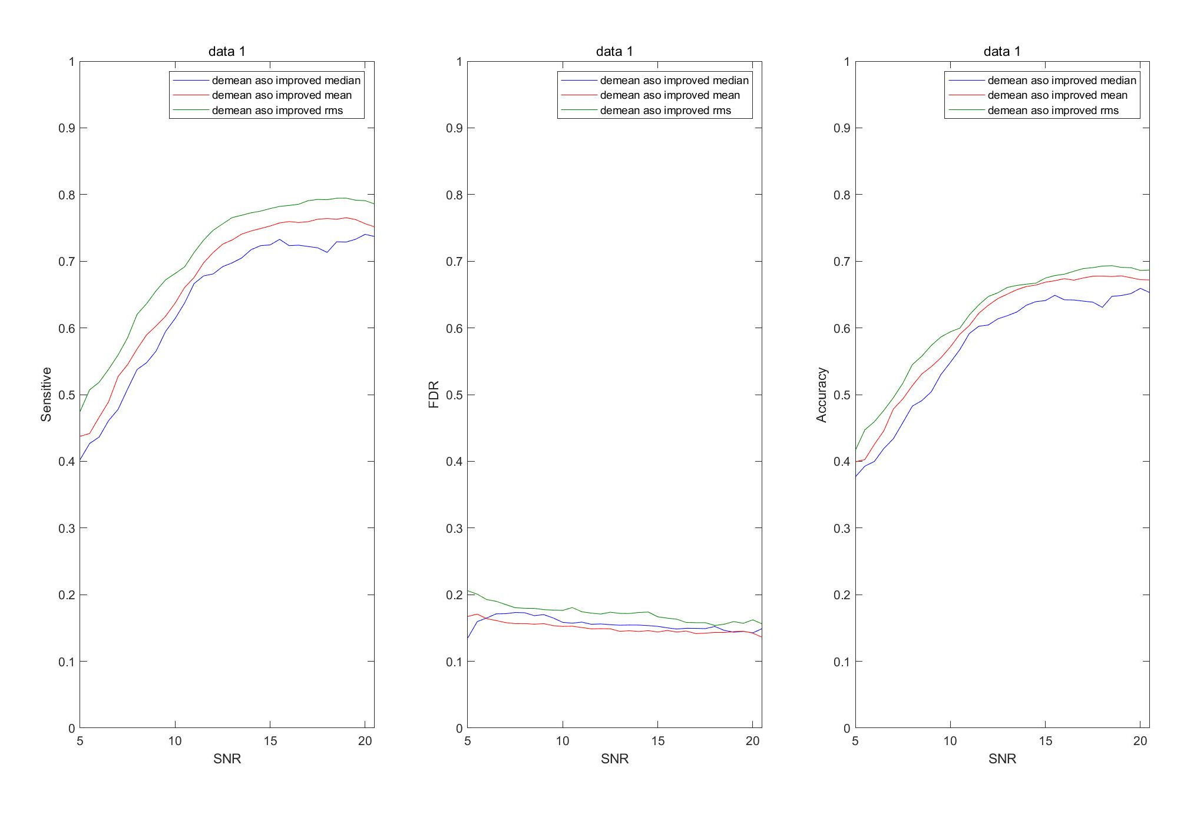
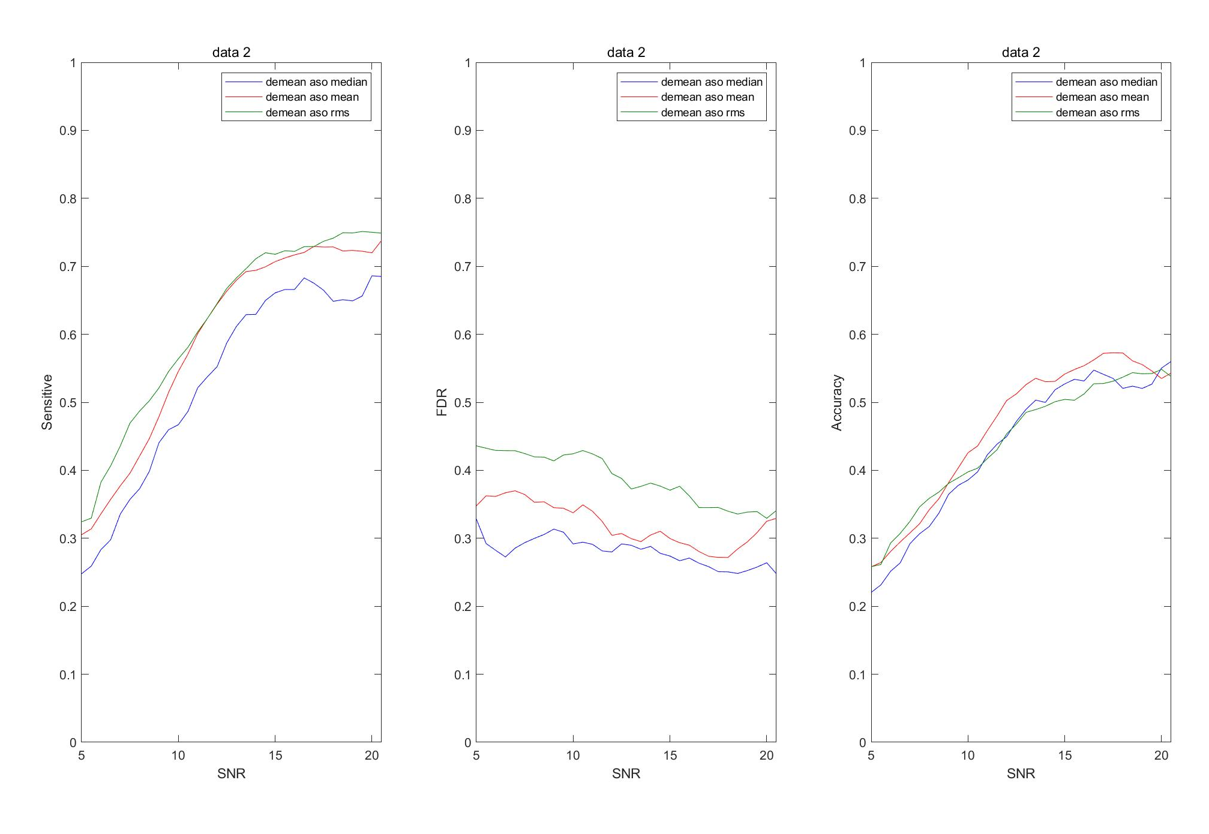
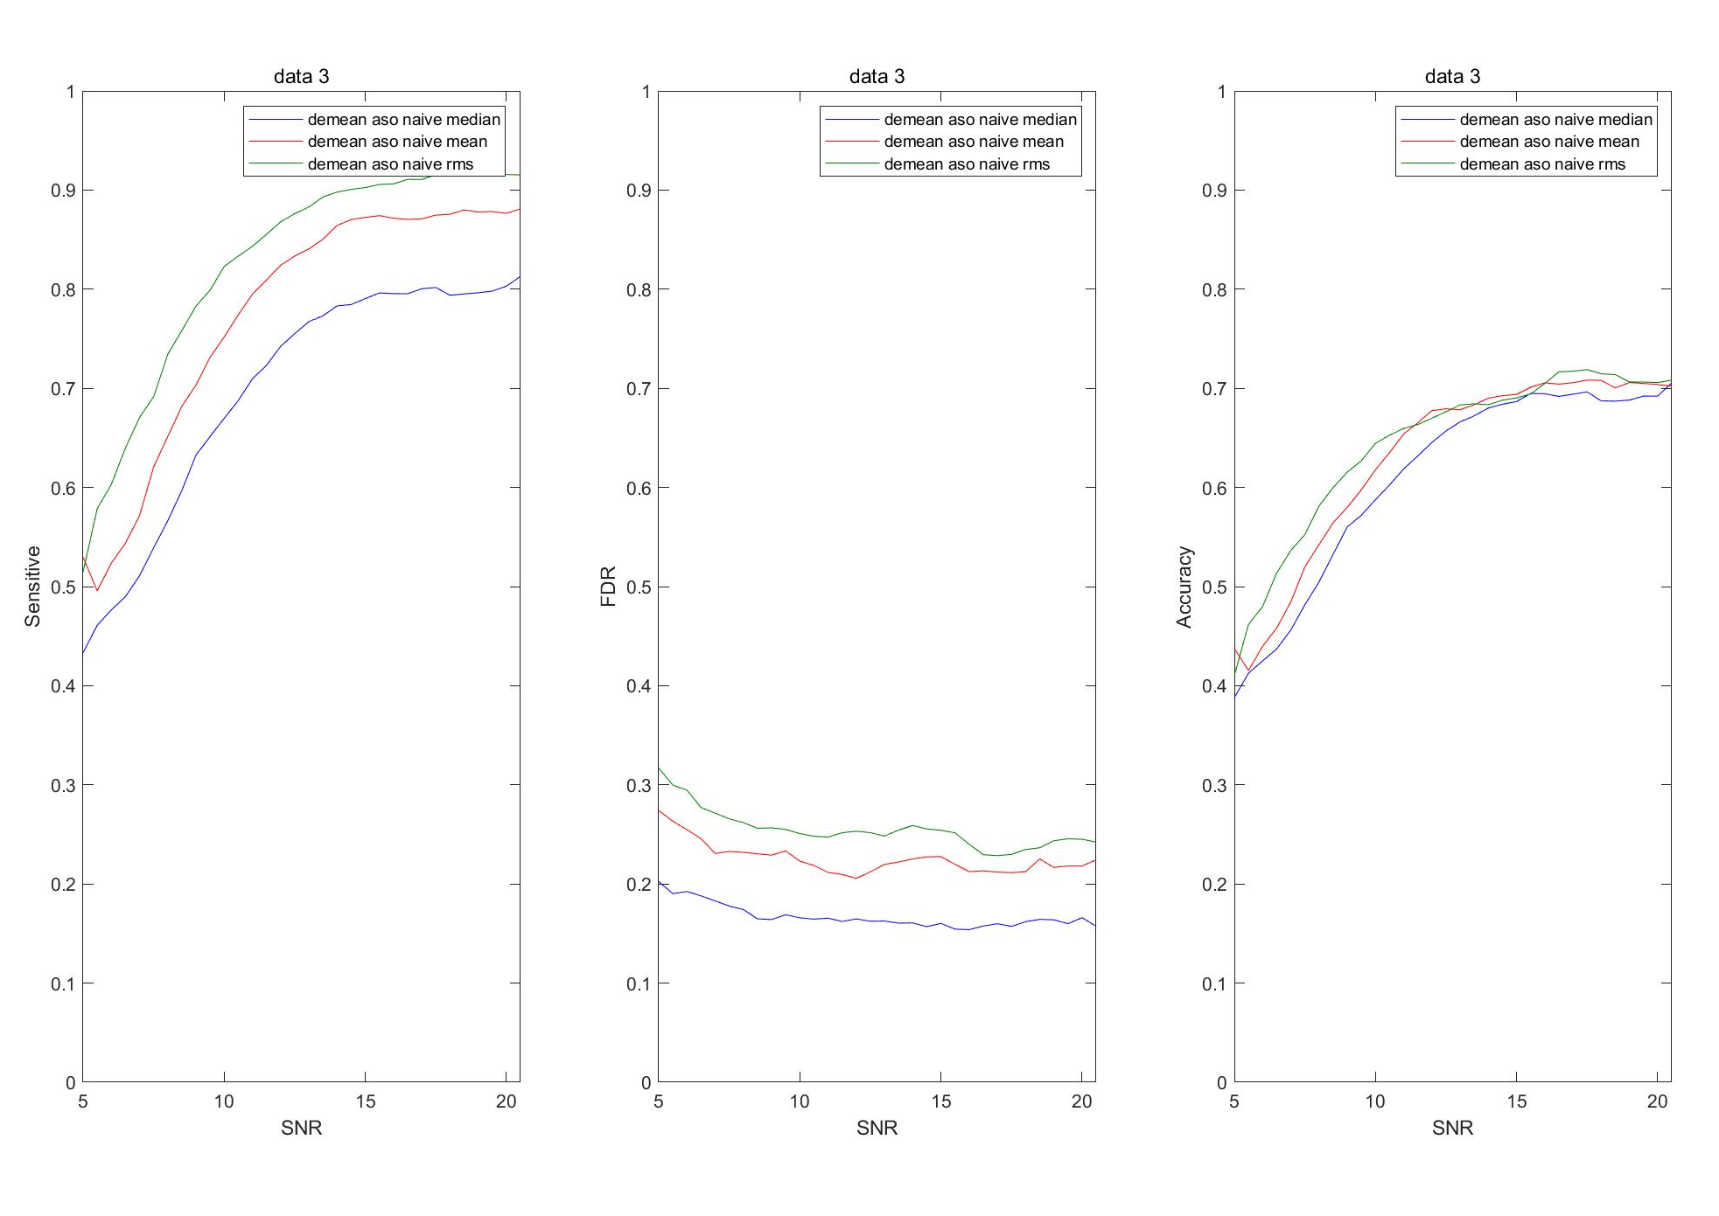
Results - Comparison on Thresholding Metrics
Some sample results are shown below (the red one is Mean):
Conclusion:
RMS is the best one, which can achieve highest scores, but it is also the most computational inefficient one. Mean comes the next, which is preferred.

Slide 10
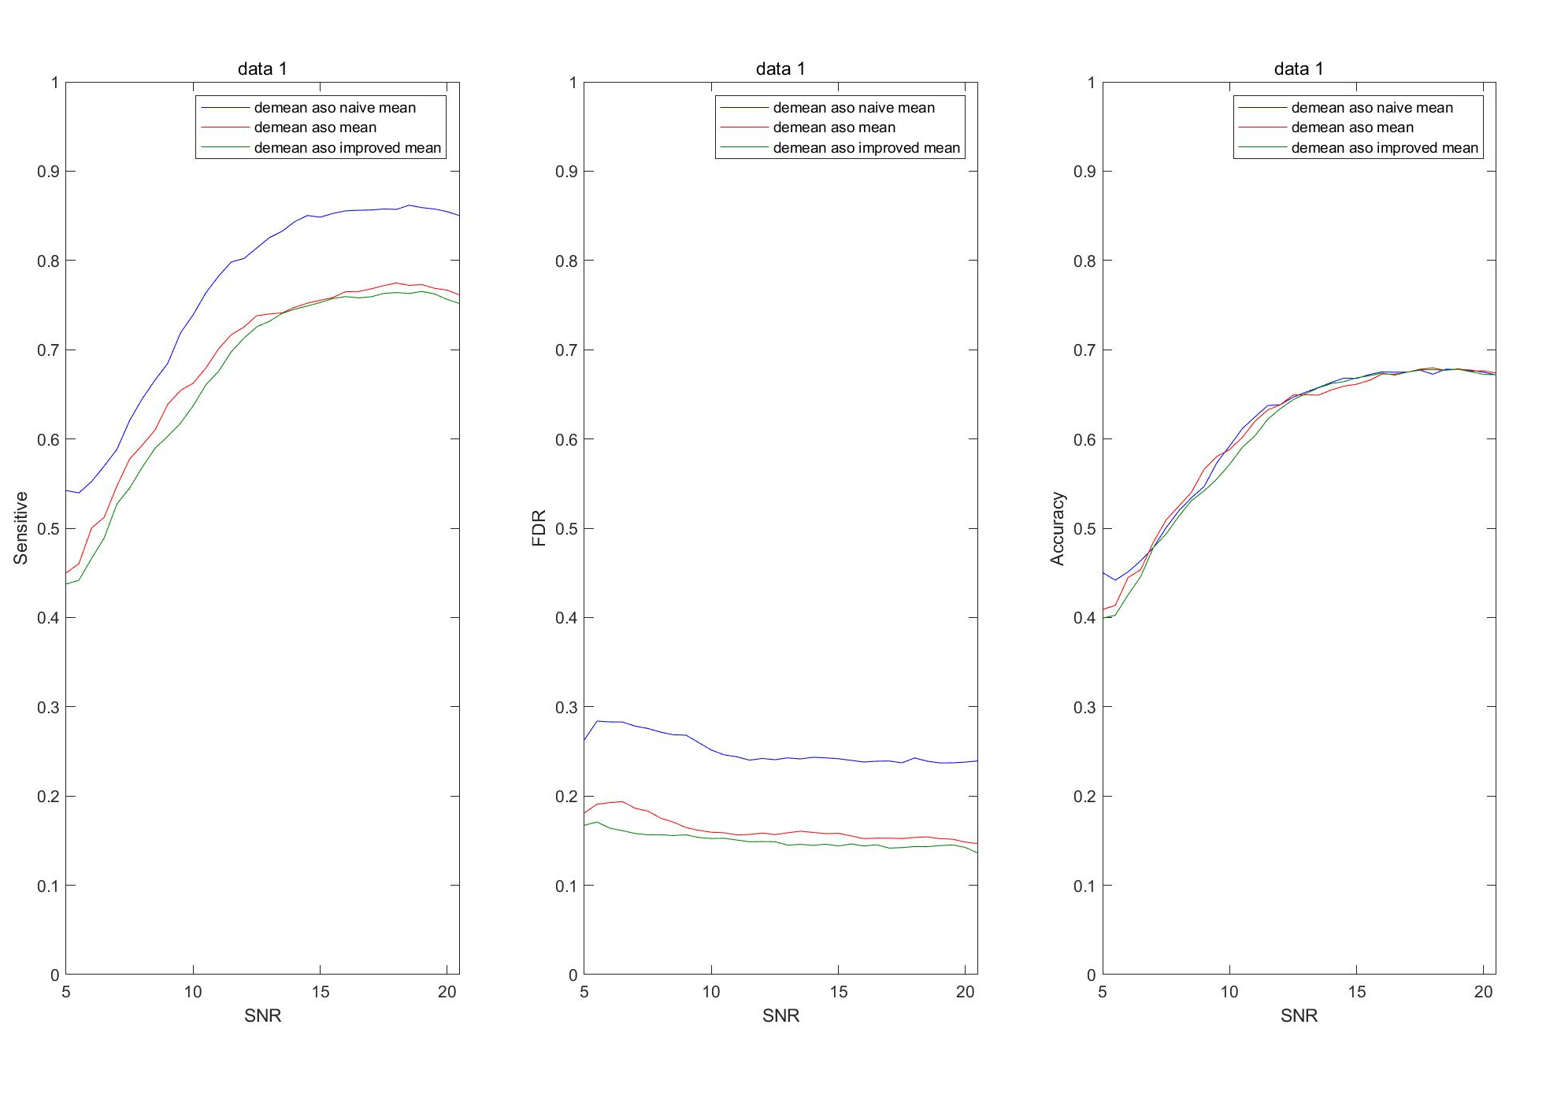
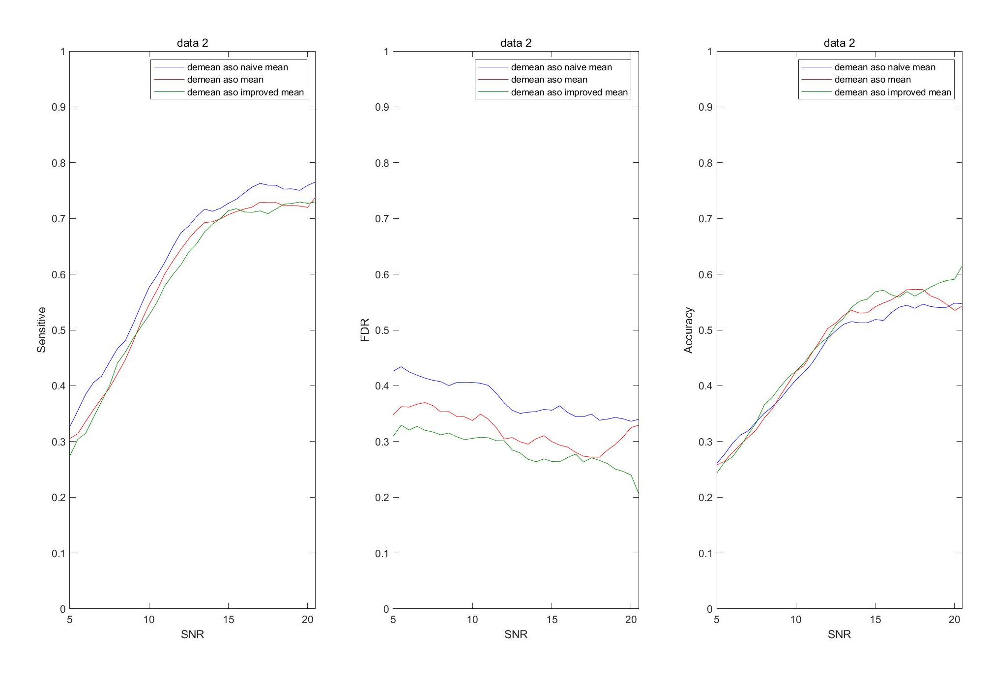
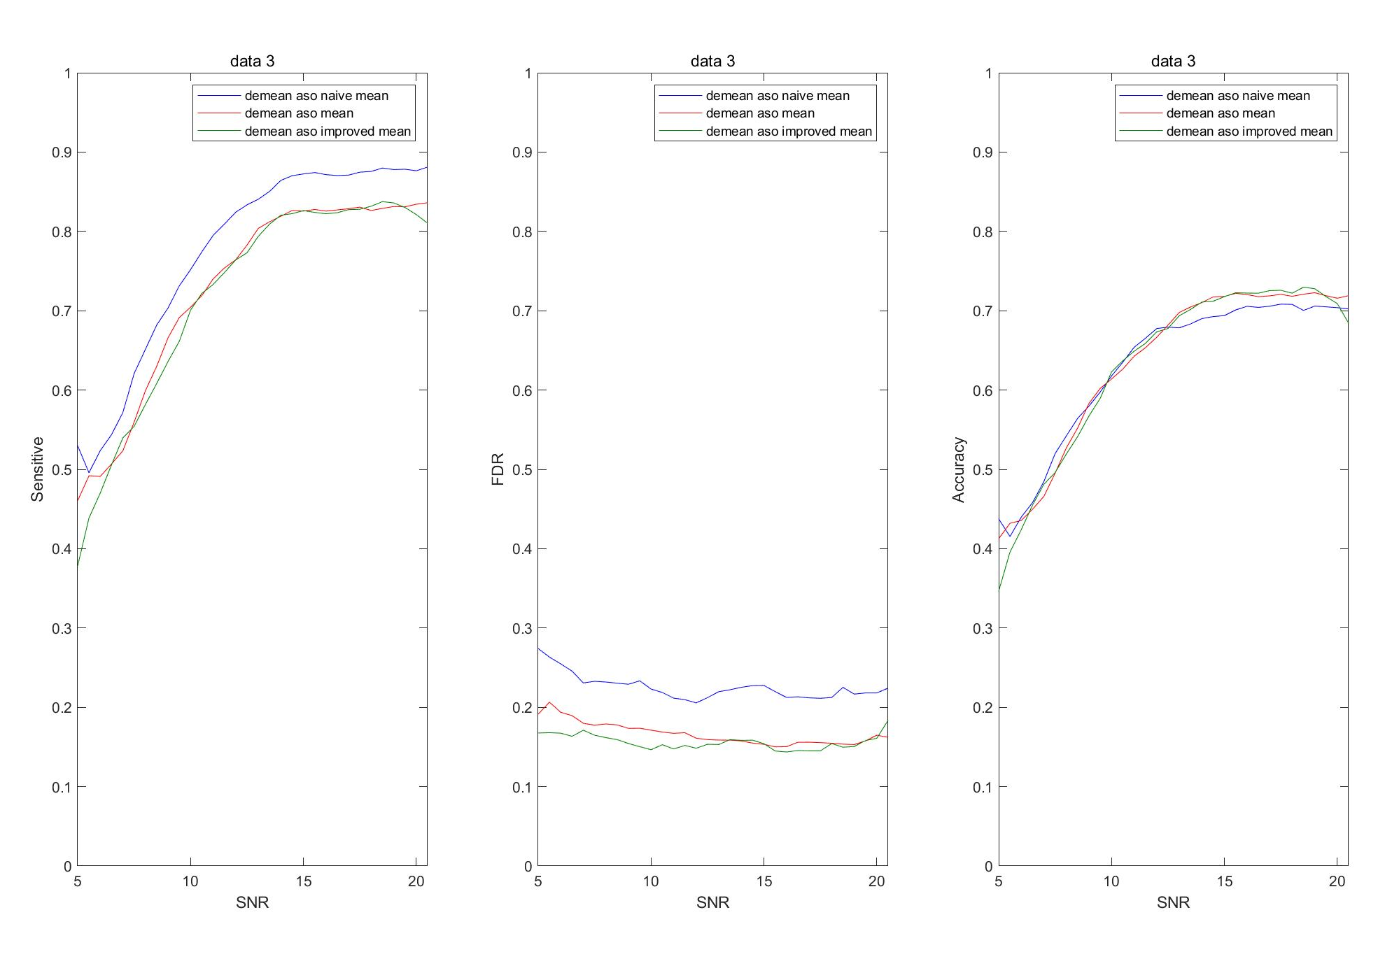
Results -Comparison on thresholding tricks
Only Mean Thresholding is compared (the green one is Improved)
Conclusion:
Standard outperforms the Naïve Mean Thresholding w.r.t Accuracy, but not distinguishable (2%~4%) in data 2 and 3. FDR is reduced (4%~8%) with scarifying Sensitivity (3%~7%). ->More spikes are founded.
Improved Thresholding reduced the FDR for ~2%, while the Sensitivity becomes lower for ~2%, which does not effect the Accuracy much.

