Slide 1
Logbook - February

Slide 2
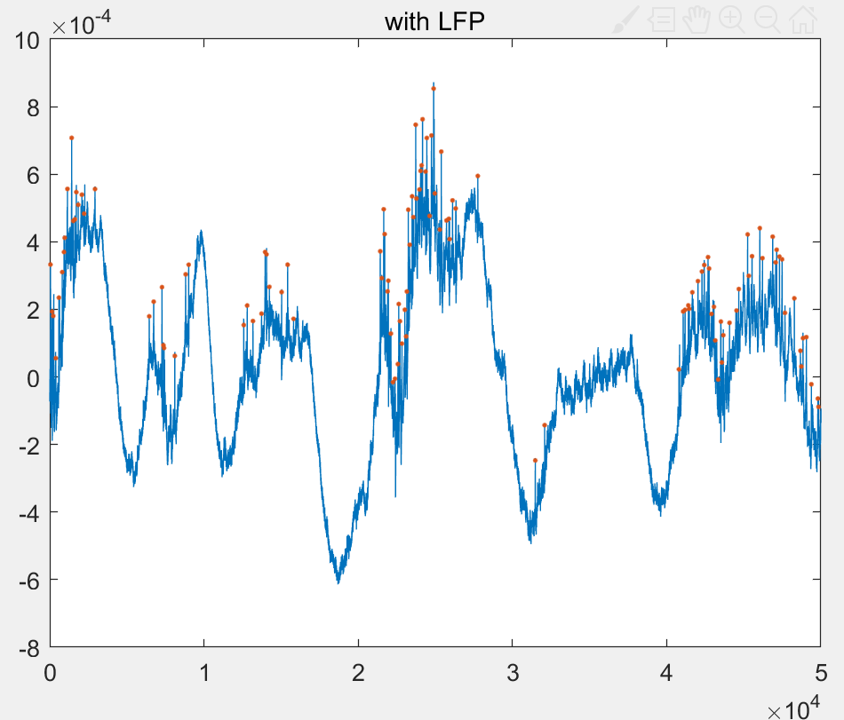
Row Data

Slide 3
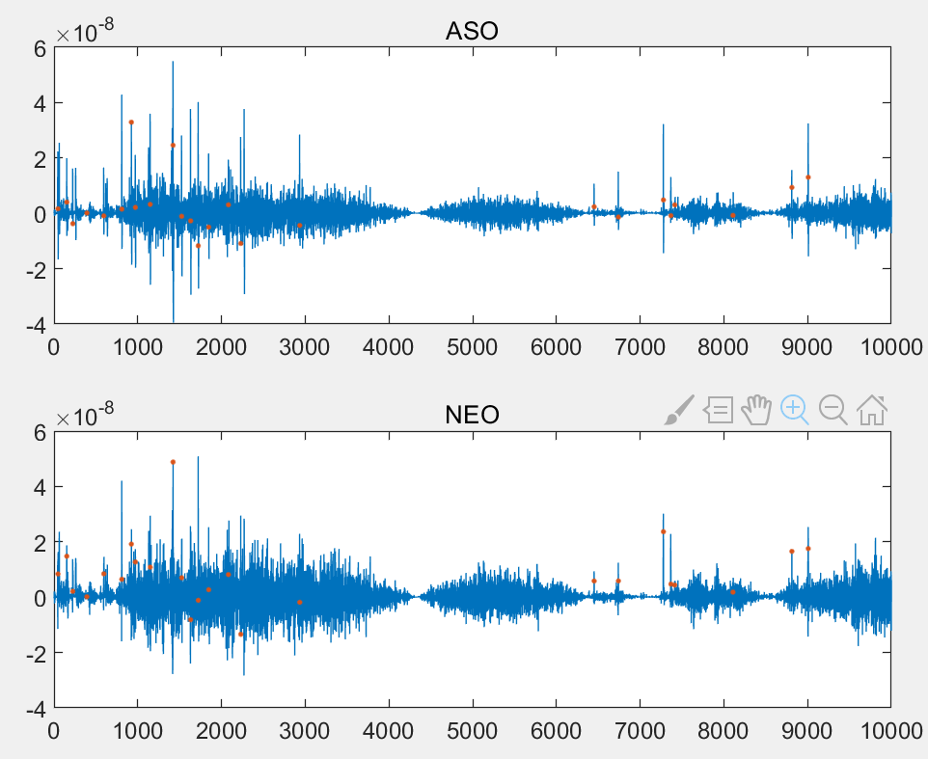
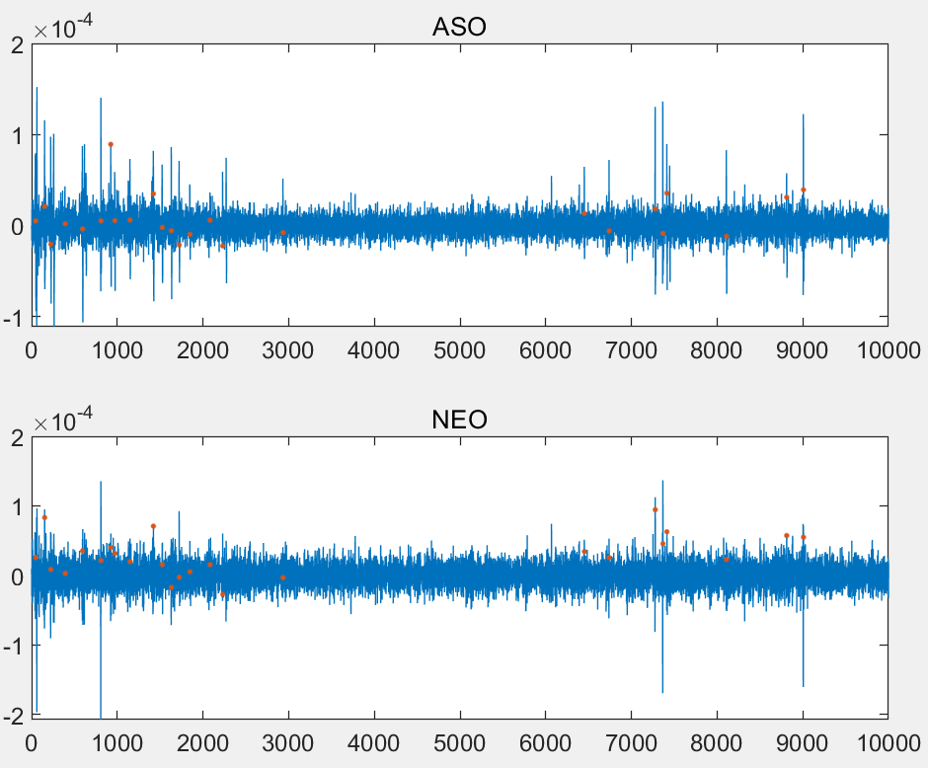
Apply operators directly to raw data
Offset the raw data by 1 and then apply operators
Output is offset by the amplitude of the raw data
Raw data offset is removed, but the noise ground is higher
ASO suffers less

Slide 4
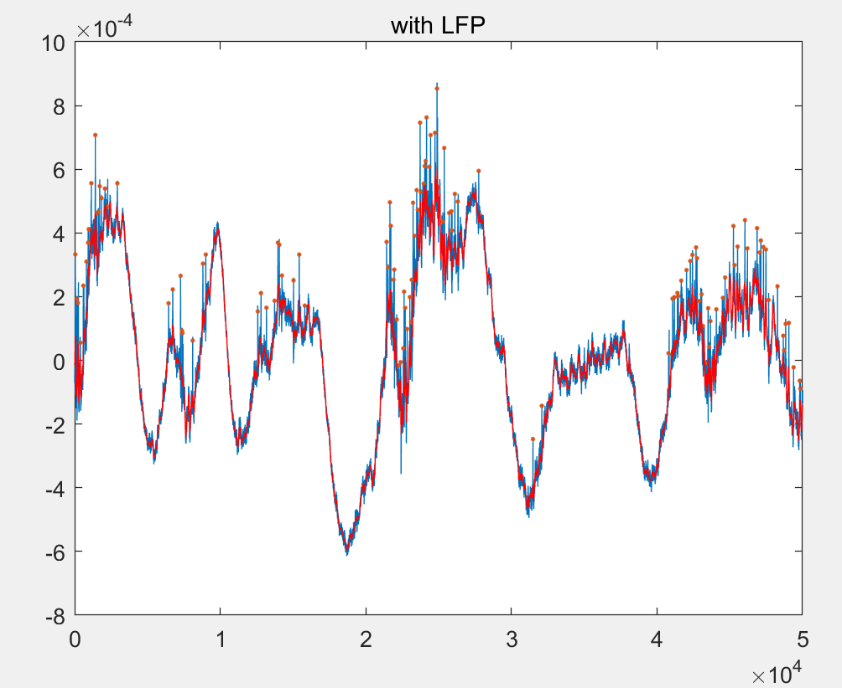
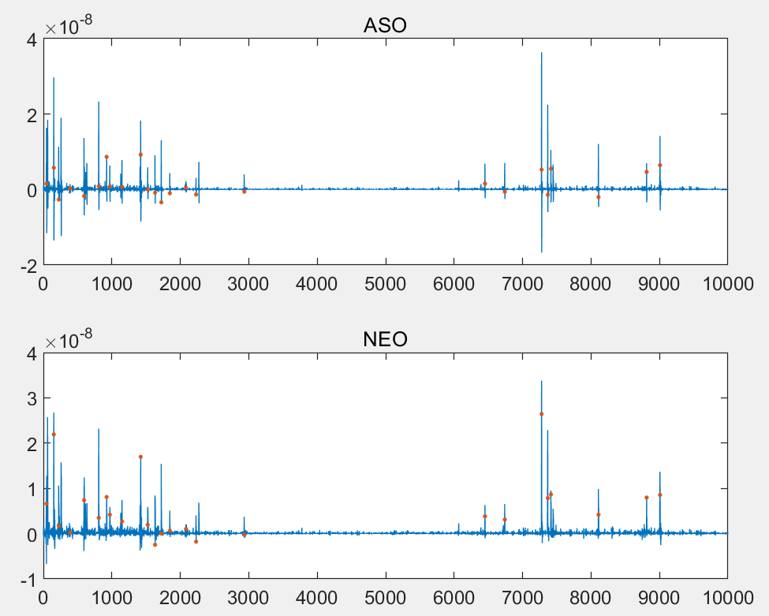
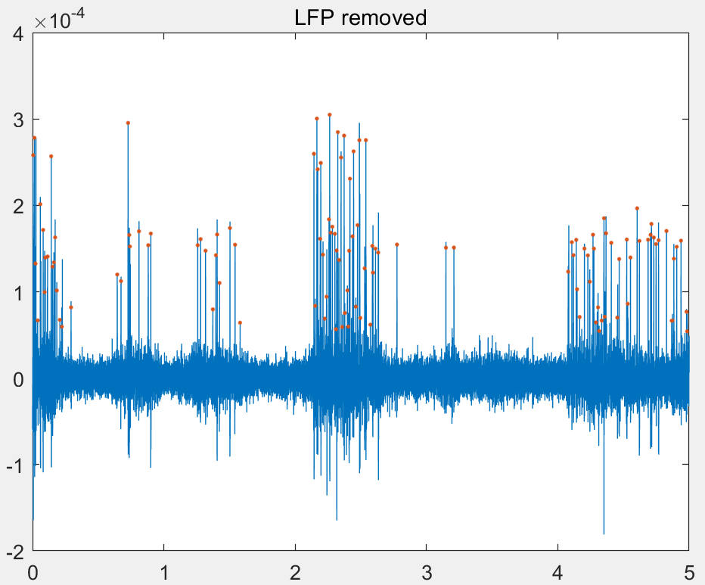
Signal with LFP and with local mean removed
Mean is measured with a window of 50
50/24414.0625= 0.002s delay
LFP is removed nearly perfect.
Visually, similar but noise ground of ASO is lower.
Note: Made mistakes
on last logbook.

Slide 5
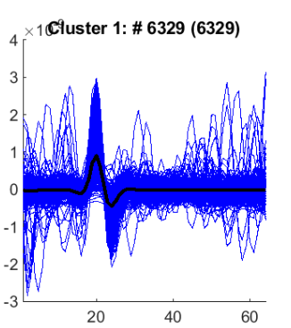
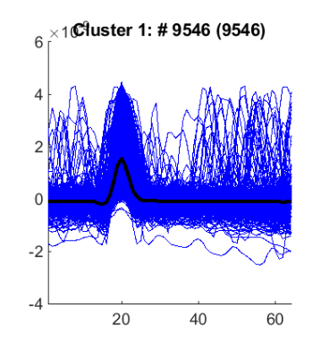
Wave form
ASO
NEO

Slide 6
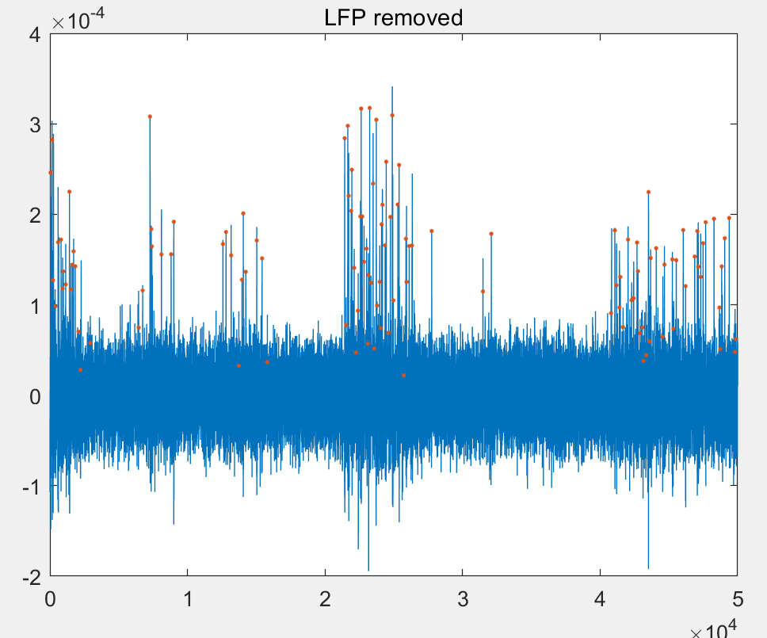
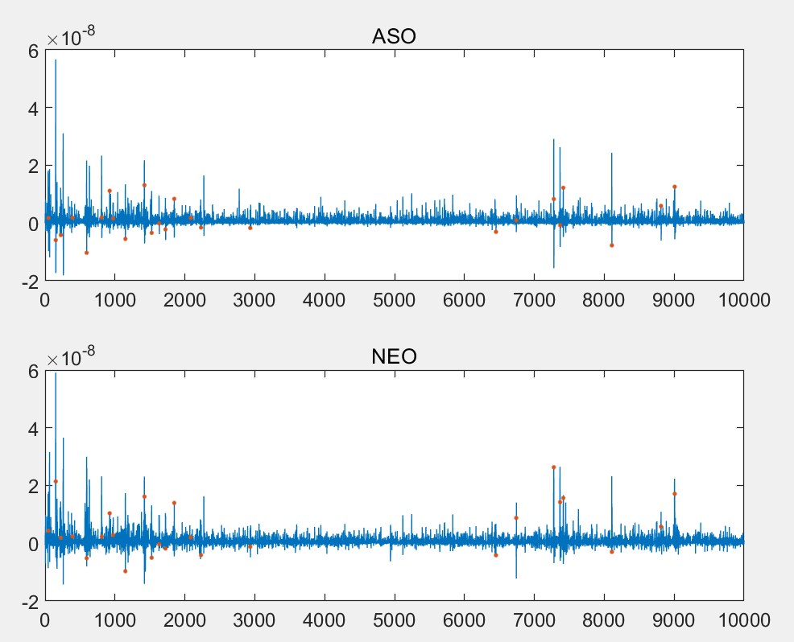
5 dB WGN added
Noise ground is higher
It is noticeable that the noise after ASO is nearly always positive

Slide 7
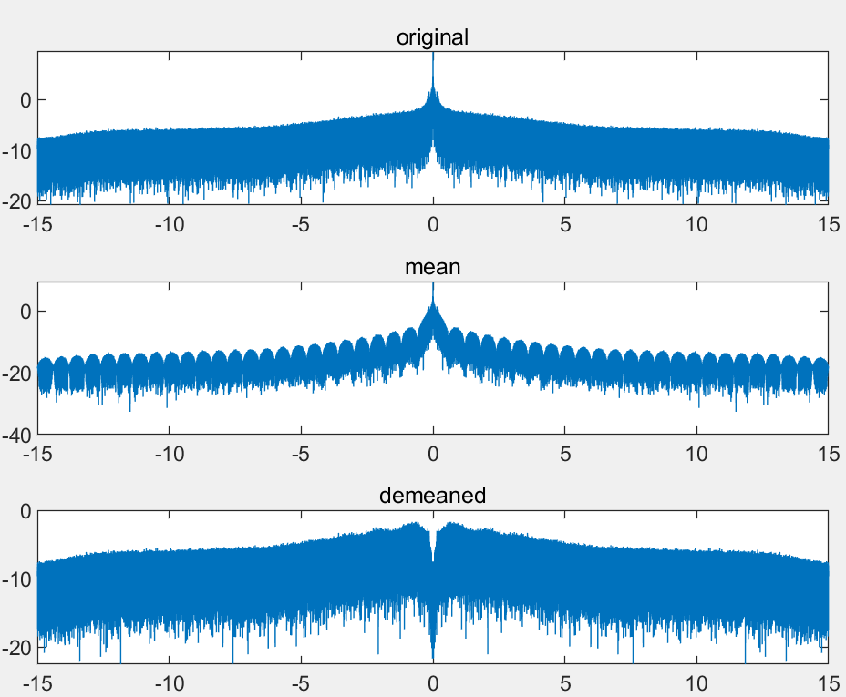
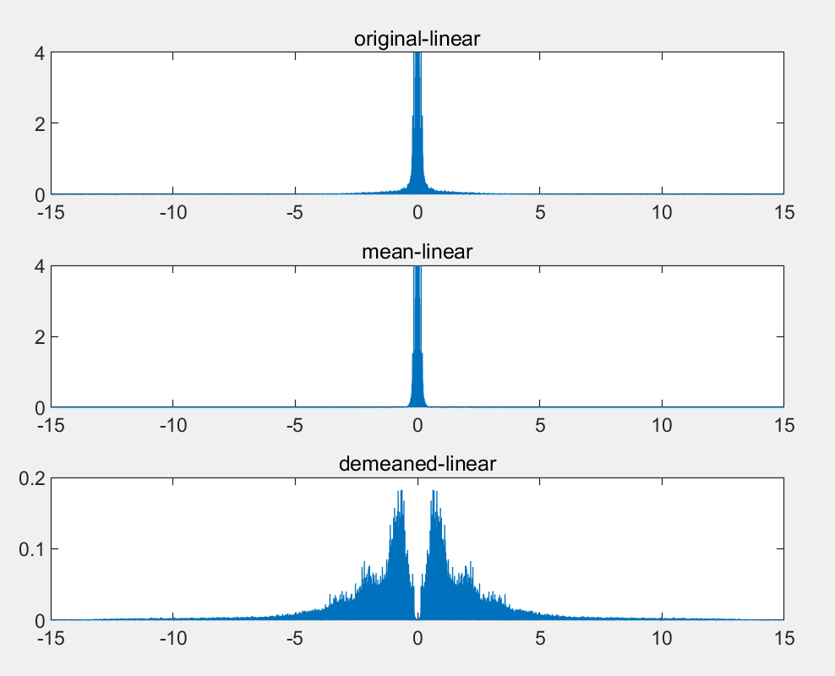
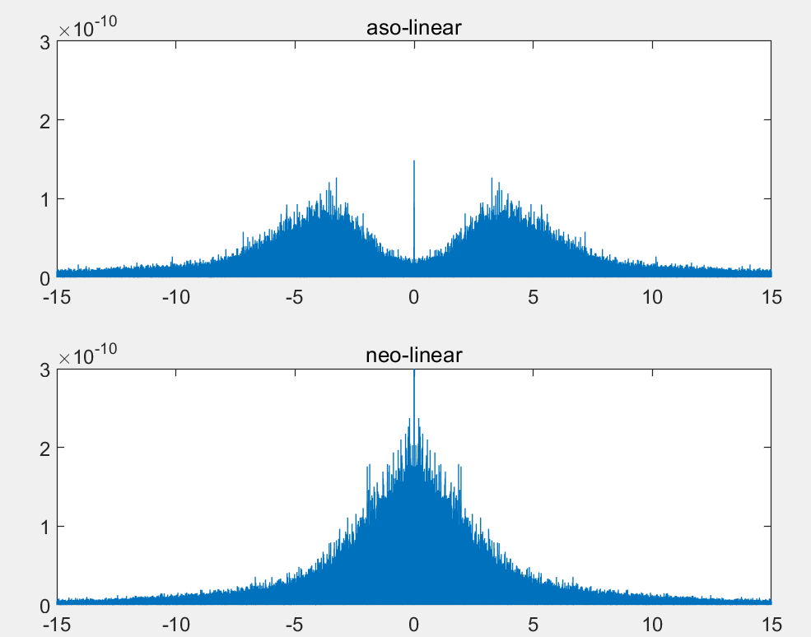
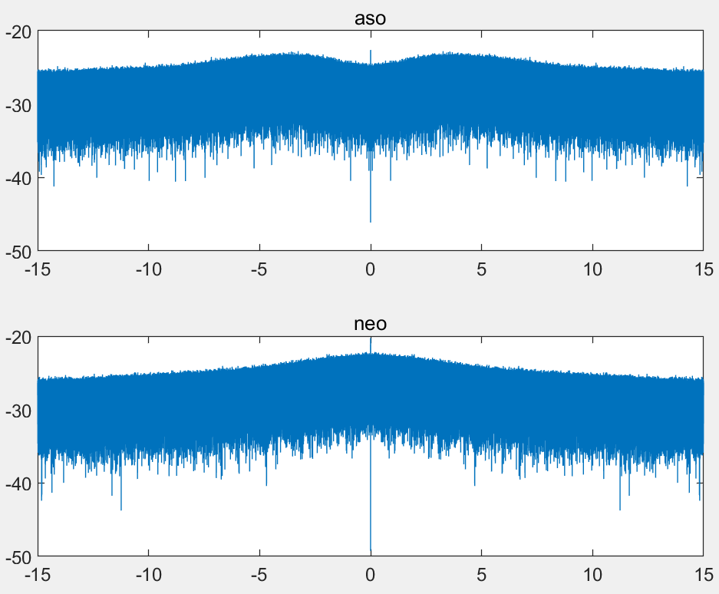
Power Spectrum Analysis
Do not have much insights in these PSDs

Slide 8
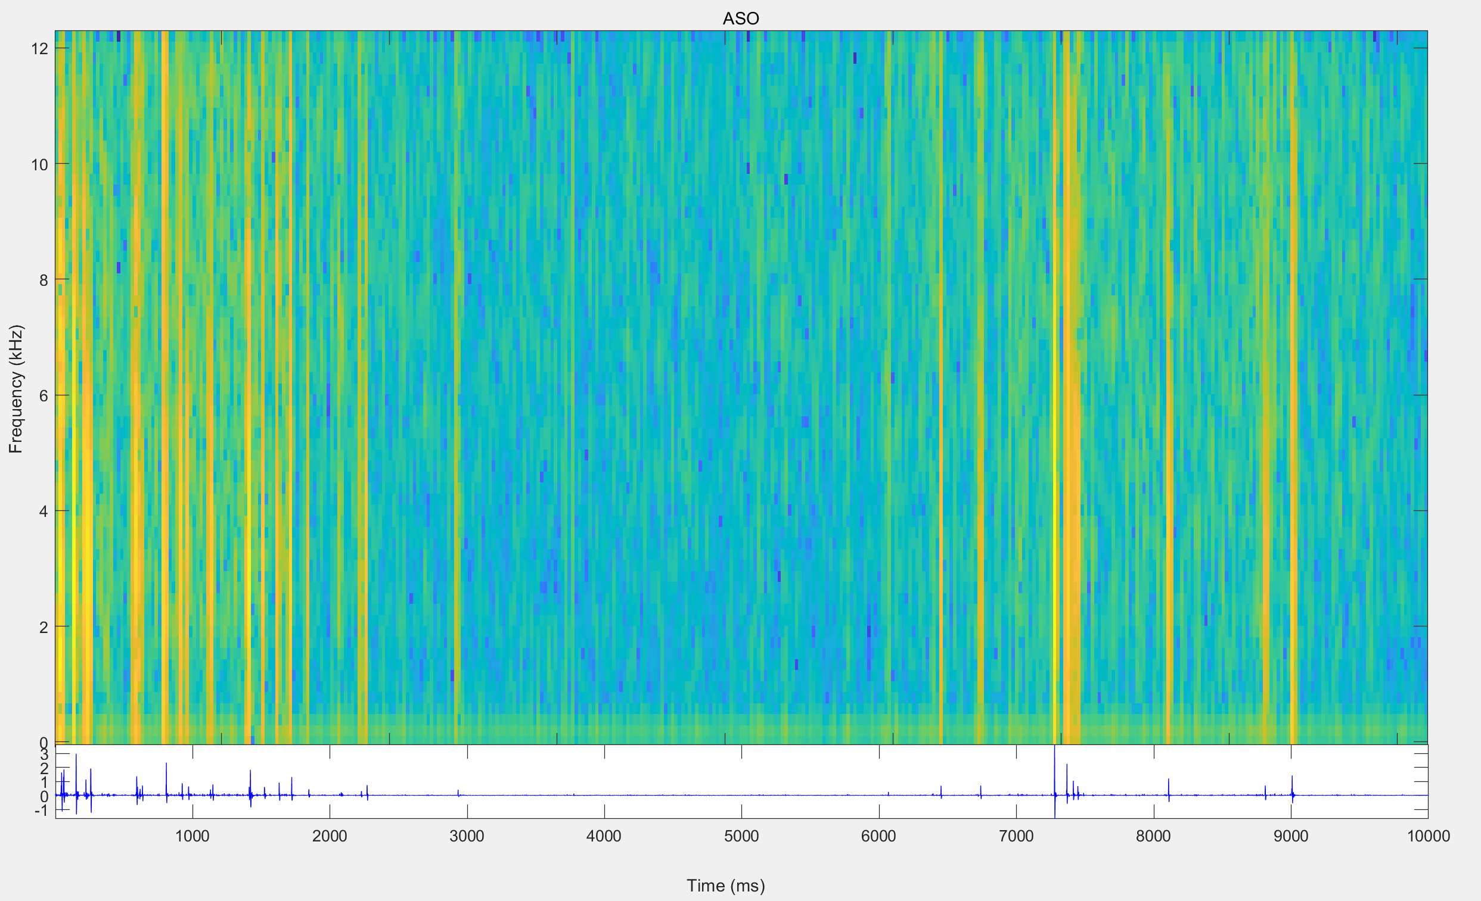
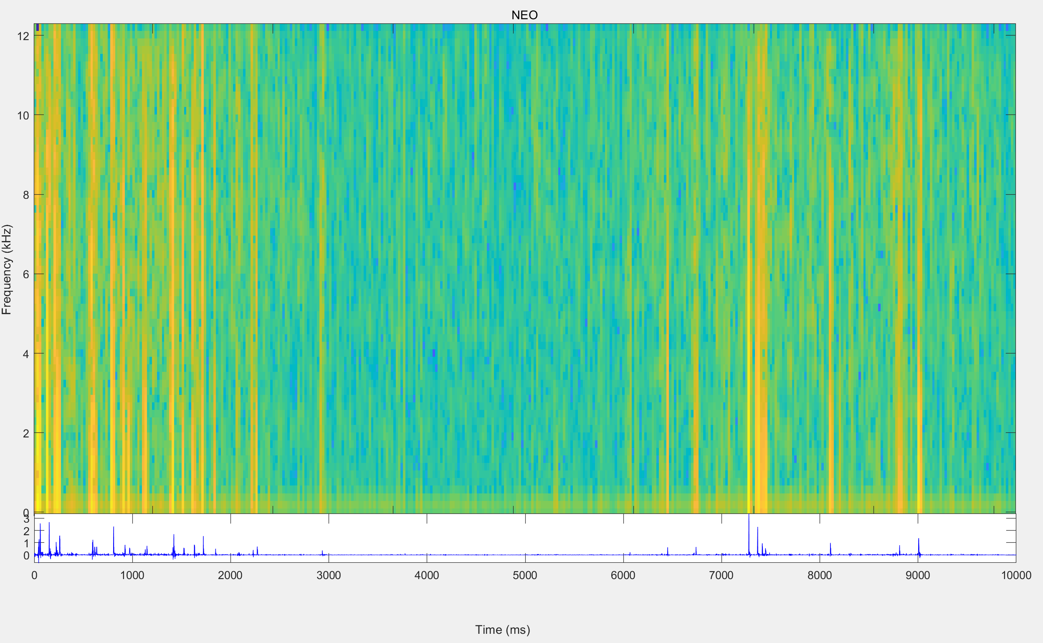
Spectrogram
The amplitude contrast between noise and spikes of ASO output is higher than that of NEO

Slide 9
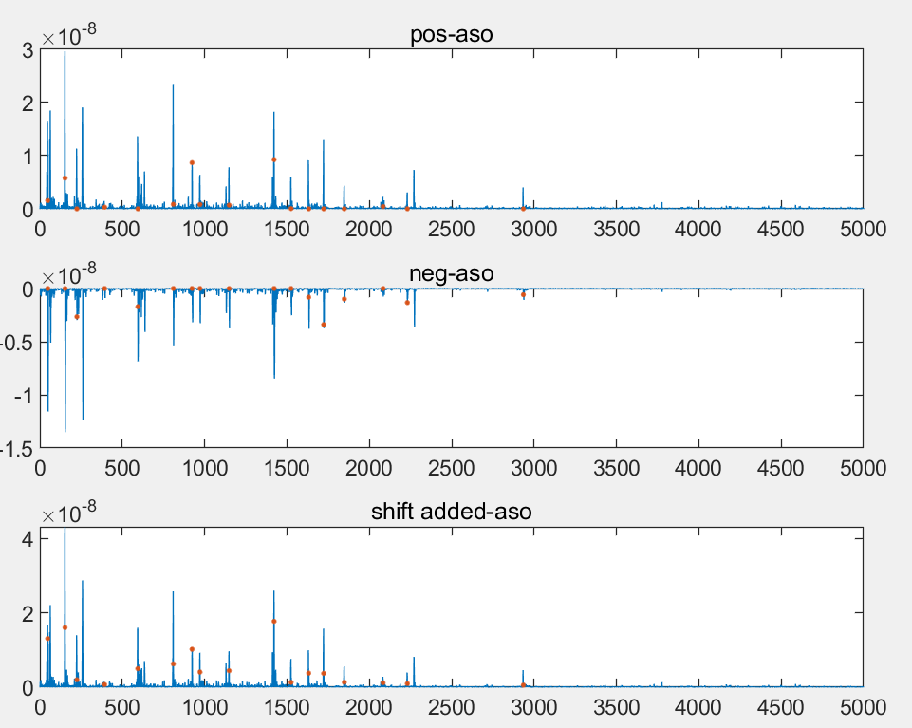
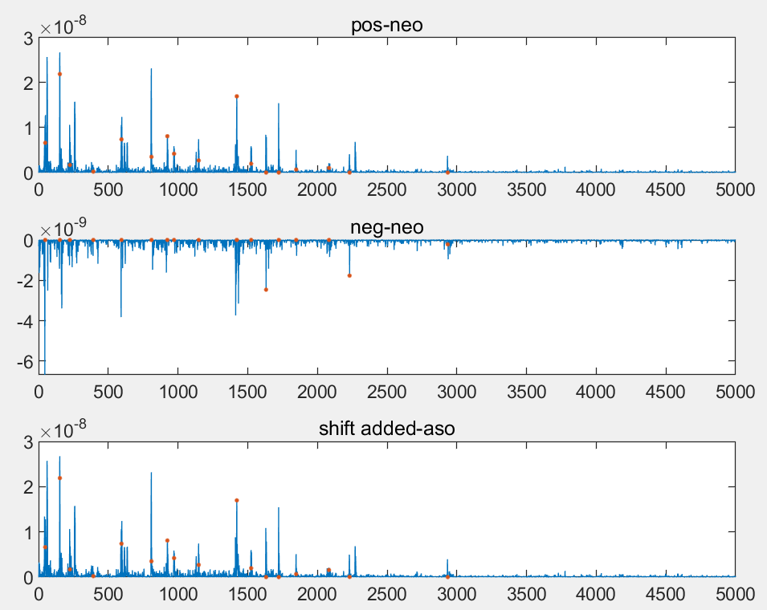
Positive and negative part of the output
out_add=pos+circshift(-neg,-2);
Not ideal. Both noise and spikes are added

Slide 10
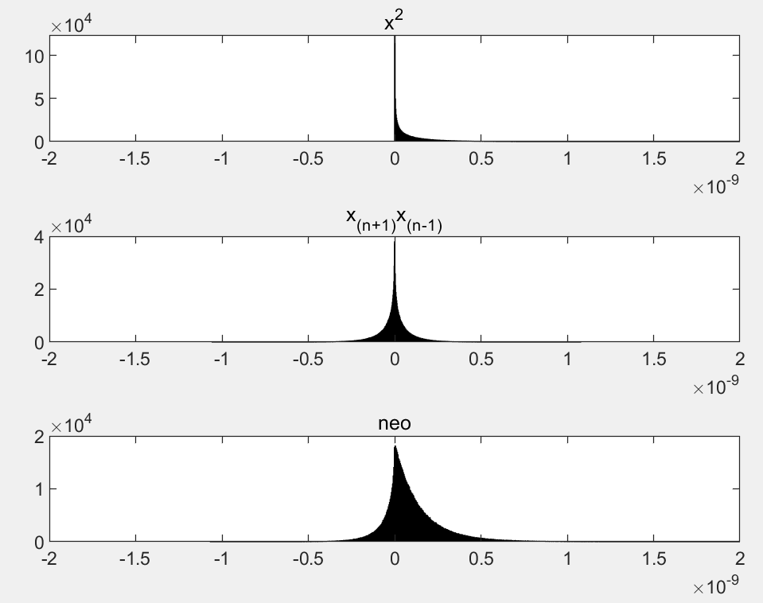
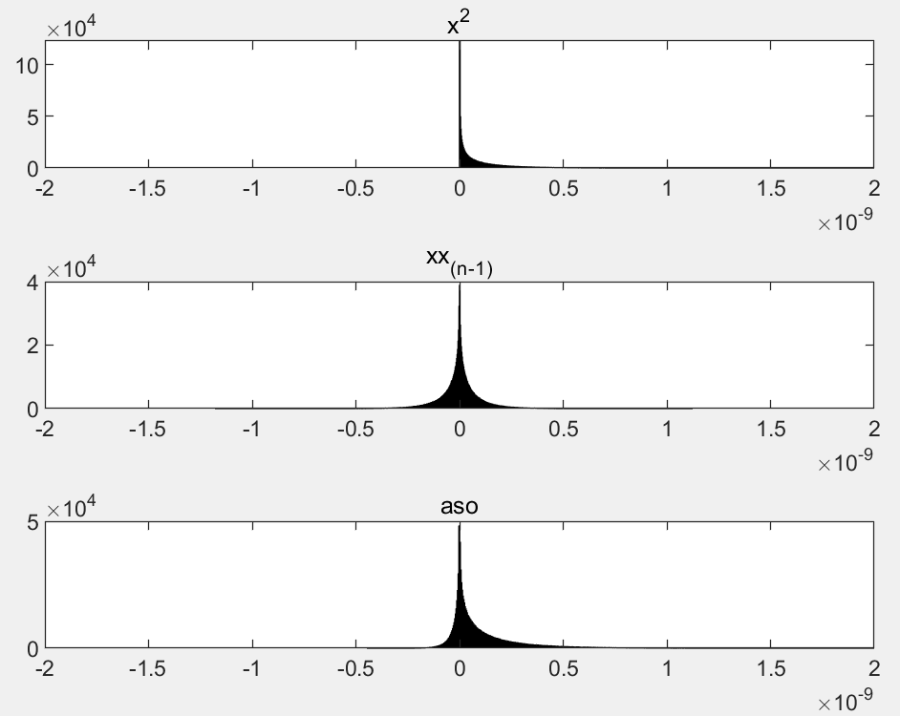
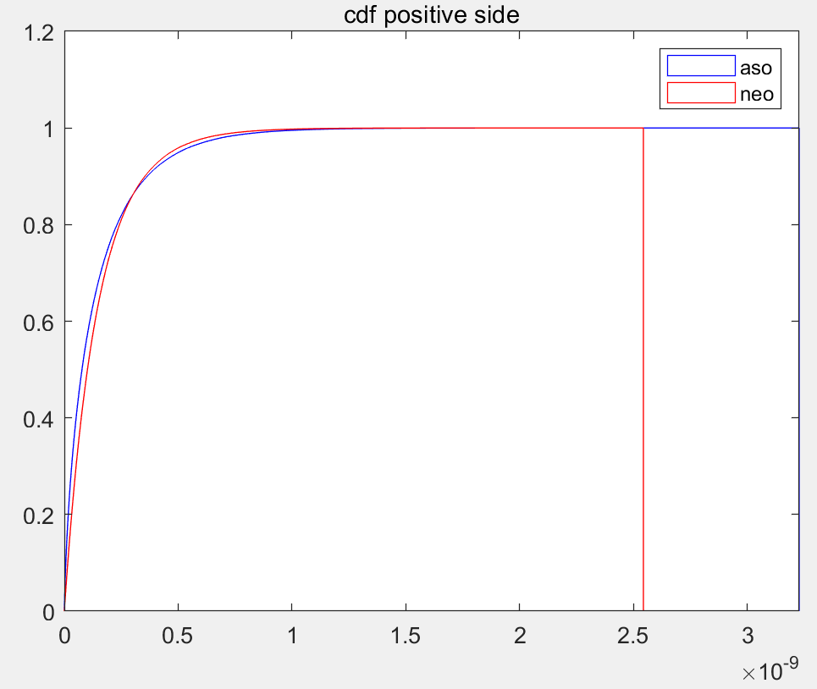
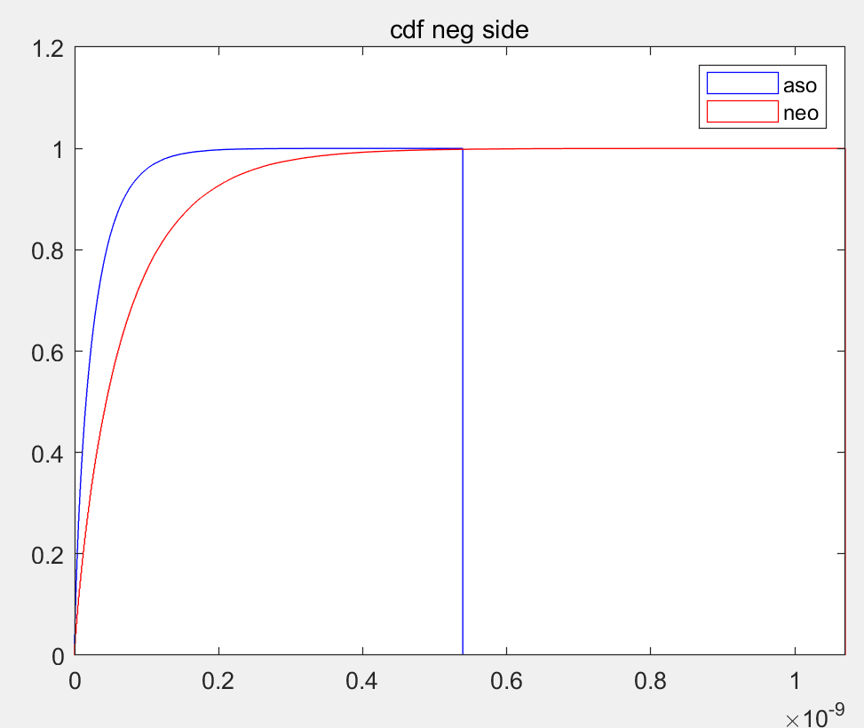
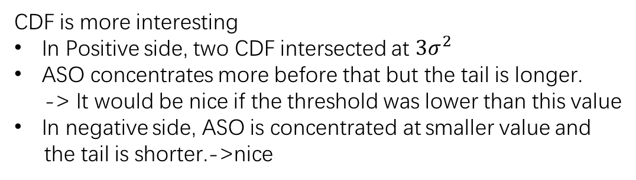
PDF and CDF of operator outputs
CDF is more interesting
In Positive side, two CDF intersected at ${3σ}^{2}$
ASO concentrates more before that but the tail is longer.
-> It would be nice if the threshold was lower than this value
In negative side, ASO is concentrated at smaller value and
the tail is shorter.->nice

Slide 11

Statistical properties
Input：N(0,$σ^{2}$)
Output of:
${x(n)}^{2}$: mean $σ^{2}$, variance ${2σ}^{4}$
$x(n)∗x(n−1)$ or $x\left(n+1\right)∗x\left(n−1\right):$ mean 0, variance $σ^{4}$
NEO or ASO: mean $σ^{2}$, variance: ${3σ}^{4}$

Slide 12
Haven’t tested the accuracy. Visually, ASO is at least similar to NEO
Improvement should be made to Rafael’s work on thresholding
Not only masking the successive signals, but also some previous ones to avoid the abrupt jump after a spike
Already obtained lots of statistics of ASO output. Trying to summarising a good thresholding schema.
Haven’t though out an adaptive approach to handle the problem when noise is large.

