Slide 1
Logbook-January

Slide 2


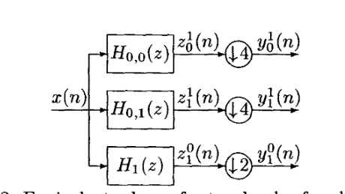
Preprocessing
NEO
SNEO
triangle window is used
Reason: E{} cannot be well estimated since the operator is nonlinear
SWT -> shift invariant
WT+SNEO
……
}+ SNEO

Slide 3

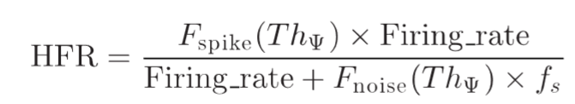

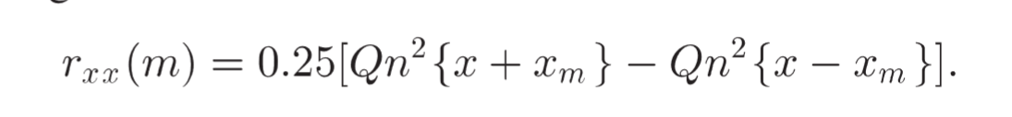
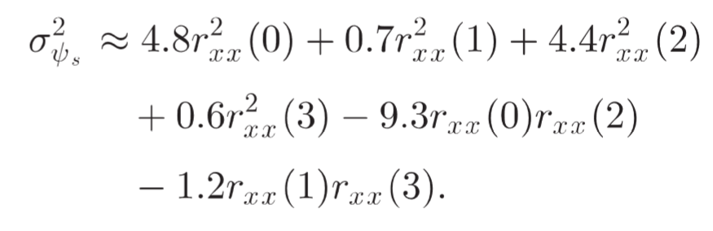
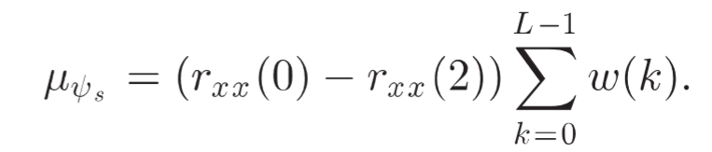
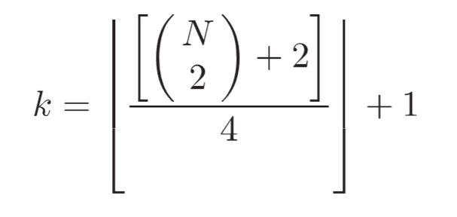
Adaptive Thresholding
Thresholding Based on Std and RMS freq. of noise
Optimize ->C0 =9.5 when fs=20kHz.
! Firing rate not sure
Thresholding method independent on firing rate -> eliminate the detected spike.
Robust statistic based algorithms
p user define
K-order moments

Slide 4



Proposed operator
amplitude * derivative -> proved
Advantages: Even less computation and similar performance to NEO
Experiment on speed:
Float point operations: reduced to a half. (input dim: 1e5 )
Running time: reduced for 20% on MATLAB (1e5 input vector length, repeat 1e6 times)
NEO: 46.3s Proposed: 36.9s
Experiment on performance, slightly lower on sensitive and higher on false detection rate. Overall similar.
thresholding method: from Rafael; data: C_Easy1_noise02.mat
$$ψ\left(x\left(n\right)\right)=x\left(n\right)(x\left(n\right)−x(n−1))$$
 | Sens | fdr
NEO-mean | 0.9885 | 0.0138
NEO-RMS | 0.9826 | 0.0136
Proposed/abs(proposed)-mean | 0.9864/0.9719 | 0.02/0.017
Proposed/abs(proposed)-RMS | 0.9784/0.9625 | 0.0155/0.0154

Slide 5
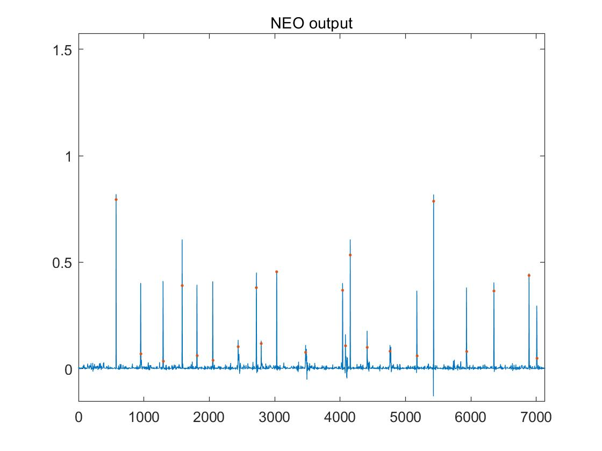
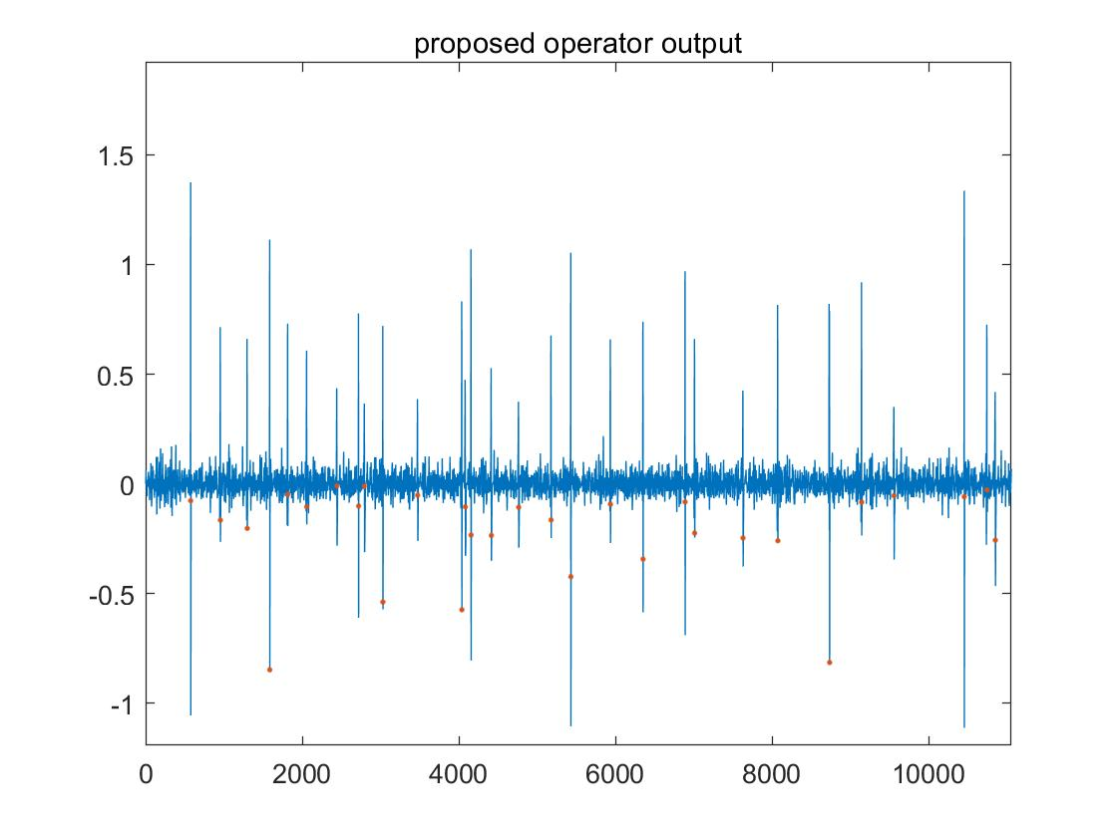
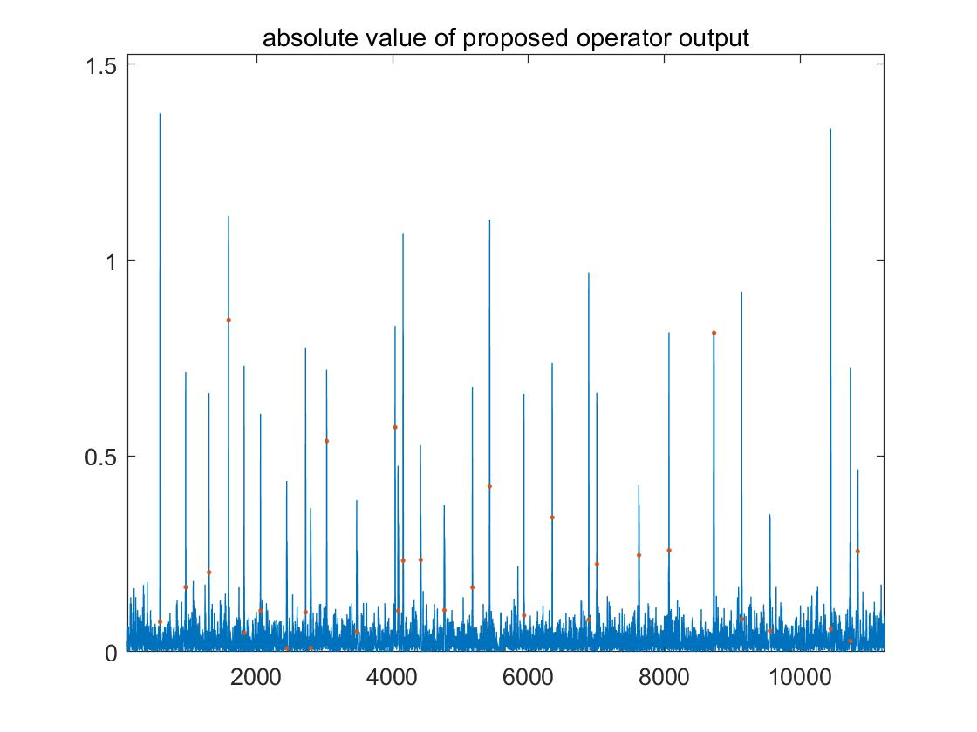
Pre-emphasised signals
Visually, NEO is better, but the pre-emphasised spikes of proposed operator are distinguishable enough for detection.
-> However, the performance would degrade more than it is with NEO, if SNR is low.
Maybe the double-side amplitude of the proposed output can be utilised in thresholding for higher sens and lower fdr.

Slide 6
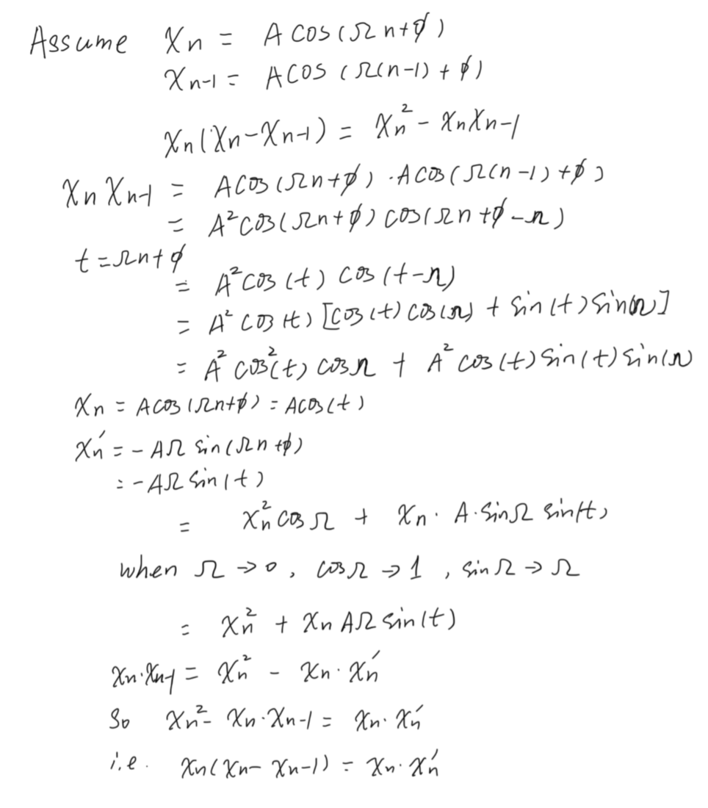
Proof of the proposed operator

Slide 7
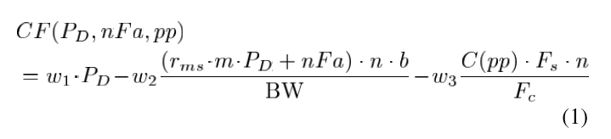
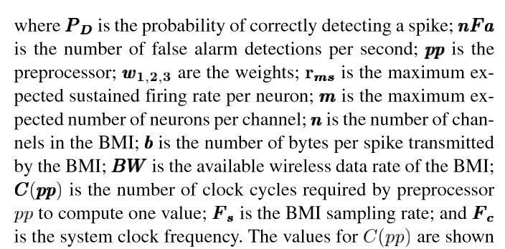
Evaluation Method
W1 = 10; W2=1; W3= 1;
This idea is good, but one can play with weights and make any algorithm it wants to be the best one.

