Slide 1
Logbook-Holiday

Slide 2
Thesis-2015
Innovation:
Microelectrode array
Larger amount of data. 1.more info. 2. hard to transmit
Limitation on size and power of the local devices.
Measuring methods
Extracellular recordings. √
Intracellular recordings
Signal Characters
Signal of interests->300~6kHz
Local field potential(LPF)-signal from other units->60Hz-

Slide 3


Algorithms- reviewed
NEO
MTEO
->Upgrade to adaptive algorithm with dynamic thresholding
RMS measuring with sliding window->threshold inflation
With nonoverlapping window
Robust statistics theory-based adaptive thresholding
TEO->Hanning window->
u mean, sigma std. P- user defined probability. ‘A high value of ‘p’ will decrease this probability but it will also decrease the probability of detecting true spikes. ‘
Con. High complexity
Absolute value & stationary WT
Low SNR->SWT, High SNR -> absolute value
High computational cost

Slide 4
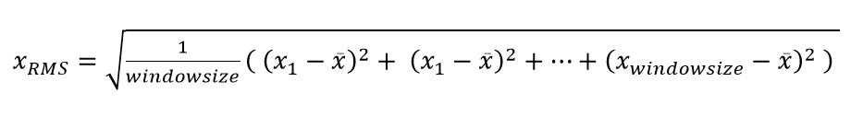
Parallel Spike detection
Procedure
1st pathway: MTEO/NEO
2nd pathway: SAM
Adaptive RMS thresholding (‘signal during a spike is not considered’ )
‘The adaptive thresholding algorithm only considers threshold crossings as spikes if they have occurred more than 15 samples since the last spike’
Combining unique spikes
Two pathway emphasis different features-> which features?
NEO larger differences
SAM large values

Slide 5
Series Spike Detection
Procedure
NEO/SAM->SAM/NEO->Adaptive Thresholding
Very distinguishable spikes after two emphasises, but maybe some small spikes are suppressed to nearly zero.

Slide 6
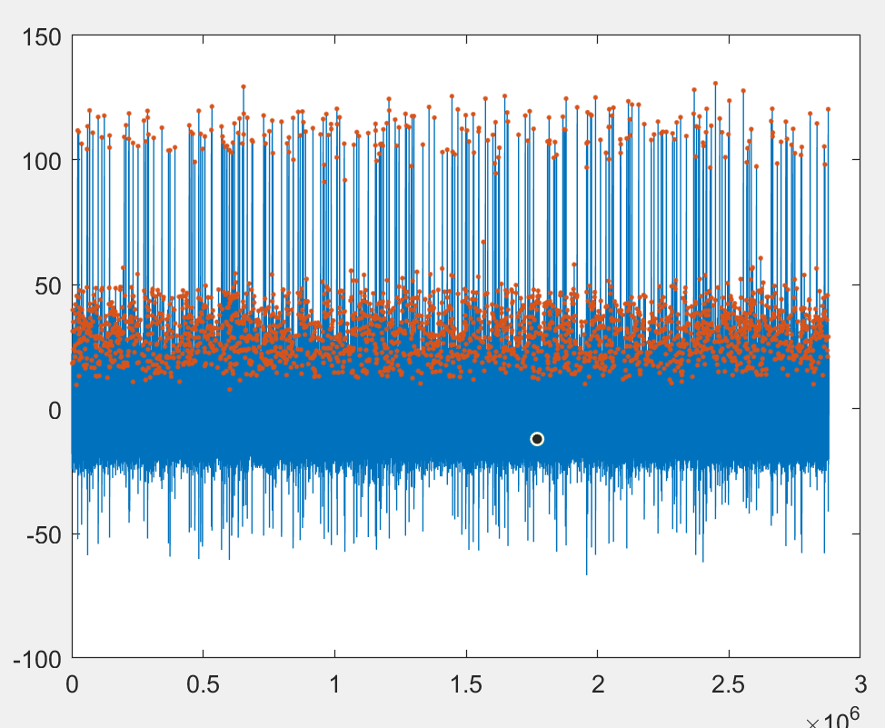
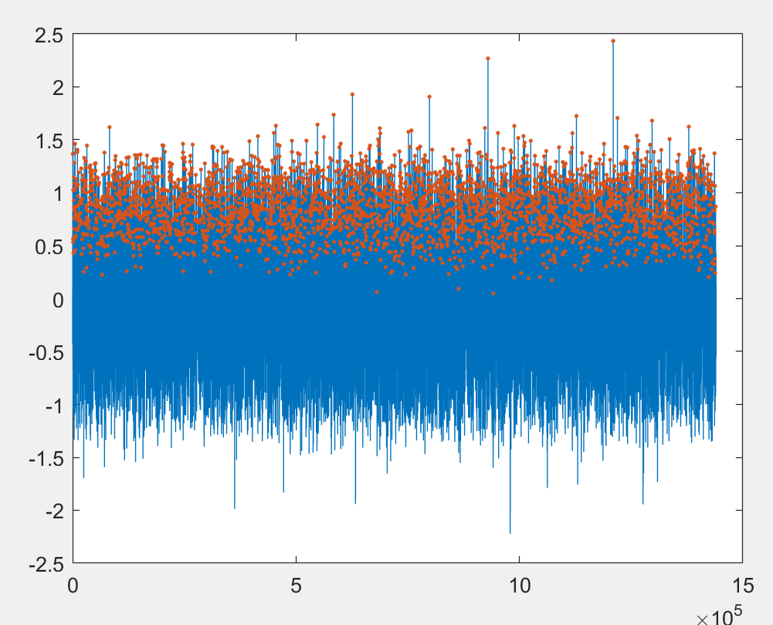
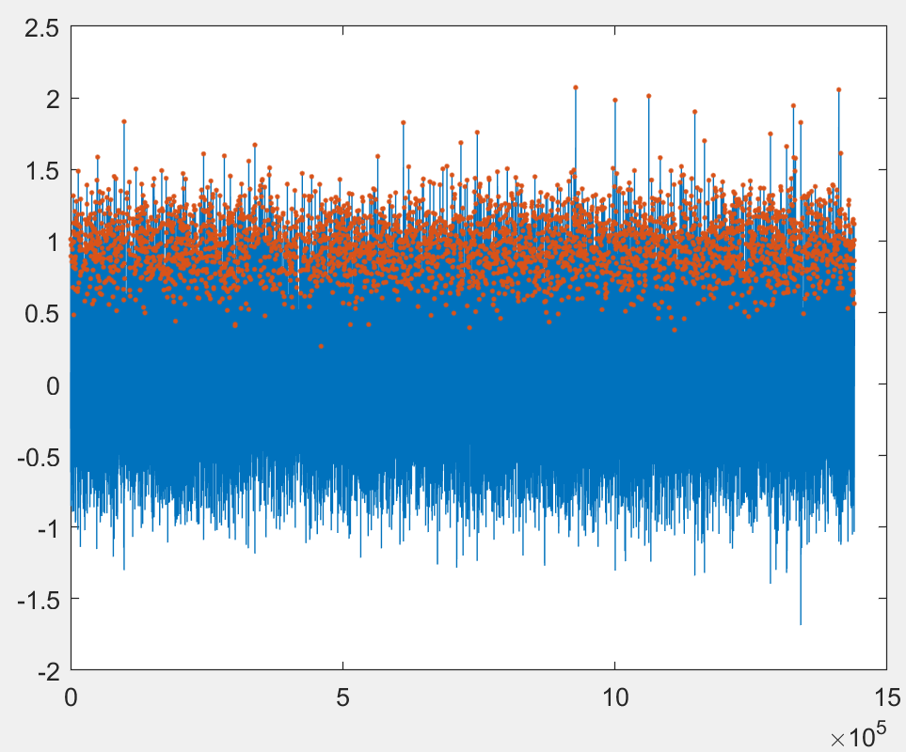
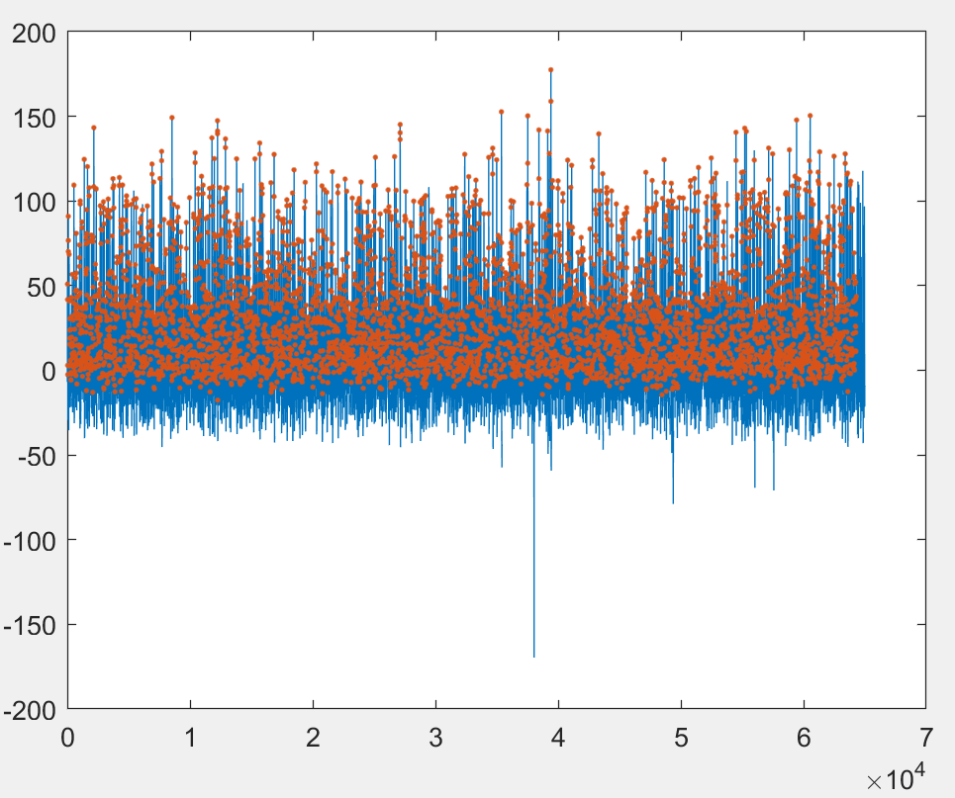
Data
Simulation 1
easy2
Hard2
Real-not sure

Slide 7










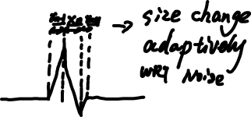





Some ideas
New operator
$\left(x\left(n\right)−x\left(n−k\right)\right)∗(x\left(n+k\right)−x(n))$
Two subtractions, one multiplication. Less computation than NEO
Difference between spike and noise
New methods
1.
Converge to a single elastic algorithm

