Slide 1
Adaptive Neural Spike Detection
Adaptive Neural Spike Detection
MSc. Communications and Signal Processing
Zheng Zhang
Supervisor: Dr. Timothy Constantinou

Slide 2
Content
Adaptive Neural Spike Detection
Background
Proposed Method
Experiment Results and Evaluations
Future Work

Slide 3
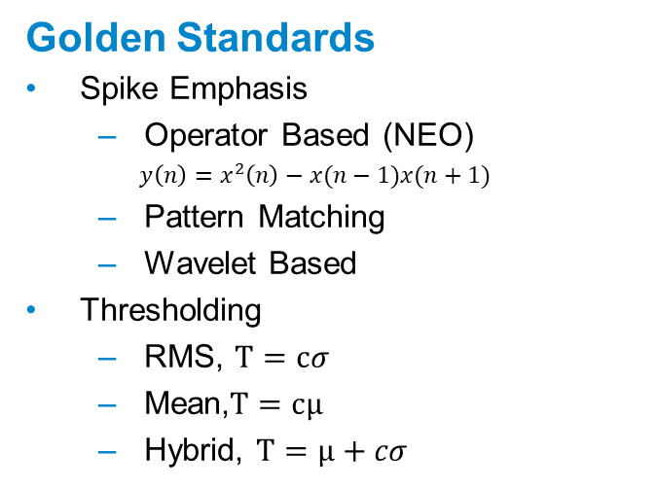
Background
Adaptive Neural Spike Detection
Innovation
Massive Amount of Data
Limited Bandwidth
Limited Battery Life
Time varying Noise Level
…
Golden Standards
Spike Emphasis
Operator Based (NEO)
$y\left(n\right)=x^{2}\left(n\right)−x(n−1)x(n+1)$
Pattern Matching
Wavelet Based
Thresholding
RMS, $T=cσ$
Mean,$T=cμ$
Hybrid, $T=μ+cσ$

Slide 4
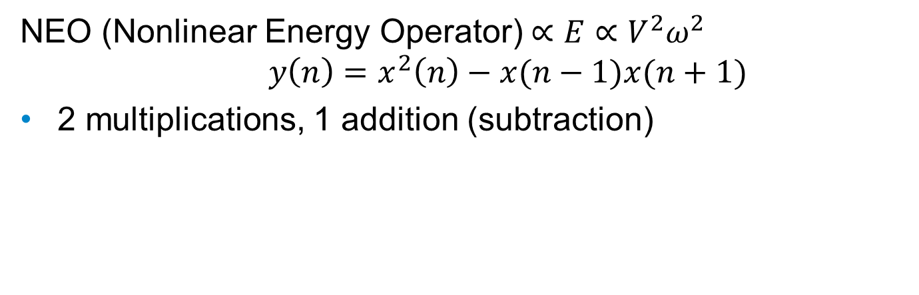
Proposed Method
Adaptive Neural Spike Detection
NEO (Nonlinear Energy Operator)$∝E∝V^{2}ω^{2}$
$$y\left(n\right)=x^{2}\left(n\right)−x(n−1)x(n+1)$$
2 multiplications, 1 addition (subtraction)

Slide 5
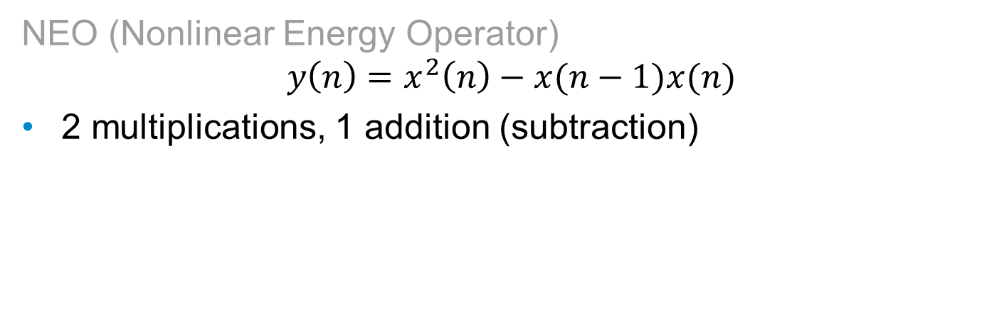
Proposed Method
Adaptive Neural Spike Detection
NEO (Nonlinear Energy Operator)
$$y\left(n\right)=x^{2}\left(n\right)−x(n−1)x(n)$$
2 multiplications, 1 addition (subtraction)

Slide 6
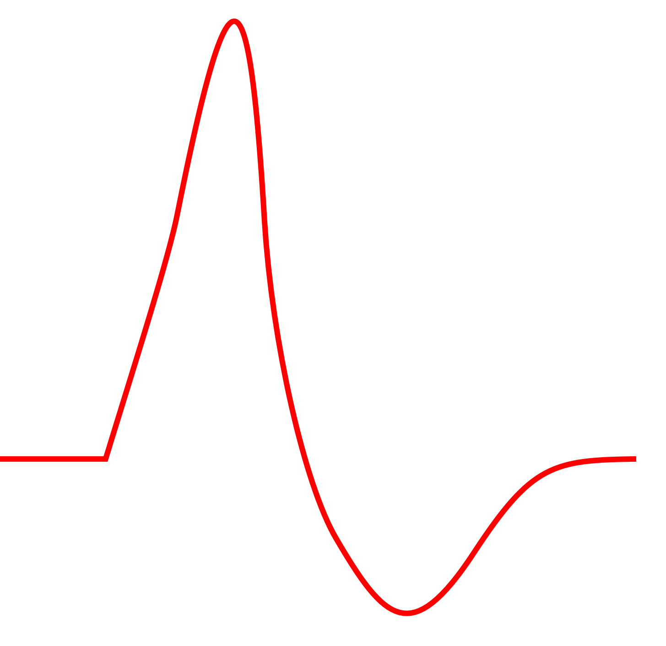
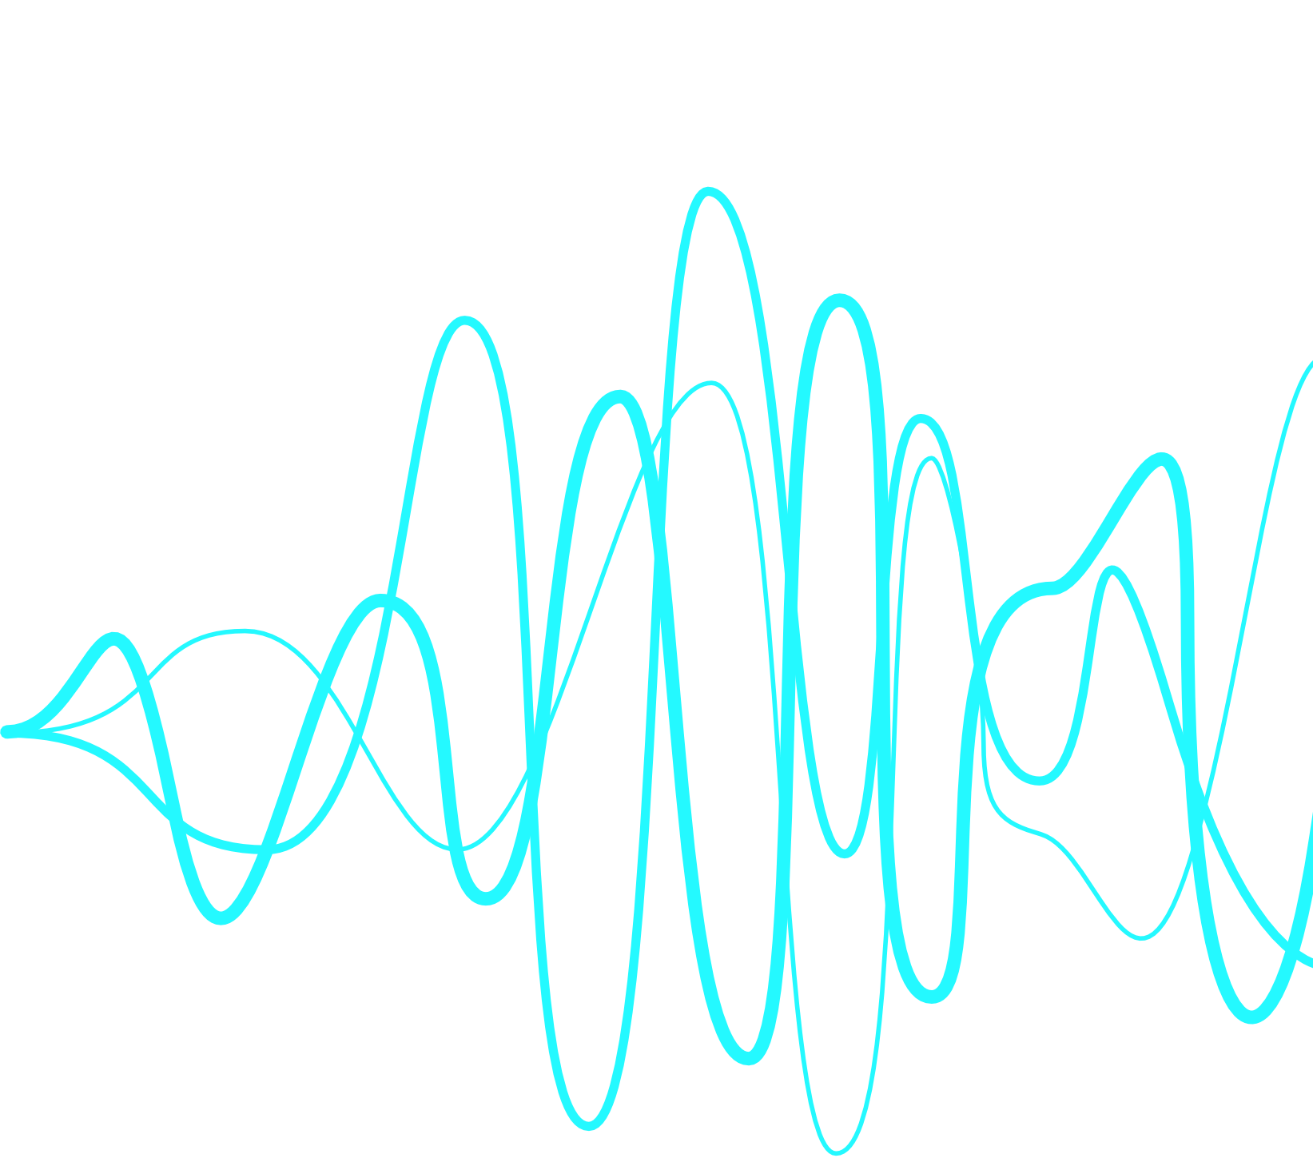
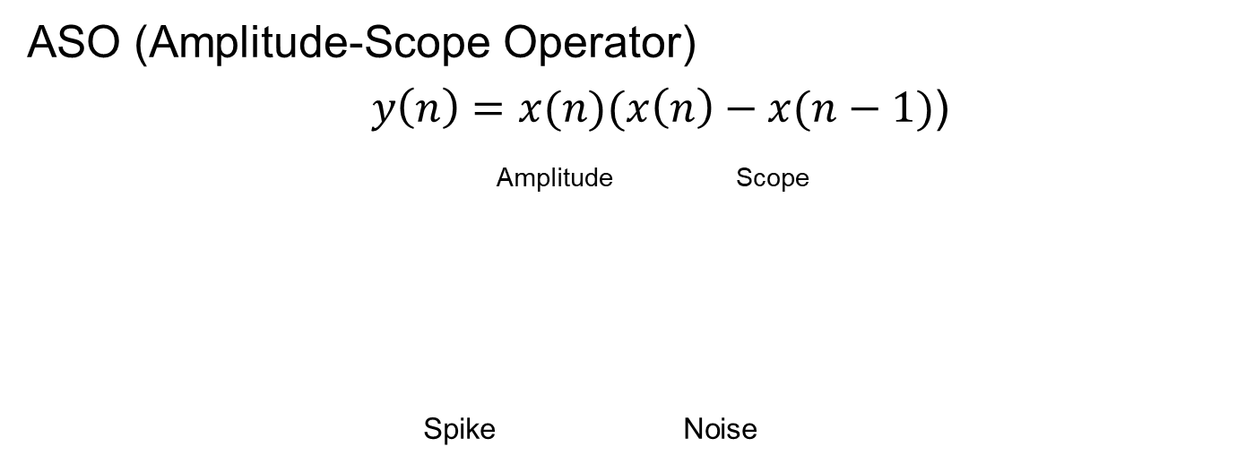
Proposed Method
Adaptive Neural Spike Detection
ASO (Amplitude-Scope Operator)
$y\left(n\right)=x(n)(x\left(n\right)−x(n−1)$)
Amplitude Scope
Spike Noise

Slide 7
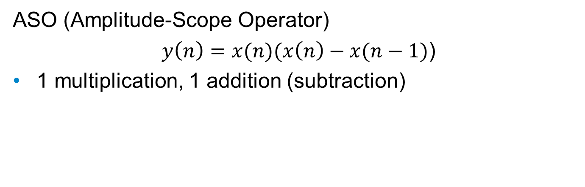
Proposed Method
Adaptive Neural Spike Detection
ASO (Amplitude-Scope Operator)
$y\left(n\right)=x(n)(x\left(n\right)−x(n−1)$)
1 multiplication, 1 addition (subtraction)

Slide 8
Experiment Results and Evaluation
Adaptive Neural Spike Detection
Computational Cost
Flops
Execution Time
Detection Accuracy
Different Noise Levels

Slide 9
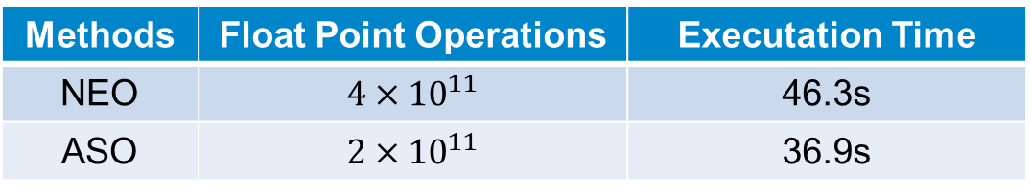


Computational Cost (${10}^{11}$ input data points*)
Adaptive Neural Spike Detection
Methods | Float Point Operations | Executation Time
NEO | ${4×10}^{11}$ | 46.3s
ASO | ${2×10}^{11}$ | 36.9s
$$50\%$$
$$21.6\%$$
* Achieved by processing ${10}^{5}$ data for ${10}^{6}$ times in MATLAB

Slide 10
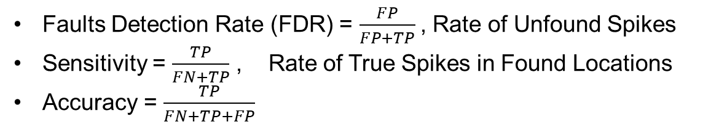
Evaluation Metrics
Adaptive Neural Spike Detection
Faults Detection Rate (FDR) = $\frac{FP}{FP+TP}$, Rate of Unfound Spikes
Sensitivity = $\frac{TP}{FN+TP}$ , Rate of True Spikes in Found Locations
Accuracy = $\frac{TP}{FN+TP+FP}$

Slide 11
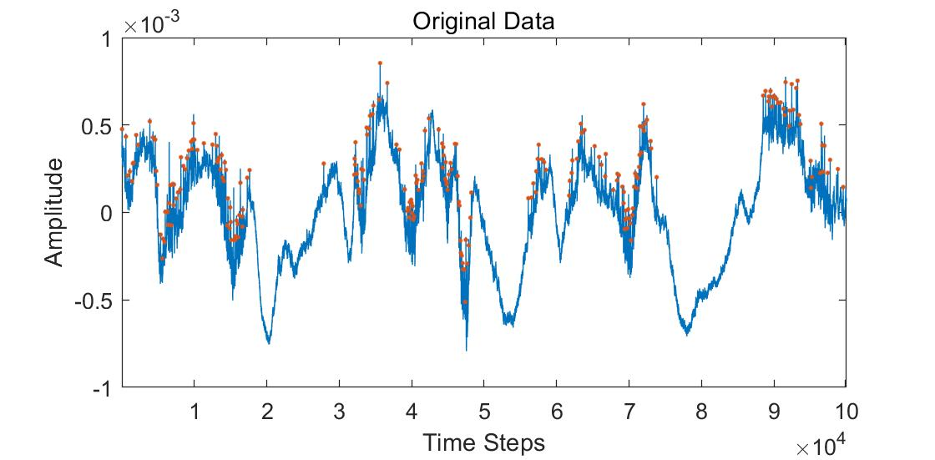
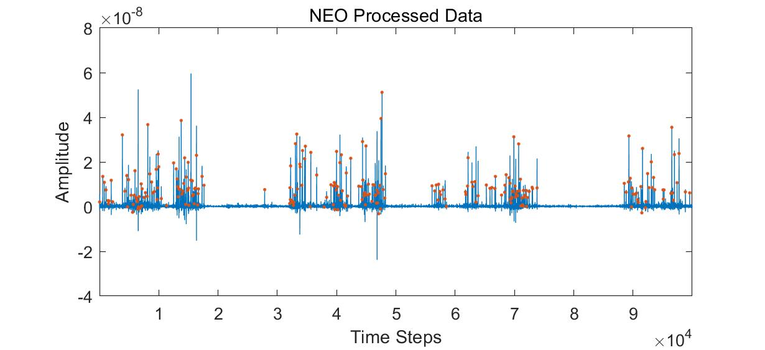
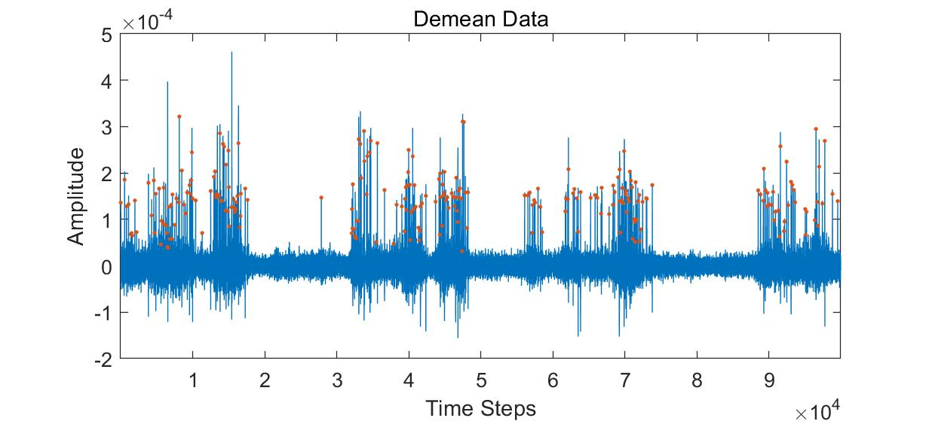
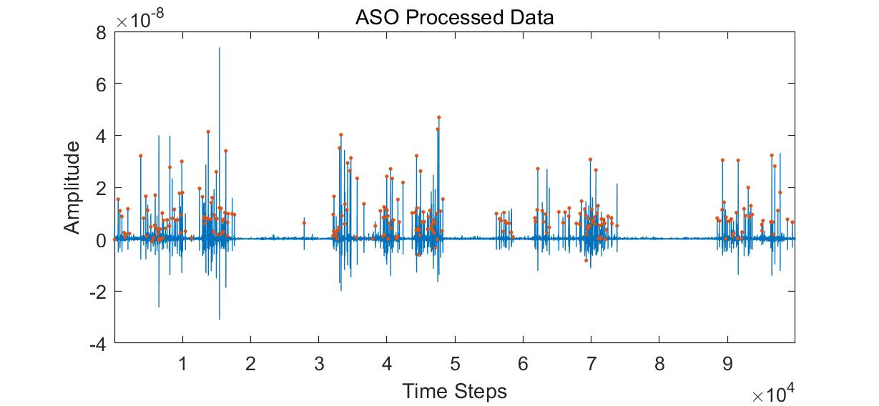
Experiment Results-No Additional Noise
Adaptive Neural Spike Detection
Subtracting
the Average
Calculated from a Window with Length 16.

Slide 12
Spike Detection Performance- No Additional Noise
Adaptive Neural Spike Detection
 | Data A |  |  | Data B
 | Sens | FDR | ACC | Sens | FDR | ACC
ASO-RMS | 0.8257 | 0.1943 | 0.6886 | 0.8414 | 0.1757 | 0.7135
NEO-RMS | 0.7935 | 0.2065 | 0.6577 | 0.8255 | 0.1689 | 0.7069
ASO-mean | 0.7992 | 0.1781 | 0.6812 | 0.8146 | 0.1689 | 0.6986
NEO-mean | 0.7795 | 0.1984 | 0.6535 | 0.82 | 0.1689 | 0.7029
$$50\%$$
$$21.6\%$$

Slide 13
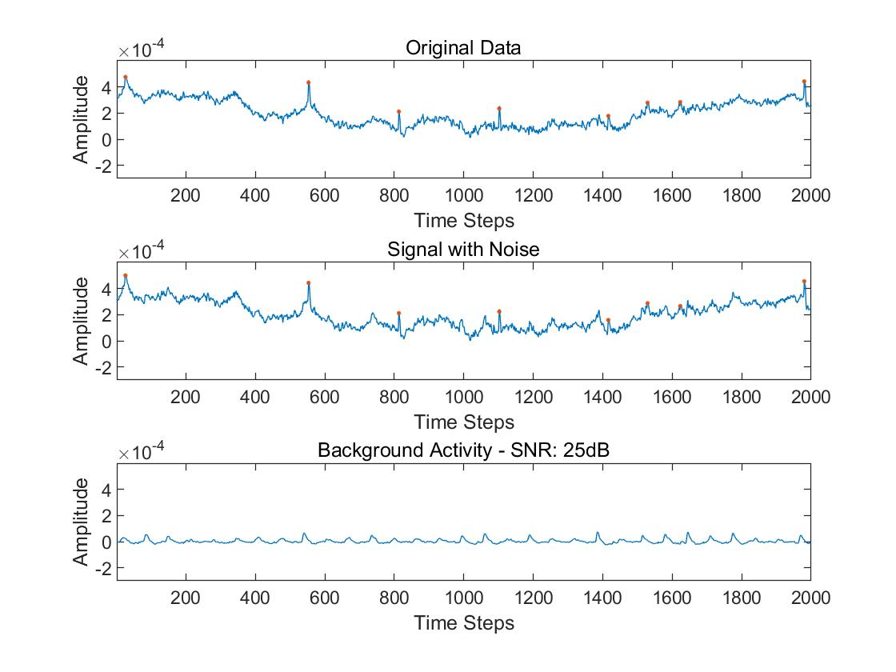
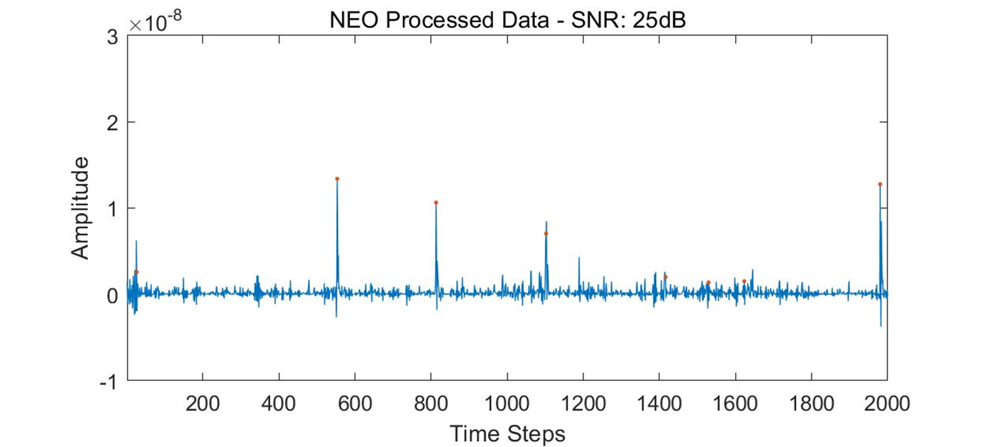
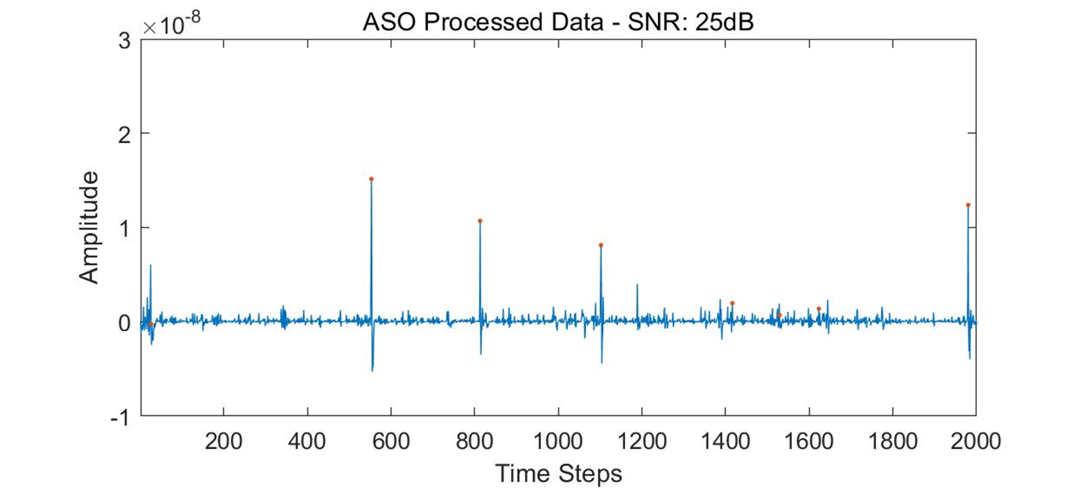
Experiment Results- 25dB Additional Noise
Adaptive Neural Spike Detection

Slide 14
Spike Detection Performance- 25dB Additional Noise
Adaptive Neural Spike Detection
 | Data A |  |  | Data B
 | Sens | FDR | ACC | Sens | FDR | ACC
ASO-RMS | 0.8190 | 0.2308 | 0.6574 | 0.8243 | 0.1757 | 0.7011
NEO-RMS | 0.7833 | 0.2389 | 0.6288 | 0.8052 | 0.1622 | 0.6955
ASO-mean | 0.8112 | 0.1822 | 0.6871 | 0.7987 | 0.1689 | 0.6872
NEO-mean | 0.7796 | 0.2267 | 0.6346 | 0.7848 | 0.1622 | 0.6813
Best-Before | 0.8257 | 0.1781 | 0.6886 | 0.8414 | 0.1689 | 0.7135
$$50\%$$
$$21.6\%$$

Slide 15
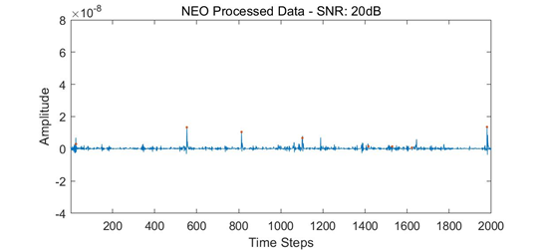
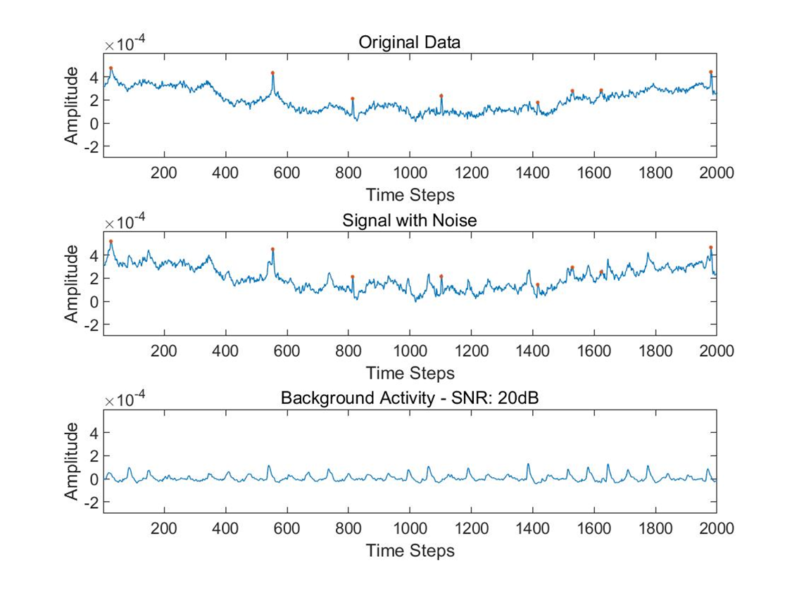
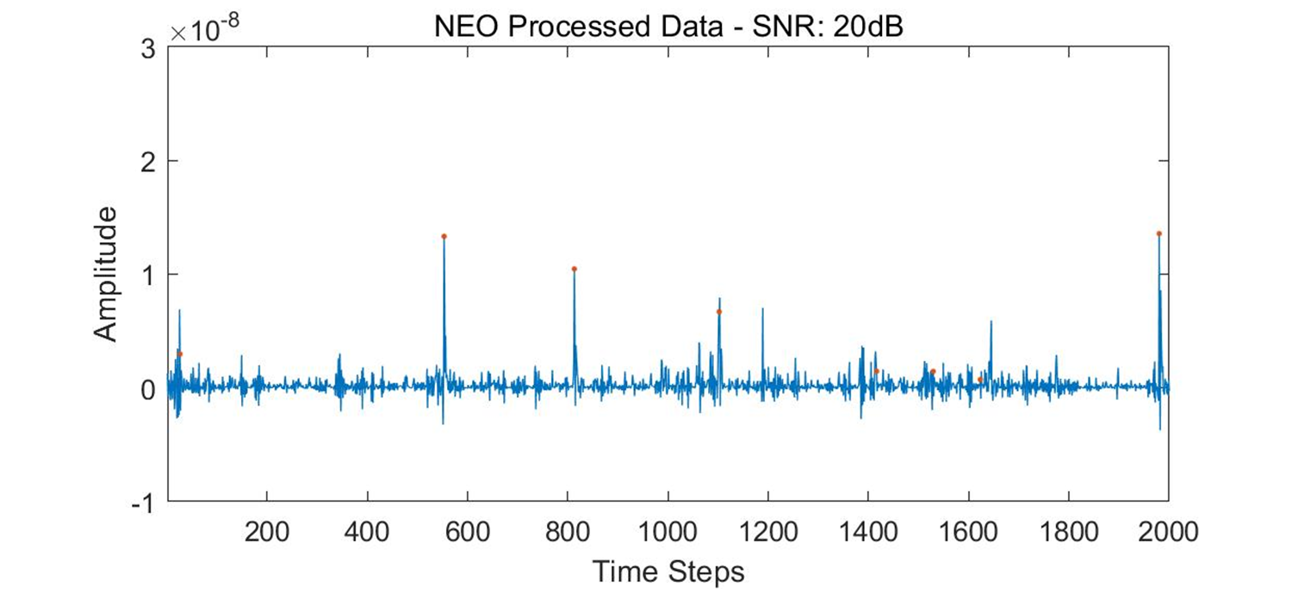
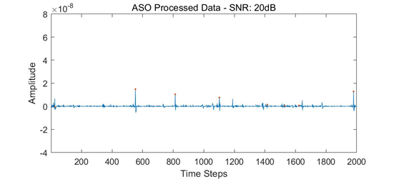
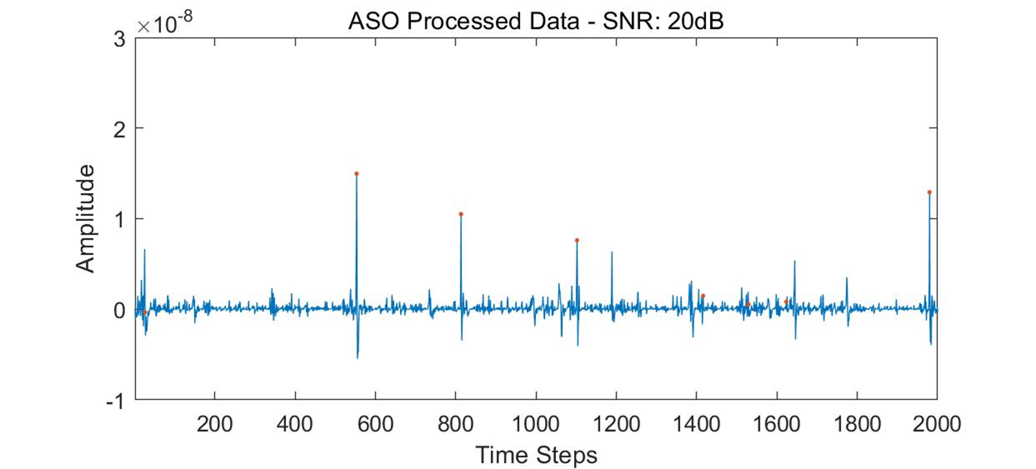
Experiment Results- SNR 20dB
Adaptive Neural Spike Detection

Slide 16
Spike Detection Performance- SNR 20dB
Adaptive Neural Spike Detection
 | Data A |  |  | Data B
 | Sens | FDR | ACC | Sens | FDR | ACC
ASO-RMS | 0.8130 | 0.2429 | 06448 | 0.7806 | 0.1824 | 0.6648
NEO-RMS | 0.7778 | 0.2632 | 0.6087 | 0.68 | 0.1959 | 0.5833
ASO-mean | 0.8025 | 0.2105 | 0.6610 | 0.7219 | 0.1757 | 0.6256
NEO-mean | 0.7733 | 0.2267 | 0.6304 | 0.6436 | 0.1824 | 0.5628
Best-Before | 0.8257 | 0.1781 | 0.6886 | 0.8414 | 0.1689 | 0.7135
$$50\%$$
$$21.6\%$$

Slide 17
Conclusion
Adaptive Neural Spike Detection
ASO is more computation-efficient.
ASO is able to give higher detection accuracy in different noise level.
The same parameters are able to adaptive to different data and noise levels.
However, when noise is large, the detection performance can be degraded.

Slide 18
Future Work
Adaptive Neural Spike Detection
Labeled Real Data
New Thresholding Scheme
Adaptive Spike Emphasis Algorithm

Slide 19
Adaptive Neural Spike Detection
Thank You

