Slide 1
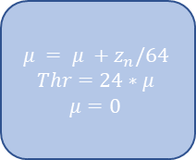
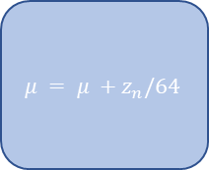
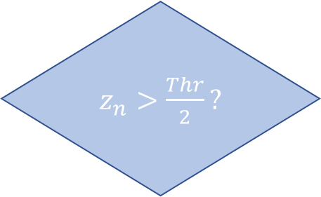
$$μ = μ +z_{n}/64$$
No
$z_{n}>\frac{Thr}{2}?$
63 Samples have been Added?
In
$$μ = μ +z_{n}/64$$
$$Thr=24∗μ$$
$μ=0$
Out
Yes
Yes
No

