Slide 1

Data Analysis and Visualization
This presentation covers data analysis and visualization tasks. It includes Tableau, Power BI, and data-driven insights.
by James Dark

Slide 2
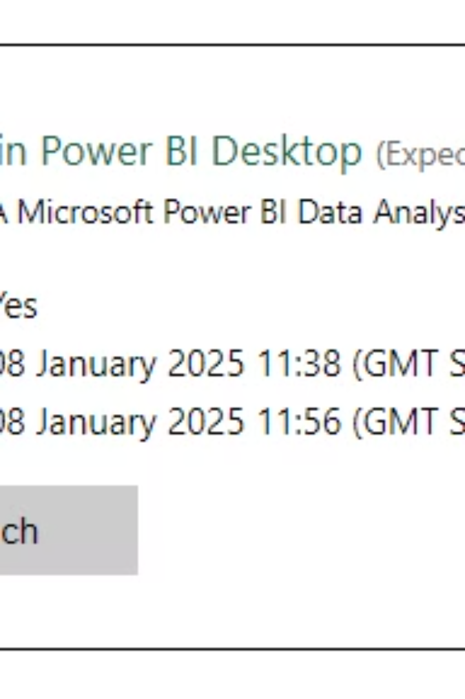

Power BI Lab 1
Get Data
Completed lab.

Slide 3

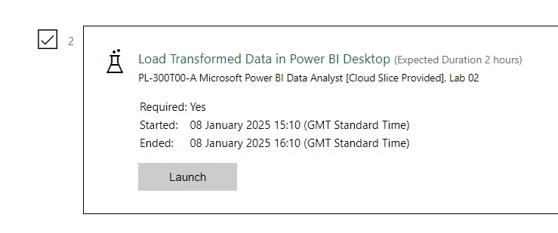
Power BI Lab 2
Load Transformed Data
Completed lab.

Slide 4

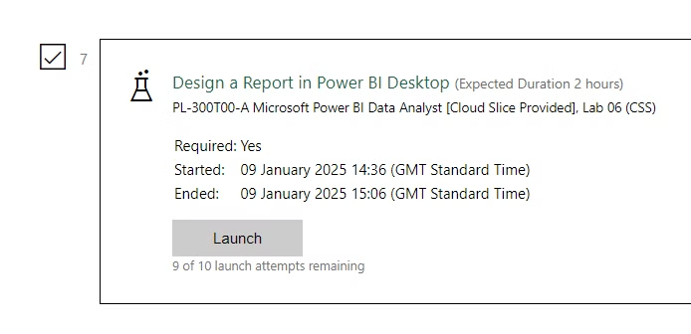
Power BI Lab 6
Design a Report
1
Completed lab.

