Slide 1

Excel Training Overview
This Excel training covered essential tools for data analysis and presentation, focusing on Pivot Tables and Visualizations.
by James Dark
Feb 2025

Slide 2
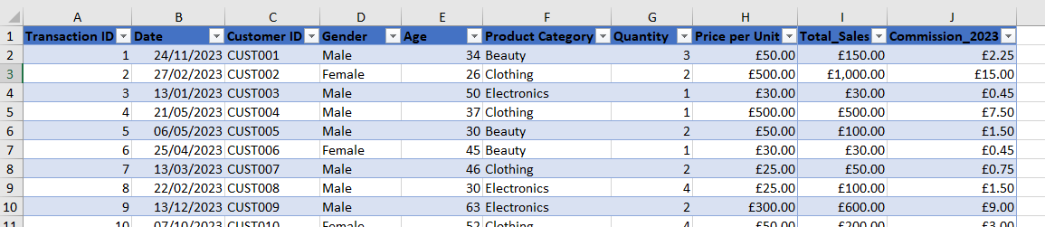
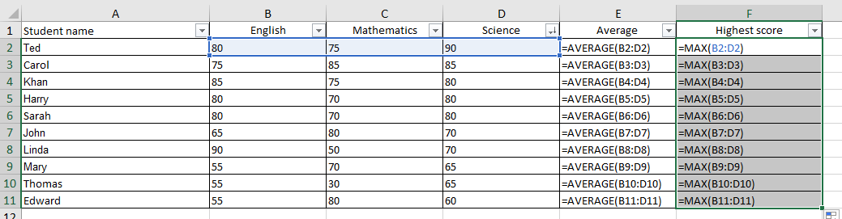
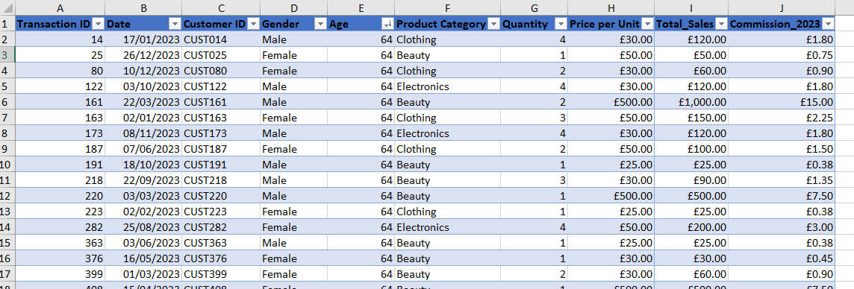
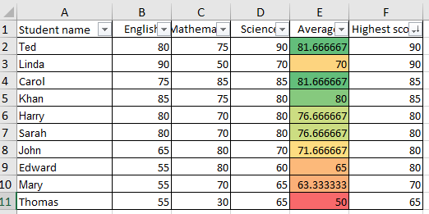
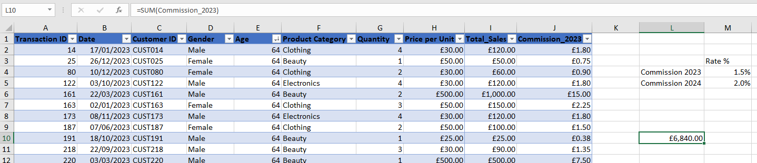
Data Analysis: Retail Sales Dataset
Task 1
Task 2
Sorting and filtering data in the retail sales dataset, calculating the total and average commission.
Analyzing student performance in a classroom dataset, identifying top performers and applying conditional formatting.

Slide 3
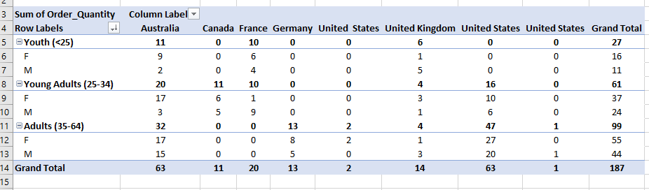
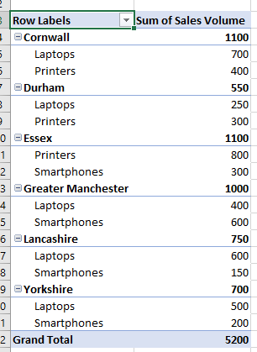
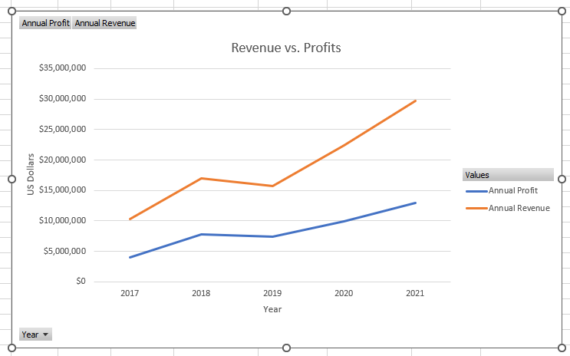
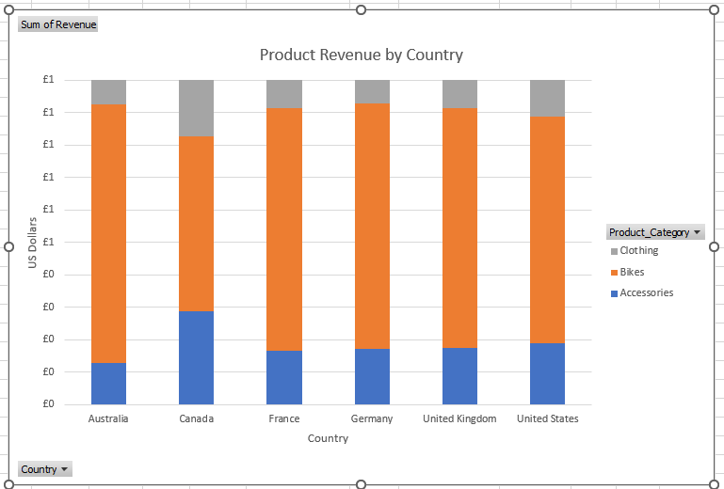
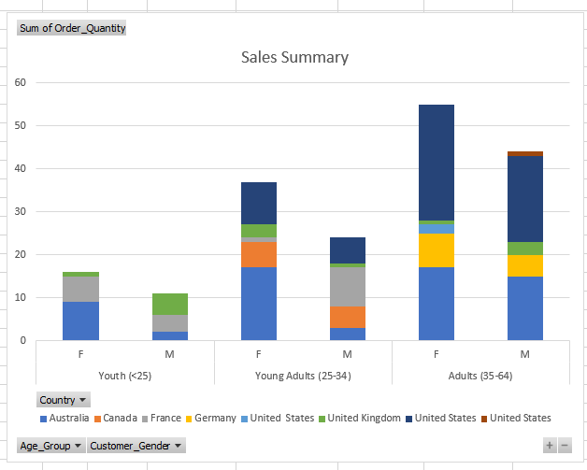
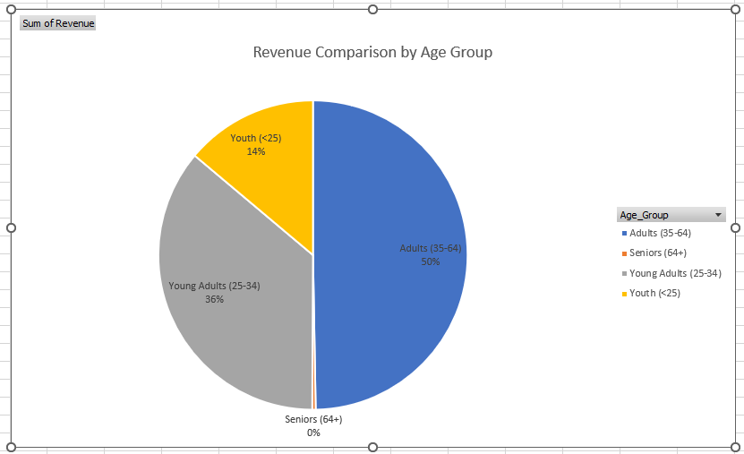
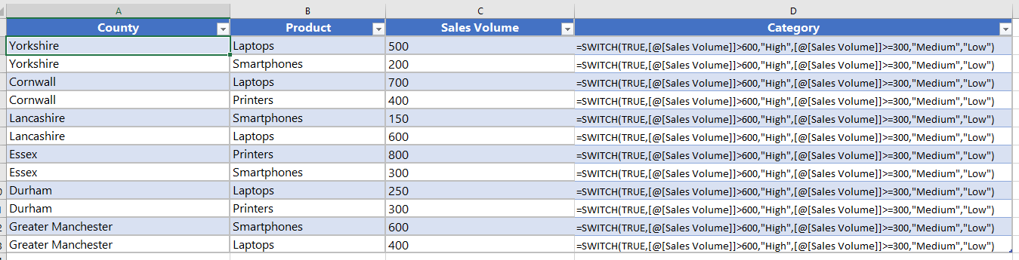
Data Visualization: Exploring Bike Sales
Task 1
Task 2
Task 3
Creating a pivot table answer questions about customer demographics and market trends.
Categorizing products based on sales volume using the SWITCH function, building a comprehensive sales summary.
Creating visualizations from a bike sales dataset, exploring key insights from the data.

