Slide 1
Rapidly Produced Audio Datasets against a CNN
Brent Redmon

Slide 2
Motive
There are few single word datasets available (GoogleAIY, SpeechCommands)
We need a way for a user to be able to rapidly produce a MVP against a single word recognition model with limited resources.
Relying on crowdsourcing for audio snippets is time consuming, and we must trust that the data we receive is valid.
Can we rapidly produce a set of audio, free of human error, and diverse enough to function suitably enough?

Slide 3
WordEnsemble
Utilizes the Selenium API to gather words from LingoJam.com at different pitches.
Sorts it into the folders in the correct format.
Caveats include the fact that there is only a male voice being used, and Selenium is a heavy piece of software.

Slide 4
Many many many Models
CNN Spectrographic analysis
VGG16 Spectrographic analysis
RNN with LSTM input
Tensorflow pre-made CNN Spectrographic Model

Slide 5
CNN Spectrographic Analysis
Dense layer with 64 nodes
Dense layer with 32 nodes
Dense layer with 32 nodes
Flatten layer
Dense layer with 2 nodes (originally trained on just 2 words)
Categorical Cross entropy, Adam optimizer, 100 epochs, alpha = .0001.
~ 38% accuracy

Slide 6
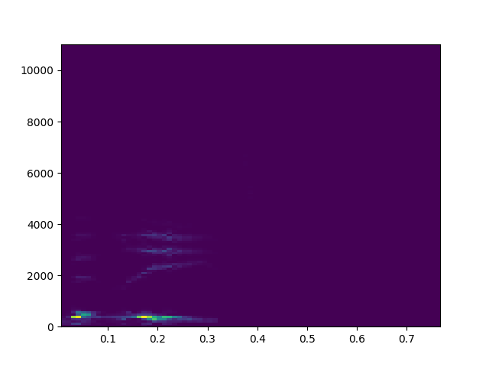
CNN Spectrographic Analysis

Slide 7
VGG16 was even worse…
Roughly 28% and decreasing
No pre-trained weights were applied
We cannot determine with our eyes what a spectrogram is supposed to represent, so ImageNet would not have anything representative

Slide 8
RNN with LSTM Input
Input LSTM with 128 nodes
Dense layer with 32 nodes
Dense layer with 64 nodes
Dense layer with 32 nodes
Dense layer with 2 nodes and softmax activation

Slide 9
RNN with LSTM Input
Trained with sparse categorical cross entropy
Accuracy remained constant each time the model was trained (32% - 45%)
Loss stayed the same as well, even after reading in the file as a string of bytes, therefore not needing to worry about normalization.

Slide 10
Tensorflow CNN Spectrographic Analysis
More versatile in how it is able to read in a dataset (time shifting, background noise incorporation, etc)
Once trained, the model outputs a pb file and a list of words, which are fed into the model once trained.

Slide 11



Tensorflow CNN Spectrographic Analysis
z
First layer uses an 8 x 20 x 64 filter (Relu)
Second layer uses a 4 x 10 x 64 filter (Relu)
2x2 Max Pooling
Converts audio into more precise spectrograms
Output Dense layer with softmax activation
Learning rate of .0001
Adam optimizer on categorical cross entropy
On 4 words, I was able to achieve 99% accuracy over 130 epochs

Slide 12
Tensorflow CNN Spectrographic Analysis

Slide 13
Difficulties
Difference in sample rate from training set vs. user input
Python cannot process compressed files

Slide 14
Frontend Web Implementation

