Slide 1

EARLY WARNING SYSTEM FOR ACUTE FOOD CRISIS
Using Climate Shocks, Market Prices & Conflict Data
👤Authors: Blex Olonde, Dennis Muriungi, Shem Omondi, Jasho Kiplangat, Valary Kones
Date: Feb 28, 2026

Slide 2

PROBLEM STATEMENT
Kenya faces recurring droughts, high food prices, and localized conflict.
Food security reports are mostly descriptive (reactive).
No integrated predictive model combining climate, market, and conflict indicators.
Need for a data-driven early warning system.

Slide 3

OBJECTIVE OF THE PROJECT
Main Goal:
Predict probability of a county entering IPC Phase 3+ (Crisis or worse)
one month ahead.
Specific Objectives:
Build a county-month dataset
Engineer lagged climate & market features
Compare ML classification models
Identify key drivers of food insecurity
Phase | Classification | Meaning
1 | Minimal | Food needs are met
2 | Stressed | Households meet minimum needs but face stress
3 | Crisis | Urgent assistance required
4 | Emergency | Severe food consumption gaps
5 | Famine | Extreme starvation and mortality risk

Slide 4

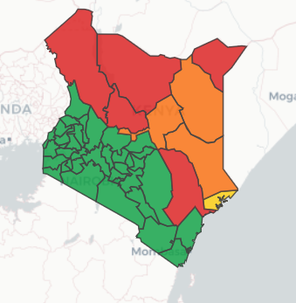
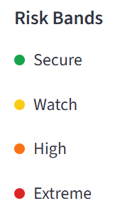
DATA SOURCES
Target Variable
Integrated Food Security Phase Classification (IPC Phases)
Predictor Variables
Climate: Rainfall anomalies, NDVI
Market: Monthly maize retail prices
Conflict: Event counts & fatalities
Panel structured as county-month dataset

Slide 5
METHODOLOGY
Data Cleaning & Harmonization
Feature Engineering (lag variables)
Train/Test Split (time-aware validation)
Models Compared:
Logistic Regression
Random Forest
XGBoost
Evaluation: Accuracy, Precision, Recall, ROC-AUC

Slide 6

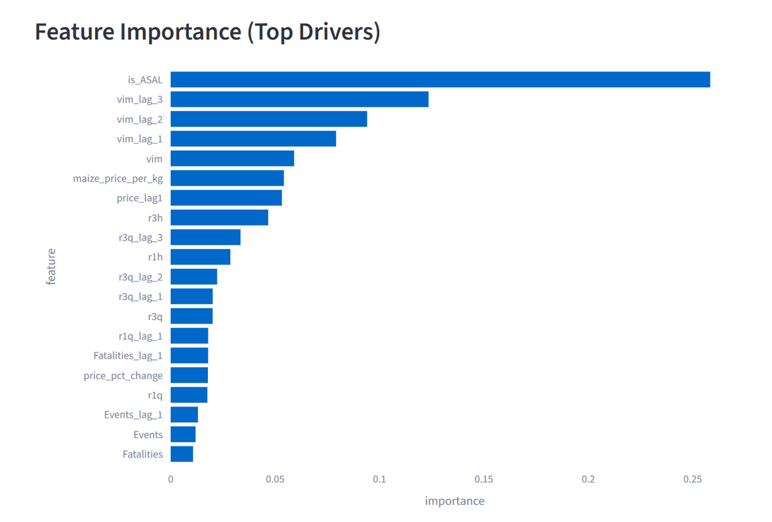
KEY RESULTS
Machine learning models improved prediction over baseline.
Climate shocks + maize price spikes strongly associated with IPC 3+.
Conflict contributes but less consistently than climate & prices.
Model can flag high-risk counties one month in advance.

Slide 7

CONCLUSION & IMPACT
Predictive analytics improves preparedness.
Supports humanitarian agencies & county governments.
Enables proactive food assistance allocation.
Scalable to other drought-prone regions in East Africa.

Slide 8


THANK YOU
www.reallygreatsite.com

