Slide 1





DATA-DRIVEN PERSPECTIVES ON A NEW FILM STUDIO
Presented By: Group 5

Slide 2



BUSINESS CHALLENGE
  New studio lacks production experience
  Uncertainty: which movies will succeed
  Need data-driven guidance

Slide 3
PROJECT GOALS
  Identify success drivers in film performance
  Link genre, budget, and ratings to outcomes
  Research focus:
  1️⃣ Ratings by genre
  2️⃣ Profitability by genre
  3️⃣ Budget vs revenue

Slide 4
DATA SOURCES & RELEVANCE
  Sources: TM Movie Budgets, TMDb Movies, IMDb Ratings
  Contain budget, revenue, genre, and rating details
  Support profitability and performance insights

Slide 5
DATA PREPARATION
  Renamed columns for consistency
  Merged datasets on movie title and ID
  Converted currency strings to numeric
  Calculated profitability ratio
  Mapped genre IDs to readable names

Slide 6
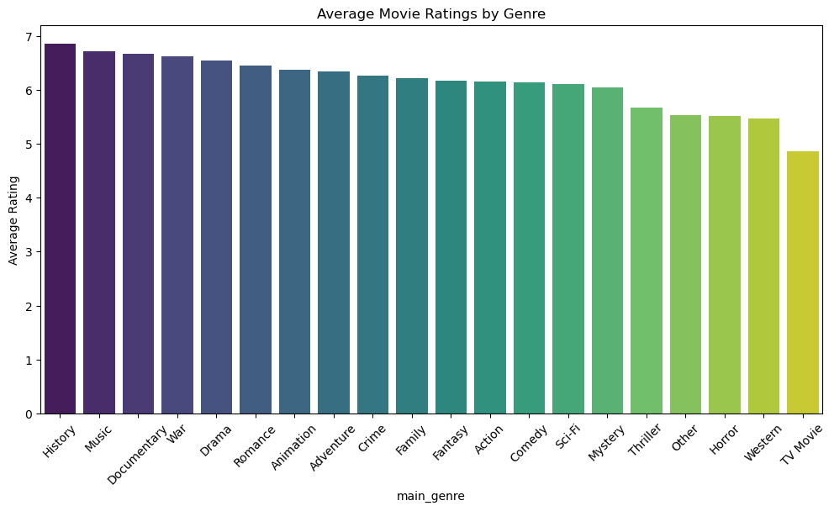
INSIGHT 1: RATINGS BY GENRE
  Genres differ in average audience ratings
  Top: History, Music, Documentary
  Lowest: TV Movies, Western, Horror
  Ratings range between 4.9 and 6.9
Your paragraph text
Your paragraph text

Slide 7
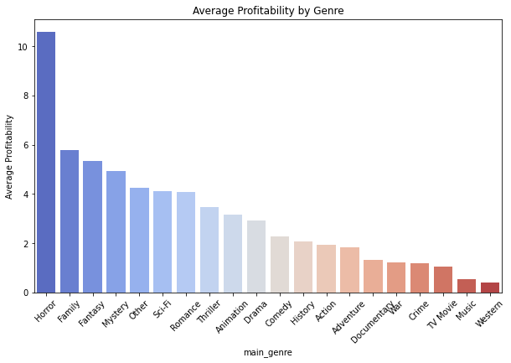
INSIGHT 2: PROFITABILITY BY GENRE
  Profitability varies widely by genre
  Top: Horror, Family, Fantasy
  Lowest: Music, Western
  Low-budget films yield higher ROI

Slide 8
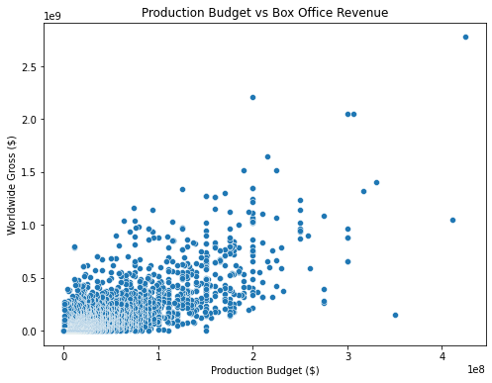
INSIGHT 3: BUDGET VS BOX OFFICE REVENUE
  Strong positive correlation (r ≈ 0.75)
  Higher budgets yield higher revenues
  ROI decreases with large budgets
  Mid-range budgets offer best balance

Slide 9
STRATEGIC RECOMMENDATIONS
  Focus on Adventure & Family genres
  Leverage low-cost Horror for growth
  Control budgets for Action/Sci-Fi
  Prioritize mid-budget productions
  Base funding on data-driven ROI

Slide 10
CONCLUSION & NEXT STEPS
  Genre and budget drive film success
  Family, Adventure, Horror = top ROI focus
  Big budgets ≠ guaranteed profits
  Use data to guide greenlight decisions
  Next: include marketing & streaming data

Slide 11
THANK YOU
For Your Attention

