Slide 1
UNDERSTANDING PROGRAM EFFICIENCY: 1
LECTURE 11
LECTURE 11

Slide 2
To day
Measuring orders of growth of algorithms
Big “Oh” notation
Complexity classes
LECTURE 11

Slide 3
WANT TO UNDERSTAND EFFICIENCY OF PROGRAMS
computers are fast and geting faster – so maybe eﬃcient programs don’t mater?
but data sets can be very large (e.g., in 2014, Google served 30,000,000,000,000 pages, covering 100,000,000 GB – how long to search brute force?)
thus, simple solutions may simply not scale with size in acceptable manner
how can we decide which option for program is most eﬃcient?
separate time and space eﬃciency of a program
tradeoﬀ between them:
can sometimes pre-compute results are stored; then use “lookup” to retrieve (e.g., memoization for Fibonacci)
will focus on time eﬃciency
LECTURE 11

Slide 4
WANT TO UNDERSTAND EFFICIENCY OF PROGRAMS
Challenges in understanding eﬃciency of solution to a computational problem:
a program can be implemented in many diﬀerent ways
you can solve a problem using only a handful of diﬀerent algorithms
would like to separate choices of implementation from choices of more abstract algorithm
LECTURE 11

Slide 5
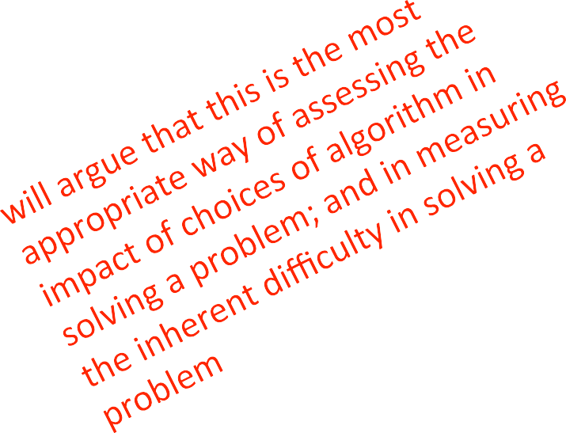
HOW TO EVALUATE EFFICIENCY OF PROGRAMS
measure with a timer
count the operations
abstract notion of order of growth
LECTURE 11

Slide 6
TIMING A PROGRAM
use time module
recall that importing means to bring in that class into your own ﬁle
start clock
call function
stop clock
import time
def c_to_f(c):
return c*9/5 + 32
t0 = time.perf_counter()
c_to_f(100000)
t1 = time.perf_counter() - t0t1,
Print("t =", t,
":",
"s,”)
LECTURE 11

Slide 7
TIMING PROGRAMS IS INCONSISTENT
GOAL: to evaluate diﬀerent algorithms
running time varies between algorithms
running time varies between implementaions
running time varies between computers
running time is not predictable based on small inputs
time varies for diﬀerent inputs but cannot really express a relationship between inputs and time
LECTURE 11

Slide 8

COUNTING OPERATIONS
assume these steps take
constantion :
mathematical operations
comparisons
assignments
accessing objects in memory
then count the number of operations executed as function of size of input
def c_to_f(c):
Return c*9.0/5 + 32
def mysum(x):
total = 0
for i in range(x+1):
total += i
return total
mysum 1+3x ops
LECTURE 11

Slide 9
COUNTING OPERATIONS IS BETTER, BUT STILL…
GOAL: to evaluate diﬀerent algorithms
count depends on algorithm
count depends on implementaions
count independent of computers
no clear deﬁnition of which operaions to count
count varies for diﬀerent inputs and can come up with a relationship between inputs and the count
LECTURE 11

Slide 10
STILL NEED A BETTER WAY
Aming and counting evaluate implementations
Aming evaluates machines
want to evaluate algorithm
want to evaluate scalability
want to evaluate in terms of input size
10

Slide 11
STILL NEED A BETTER WAY
Going to focus on idea of counting operations in an algorithm, but not worry about small variations in implementation (e.g., whether we take 3 or 4 primitive operations to execute the steps of a loop)
Going to focus on how algorithm performs when size of problem gets arbitrarily large
Want to relate time needed to complete a computation, measured this way, against the size of the input to the problem
Need to decide what to measure, given that actual number of steps may depend on speciﬁcs of trial

Slide 12
NEED TO CHOOSE WHICH INPUT TO USE TO EVALUATE A FUNCTION
want to express eﬃciency in terms of size of input, so need to decide what your input is
could be an integer
-- mysum(x)
could be length of list
-- list_sum(L)
you decide when multiple partimeters to a function
-- search_for_elmt(L, e)

Slide 13
DIFFERENT INPUTS CHANGE HOW THE PROGRAM RUNS
a function that searches for an element in a list
def search_for_elmt(L, e): for i in L:
if i == e:
return True False
return
when e is ﬁrst element in the list BEST CASE
when e is not in list WORST CASE
when look through about half of the elements in list AVERAGE CASE
want to measure this behavior in a general way

Slide 14

BEST, AVERAGE, WORST CASES
suppose you are given a list L of some length len(L)
best case: minimum running time over all possible inputs of a given size, len(L)
constant for search_for_elmt
ﬁrst element in any list
average case: average running time over all possible inputs of a given size, len(L)
practical measure
worst case: maximum running time over all possible inputs of a given size, len(L)
linear in length of list for search_for_elmt
must search enAre list and not ﬁnd it

Slide 15
ORDERS OF GROWTH
Goals:
want to evaluate program’s eﬃciency when input is very big
want to express the growth of program’s runtime as input size grows
want to put an upper bound on growth – as tight as possible
do not need to be precise: “order of” not “exact” growth
we will look at largest factors in run time (which section of the program will take the longest to run?)
thus, generally we want tight upper bound on growth, as function of size of input, in worst case

Slide 16
MEASURING ORDER OF GROWTH: BIG OH NOTATION
Big Oh notation measures an upper bound on the asymptotic growth, oien called order of growth
Big Oh or O() is used to describe worst case
worst case occurs oien and is the boLleneck when a program runs
express rate of growth of program relative to the input size
evaluate algorithm NOT machine or implementation

Slide 17
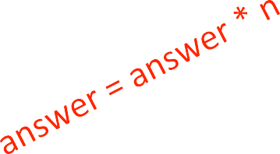
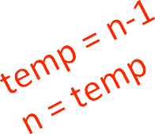
EXACT STEPS vs O()
def fact_iter(n):
"""assumes n an int answer = 1
while n > 1:
>= 0"""
answer *= n n -= 1
return answer
computes factorial
number of steps:
worst case asymptoAc complexity:
ignore addiAve constants
ignore mulAplicaAve constants

Slide 18
WHAT DOES O(N) MEASURE?
Interested in describing how amount of time needed grows as size of (input to) problem grows
Thus, given an expression for the number of operations needed to compute an algorithm, want to know asymptoAc behavior as size of problem gets large
Hence, will focus on term that grows most rapidly in a sum of terms
And will ignore mulAplicaAve constants, since want to know how rapidly time required increases as increase size of input

Slide 19
SIMPLIFICATION EXAMPLES
drop constants and mulAplicaAve factors
focus on dominant terms
)
: n²+ 2n + 2
: n² + 100000n +3¹⁰⁰⁰
: log(n) + n + 4
:0.0001*n*log(n) +300n
:_{2n}30 + ₃n
2
O(n
)
2
O(n
O(n)
O(n log n)
)
n
O(3

Slide 20
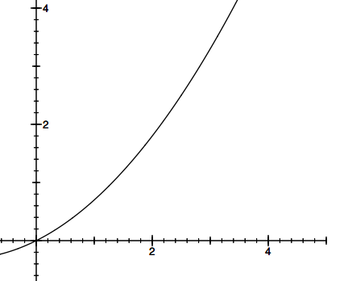
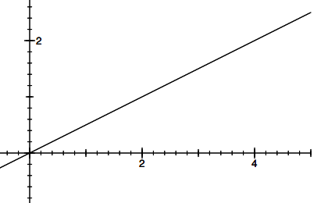



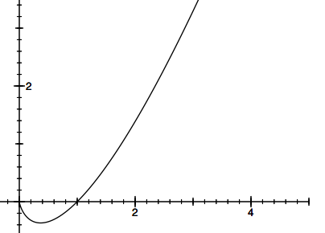
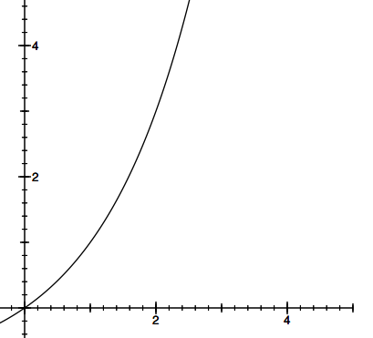
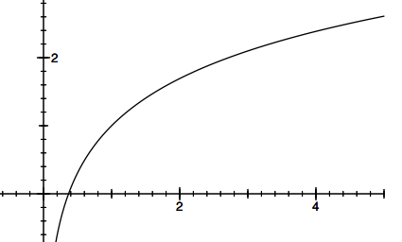
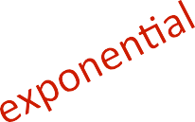
TYPES OF ORDERS OF GROWTH
20

Slide 21
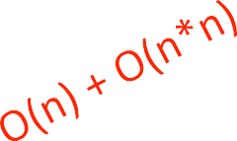
ANALYZING PROGRAMS AND THEIR COMPLEXITY
combine complexity classes
analyze statements inside functions
apply some rules, focus on dominant term
Law of Addi!on for O():
used with sequen!al statements
• O(f(n)) + O(g(n)) is O( f(n) + g(n) )
for example,
for i in range(n): print('a')
for j in range(n*n):
print('b')
is O(n) + O(n*n) = O(n+n²) = O(n²) because of dominant term
21

Slide 22
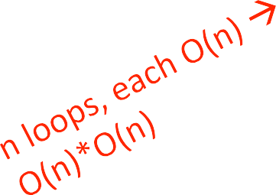
ANALYZING PROGRAMS AND THEIR COMPLEXITY
combine complexity classes
analyze statements inside functions
apply some rules, focus on dominant term
Law of Mul!plica!on for O():
used with nested statements/loops
• O(f(n)) * O(g(n)) is O( f(n) * g(n) )
for example,
for i in range(n):
for j in range(n): print('a')
is O(n)*O(n) = O(n*n) = O(n²) because the outer loop goes n times and the inner loop goes n times for every outer loop iter.

Slide 23
COMPLEXITY CLASSES
O(1) denotes constant running time
O(log n) denotes logarithmic running time
O(n) denotes linear running time
O(n log n) denotes log-linear running time
O(n^{c}) denotes polynomial running time (c is a constant)
O(c^{n}) denotes exponenAal running time (c is a constant being raised to a power based on size of input)

Slide 24
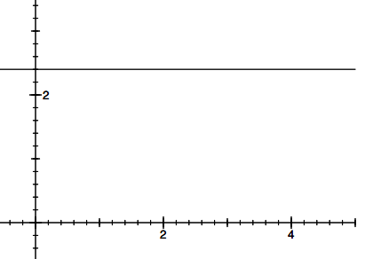

COMPLEXITY CLASSES ORDERED LOW TO HIGH
O(1):
O(log n):
O(n):
O(n log n):
O(n^{c}):
O(c^{n}):
constant
Logarithmic
linear
Loglinear
polynomial
exponenAal

Slide 25

COMPLEXITY GROWTH
CLASS | n=10 | = 100 | = 1000 | = 1000000
O(1) | 1 | 1 | 1 | 1
O(log n) | 1 | 2 | 3 | 6
O(n) | 10 | 100 | 1000 | 1000000
O(n log n) | 10 | 200 | 3000 | 6000000
O(n^2) | 100 | 10000 | 1000000 | 1000000000000
O(2^n) | 1024 | 12676506 | 1071508607186267320948425049060 | Good luck!!
 |  | 00228229 | 0018105614048117055336074437503
 |  | 40149670 | 8837035105112493612249319837881
 |  | 3205376 | 5695858127594672917553146825187
 |  |  | 1452856923140435984577574698574
 |  |  | 8039345677748242309854210746050
 |  |  | 6237114187795418215304647498358
 |  |  | 1941267398767559165543946077062
 |  |  | 9145711964776865421676604298316
 |  |  | 52624386837205668069376

Slide 26
LINEAR COMPLEXITY
Simple iterative loop algorithms are typically linear in complexity

Slide 27
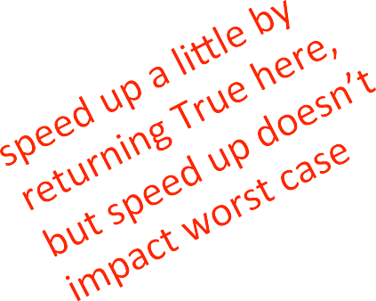
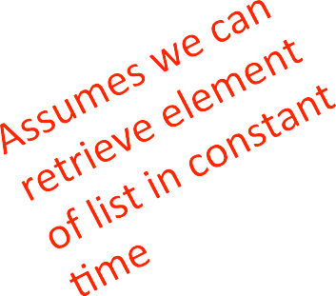
LINEAR SEARCH ON UNSORTED LIST
def linear_search(L, e): found = False
for i in range(len(L)): if e == L[i]:
found = True return found
must look through all elements to decide it’s not there
O(len(L)) for the loop * O(1) to test if e == L[i]
◦ O(1 + 4n + 1) = O(4n + 2) = O(n)
overall complexity is O(n) – where n is len(L)
LECTURE 12

Slide 28
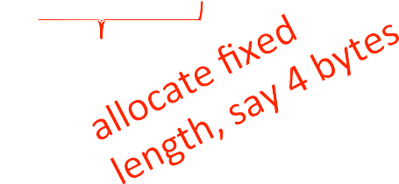


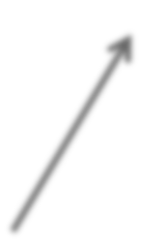
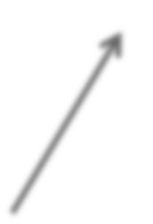
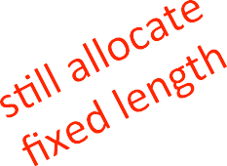


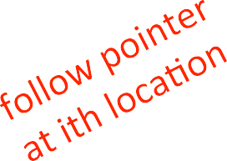


CONSTANT TIME LIST ACCESS
if list is all ints
i^{th} element at
base + 4*i
if list is heterogeneous
indirection
references to other objects
…
…
LECTURE 12

Slide 29

LINEAR SEARCH ON SORTED LIST
def search(L, e):
for i in range(len(L)):
if L[i] == e:
return True if L[i] > e:
return False
False
return
must only look until reach a number greater than e
O(len(L)) for the loop * O(1) to test if e == L[i]
overall complexity is O(n) – where n is len(L)
NOTE: order of growth is stime, though run time may diﬀer for two search methods
LECTURE 12

Slide 30
LINEAR COMPLEXITY
searching a list in sequence to see if an element is present
add characters of a string, assumed to be composed of decimal digits
def addDigits(s):
val | = | 0
for | c | in | s:
val+= int(c)
return val
O(len(s))
30

Slide 31
LINEAR COMPLEXITY
complexity oien depends on number of iterations
def fact_iter(n): prod = 1
for i in range(1, n+1): prod *= i
return prod
number of times around loop is n
number of operations inside loop is a constant (in this case, 3 – set i, mulAply, set prod)
◦ O(1 + 3n + 1) = O(3n + 2) = O(n)
overall just O(n)

Slide 32
NESTED LOOPS
simple loops are linear in complexity
what about loops that have loops within them?

Slide 33
QUADRATIC COMPLEXITY
determine if one list is subset of second, i.e., every element of ﬁrst, appears in second (assume no duplicates)
def isSubset(L1, L2):
for e1 in L1:
matched =
False L2:
for e2 in
if e1
== e2:
matched break
= True
if not matched: return False
return
True

Slide 34
QUADRATIC COMPLEXITY
def isSubset(L1, L2): for e1 in L1:
outer loop executed len(L1)
times
each iteration will execute inner loop up to len(L2) times, with constant number of operations
O(len(L1)*len(L2))
worst case when L1 and L2 stime length, none of elements of L1 in L2
O(len(L1)²)
matched for e2
if
= False in L2:
e1 == e2:
matched = break
matched:
True
if not
return False return True

Slide 35
QUADRATIC COMPLEXITY
ﬁnd intersection of two lists, return a list with each element appearing only once
def intersect(L1, L2):
tmp = []
for e1 in L1:
in
for e2
L2:
== e2:
if e1
tmp.append(e1)
res | = | []
for | e | in | tmp:
if not(e in res): res.append(e)
res
return

Slide 36
QUADRATIC COMPLEXITY
def intersect(L1, L2): tmp = []
for e1 in L1:
tmp.append(e1)
res = []
for e in tmp:
if not(e in res): res.append(e)
return res
ﬁrst nested loop takes
len(L1)*len(L2) steps
second loop takes at most len(L1) steps
determining if element in list might take len(L1) steps
if we assume lists are of roughly stime length, then
O(len(L1)^2)
for e2 | in | L2:
if | e1 | == e2:

Slide 37
O() FOR NESTED LOOPS
def g(n):
""" assume n >= 0 """ x = 0
for i in
range(n):
for j in
x += 1
return x
range(n):
computes n² very ineﬃciently
when dealing with nested loops, look at the ranges
nested loops, each iterating n times
O(n²)

Slide 38
THIS TIME AND NEXT TIME
have seen examples of loops, and nested loops
give rise to linear and quadratic complexity algorithms
next time, will more carefully examine examples from each of the diﬀerent complexity classes

