Slide 1
BRANCHING,
ITERATION
LECTURE 2
LECTURE 2

Slide 2
LAST TIME
syntax and semantics
scalar objects
simple operations
expressions, variables and values
LECTURE 2

Slide 3
TODAY
string object type
branching and conditionals
indentation
iteration and loops
LECTURE 2

Slide 4
STRINGS
letters, special characters, spaces, digits
enclose in quotation marks or single quotes
hi = "hello there"
concatenate strings
name = "ana"
greet = hi + name
greeting = hi + " " + name
do some operations on a string as defined in Python docs
silly = hi + " " + name * 3
LECTURE 2

Slide 5
INPUT/OUTPUT: print
used to output stuff to console
keyword is print
x = 1
print(x)
x_str = str(x)
print("my fav num is", print("my fav num is " | x, ".", + x_str | "x =", x) + ". " + "x = " + x_str)
LECTURE 2

Slide 6
INPUT/OUTPUT: input("")
prints whatever is in the quotes
user types in something and hits enter
binds that value to a variable
text = input("Type anything... ") print(5*text)
input
gives you a string so must cast if working
with numbers
num =
int(input("Type
a number... "))
print(5*num)
LECTURE 2

Slide 7
COMPARISON OPERATORS ON
int, float, string
i and j are variable names
comparisons below evaluate to a Boolean
i > j i >= j i < j
i <= j
i == j → equality test, True if i is the same as j
i != j → inequality test, True if i not the same as j
LECTURE 2

Slide 8
LOGIC OPERATORS ON bools
a and b are variable names (with Boolean values)
not a →
True if a is False False if a is True
a and b → True if both are True
a or b → True if either or both are True
A | B | A and B | A or B
True | True | True | True
True | False | False | True
False | True | False | True
False | False | False | False
LECTURE 2

Slide 9
COMPARISON EXAMPLE
pset_time = 15
sleep_time = 8 print(sleep_time
> pset_time)
derive = True drink = False both = drink and print(both)
derive
LECTURE 2

Slide 10
If right clear, go right
If right blocked, go forward
If right and front blocked,
go left
If right , front, left blocked,
go back

Slide 11
CONTROL FLOW - BRANCHING
if <condition>:
<expression>
<expression>
...
if <condition>:
<expression>
<expression>
...
elif <condition>:
<expression>
<expression>
...
else:
<expression>
<expression>
...
if <condition>:
<expression>
<expression>
...
else:
<expression>
<expression>
...
<condition> has a value True or False
evaluate expressions in that block if <condition> is True
11

Slide 12
INDENTATION
matters in Python
how you denote blocks of code
x = float(input("Enter a number | for | x: | "))
y = float(input("Enter a number | for | y: | "))
if x == y:
print("x and y are equal") if y != 0::
 | print("therefore, x / y is", x/y)
print("x
and y are
equal"
if y != 0
print("therefore
, x / y is",
x/y
elif x < y:
print("x is smaller") else:
print("y is smaller") print("thanks!")
print("x
is
smaller"
print("y
is
smaller"

Slide 13
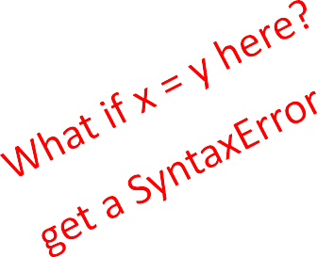
= vs ==
x = float(input("Enter a number y = float(input("Enter a number if x == y:
print("x and y are equal") if y != 0:
for x: "))
for y: "))
print("therefore, x / y y:
is",
x/y)
elif x <
print("x else:
print("y
is smaller")
is smaller")
print("thanks!")

Slide 14
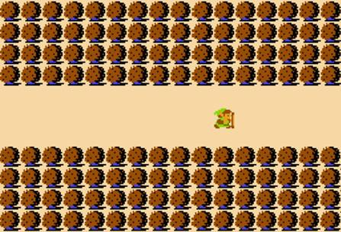
Legend of Zelda – Lost Woods
keep going right, takes you back to this same screen, stuck in a loop
Image Courtesy Nintendo, All Rights Reserved. This content is excluded from our Creative Commons license. For more information, see http://ocw.mit.edu/help/faq-fair-use/.
if <exit right>:
<set background to woods_background if <exit right>::
<set background to woods_background if <exit right>:
set background to woods_background
and so on and on and on... else:
set background to exit_background
else:
<set background to exit_background
else:
<set background to exit_background
<set background to
woods_background
>
if <exit right>
<set background to
woods_background
>
if
<exit right>
<
set background to
woods_background
>
and so on and on and on..
else
<
set background to
exit_background
>
else
<set background to
exit_background
>
<set background to
exit_background
>

Slide 15
Legend of Zelda – Lost Woods
keep going right, takes you back to this same screen, stuck in a loop
Word Cloud copyright unknown, All Right Reserved. This content is excluded from our Creative Commons license. For more information, see http://ocw.mit.edu/help/faq-fair-use/.
while <exit right>:
<set background to woods_background
<set background to exit_background>
<set background to
woods_background
>

Slide 16
CONTROL FLOW:
while LOOPS
while <condition>:
<expression>
<expression>
...
<condition>
evaluates to a Boolean
if <condition> is True, do all the steps inside the while code block
check <condition> again
repeat until <condition>
is False

Slide 17
while LOOP EXAMPLE
You are in the Lost
************
************
☺
************
************
Go left or right?
Forest.
PROGRAM:
n = input("You're in the Lost Forest. Go left or right? ")
while n == "right":
n = input("You're in the Lost Forest. Go left or right? ") print("You got out of the Lost Forest!")

Slide 18
CONTROL FLOW:
while and for LOOPS
iterate through numbers in a sequence
# more complicated with while n = 0
while n < 5:
loop
print(n) n = n+1
# shortcut with for
loop
for n in range(5): print(n)

Slide 19
CONTROL FLOW: for LOOPS
for <variable> in
<expression>
<expression>
...
range(<some_num>):
each time through the loop, <variable>
takes a value
first time, <variable> starts at the smallest value
next time, <variable>
etc.
gets the prev value + 1

Slide 20
range(start,stop,step)
default values are start
= 0 and step = 1 and optional
- 1
loop until value is stop
mysum = 0 for i
in range(7,
10):
mysum += i print(mysum)
mysum = 0 for i
in range(5,
11, 2):
mysum += i print(mysum)
20

Slide 21
break STATEMENT
immediately exits whatever loop it is in
skips remaining expressions in code block
exits only innermost loop!
while
<condition_1>:
while <condition_2>:
<expression_a>
break
<expression_b>
<expression_c>

Slide 22
break STATEMENT
mysum | = 0
for i | in | range(5, | 11, | 2):
mysum |  |  |  |  | =
if |  | mysum |  |  |  | == | 5:
mysum
+=
i
if
mysum
== 5
break mysum += 1
print(mysum)
what happens in this program?
break

Slide 23
VS while LOOPS
for
for loops
know number of iterations
can end early via
break
uses a counter
can rewrite a for
while loops
unbounded number of iterations
can end early via break
can use a counter but must initialize before loop and increment it inside loop
may not be able to rewrite a while loop using a for loop
loop
using a while loop

