Slide 1
DECOMPOSITION, ABSTRACTION,
FUNCTIONS
LECTURE 4
LECTURE 4
1

Slide 2
LAST TIME
while loops vs for loops
should know how to write both kinds
should know when to use them
guess-and-check and approximation methods
bisection method to speed up programs
LECTURE 4
2

Slide 3
TODAY
structuring programs and hiding details
functions
specifications
keywords: return vs print
scope
LECTURE 4
3

Slide 4
HOW DO WE WRITE CODE?
so far…
covered language mechanisms
know how to write different files for each computation
each file is some piece of code
each code is a sequence of instructions
problems with this approach
easy for small-scale problems
messy for larger problems
hard to keep track of details
how do you know the right info is supplied to the right part of code
LECTURE 4
4

Slide 5
GOOD PROGRAMMING
more code not necessarily a good thing
measure good programmers by the amount of functionality
introduce functions
mechanism to achieve decomposition and abstraction
LECTURE 4
5

Slide 6
EXAMPLE – PROJECTOR
a projector is a black box
don’t know how it works
know the interface: input/output
connect any electronic to it that can communicate with that input
black box somehow converts image from input source
to a wall, magnifying it
ABSTRACTION IDEA: do not need to know how projector works to use it
LECTURE 4
6

Slide 7
EXAMPLE – PROJECTOR
projecting large image for Olympics decomposed into
separate tasks for separate projectors
each projector takes input and produces separate output
all projectors work together to produce larger image
DECOMPOSITION IDEA: different devices work together to achieve an end goal
LECTURE 4
7

Slide 8
APPLY THESE CONCEPTS
TO PROGRAMMING!
LECTURE 4
8

Slide 9
CREATE STRUCTURE with
DECOMPOSITION
in projector example, separate devices
in programming, divide code into modules
are self-contained
used to break up code
intended to be reusable
keep code organized
keep code coherent
this lecture, achieve decomposition with functions
in a few weeks, achieve decomposition with classes
LECTURE 4
9

Slide 10
SUPRESS DETAILS with
ABSTRACTION
in projector example, instructions for how to use it are
sufficient, no need to know how to build one
in programming, think of a piece of code as a black box
cannot see details
do not need to see details
do not want to see details
hide tedious coding details
achieve abstraction with function specifications or
docstrings
10

Slide 11
FUNCTIONS
write reusable pieces/chunks of code, called functions
functions are not run in a program until they are “called” or “invoked” in a program
function characteristics:
has a name
has parameters (0 or more)
has a docstring (optional but recommended)
has a body
returns something

Slide 12
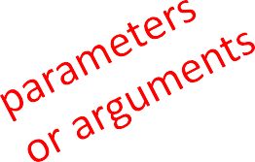
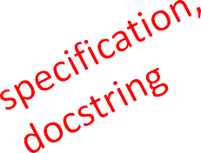
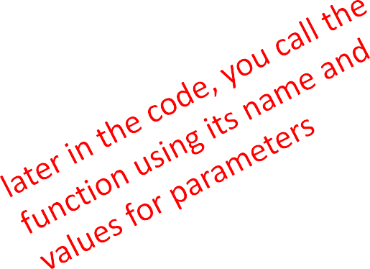
HOW TO WRITE and
CALL/INVOKE A FUNCTION
def is_even( i ):
"""
Input: Returns
"""
i, a positive int
True if i
is even, otherwise
False
print("inside return i%2 ==
is_even") 0
is_even(3)

Slide 13

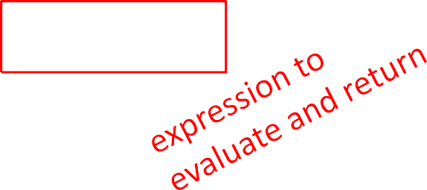
IN THE FUNCTION BODY
def is_even( i ): """
Input: Returns """
i, a positive int
True if
i is even, otherwise
False
print("inside is_even") return i%2 == 0

Slide 14
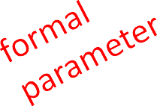
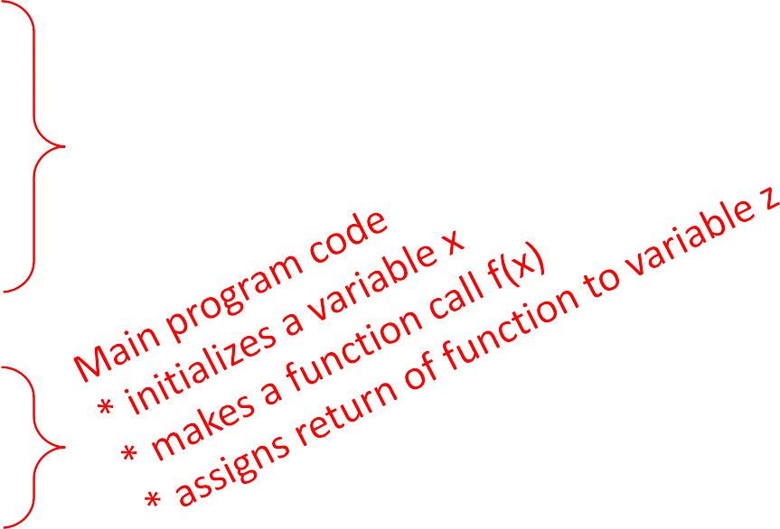
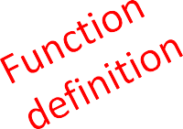
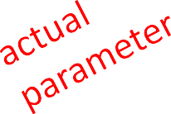
VARIABLE SCOPE
formal parameter gets bound to the value of
actual parameter when function is called
new scope/frame/environment created when enter a function
scope is mapping of names to objects
def f( x ):
x = x + 1
print('in return x
f(x): x
=', x)
x | = | 3
z | = | f( | x | )

Slide 15
VARIABLE SCOPE
def f( x ):
x = x + 1
Global scope f
xz
f scope x
print('in return x
f(x): x
=', x)
Some code
3
3
x | = | 3
z | = | f( x | )

Slide 16

VARIABLE SCOPE
def f( x ):
x = x + 1
Global scope f
x z
f scope x
Some code
4
print('in return x
f(x): x
=', x)
3
x | = | 3
z | = | f( x | )

Slide 17
VARIABLE SCOPE
def f( x ):
x = x + 1
Global scope f
x z
f scope x
returns 4
Some code
4
print('in return x
f(x): x
=', x)
3
x | = | 3
z | = | f( x | )

Slide 18
VARIABLE SCOPE
def f( x ):
x = x + 1
Global scope
f
Some code
print('in return x
f(x): x
=', x)
3
x
4
x | = | 3
z | = | f( x | )
z

Slide 19
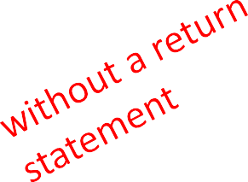
ONE WARNING IF NO
return STATEMENT
def is_even( i ):
"""
Input: i, a positive int
Does not return anything
"""
i%2 == 0
Python returns the value None, if no return given
represents the absence of a value

Slide 20
return vs.
print
return only has meaning
inside a function
only one return executed inside a function
code inside function but after return statement not executed
has a value associated with it, given to function caller
print can be used outside
functions
can execute many print statements inside a function
code inside function can be executed after a print statement
has a value associated with it, outputted to the console
20

Slide 21
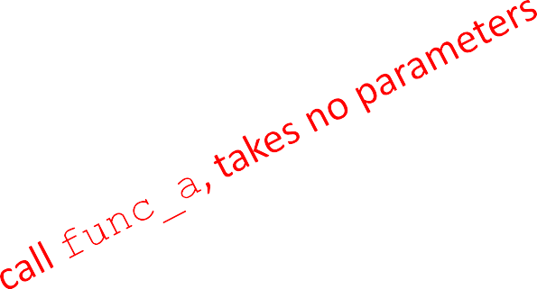
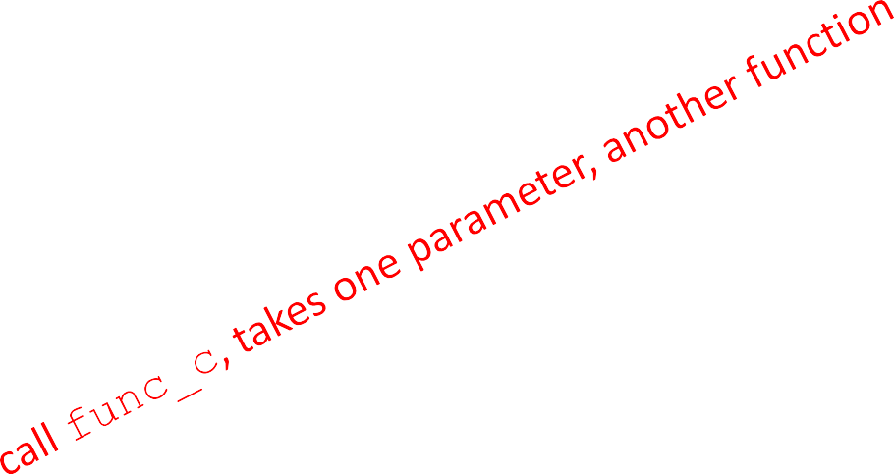
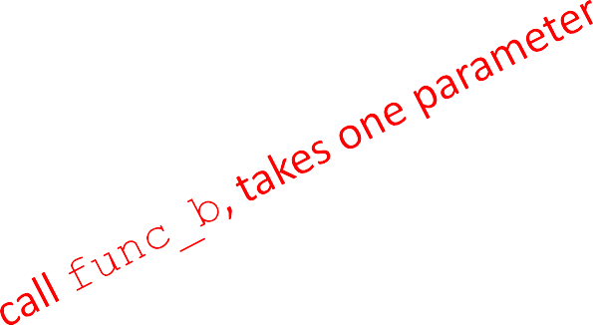
FUNCTIONS AS ARGUMENTS
arguments can take on any type, even functions
def func_a():
print 'inside def func_b(y):
print 'inside return y
def func_c(z):
print 'inside return z()
func_a'
func_b'
func_c'
print func_a() print 5 + func_b(2) print func_c(func_a)

Slide 22
FUNCTIONS AS ARGUMENTS
Global scope func_a scope
def def def | func_a(): print 'inside func_b(y): print 'inside return y func_c(z): | func_b'
 | print 'inside return z() | func_c'
func_a
Some code
Some code
func_b
Some code
func_c
None
returns None
print
func_a()
print print
5 + func_b(2) func_c(func_a)

Slide 23
FUNCTIONS AS ARGUMENTS
Global scope func_b scope
def func_a():
print 'inside def func_b(y):
print 'inside return y
def func_c(z):
print 'inside return z()
Some
code
2
func_a
y
func_a'
Some code
func_b
func_b'
Some code
func_c
func_c'
None
print print print
func_a()
5 + func_b(2) func_c(func_a)
7
returns 2

Slide 24
FUNCTIONS AS ARGUMENTS
Global scope
func_c scope
def | func_a():
 | print 'inside | func_a'
def | func_b(y):
 | print 'inside | func_b'
 | return y
def | func_c(z): print 'inside | func_c'
Some
code
func_a
func_a
z
Some code
func_b
func_a scope
Some code
func_c
None
return z()
7
returns None
print print print
func_a()
5 + func_b(2)
func_c(func_a)
None
returns None

Slide 25
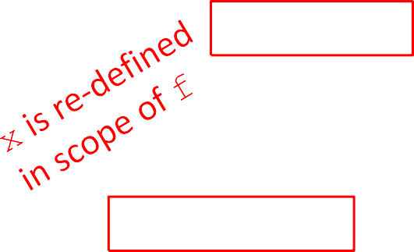

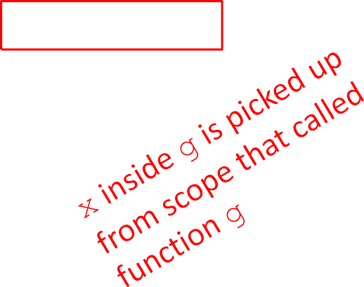
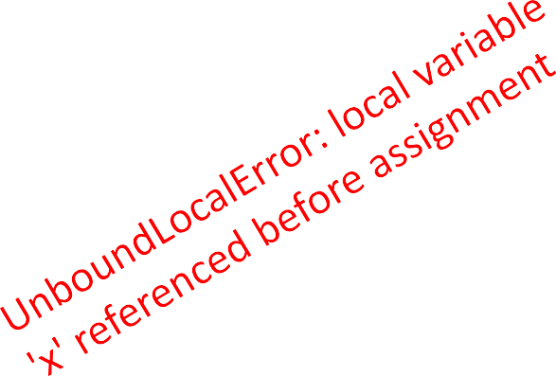
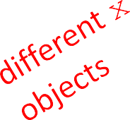
SCOPE EXAMPLE
inside a function, can access a variable defined outside
inside a function, cannot modify a variable defined outside -- can using global variables, but frowned upon
def f(y): def g(y): def h(y): x = 1 print(x) x += 1
x += 1 print(x + 1) print(x) x = 5
x = 5 g(x) print(x)
h(x) print(x)
x = 5 f(x) print(x)
25

Slide 26
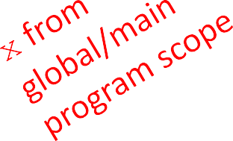
SCOPE EXAMPLE
inside a function, can access a variable defined outside
inside a function, cannot modify a variable defined outside -- can using global variables, but frowned upon
def f(y): def
g(y): def h(y): print(x) x += 1
x = 5
x = 1
x += 1
print(x)
x = 5 h(x)
x = 5 f(x)
g(x) print(x)
print(x)
print(x)

Slide 27
HARDER SCOPE EXAMPLE
IMPORTANT
and TRICKY!
Python Tutor is your best friend to help sort this out!
http://www.pythontutor.com/

Slide 28
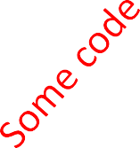
SCOPE DETAILS
def g(x):
def h():
x = 'abc' x = x + 1
Global scope
g
x
z
Some code
3
print('g: h() return x
x =', x)
x | = | 3
z | = | g(x)

Slide 29
SCOPE DETAILS
def g(x):
def h():
Global scope
g
x
z
g scope
x
h
Some code
3
x = 'abc' x = x + 1
3
Some code
print('g: h() return x
x =', x)
x = 3
z = g(x)

Slide 30

SCOPE DETAILS
def g(x):
def h():
Global scope
g
x
z
g scope
x
h
Some code
43
x = 'abc' x = x + 1
3
Some code
print('g: h() return x
x =', x)
x = 3
z = g(x)
30

Slide 31
SCOPE DETAILS
def g(x):
def h():
Global scope
g
x
z
g scope
x
h
h scope
x
returns None
Some code
3
4
“abc”
x = 'abc' x = x + 1
3
Some code
print('g: h() return x
x =', x)
x = 3
z = g(x)

Slide 32
SCOPE DETAILS
def g(x):
def h():
x = 'abc' x = x + 1
Global scope g scope
g
Some code
x
4
3
Some code
print('g: h() return x
x =', x)
x
h
None
z
x = 3
z = g(x)
returns 4

Slide 33
SCOPE DETAILS
def g(x):
def h():
Global scope
g
Some code
x = 'abc' x = x + 1
3
print('g: h() return x
x =', x)
x
4
z
x = 3
z = g(x)

Slide 34
DECOMPOSITION &
ABSTRACTION
powerful together
code can be used many times but only has to be debugged once!

