Slide 1
RECURSION, DICTIONARIES
LECTURE 6
LECTURE 6

Slide 2
QUIZ PREP
a paper and an online component
open book/notes
not open Internet, not open computer
start prinSng out whatever you may want to bring
LECTURE 6

Slide 3
LAST TIME
tuples - immutable
lists - mutable
aliasing, cloning
mutability side eﬀects

Slide 4
TODAY
recursion – divide/decrease and conquer
dicSonaries – another mutable object type

Slide 5
RECURSION
Recursion is the process of repeating
items in a self-similar way.

Slide 6
WHAT IS RECURSION?
Algorithmically: a way to design solutions to problems by divide-and-conquer or decrease-and-conquer
reduce a problem to simpler versions of the same problem
Semantically: a programming technique where a
function calls itself
in programming, goal is to NOT have inﬁnite recursion
must have 1 or more base cases that are easy to solve
must solve the same problem on some other input with the goal of simplifying the larger problem input

Slide 7
ITERATIVE ALGORITHMS SO FAR
looping constructs (while and for loops) lead to
iterative algorithms
can capture compution in a set of state variables
that update on each iteration through loop

Slide 8



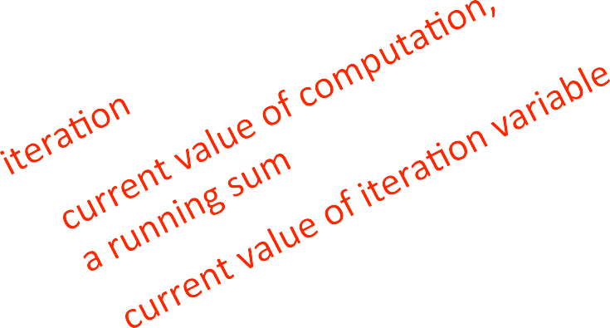
MULTIPLICATION – ITERATIVE SOLUTION
“multiply a * b” is equivalent to “add a to itself b times”
capture state by
an iteration number (i) starts at b
i i-1 and stop when 0
a + a + a
+ a + … + a
0a 1a 2a 3a 4a
a current value of computation (result)
result result + a
def mult_iter(a, b):
result = 0
while b > 0:
 | result += a
 | b -= 1
return
result

Slide 9


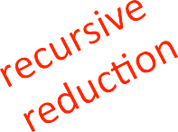



MULTIPLICATION – RECURSIVE SOLUTION
recursive step
think how to reduce problem to a simpler/ smaller version of same problem
base case
keep reducing problem until reach a simple case that can be solved directly
when b = 1, a*b = a
a*b = a + a + a + a + … + a
a + a + … + a
= a + a * (b-1)
def mult(a, b): if b == 1:
return a
= a + a +
else:
return a
+ mult(a,
b-1)

Slide 10


FACTORIAL
n! = n*(n-1)*(n-2)*(n-3)* … * 1
for what n do we know the factorial?
n = 1
if n == 1:
return 1
how to reduce problem? Rewrite in terms of something simpler to reach base case
n*(n-1)!
else:
return n*factorial(n-1)

Slide 11
RECURSIVE FUNCTION SCOPE EXAMPLE
def fact(n):
if n == 1:
return 1 else:
return n*fact(n-1)
print(fact(4))
Global scope
fact
fact scope (call w/ n=4)
n
fact scope (call w/ n=3)
n
fact scope (call w/ n=2)
n
fact scope (call w/ n=1)
n
Some code
4
3
2
1
print(fact(4))
return 4*fact(3)
return 2*fact(1)
return 3*fact(2)
return 1
return 24
return 4*6
return 3*2
return 2*1
base case

Slide 12
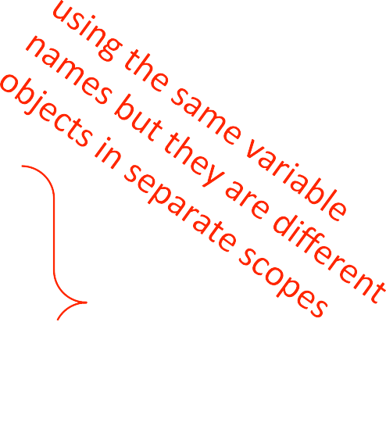
SOME OBSERVATIONS
each recursive call to a function creates its
own scope/environment
bindings of variables in a scope are not changed by recursive call
ﬂow of control passes back to previous scope once function call returns value

Slide 13
ITERATION vs.
RECURSION
def factorial_iter(n): prod = 1
def factorial(n): if n == 1:
return 1 else:
return n*factorial(n-1)
for i in
prod
range(1,n+1):
*= i
return prod
recursion may be simpler, more intuitive
recursion may be eﬃcient from programmer POV
recursion may not be eﬃcient from computer POV

Slide 14
INDUCTIVE REASONING
How do we know that our recursive code will work?
mult_iter terminates because b is initially positive, and decreases by 1 each time around loop; thus must eventually become less than 1
mult called with b = 1 has no recursive call and stops
mult called with b > 1 makes a recursive call with a smaller version of b; must eventually reach call with b = 1
def mult_iter(a, b): result = 0
while b > 0:
result += a b -= 1
return result
def mult(a, b): if b == 1:
return a else:
return a + mult(a,
b-1)

Slide 15
MATHEMATICAL INDUCTION
To prove a statement indexed on integers is true for all values of n:
Prove it is true when n is smallest value (e.g. n = 0 or n = 1)
Then prove that if it is true for an arbitrary value of n, one can show that it must be true for n+1

Slide 16
EXAMPLE OF INDUCTION
§ 0 + 1 + 2 + 3 + … + n = (n(n+1))/2
Proof:
If n = 0, then LHS is 0 and RHS is 0*1/2 = 0, so true
Assume true for some k, then need to show that 0 + 1 + 2 + … + k + (k+1) = ((k+1)(k+2))/2
LHS is k(k+1)/2 + (k+1) by assumpSon that property holds for problem of size k
This becomes, by algebra, ((k+1)(k+2))/2
Hence expression holds for all n >= 0

Slide 17
RELEVANCE TO CODE?
Same logic applies
def mult(a, b):
if b == 1:
return a else:
return
a + mult(a, b-1)
Base case, we can show that mult
must return correct answer
For recursive case, we can assume that mult
correctly returns an
answer for problems of size smaller than b, then by the addiSon step, it must also return a correct answer for problem of size b
Thus by induction, code correctly returns answer

Slide 18
TOWERS OF HANOI
The story:
3 tall spikes
Stack of 64 diﬀerent sized discs – start on one spike
Need to move stack to second spike (at which point universe ends)
Can only move one disc at a time, and a larger disc can never cover up a small disc

Slide 19
TOWERS OF HANOI
Having seen a set of examples of diﬀerent sized stacks, how would you write a program to print out the right set of moves?
Think recursively!
Solve a smaller problem
Solve a basic problem
Solve a smaller problem

Slide 20
def printMove(fr, to): print('move from ' + str(fr)
+ ' to ' + str(to))
def Towers(n, fr, to, spare): if n == 1:
printMove(fr, to) else:
Towers(n-1, fr, spare, to) Towers(1, fr, to, spare) Towers(n-1, spare, to, fr)
LECTURE 6

Slide 21
RECURSION WITH MULTIPLE BASE CASES
Fibonacci numbers
Leonardo of Pisa (aka Fibonacci) modeled the following challenge
Newborn pair of rabbits (one female, one male) are put in a pen
Rabbits mate at age of one month
Rabbits have a one month gestation period
Assume rabbits never die, that female always produces one new pair (one male, one female) every month from its second month on.
How many female rabbits are there at the end of one year?
LECTURE 6

Slide 22
Demo courtesy of Prof. Denny Freeman and Adam Hartz
LECTURE 6

Slide 23


Demo courtesy of Prof. Denny Freeman and Adam Hartz
LECTURE 6

Slide 24
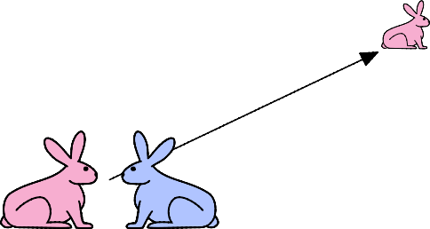
Demo courtesy of Prof. Denny Freeman and Adam Hartz
LECTURE 6

Slide 25

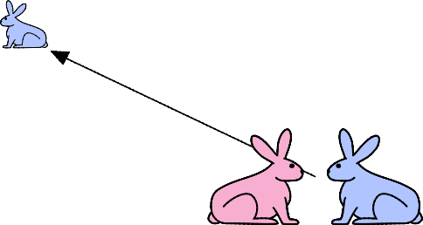
Demo courtesy of Prof. Denny Freeman and Adam Hartz
LECTURE 6

Slide 26


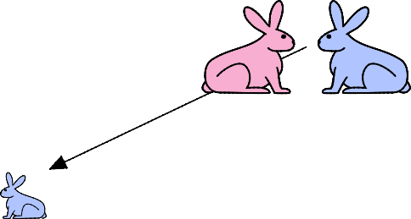
Demo courtesy of Prof. Denny Freeman and Adam Hartz
LECTURE 6

Slide 27
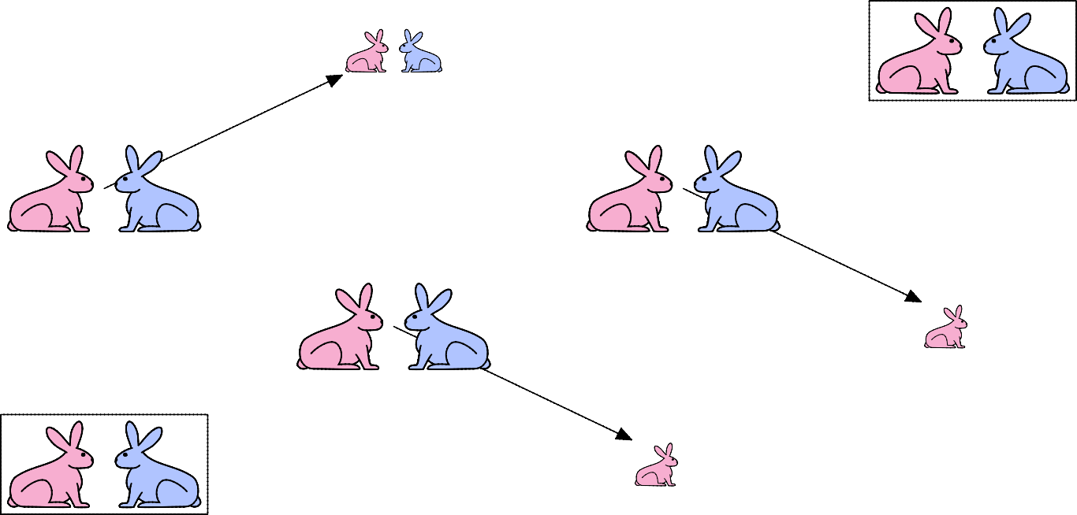
Demo courtesy of Prof. Denny Freeman and Adam Hartz
LECTURE 6

Slide 28
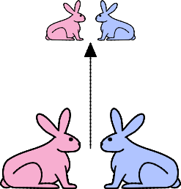

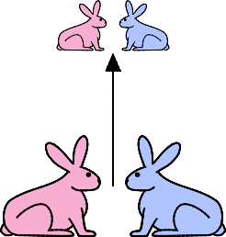
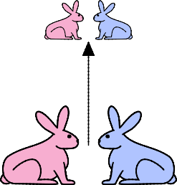
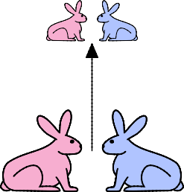

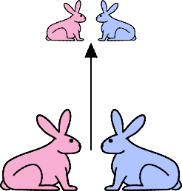

Demo courtesy of Prof. Denny Freeman and Adam Hartz
LECTURE 6

Slide 29

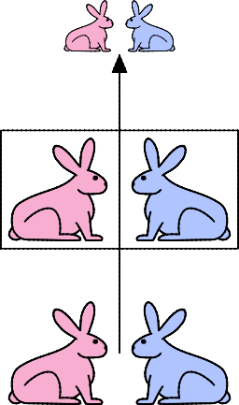
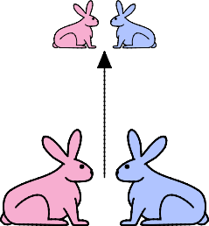

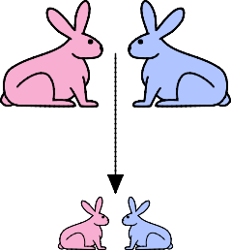

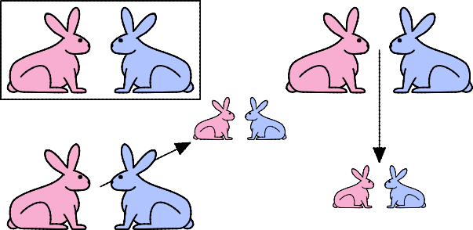
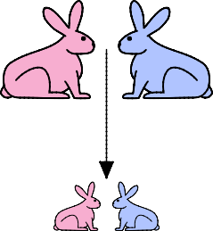
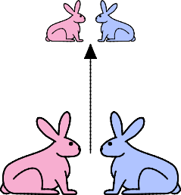
LECTURE 6

Slide 30
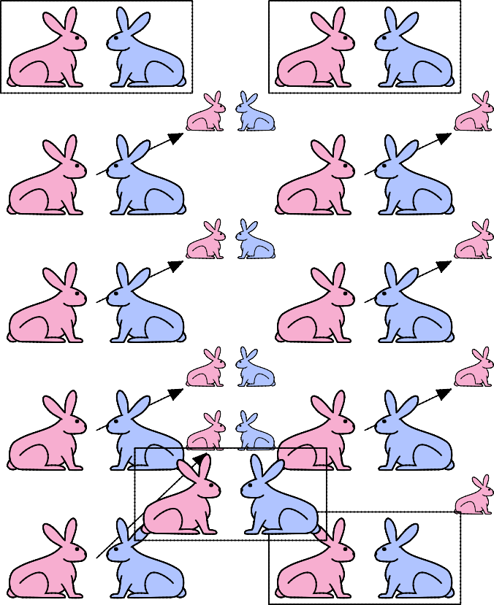
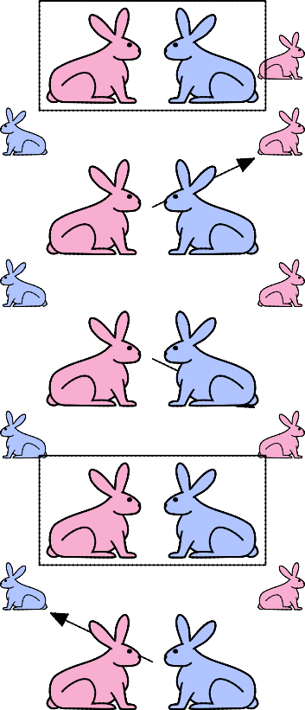
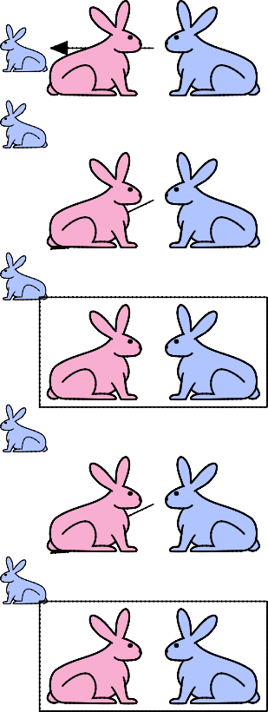
Demo courtesy of Prof. Denny Freeman and Adam Hartz

Slide 31
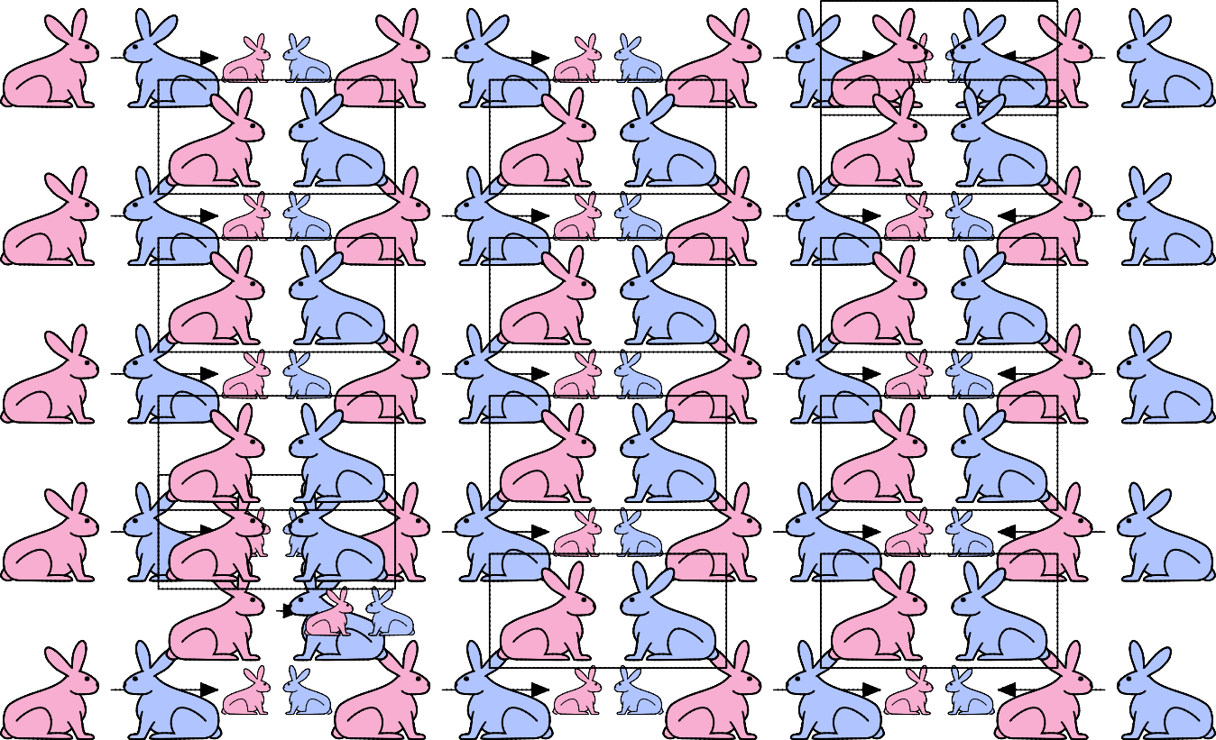
Demo courtesy of Prof. Denny Freeman and Adam Hartz

Slide 32
FIBONACCI
yer one month (call it 0) – 1 female
Ayer second month – sSll 1 female (now pregnant)
Ayer third month – two females, one pregnant, one not
In general, females(n) = females(n-1) + females(n-2)
Every female alive at month n-2 will produce one female in month n;
These can be added those alive in month n-1 to get total alive in month n
Month | Females
0 | 1
1
1
2
2
3
3
4
5
5
8
6
13
LECTURE 6

Slide 33
FIBONACCI
Base cases:
Females(0) = 1
Females(1) = 1
Recursive case
Females(n) = Females(n-1) + Females(n-2)
LECTURE 6

Slide 34
FIBONACCI
def fib(x):
"""assumes x an int >= 0 returns Fibonacci of x"""
if x == 0 or x == 1:
return 1 else:
return fib(x-1) + fib(x-2)
LECTURE 6

Slide 35
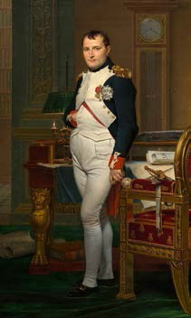

RECURSION ON NON- NUMERICS
how to check if a string of characters is a palindrome, i.e., reads the same forwards and backwards
“Able was I, ere I saw Elba” – attributed to Napoleon
“Are we not drawn onward, we few, drawn onward to new era?” – attributed to Anne Michaels
Image courtesy of wikipedia, in the public domain.
By Larth_Rasnal (Own work) [GFDL (https://www.gnu.org/licenses/fdl-1.3.en.html) or CC BY 3.0 (https://creativecommons.org/licenses/by/3.0)], via Wikimedia Commons.
LECTURE 6

Slide 36
SOLVING RECURSIVELY?
First, convert the string to just characters, by stripping out punctuation, and converting upper case to lower case
Then
Base case: a string of length 0 or 1 is a palindrome
Recursive case:
If ﬁrst character matches last character, then is a palindrome if middle section is a palindrome
LECTURE 6

Slide 37
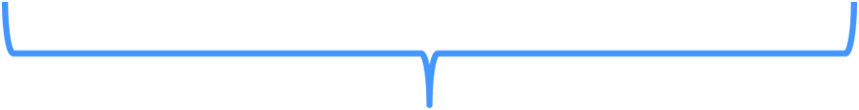

EXAMPLE
‘Able was I, ere I saw Elba’ ‘ablewasiereisawleba’
isPalindrome(‘ablewasiereisawleba’) is same as
◦ ‘a’ == ‘a’ and
isPalindrome(‘blewasiereisawleb’)
LECTURE 6

Slide 38
def isPalindrome(s): def toChars(s):
s = s.lower() ans = ''
for c in s:
if c in 'abcdefghijklmnopqrstuvwxyz': ans = ans + c
return ans
def isPal(s):
if len(s) <= 1: return True
else:
return s[0] == s[-1] and isPal(s[1:-1])
return isPal(toChars(s))
LECTURE 6

Slide 39
DIVIDE AND CONQUER
an example of a “divide and conquer” algorithm
solve a hard problem by breaking it into a set of sub- problems such that:
sub-problems are easier to solve than the original
solutions of the sub-problems can be combined to solve the original
LECTURE 6

Slide 40
DICTIONARIES

Slide 41

HOW TO STORE STUDENT INFO
so far, can store using separate lists for every info
names = ['Ana', 'John', 'Denise', 'Katy']
grade = ['B', 'A+', 'A', 'A']
course = [2.00, , 20.002, 9.01]
a separate list for each item
each list must have the same length
info stored across lists at same index, each index refers to info for a diﬀerent person

Slide 42
HOW TO UPDATE/RETRIEVE STUDENT INFO
def get_grade(student, name_list, i = name_list.index(student) grade = grade_list[i]
course = course_list[i] return (course, grade)
grade_list, course_list):
messy if have a lot of diﬀerent info to keep track of
must maintain many lists and pass them as arguments
must always index using integers
must remember to change mulSple lists

Slide 43
A BETTER AND CLEANER WAY – A DICTIONARY
nice to index item of interest directly (not always int)
nice to use one data structure, no separate lists
A list A dic0onary
0 | Elem 1
1 | Elem 2
2 | Elem 3
3 | Elem 4
… | …
Key 1 | Val 1
Key 2 | Val 2
Key 3 | Val 3
Key 4 | Val 4
… | …

Slide 44



A PYTHON DICTIONARY
' | na' | 'B'
'De | nise' | 'A'
'J | ohn' | 'A+'
'K | aty' | 'A'
store pairs of data
key
value
Key 1
Val 1
A
Key 2
Val 2
Key 3
Val 3
…
…
my_dict = {}
grades = {'Ana':'B',
key1 val1
'John':'A+', 'Denise':'A',
'Katy':'A'}
key4 val4
key2 val2
key3 val3

Slide 45
DICTIONARY LOOKUP
similar to indexing into a list
looks up the key
returns the value associated with the key
if key isn’t found, get an error
'Ana' | 'B'
'Denise' | 'A'
'John' | 'A+'
'Katy' | 'A'
grades = {'Ana':'B', 'John':'A+',
'Denise':'A',
'Katy':'A'}
grades['John'] grades['Sylvan']
à evaluates to 'A+'
à gives a KeyError

Slide 46
DICTIONARY OPERATIONS | 'Ana' | 'B'
 | 'Denise' | 'A'
 | 'John' | 'A+'
 | 'Katy' | 'A'
 | 'Sylvan' | 'A'
grades = {'Ana':'B', 'John':'A+', 'Denise':'A',
add an entry
grades['Sylvan'] = 'A'
test if key in dicSonary
'Katy':'A'}
'John' in grades 'Daniel' in grades
delete entry
del(grades['Ana'])
à returns True
à returns False

Slide 47


DICTIONARY OPERATIONS | 'Ana' | 'B'
 | 'Denise' | 'A'
 | 'John' | 'A+'
 | 'Katy' | 'A'
grades = {'Ana':'B', 'John':'A+', 'Denise':'A', 'Katy':'A'}
get an iterable that acts like a tuple of all keys
grades.keys()
à returns ['Denise','Katy','John','Ana']
get an iterable that acts like a tuple of all values
grades.values() à returns ['A', 'A', 'A+', 'B']

Slide 48
DICTIONARY KEYS and VALUES
values
any type (immutable and mutable)
can be duplicates
dicSonary values can be lists, even other dicSonaries!
keys
must be unique
immutable type (int, float, string, tuple,bool)
actually need an object that is hashable, but think of as immutable as all immutable types are hashable
careful with float type as a key
no order to keys or values!
d = {4:{1:0}, (1,3):"twelve", 'const':[3.14,2.7,8.44]}

Slide 49
list vs
dict
ordered sequence of elements
look up elements by an integer index
indices have an order
index is an integer
matches “keys” to “values”
look up one item by another item
no order is guaranteed
key can be any
immutable type

Slide 50
EXAMPLE: 3 FUNCTIONS TO ANALYZE SONG LYRICS
create a frequency dic0onary mapping str:int
ﬁnd word that occurs the most and how many Smes
use a list, in case there is more than one word
return a tuple (list,int) for (words_list, highest_freq)
ﬁnd the words that occur at least X 0mes
let user choose “at least X Smes”, so allow as parameter
return a list of tuples, each tuple is a (list,
int)
containing the list of words ordered by their frequency
IDEA: From song dicSonary, ﬁnd most frequent word. Delete most common word. Repeat. It works because you are mutaSng the song dicSonary.

Slide 51
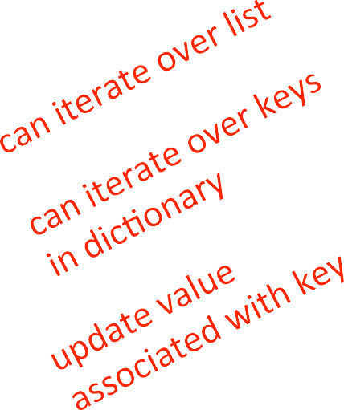
CREATING A DICTIONARY
def lyrics_to_frequencies(lyrics):
myDict = {} for word in
lyrics:
if word in myDict: myDict[word] += 1
else:
myDict[word] = 1 return myDict

Slide 52
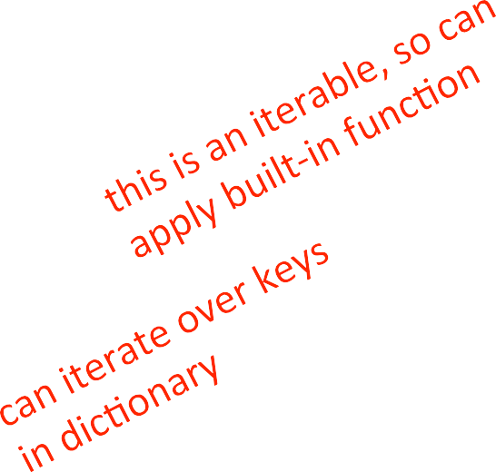
USING THE DICTIONARY
def most_common_words(freqs): values = freqs.values()
best = words
max(values)
= []
for k in
freqs:
if freqs[k] == best: words.append(k)
(words, best)
return

Slide 53
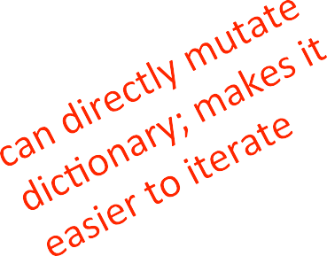
LEVERAGING DICTIONARY PROPERTIES
def words_often(freqs, minTimes): result = []
done = False while not done:
temp = most_common_words(freqs) if temp[1] >= minTimes:
result.append(temp) for w in temp[0]:
del(freqs[w])
else:
done = True return result
print(words_often(beatles, 5))

Slide 54
FIBONACCI RECURSIVE CODE
def fib(n):
if n == 1:
return 1 elif n == 2:
return 2 else:
return fib(n-1)
+ fib(n-2)
two base cases
calls itself twice
this code is ineﬃcient

Slide 55






INEFFICIENT FIBONACCI
fib(n) = fib(n-1) + fib(n-2)
fib(5)
fib(4)
fib(3)
fib(3)
fib(2)
fib(2)
fib(1)
fib(2)
fib(1)
recalcula0ng the same values many Smes!
could keep track of already calculated values

Slide 56
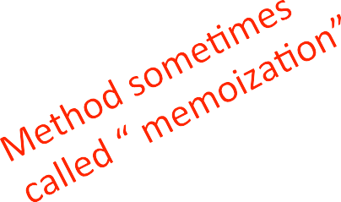
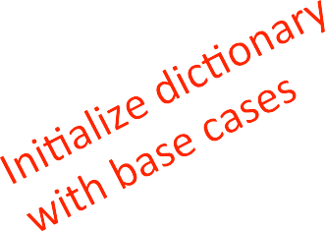
FIBONACCI WITH A DICTIONARY
def fib_efficient(n, d): if n in d:
return d[n] else:
ans = fib_efficient(n-1, d[n] = ans
return ans
d) + fib_efficient(n-2, d)
d = {1:1, 2:2}
print(fib_efficient(6, d))
do a lookup ﬁrst in case already calculated the value
modify dic0onary as progress through funcSon calls

Slide 57
EFFICIENCY GAINS
Calling ﬁb(34) results in 11,405,773 recursive calls to the procedure
Calling ﬁb_eﬃcient(34) results in 65 recursive calls to the procedure
Using dicSonaries to capture intermediate results can be very eﬃcient
But note that this only works for procedures without side eﬀects (i.e., the procedure will always produce the same result for a speciﬁc argument independent of any other computaSons between calls)

