Slide 1
PYTHON CLASSES
and INHERITANCE
LECTURE 9
LECTURE 9
1

Slide 2
LAST TIME
abstract data types through classes
Coordinate example
Fraction example
TODAY
more on classes
getters and setters
information hiding
class variables
inheritance
LECTURE 9
2

Slide 3
write code from two different perspectives
IMPLEMENTING |  | USING
THE CLASS | vs | THE CLASS
implementing a new object type with a class
define the class
define data attributes
(WHAT IS the object)
define methods
(HOW TO use the object)
using the new object type in code
create instances of the object type
do operations with them
LECTURE 9
3

Slide 4
CLASS DEFINITION
OF AN OBJECT TYPE
INSTANCE
vs OF A CLASS
class name is the type
class Coordinate(object)
class is defined generically
instance is one specific object
coord = Coordinate(1,2)
data attribute values vary between instances
c1 = Coordinate(1,2)
c2 = Coordinate(3,4)
c1 and c2 have different data attribute values c1.x and c2.x because they are different objects
instance has the structure of the class
use self
to refer to some
instance while defining the class
(self.x – self.y)**2
self is a parameter to methods in class definition
class defines data and methods common across all instances
LECTURE 9
4

Slide 5
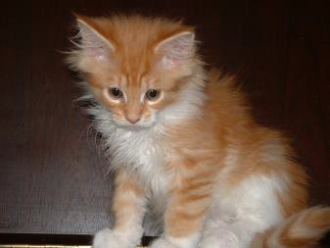


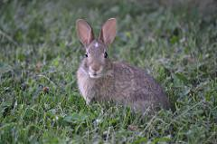
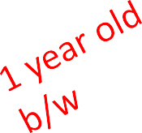
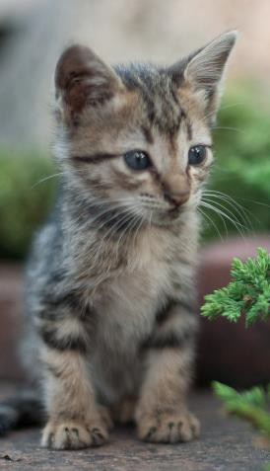


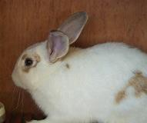
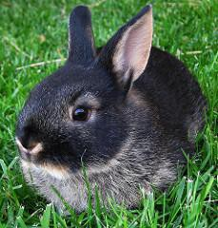


WHY USE OOP AND
CLASSES OF OBJECTS?
mimic real life
group different objects part of the same type
Image Credits, clockwise from top: Image Courtesy Harald Wehner, in the public Domain. Image Courtesy MTSOfan, CC-BY-NC-SA. Image Courtesy Carlos Solana, license CC- BY-NC-SA. Image Courtesy Rosemarie Banghart-Kovic, license CC-BY-NC-SA. Image Courtesy Paul Reynolds, license CC-BY. Image Courtesy Kenny Louie, License CC-BY

Slide 6

WHY USE OOP AND
CLASSES OF OBJECTS?
mimic real life
group different objects part of the same type
Image Credits, clockwise from top: Image Courtesy Harald Wehner, in the public Domain. Image Courtesy MTSOfan, CC-BY-NC-SA. Image Courtesy Carlos Solana, license CC- BY-NC-SA. Image Courtesy Rosemarie Banghart-Kovic, license CC-BY-NC-SA. Image Courtesy Paul Reynolds, license CC-BY. Image Courtesy Kenny Louie, License CC-BY

Slide 7
GROUPS OF OBJECTS HAVE
ATTRIBUTES (RECAP)
data attributes
how can you represent your object with data?
what it is
for a coordinate: x and y values
for an animal: age, name
procedural attributes (behavior/operations/methods)
how can someone interact with the object?
what it does
for a coordinate: find distance between two
for an animal: make a sound

Slide 8
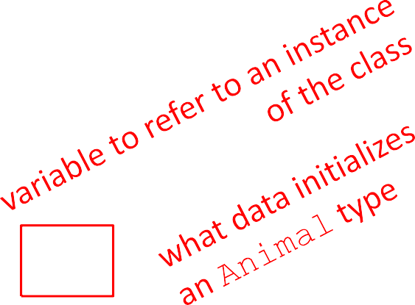
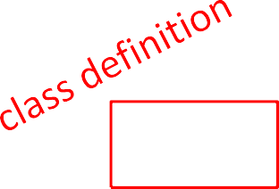

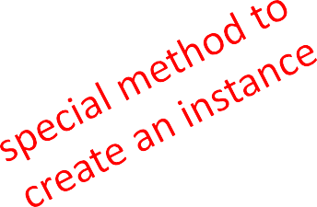
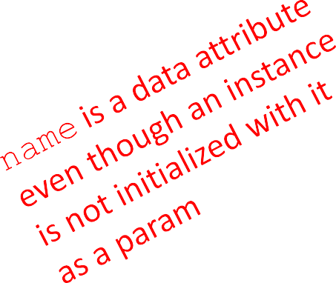
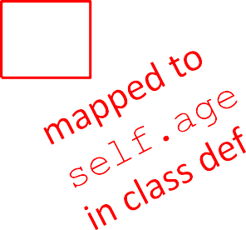

HOW TO DEFINE A CLASS
(RECAP)
class
Animal(object):
def init (self, self.age = age
age):
self.name = None
myanimal
= Animal(3)

Slide 9


GETTER AND SETTER METHODS
class Animal(object):
def init (self, age): self.age = age self.name = None
def get_age(self): return self.age
def get_name(self): return self.name
def set_age(self, newage): self.age = newage
def set_name(self, newname=""):
self.name = newname def str (self):
return "animal:"+str(self.name)+":"+str(self.age)
getters and setters should be used outside of class to access data attributes

Slide 10

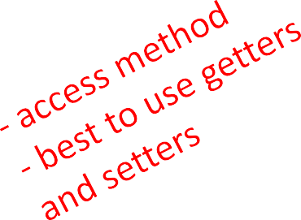
AN INSTANCE and
DOT NOTATION (RECAP)
instantiation creates an instance of an object
a = Animal(3)
dot notation used to access attributes (data and methods) though it is better to use getters and setters to access data attributes
a.age
a.get_age()
10

Slide 11

INFORMATION HIDING
author of class definition may change data attribute
variable names
class Animal(object):
def init (self, age): self.years = age
def get_age(self): return self.years
if you are accessing data attributes outside the class and class definition changes, may get errors
outside of class, use getters and setters instead use a.get_age() NOT a.age
good style
easy to maintain code
prevents bugs

Slide 12
PYTHON NOT GREAT AT
INFORMATION HIDING
allows you to access data from outside class definition
print(a.age)
allows you to write to data from outside class definition
a.age = 'infinite'
allows you to create data attributes for an instance from outside class definition
a.size = "tiny"
it’s not good style to do any of these!

Slide 13


DEFAULT ARGUMENTS
default arguments for formal parameters are used if no actual argument is given
def set_name(self, newname=""): self.name = newname
default argument used here
a = Animal(3) a.set_name()
print(a.get_name())
argument passed in is used here
a = Animal(3) a.set_name("fluffy")
print(a.get_name())

Slide 14



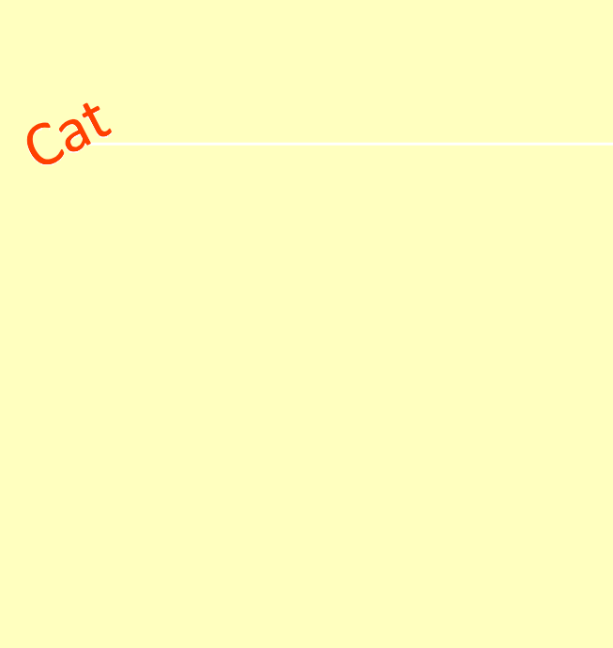


HIERARCHIES
Image Credits, clockwise from top: Image Courtesy Deeeep, CC-BY-NC. Image Image Courtesy MTSOfan, CC-BY-NC-SA. Image Courtesy Carlos Solana, license CC-BY-NC-SA. Image Courtesy Rosemarie Banghart-Kovic, license CC-BY-NC-SA. Image Courtesy Paul Reynolds, license CC-BY. Image Courtesy Kenny Louie, License CC-BY. Courtesy Harald Wehner, in the public Domain.

Slide 15
HIERARCHIES
parent class
(superclass)
child class
(subclass)
inherits all data and behaviors of parent class
add more info
add more behavior
override behavior
Animal
Person
Cat
Rabbit
Student

Slide 16
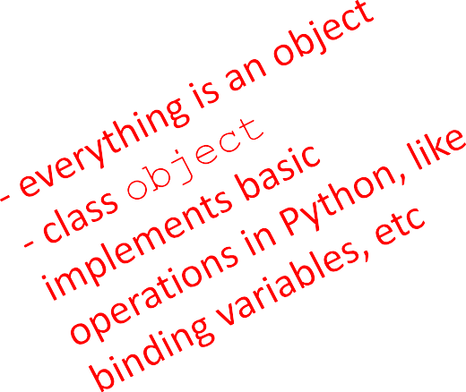
INHERITANCE:
PARENT CLASS
class Animal(object):
def init (self, age): self.age = age self.name = None
def get_age(self): return self.age
def get_name(self): return self.name
def set_age(self, newage): self.age = newage
def set_name(self, newname=""): self.name = newname
def str (self):
return "animal:"+str(self.name)+":"+str(self.age)

Slide 17
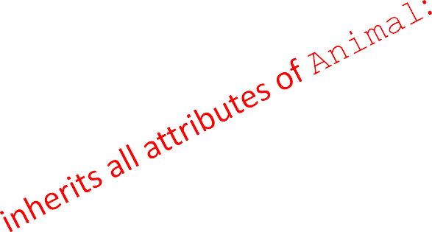
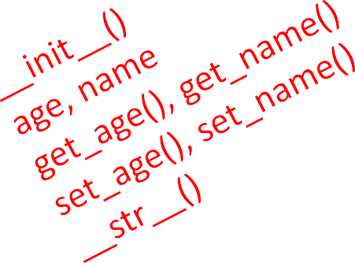
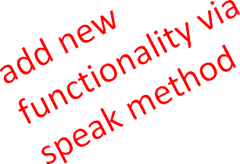
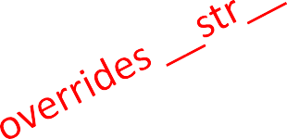
INHERITANCE:
SUBCLASS
class Cat(Animal):
def speak(self):
print("meow")
def str (self):
return "cat:"+str(self.name)+":"+str(self.age)
add new functionality with speak()
instance of type Cat can be called with new methods
instance of type Animal throws error if called with Cat’s new method
init is not missing, uses the Animal version

Slide 18
WHICH METHOD TO USE?
subclass can have methods with same name as
superclass
for an instance of a class, look for a method name in
current class definition
if not found, look for method name up the hierarchy
(in parent, then grandparent, and so on)
use first method up the hierarchy that you found with that method name

Slide 19
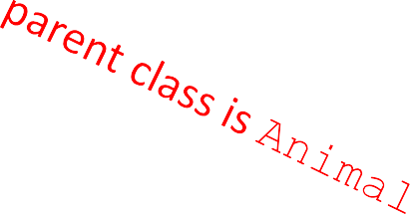

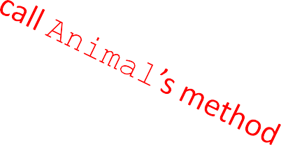



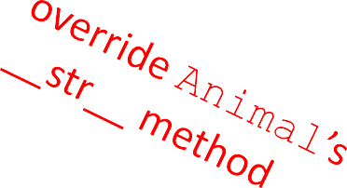
class Person(Animal):
def init (self, name,
age):
 | Animal. init (self, age)
 | self.set_name(name)
 | self.friends = []
def get_friends(self):
return self.friends
def add_friend(self, fname):
if fname not in self.friends: self.friends.append(fname)
def speak(self):
print("hello")
def age_diff(self, other):
diff = self.age - other.age print(abs(diff), "year difference")
def str (self):
return "person:"+str(self.name)+":"+str(self.age)

Slide 20
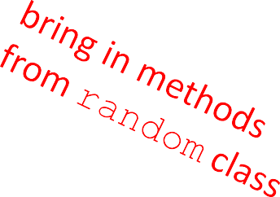
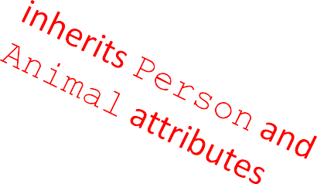

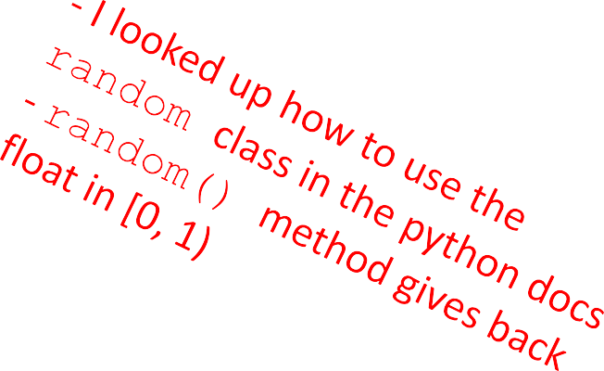
import random
class Student(Person):
def init (self, name, age, major=None):
Person. init (self, name, age)
self.major = major
def change_major(self, major): self.major = major
def speak(self):
r = random.random()
if r < 0.25:
print("i
elif 0.25 <=
print("i
have homework")
r < 0.5:
need sleep")
elif 0.5 <= r < 0.75: print("i should eat")
else:
print("i am watching tv") def str (self):
return "student:"+str(self.name)+":"+str(self.age)+":"+str(self.major)
20

Slide 21

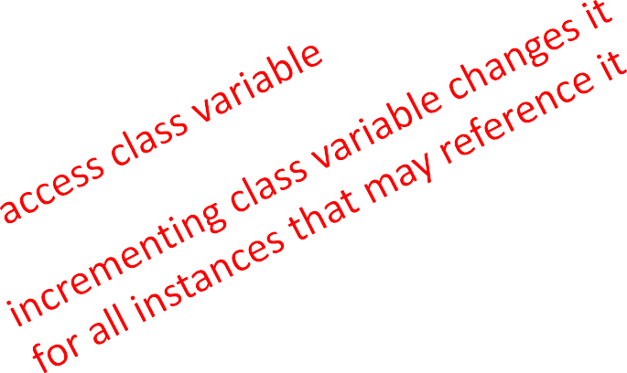
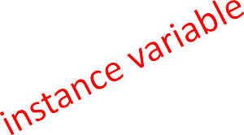
CLASS VARIABLES AND THE
Rabbit SUBCLASS
class variables and their values are shared between all
instances of a class
class Rabbit(Animal):
tag
= 1
def init (self, age, parent1=None, Animal. init (self, age) self.parent1 = parent1 self.parent2 = parent2
parent2=None):
self.rid | = | Rabbit.tag
Rabbit.tag += 1
tag used to give unique id to each new rabbit instance

Slide 22
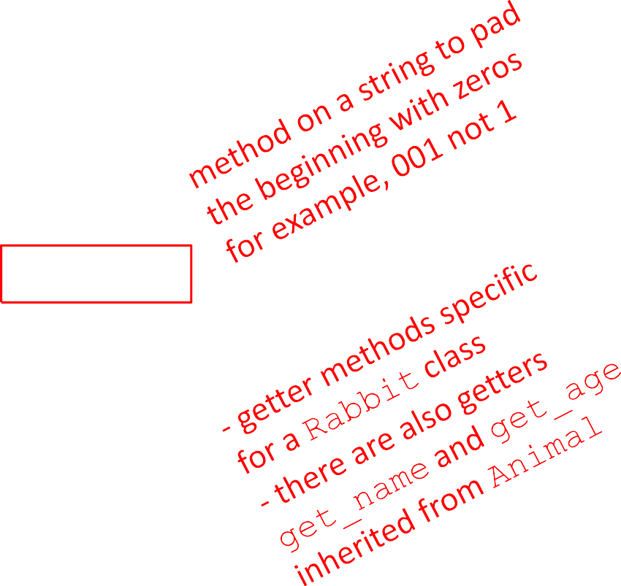
Rabbit GETTER METHODS
class Rabbit(Animal):
tag = 1
def init (self, age, parent1=None, Animal. init (self, age) self.parent1 = parent1 self.parent2 = parent2
self.rid = Rabbit.tag Rabbit.tag += 1
def get_rid(self):
return str(self.rid).zfill(3) def get_parent1(self):
return self.parent1 def get_parent2(self):
return self.parent2
parent2=None):

Slide 23
WORKING WITH YOUR OWN
TYPES
def __add__(self, other):
# returning object of same type as this class return Rabbit(0, self, other)
recall Rabbit’s
init (self, age, parent1=None, parent2=None)
define + operator between two Rabbit instances
define what something like this does: r4 = r1 + r2
where r1 and r2 are Rabbit instances
r4 is a new Rabbit instance with age 0
r4 has self as one parent and other as the other parent
in init , parent1 and parent2 are of type Rabbit

Slide 24

SPECIAL METHOD TO
COMPARE TWO Rabbits
decide that two rabbits are equal if they have the same two
parents
def eq (self, other):
parents_same
= self.parent1.rid == other.parent1.rid \ and self.parent2.rid == other.parent2.rid
parents_opposite
= self.parent2.rid == other.parent1.rid \ and self.parent1.rid == other.parent2.rid
return parents_same or parents_opposite
compare ids of parents since ids are unique (due to class var)
note you can’t compare objects directly
for ex. with self.parent1 == other.parent1
this calls the eq method over and over until call it on None and gives an AttributeError when it tries to do None.parent1

Slide 25
OBJECT ORIENTED
PROGRAMMING
create your own collections of data
organize information
division of work
access information in a consistent manner
add layers of complexity
like functions, classes are a mechanism for
decomposition and abstraction in programming

