Slide 1
UNDERSTANDING PROGRAM EFFICIENCY: 2
LECTURE 12
1

Slide 2
TODAY
Classes of complexity
Examples characteristic of each class
2

Slide 3
WHY WE WANT TO UNDERSTAND EFFICIENCY OF PROGRAMS
how can we reason about an algorithm in order to predict the amount of time it will need to solve a problem of a particular size?
how can we relate choices in algorithm design to the time eﬃciency of the resulting algorithm?
are there fundamental limits on the amount of time we will need to solve a particular problem?
3

Slide 4
ORDERS OF GROWTH: RECAP
Goals:
want to evaluate program’s eﬃciency when input is very big
want to express the growth of program’s run time as input size grows
want to put an upper bound on growth – as tight as possible
do not need to be precise: “order of” not “exact” growth
we will look at largest factors in run time (which section of the program will take the longest to run?)
thus, generally we want tight upper bound on growth, as function of size of input, in worst case
4

Slide 5

COMPLEXITY CLASSES: RECAP
O(1) denotes constant running time
O(log n) denotes logarithmic running time
O(n) denotes linear running time
O(n log n) denotes log-linear running time
O(n^{c}) denotes polynomial running time (c is a constant)
O(c^{n}) denotes exponential running time (c is a constant being raised to a power based on size of input)
5

Slide 6
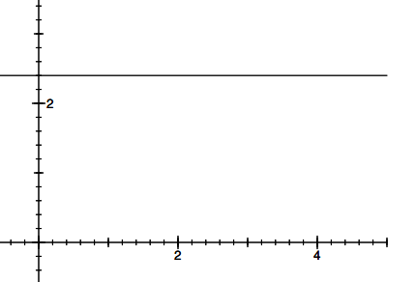
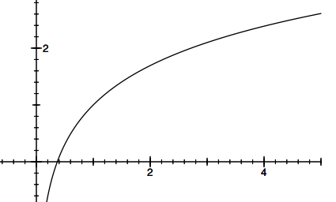
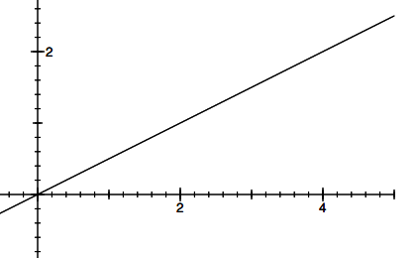
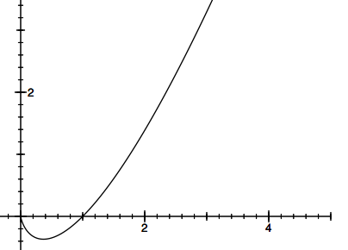
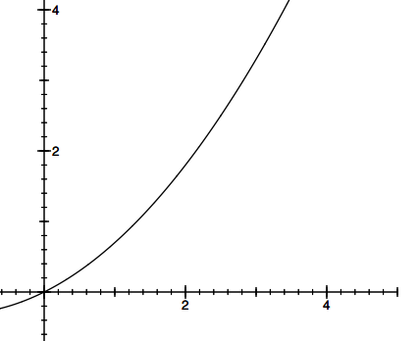

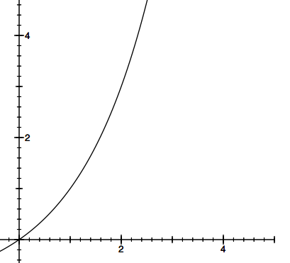
COMPLEXITY CLASSES ORDERED LOW TO HIGH
O(1)
O(log n) :
O(n) :
O(n log n):
O(n^{c}) :
O(c^{n}) :
:
constant
logarithmic
linear
loglinear
polynomial
exponential
6

Slide 7

COMPLEXITY GROWTH
CLASS | n=10 | = 100 | = 1000 | = 1000000
O(1) | 1 | 1 | 1 | 1
O(log n) | 1 | 2 | 3 | 6
O(n) | 10 | 100 | 1000 | 1000000
O(n log n) | 10 | 200 | 3000 | 6000000
O(n^2) | 100 | 10000 | 1000000 | 1000000000000
O(2^n) | 1024 | 12676506 00228229 | 1071508607186267320948425049060 0018105614048117055336074437503 | Good luck!!
 |  | 40149670 | 8837035105112493612249319837881
 |  | 3205376 | 5695858127594672917553146825187
 |  |  | 1452856923140435984577574698574
 |  |  | 8039345677748242309854210746050
 |  |  | 6237114187795418215304647498358
 |  |  | 1941267398767559165543946077062
 |  |  | 9145711964776865421676604298316
 |  |  | 52624386837205668069376
7

Slide 8
CONSTANT COMPLEXITY
complexity independent of inputs
very few interesting algorithms in this class, but can ofen have pieces that ﬁt this class
can have loops or recursive calls, but ONLY IF number of iterations or calls independent of size of input
8

Slide 9
LOGARITHMIC COMPLEXITY
complexity grows as log of size of one of its inputs
example:
bisection search
binary search of a list
9

Slide 10
BISECTION SEARCH
suppose we want to know if a particular element is present in a list
saw last time that we could just “walk down” the list, checking each element
complexity was linear in length of the list
suppose we know that the list is ordered from smallest to largest
saw that sequential search was still linear in complexity
can we do better?
10

Slide 11
BISECTION SEARCH
pick an index, i, that divides list in half
ask if L[i] == e
if not, ask if L[i] is larger or smaller than e
depending on answer, search leY or right half of L for e
A new version of a divide-and-conquer algorithm
break into smaller version of problem (smaller list), plus some simple operations
answer to smaller version is answer to original problem

Slide 12
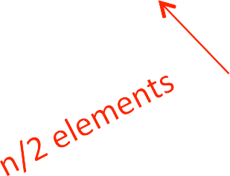








BISECTION SEARCH COMPLEXITY ANALYSIS
ﬁnish looking through list when
1 = n/2^{i}
so i = log n
…
…
complexity of recursion is O(log n) – where n is len(L)

Slide 13
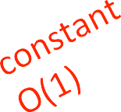





BISECTION SEARCH IMPLEMENTATION 1
def bisect_search1(L, e):
if L == []:
return False
elif len(L) == 1:
return L[0] == e
else:
half = len(L)//2
if
L[half] > e:
return bisect_search1( | L[:half | , e)
]
else:
return bisect_search1( | L[half: | , e)
]

Slide 14
COMPLEXITY OF FIRST BISECTION SEARCH METHOD
implementation 1 – bisect_search1
O(log n) bisection search calls
On each recursive call, size of range to be searched is cut in half
If original range is of size n, in worst case down to range of size 1 when n/(2^k) = 1; or when k = log n
O(n) for each bisection search call to copy list
This is the cost to set up each call, so do this for each level of recursion
O(log n) * O(n) → O(n log n)
if we are really careful, note that length of list to be copied is also halved on each recursive call
turns out that total cost to copy is O(n) and this dominates the log n cost due to the recursive calls

Slide 15













BISECTION SEARCH ALTERNATIVE
still reduce size of
problem by factor
of two on each step
but just keep track
of low and high
portion of list to be
searched
avoid copying the
list
complexity of
recursion is again
O(log n) – where n is len(L)

Slide 16


BISECTION SEARCH IMPLEMENTATION 2
def bisect_search2(L, e):
def bisect_search_helper(L, e, low, high):
if high ==
return mid = (low
low:
L[low] == e
+ high)//2
if L[mid] == e: return True
elif L[mid] > e:
if low == mid: #nothing left to search return False
else:
return bisect_search_helper(L, e, low, mid - 1)
else:
return bisect_search_helper(L, e, mid + 1, high) if len(L) == 0:
return False else:
return bisect_search_helper(L, e, 0, len(L) - 1)

Slide 17
COMPLEXITY OF SECOND BISECTION SEARCH METHOD
implementation 2 – bisect_search2 and its helper
O(log n) bisection search calls
On each recursive call, size of range to be searched is cut in half
If original range is of size n, in worst case down to range of size 1 when n/(2^k) = 1; or when k = log n
pass list and indices as parameters
list never copied, just re-passed as a pointer
thus O(1) work on each recursive call
O(log n) * O(1) → O(log n)

Slide 18
LOGARITHMIC COMPLEXITY
def intToStr(i):
digits = '0123456789' if i == 0:
return '0'
result = '' while i > 0:
=
result
digits[i%10]
+ result
i = i//10 return result

Slide 19
LOGARITHMIC COMPLEXITY
def intToStr(i):
digits = '0123456789' if i == 0:
return '0' res = ''
only have to look at loop as no function calls
within while loop, constant number of steps
how many times through loop?
how many times can one divide i by 10?
O(log(i))
while i > 0:
res = digits[i%10] i = i//10
+ res
return result

Slide 20
LINEAR COMPLEXITY
saw this last time
searching a list in sequence to see if an element is present
iterative loops
20

Slide 21
O() FOR ITERATIVE FACTORIAL
complexity can depend on number of iterative calls
def fact_iter(n):
prod = 1 for i in
prod
range(1,
*= i
n+1):
return prod
overall O(n) – n times round loop, constant cost each time

Slide 22
O() FOR RECURSIVE
FACTORIAL
def fact_recur(n):
""" assume if n <= 1:
return 1
else:
return
n >= 0 """
n*fact_recur(n – 1)
computes factorial recursively
if you time it, may notice that it runs a bit slower than iterative version due to function calls
still O(n) because the number of function calls is linear in n, and constant eﬀort to set up call
iterative and recursive factorial implementations are the same order of growth

Slide 23
LOG-LINEAR COMPLEITY
many practical algorithms are log-linear
very commonly used log-linear algorithm is merge sort
will return to this next lecture

Slide 24
POLYNOMIAL COMPLEXITY
most common polynomial algorithms are quadratic, i.e., complexity grows with square of size of input
commonly occurs when we have nested loops or recursive function calls
saw this last time

Slide 25
EXPONENTIAL COMPLEXITY
recursive functions where more than one recursive call for each size of problem
Towers of Hanoi
many important problems are inherently exponential
unfortunate, as cost can be high
will lead us to consider approximate solutions as may provide reasonable answer more quickly

Slide 26
COMPLEXITY OF TOWERS OF HANOI
Let t_{n} denote time to solve tower of size n
t_{n} = 2t_{n-1} + 1
▪ = 2(2t_{n-2} + 1) + 1
▪ = 4t_{n-2} + 2 + 1
▪ = 4(2t_{n-3} + 1) + 2 + 1
▪ = 8t_{n-3} + 4 + 2 + 1
▪ = 2^{k} t_{n-k} + 2^{k-1} + … + 4 + 2 + 1
▪ = 2^{n-1} + 2^{n-2} + ... + 4 + 2 + 1
▪ = 2^{n} – 1
so order of growth is O(2^{n})
Geometric growth
a = 2^{n-1} + … + 2 + 1 2a = 2^{n} + 2^{n-1} + ... + 2
a = 2^{n} - 1

Slide 27
EXPONENTIAL COMPLEXITY
given a set of integers (with no repeats), want to generate the collection of all possible subsets – called the power set
{1, 2, 3, 4} would generate
{}, {1}, {2}, {3}, {4}, {1, 2}, {1, 3}, {1, 4}, {2, 3}, {2, 4}, {3, 4},
{1, 2, 3}, {1, 2, 4}, {1, 3, 4}, {2, 3, 4}, {1, 2, 3, 4}
order doesn’t matter
{}, {1}, {2}, {1, 2}, {3}, {1, 3}, {2, 3}, {1, 2, 3}, {4}, {1, 4}, {2,
4}, {1, 2, 4}, {3, 4}, {1, 3, 4}, {2, 3, 4}, {1, 2, 3, 4}

Slide 28
POWER SET – CONCEPT
we want to generate the power set of integers from 1 to n
assume we can generate power set of integers from 1 to
n-1
then all of those subsets belong to bigger power set
(choosing not include n); and all of those subsets with n
added to each of them also belong to the bigger power set
(choosing to include n)
▪
{} | , {1} | , {2}, {1, 2} | , {3}, {1, 3}, {2, 3}, {1, 2, 3}
, {4}, {1, 4}, {2, 4}, {1, 2,
4}, {3, 4}, {1, 3, 4}, {2, 3, 4}, {1, 2, 3, 4}
nice recursive description!

Slide 29
EXPONENTIAL COMPLEXITY
def genSubsets(L): res = []
if len(L) == 0:
return [[]] #list of empty smaller = genSubsets(L[:-1]) #
last element
extra = L[-1:] # create a list new = []
for small in smaller: new.append(small+extra) #
list
all subsets without
of just last element
for all smaller
solutions, add one with last element
return smaller+new # combine those with last element and those without

Slide 30
EXPONENTIAL COMPLEXITY
def genSubsets(L): res = []
if len(L) == 0: return [[]]
smaller = genSubsets(L[:-1]) extra = L[-1:]
new = []
for small in smaller: new.append(small+extra)
return smaller+new
assuming append is constant time
time includes time to solve smaller problem, plus time needed to make a copy of all elements in smaller problem
LECTURE 12
30

Slide 31
EXPONENTIAL COMPLEXITY
def genSubsets(L): res = []
if len(L) == 0: return [[]]
smaller = genSubsets(L[:-1]) extra = L[-1:]
new = []
for small in smaller: new.append(small+extra)
return smaller+new
but important to think about size of smaller
know that for a set of size k there are 2^{k} cases
how can we deduce overall complexity?

Slide 32
EXPONENTIAL COMPLEXITY
let t_{n} denote time to solve problem of size n
let s_{n} denote size of solution for problem of size n
t_{n} = t_{n-1} + s_{n-1} + c (where c is some constant number of operations)
t_{n} = t_{n-1} + 2^{n-1} + c
▪ = t_{n-2} + 2^{n-2} + c + 2^{n-1} + c
▪ = t_{n-k} + 2^{n-k} + … + 2^{n-1} + kc
▪ = t₀ + 2⁰ + ... + 2^{n-1} + nc
▪ = 1 + 2^{n} + nc
Thus computing power set is O(2^{n})

Slide 33
COMPLEXITY CLASSES
O(1) – code does not depend on size of problem
O(log n) – reduce problem in half each time through process
O(n) – simple iterative or recursive programs
O(n log n) – will see next time
O(n^{c}) – nested loops or recursive calls
O(c^{n}) – multiple recursive calls at each level

Slide 34
SOME MORE EXAMPLES OF ANALYZING COMPLEXITY

Slide 35


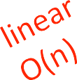

COMPLEXITY OF
ITERATIVE FIBONACCI
def fib_iter(n): if n == 0:
return 0 elif n == 1:
return 1 else:
Best case:
O(1)
Worst case:
O(1) + O(n) + O(1) ➔ O(n)
fib_i = 0 fib_ii = 1
for i in range(n-1): tmp = fib_i fib_i = fib_ii fib_ii = tmp + fib_ii
return fib_ii

Slide 36
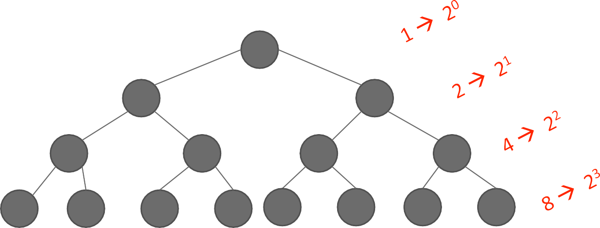
COMPLEXITY OF
RECURSIVE FIBONACCI
def fib_recur(n):
""" assumes n an int >= 0 """ if n == 0:
return 0
elif n == 1:
return 1 else:
return fib_recur(n-1)
+ fib_recur(n-2)
Worst case:
O(2^{n})

Slide 37
COMPLEXITY OF RECURSIVE FIBONACCI
fib(5)
fib(4)
fib(3)
fib(3)
fib(2)
fib(2)
fib(1)
fib(2) fib(1)
actually can do a bit better than 2^{n} since tree of cases thins out to right
but complexity is still exponential

Slide 38
BIG OH SUMMARY
compare eﬃciency of algorithms
notation that describes growth
lower order of growth is better
independent of machine or speciﬁc implementation
use Big Oh
describe order of growth
asymptotic notation
upper bound
worst case analysis
40

Slide 39
COMPLEXITY OF COMMON PYTHON FUNCTIONS
Lists: n is len(L)
Dictionaries: n is len(d)
worst case
index O(n)
index
store
O(1)
O(1)
length | O(1)
store | O(n)
append
• ==
remove
copy
reverse
iteration
in list
O(1)
O(n)
O(n)
O(n)
O(n)
O(n)
O(n)
length
delete
iteration
O(n)
O(n)
O(n)
average case
index
store
delete
iteration
O(1)
O(1)
O(1)
O(n)
41

