Slide 1
SEARCHING AND SORTING ALGORITHMS
LECTURE 13
1

Slide 2
SEARCH ALGORITHMS
search algorithm – method for ﬁnding an item or group of items with speciﬁc properties within a collection of items
collection could be implicit
example – ﬁnd square root as a search problem
exhaustive enumeration
bisection search
Merged Listton-Raphson
collection could be explicit
example – is a student record in a stored collection of data?
2

Slide 3
SEARCHING ALGORITHMS
linear search
brute force search (aka British Museum algorithm)
list does not have to be sorted
bisection search
list MUST be sorted to give correct answer
saw two diﬀerent implementations of the algorithm
3

Slide 4

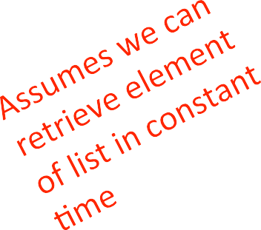
LINEAR SEARCH
ON UNSORTED LIST: RECAP
def linear_search(L, e): found = False
for i in range(len(L)): if e == L[i]:
found = True return found
must look through all elements to decide it’s not there
O(len(L)) for the loop * O(1) to test if e == L[i]
overall complexity is O(n) – where n is len(L)
4

Slide 5
LINEAR SEARCH
ON SORTED LIST: RECAP
def search(L, e):
for i in range(len(L)):
if L[i] == e:
return True if L[i] > e:
return False False
return
must only look until reach a number greater than e
O(len(L)) for the loop * O(1) to test if e == L[i]
overall complexity is O(n) – where n is len(L)
5

Slide 6
USE BISECTION SEARCH: RECAP
Pick an index, i, that divides list in half
Ask if L[i] == e
If not, ask if L[i] is larger or smaller than e
Depending on answer, search left or right half of L for e
A Merged List version of a divide-and-conquer algorithm
Break into smaller version of problem (smaller list), plus some simple operations
Answer to smaller version is answer to original problem
6

Slide 7
BISECTION SEARCH IMPLEMENTATION: RECAP
def bisect_search2(L, e):
def bisect_search_helper(L, e, low, high):
if high ==
return mid = (low
low:
L[low] == e
+ high)//2
if L[mid] == e: return True
elif L[mid] > e:
if low == mid: #nothing left to search return False
else:
return bisect_search_helper(L, e, low, mid - 1)
else:
return bisect_search_helper(L, e, mid + 1, high) if len(L) == 0:
return False else:
return bisect_search_helper(L, e, 0, len(L) - 1)
7

Slide 8
COMPLEXITY OF BISECTION SEARCH: RECAP
bisect_search2 and its helper
O(log n) bisection search calls
reduce size of problem by factor of 2 on each step
pass list and indices as parameters
list never copied, just re-passed as pointer
constant work inside function
→ O(log n)
8

Slide 9
SEARCHING A SORTED LIST
-- n is len(L)
using linear search, search for an element is O(n)
using binary search, can search for an element in O(log n)
assumes the list is sorted!
when does it make sense to sort ﬁrst then search?
SORT + O(log n) < O(n) → SORT < O(n) – O(log n)
when sorting is less than O(n)
NEVER TRUE!
to sort a collection of n elements must look at each one at least once!
9

Slide 10
AMORTIZED COST
-- n is len(L)
why bother sorting ﬁrst?
in some cases, may sort a list once then do many searches
AMORTIZE cost of the sort over many searches
SORT + K*O(log n) < K*O(n)
→ for large K, SORT time becomes irrelevant, if cost of sorting is small enough
10

Slide 11
SORT ALGORITHMS
Want to eﬃciently sort a list of entries (typically
numbers)
Will see a range of methods, including one that is quite eﬃcient

Slide 12
MONKEY SORT
aka bogosort, stupid sort, slowsort, permutation sort, shotgun sort
to sort a deck of cards
throw them in the air
pick them up
are they sorted?
repeat if not sorted

Slide 13
COMPLEXITY OF BOGO SORT
def bogo_sort(L):
while not is_sorted(L): random.shuffle(L)
best case: O(n) where n is len(L) to check if sorted
worst case: O(?) it is unbounded if really unlucky

Slide 14
BUBBLE SORT
compare consecutive pairs
of elements
swap elements in pair such that smaller is ﬁrst
when reach end of list,
start over again
stop when no more swaps
have been made
largest unsorted element always at end after pass, so
at most n passes
CC-BY Hydrargyrum
https://commons.wikimedia.org/wiki/File:Bubble_sort_animation.gif

Slide 15


COMPLEXITY OF BUBBLE SORT
def bubble_sort(L): swap = False
while not swap:
swap = True
for j in range(1, len(L)): if L[j-1] > L[j]:
swap temp L[j]
= False
= L[j]
= L[j-1]
= temp
L[j-1]
inner for loop is for doing the comparisons
outer while loop is for doing multiple passes until no more swaps
O(n²) where n is len(L)
to do len(L)-1 comparisons and len(L)-1 passes

Slide 16
SELECTION SORT
ﬁrst step
extract minimum element
swap it with element at index 0
subsequent step
in remaining sublist, extract minimum element
swap it with the element at index 1
keep the left portion of the list sorted
at i’th step, ﬁrst i elements in list are sorted
all other elements are bigger than ﬁrst i elements

Slide 17
ANALYZING SELECTION SORT
loop invariant
given preﬁx of list L[0:i] and suﬃx L[i+1:len(L)], then preﬁx is sorted and no element in preﬁx is larger than smallest element in suﬃx
base case: preﬁx empty, suﬃx whole list – invariant true
induction step: move minimum element from suﬃx to end of preﬁx. Since invariant true before move, preﬁx sorted after append
when exit, preﬁx is entire list, suﬃx empty, so sorted
17

Slide 18
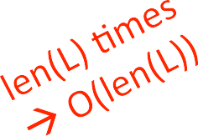
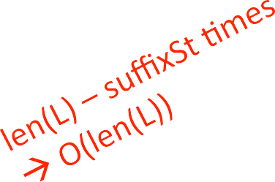
COMPLEXITY OF SELECTION SORT
def selection_sort(L): suffixSt = 0
while suffixSt != len(L):
 | for | i | in | range(suffixSt, | len(L)):
if L[i] < L[suffixSt]: L[suffixSt], L[i] =
suffixSt += 1
outer loop executes len(L) times
inner loop executes len(L) – i times
L[i], L[suffixSt]
complexity of selection sort is O(n²) where n is len(L)

Slide 19
MERGE SORT
use a divide-and-conquer approach:
if list is of length 0 or 1, already sorted
if list has more than one element, split into two lists, and sort each
merge sorted sublists
look at ﬁrst element of each, move smaller to end of the result
when one list empty, just copy rest of other list

Slide 20
Merge sort

Slide 21
MERGE SORT
divide and conquer
unsorted
unsorted
unsorted
unsorted
unsorted
unsorted
unsorted
unsor ted
unsor ted
unsor ted
unsor ted
unsor ted
unsor ted
unsor ted
unsor ted
merge
merge
merge
merge
merge
merge
merge
merge
split list in half until have sublists of only 1 element

Slide 22
MERGE SORT
divide and conquer
unsorted
unsorted
unsorted
unsorted
unsorted
unsorted
unsorted
sort
sort
sort
sort
sort
sort
sort
sort
merge
merge
merge
merge
merge such that sublists will be sorted after merge

Slide 23
MERGE SORT
divide and conquer
unsorted
unsorted
unsorted
sorted
sorted
sorted
sorted
merge
merge
merge sorted sublists
sublists will be sorted a_er merge

Slide 24
MERGE SORT
divide and conquer
unsorted
sorted
sorted
merge
merge sorted sublists
sublists will be sorted a_er merge

Slide 25
MERGE SORT
divide and conquer – done!
sorted

Slide 26












EXAMPLE OF MERGING
Left in list 1 | Left in list 2 | Compare Result
[1,5,12,18,19,20] | [2,3,4,17] | 1, 2 []
[5,12,18,19,20] | [2,3,4,17] | 5, 2 [1]
[5,12,18,19,20] | [3,4,17] | 5, 3 [1,2]
[5,12,18,19,20] | [4,17] | 5, 4 [1,2,3]
[5,12,18,19,20] | [17] | 5, 17 [1,2,3,4]
[12,18,19,20] | [17] | 12, 17 [1,2,3,4,5]
[18,19,20] | [17] | 18, 17 [1,2,3,4,5,12]
[18,19,20] | [] | 18, -- [1,2,3,4,5,12,17]
[] | [] | [1,2,3,4,5,12,17,18,19,20]

Slide 27
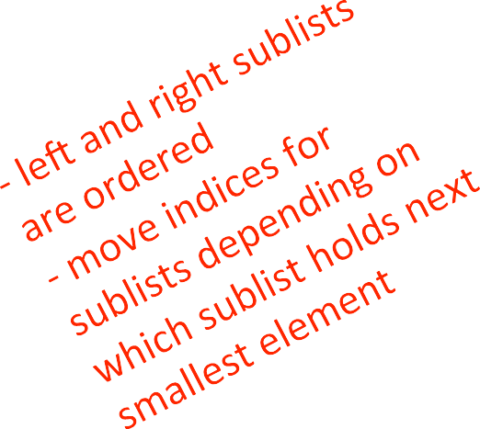


MERGING SUBLISTS STEP
def merge(left, right): result = []
i,j = while
0,0
i < len(left) and j < len(right):
if left[i] < right[j]: result.append(left[i])
i += 1
else:
result.append(right[j])
j += 1
while (i < len(left)):
result.append(left[i])
i += 1
while (j < len(right)): result.append(right[j])
j += 1
return result

Slide 28
COMPLEXITY OF
MERGING SUBLISTS STEP
go through two lists, only one pass
compare only smallest elements in each sublist
O(len(left) + len(right)) copied elements
O(len(longer list)) comparisons
linear in length of the lists

Slide 29


MERGE SORT ALGORITHM
-- RECURSIVE
def merge_sort(L):
if len(L) < 2:
return L[:]
else:
middle = len(L)//2
left = merge_sort(L[:middle]) right = merge_sort(L[middle:])
return merge(left, right)
divide list successively into halves
depth-ﬁrst such that conquer smallest pieces down one branch ﬁrst before moving to larger pieces

Slide 30
How to Merge
Here are two lists to be merged:
List 1: (12, 16, 17, 20, 21, 27)
List 2: (9, 10, 11, 12, 19)
Compare12 and 9
List 1: (12, 16, 17, 20, 21, 27)
List 2: (10, 11, 12, 19)
Merged List: (9)
Compare 12 and 10
List 1: (12, 16, 17, 20, 21, 27)
List 2: (11, 12, 19)
Merged List: (9, 10)
30

Slide 31
Merge Example
Compare 12 and 11
List 1: (12, 16, 17, 20, 21, 27)
List 2: (12, 19)
Merged List: (9, 10, 11)
Compare 12 and 12
List 1: (16, 17, 20, 21, 27)
List 2: (12, 19)
Merged List: (9, 10, 11, 12)
31

Slide 32
Merge Example
Compare 16 and 12
List 1: (16, 17, 20, 21, 27)
List 2: (19)
Merged List: (9, 10, 11, 12, 12)
Compare 16 and 19
List 1: (17, 20, 21, 27)
List 2: (19)
Merged List: (9, 10, 11, 12, 12, 16)
32

Slide 33
Merge Example
Compare 17 and 19
List 1: (20, 21, 27)
List 2: (19)
Merged List: (9, 10, 11, 12, 12, 16, 17)
Compare 20 and 19
List 1: (20, 21, 27)
List 2: ( )
Merged List: (9, 10, 11, 12, 12, 16, 17, 19)
33
Notes:
33

Slide 34
Merge Example
Checkout 20 and empty list
List 1: ( )
List 2: ( )
Merged List: (9, 10, 11, 12, 12, 16, 17, 19, 20, 21, 27)
34
Notes:
34

Slide 35
MergeSort
35
Notes:
35

Slide 36
Merge-Sort Tree
An execution of merge-sort is depicted by a binary tree
each node represents a recursive call of merge-sort and stores
unsorted sequence before the execution and its partition
sorted sequence at the end of the execution
the root is the initial call
the leaves are calls on subsequences of size 0 or 1
7 2 ⏐ 9 4 → 2 4 7 9
7 ⏐ 2 → 2 7
9 ⏐ 4 → 4 9
7 → 7
2 → 2
9 → 9
4 → 4
36
Notes:
36

Slide 37
Execution Example
Partition
7 2 9 4 ⏐ 3 8 6 1
37
Notes:
37

Slide 38
Execution Example (cont.)
Recursive call, partition
7 2 9 4 ⏐ 3 8 6 1
7 2 ⏐ 9 4
38
Notes:
38

Slide 39
Execution Example (cont.)
Recursive call, partition
7 2 9 4 ⏐ 3 8 6 1
7 2 ⏐ 9 4
7 ⏐ 2
39

Slide 40
Execution Example (cont.)
Recursive call, base case
7 2 9 4 ⏐ 3 8 6 1
7 2 ⏐ 9 4
7 ⏐ 2
7 → 7
40

Slide 41
Execution Example (cont.)
Recursive call, base case
7 2 9 4 ⏐ 3 8 6 1
7 2 ⏐ 9 4
7 ⏐ 2
7 → 7
2 → 2
41

Slide 42
Execution Example (cont.)
Merge
7 2 9 4 ⏐ 3 8 6 1
7 2 ⏐ 9 4
7 ⏐ 2 → 2 7
7 → 7
2 → 2
42

Slide 43
Execution Example (cont.)
Recursive call, …, base case, merge
7 2 9 4 ⏐ 3 8 6 1
7 2 ⏐ 9 4
7 ⏐ 2 → 2 7
9 4 → 4 9
7 → 7
2 → 2
9 → 9
4 → 4
43

Slide 44
Execution Example (cont.)
Merge
7 2 9 4 ⏐ 3 8 6 1
7 2 ⏐ 9 4 → 2 4 7 9
7 ⏐ 2 → 2 7
9 4 → 4 9
7 → 7
2 → 2
9 → 9
4 → 4
44

Slide 45
Execution Example (cont.)
Recursive call, …, merge, merge
7 2 9 4 ⏐ 3 8 6 1
7 2 ⏐ 9 4 → 2 4 7 9
3 8 6 1 → 1 3 6 8
7 ⏐ 2 → 2 7
9 4 → 4 9
3 8 → 3 8
6 1 → 1 6
7 → 7
2 → 2
9 → 9
4 → 4
3 → 3
8 → 8
6 → 6
1 → 1
45

Slide 46
Execution Example (cont.)
Merge
7 2 9 4 ⏐ 3 8 6 1 → 1 2 3 4 6 7 8 9
7 2 ⏐ 9 4 → 2 4 7 9
3 8 6 1 → 1 3 6 8
7 ⏐ 2 → 2 7
9 4 → 4 9
3 8 → 3 8
6 1 → 1 6
7 → 7
2 → 2
9 → 9
4 → 4
3 → 3
8 → 8
6 → 6
1 → 1
46

Slide 47
COMPLEXITY OF MERGE SORT
at ﬁrst recursion level
n/2 elements in each list
O(n) + O(n) = O(n) where n is len(L)
at List 2 recursion level
n/4 elements in each list
two merges → O(n) where n is len(L)
each recursion level is O(n) where n is len(L)
dividing list in half with each recursive call
O(log(n)) where n is len(L)
overall complexity is O(n log(n)) where n is len(L)

Slide 48
SORTING SUMMARY
-- n is len(L)
bogo sort
randomness, unbounded O()
bubble sort
O(n²)
selection sort
O(n²)
guaranteed the ﬁrst i elements were sorted
merge sort
O(n log(n))
O(n log(n)) is the fastest a sort can be

Slide 49
WHAT HAVE WE SEEN IN ?

Slide 50
KEY TOPICS
represent knowledge with data structures
iteration and recursion as computational metaphors
abstraction of procedures and data types
organize and modularize systems using object classes and methods
diﬀerent classes of algorithms, searching and sorting
complexity of algorithms

Slide 51
OVERVIEW OF COURSE
learn computational modes of thinking
begin to master the art of computational problem solving
make computers do what you want them to do
Hope we have started you down the path to being able to think and act like a computer scientist

Slide 52
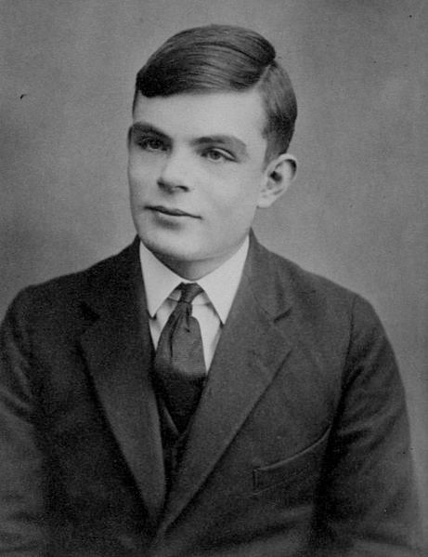
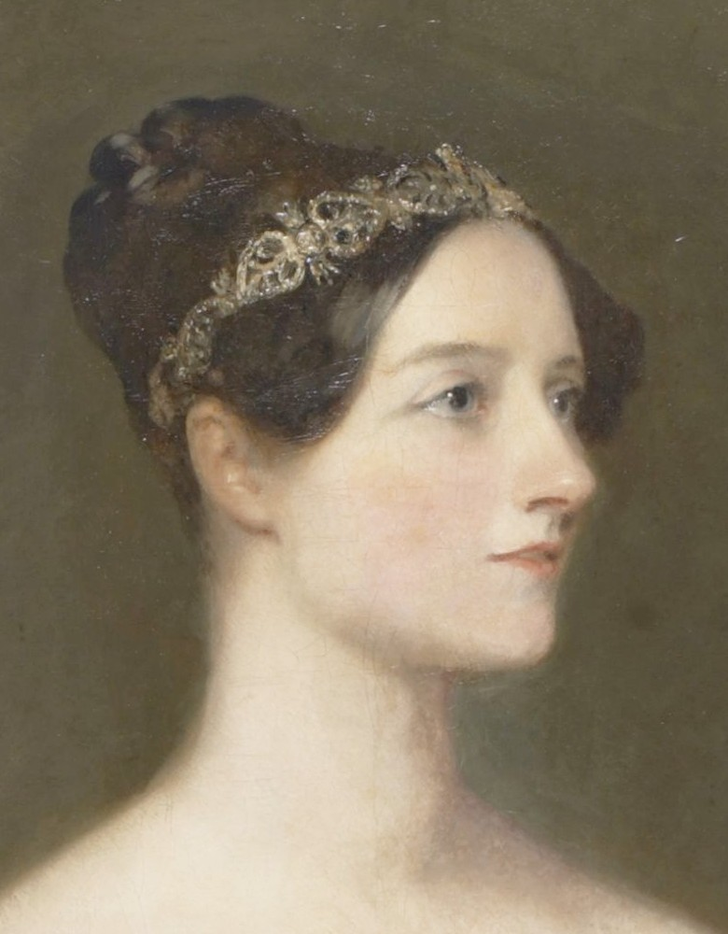

WHAT DO COMPUTER SCIENTISTS DO?
they think computationally
abstractions, algorithms, automated execution
just like the three r’s: reading,
‘riting, and ‘rithmetic – computational thinking is becoming a fundamental skill that every well-educated person will need
I
Ada Lovelace
Image in the Public Domain, courtesy of Wikipedia Commons.
Alan Turing
Image in the Public Domain, courtesy of Wikipedia Commons.
52

Slide 53










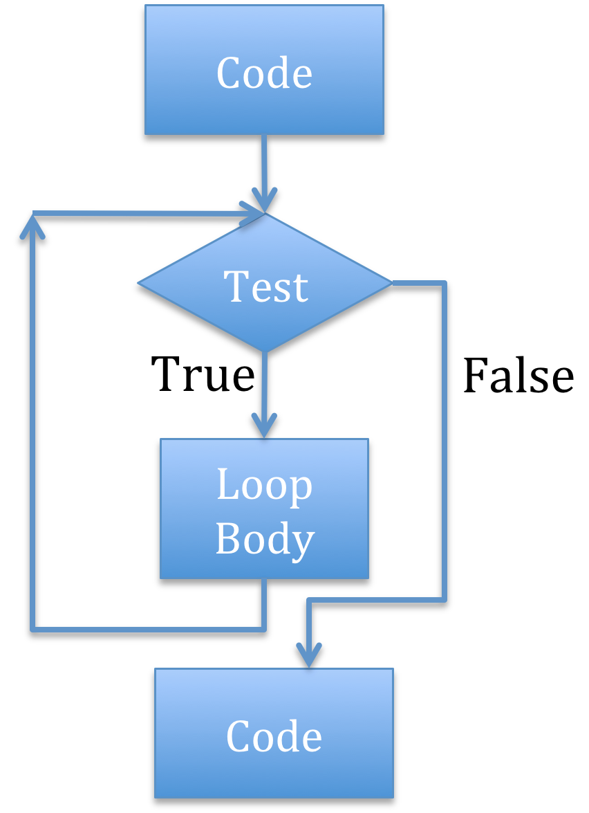
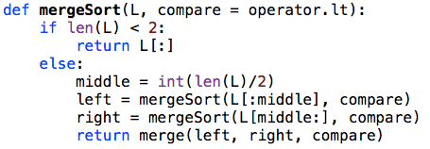
THE THREE A’S OF COMPUTATIONAL THINKING
abstraction
choosing the right abstractions
operating in multiple layers of abstraction simultaneously
deﬁning the relationships between the abstraction layers
automation
think in terms of mechanizing our abstractions
mechanization is possible – because we have precise and exacting notations and models; and because there is some “machine” that can interpret our notations layers
algorithms
language for describing automated processes
also allows abstraction of details
language for comamunicating ideas & processes
53

Slide 54
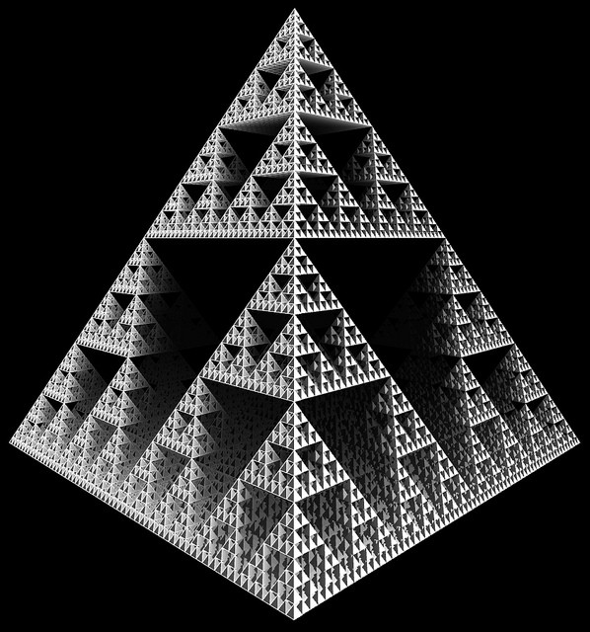
ASPECTS OF COMPUTATIONAL THINKING
how diﬃcult is this problem and how best can I solve it?
theoretical computer science gives precise meaning to these and related questions and their answers
thinking recursively
reformulating a seemingly diﬃcult problem into one which we know how to solve
reduction, embedding, transformation, simulation
O(log n) ; O(n) ; O(n log n) ; O(n²); O(c^{n})
Image Licensed CC-BY, Courtesy of Robson# on Flickr.
54

