Slide 1
VISUALIZATION OF DATA

Slide 2
VISUALIZING RESULTS
earlier saw examples of different orders of growth of procedures
used graphs to provide an intuitive sense of differences
example of leveraging an existing library, rather than writing procedures from scratch
Python provides libraries for (among other topics):
graphing
numerical computation
stochastic computation
want to explore idea of using existing library procedures to guide processing and exploration of data

Slide 3
USING PYLAB
pip install matplotlib
can import library into computing environment
import pylab as plt
allows me to reference any library procedure as
plt.<procName>
provides access to existing set of graphing/plotting
procedures
here will just show some simple examples; lots of additional information available in documentation associated with pylab
will see many other examples and details of these ideas if you opt to take other course

Slide 4
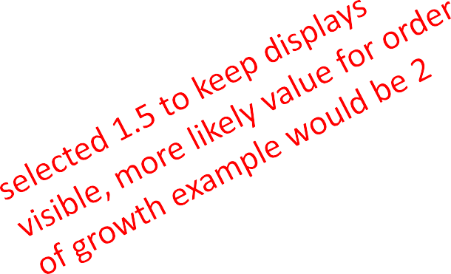

SIMPLE EXAMPLE
basic function plots two lists as x and y values
other data structures more powerful, use lists to demonstrate
first, let’s generate some example data
mySamples = []
myLinear = [] myQuadratic = [] myCubic = []
myExponential = []
for i in range(0, 30): mySamples.append(i) myLinear.append(i) myQuadratic.append(i**2) myCubic.append(i**3) myExponential.append(1.5**i)

Slide 5


SIMPLE EXAMPLE
to generate a plot, call
plt.plot(mySamples, myLinear)
arguments are lists of values (for now)
lists must be of the same length
calling function in an iPython console will generate plots within that console
calling function in a Python console will create a separate window in which plot is displayed

Slide 6
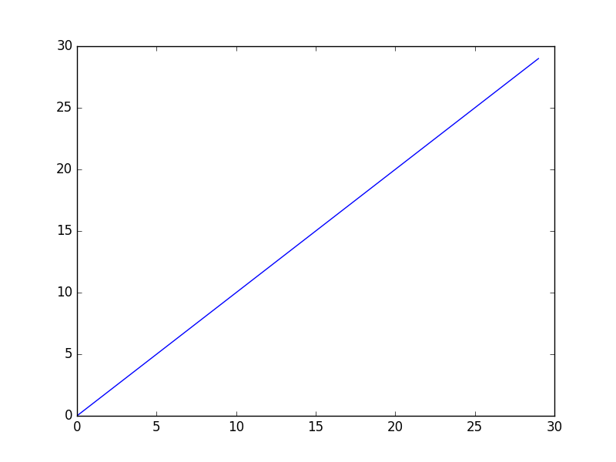
EXAMPLE DISPLAY
plt.plot(mySamples, myLinear)

Slide 8
OVERLAPPING DISPLAYS
suppose we want to display all of the graphs of the different orders of growth
we could just call: plt.plot(mySamples, myLinear) plt.plot(mySamples, myQuadratic) plt.plot(mySamples, myCubic)
plt.plot(mySamples, myExponential)

Slide 9
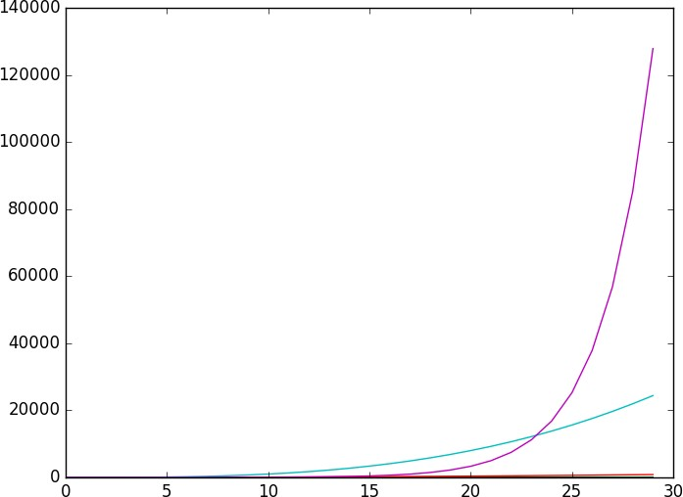
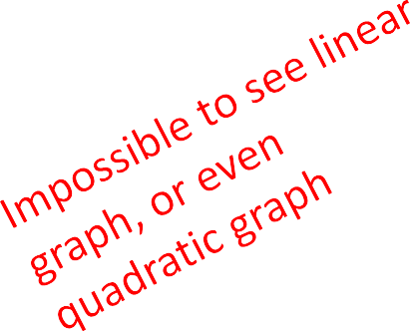

EXAMPLE OVERLAY DISPLAY
plt.plot(mySamples, myLinear) plt.plot(mySamples, myQuadratic)
plt.plot(mySamples, myCubic) plt.plot(mySamples, myExponential)

Slide 10
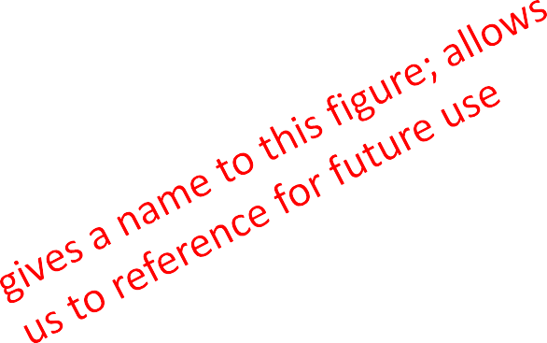

OVERLAPPING DISPLAYS
not very helpful, can’t really see anything but the biggest of the plots because the scales are so different
can we graph each one separately?
call
plt.figure(<arg>)
creates a new display with that name if one does not already exist
if a display with that name exists, reopens it for processing

Slide 11


EXAMPLE CODE
plt.figure('lin') plt.plot(mySamples, myLinear) plt.figure('quad') plt.plot(mySamples, myQuadratic) plt.figure('cube') plt.plot(mySamples, myCubic) plt.figure('expo') plt.plot(mySamples, myExponential)

Slide 12
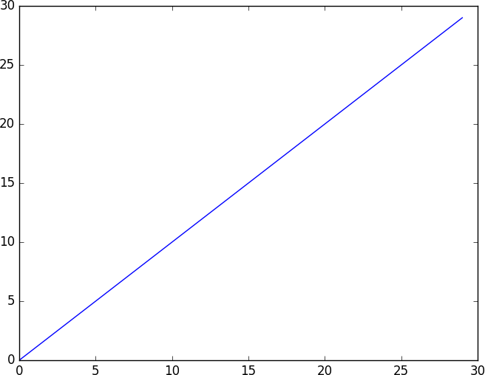
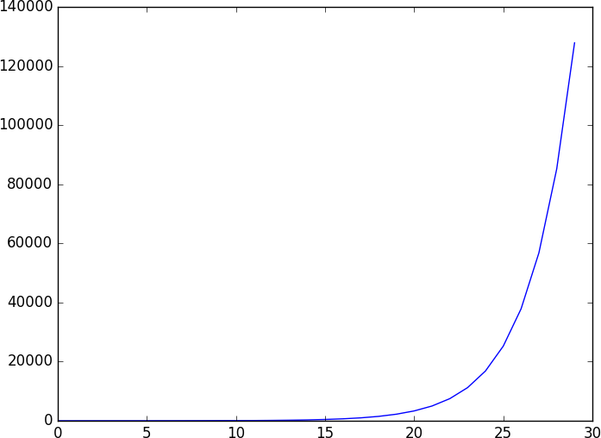
SEPARATE PLOTS
plt.figure('lin')
plt.plot(mySamples, myLinear)
plt.figure('expo') plt.plot(mySamples,
myExponential)

Slide 14
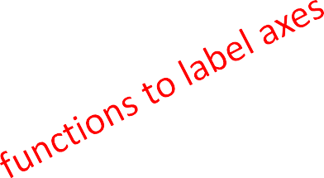


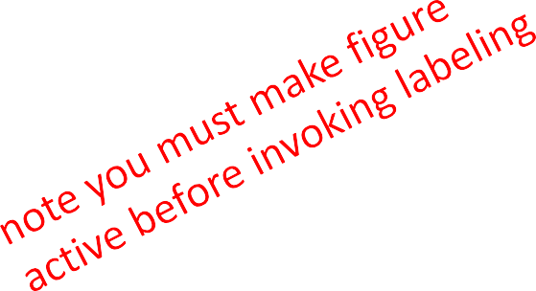

PROVIDING LABELS
Should really label the axes
plt.figure('lin')
plt.xlabel('sample points')
plt.ylabel('linear function')
plt.plot(mySamples, myLinear)
plt.figure('quad')
plt.plot(mySamples, myQuadratic) plt.figure('cube') plt.plot(mySamples, myCubic) plt.figure('expo’) plt.plot(mySamples, myExponential)
plt.figure('quad')
plt.ylabel('quadratic function')

Slide 15
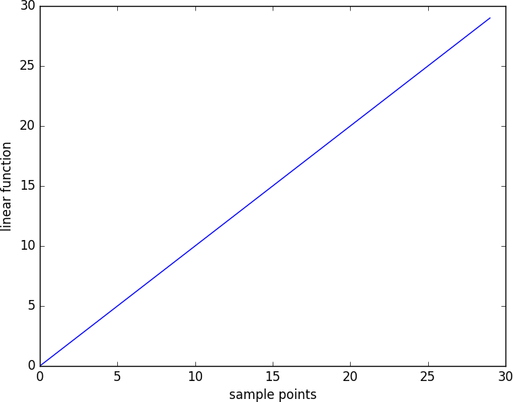
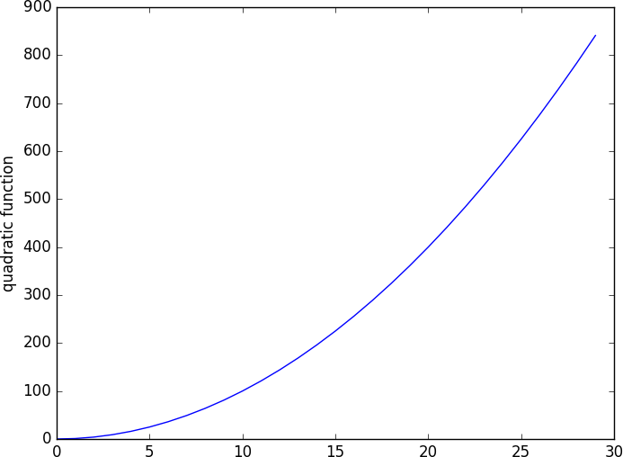
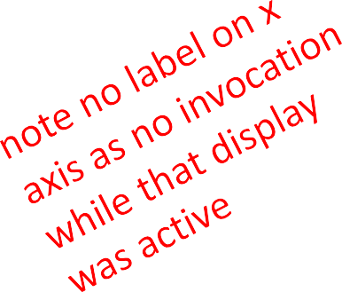
LABELED AXES

Slide 16

ADDING TITLES
plt.figure('lin') plt.plot(mySamples, myLinear) plt.figure('quad') plt.plot(mySamples, myQuadratic) plt.figure('cube') plt.plot(mySamples, myCubic) plt.figure('expo') plt.plot(mySamples, myExponential)
plt.figure('lin') plt.title('Linear') plt.figure('quad') plt.title('Quadratic') plt.figure('cube') plt.title('Cubic') plt.figure('expo') plt.title('Exponential')

Slide 17
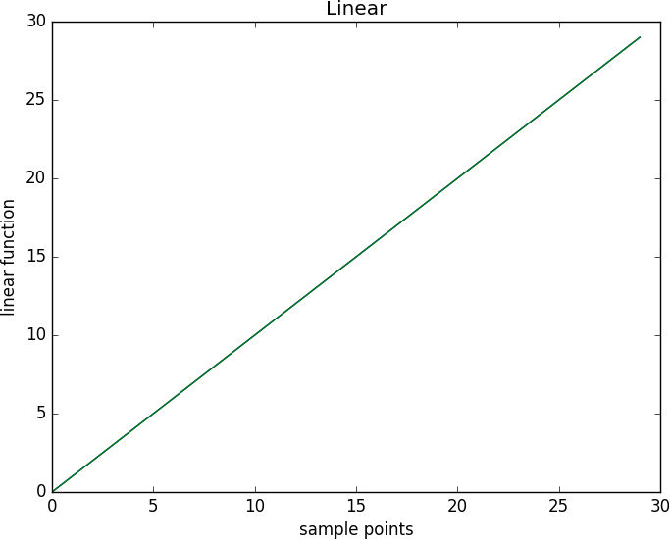
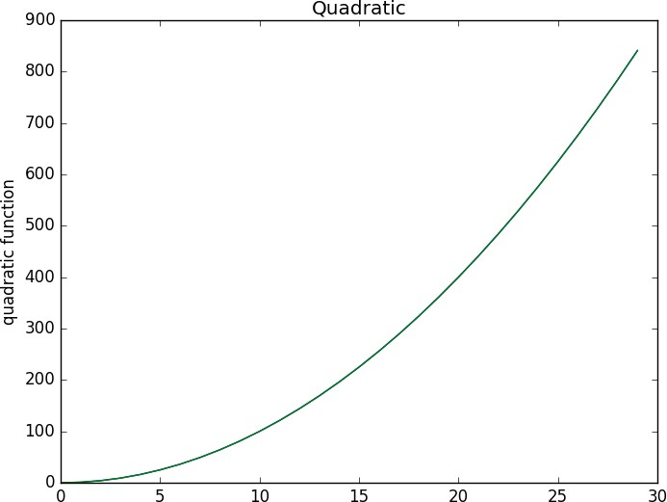
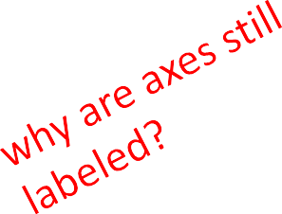
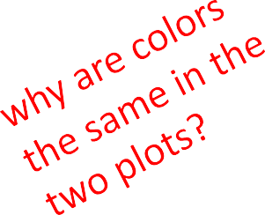
TITLED DISPLAYS

Slide 18
CLEANING UP WINDOWS
we are reusing a previously created display window
need to clear it before redrawing
because we are calling plot in a new version of a window, system starts with first choice of color (hence the same); we can control (see later)

Slide 19


CLEANING WINDOWS
plt.figure('lin')
plt.figure('lin') plt.title('Linear') plt.figure('quad') plt.title('Quadratic') plt.figure('cube') plt.title('Cubic') plt.figure('expo') plt.title('Exponential')
plt.clf()
plt.plot(mySamples, myLinear) plt.figure('quad')
plt.clf()
'
plt.plot(mySamples, myQuadratic) plt.figure('cube')
plt.clf()
plt.plot(mySamples, myCubic) plt.figure('expo') plt.clf()
plt.plot(mySamples, myExponential)

Slide 20
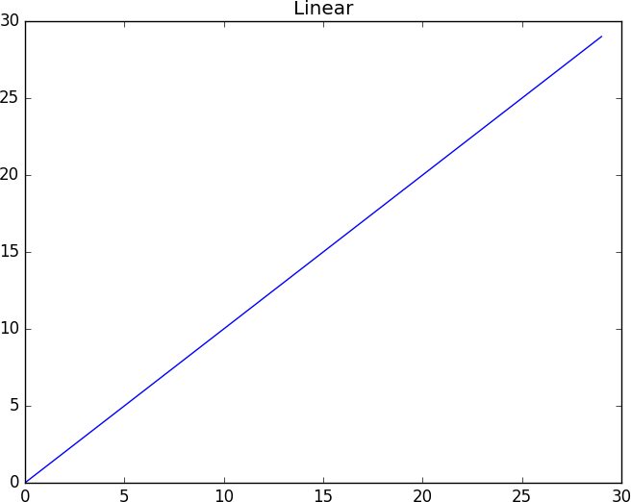
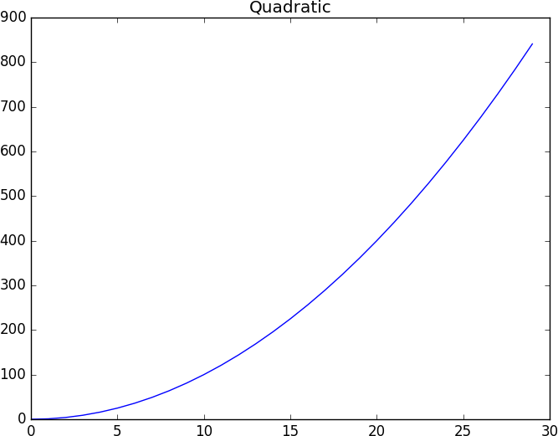
CLEARED DISPLAYS

Slide 22
COMPARING RESULTS
now suppose we would like to compare different plots
in particular, the scales on the graphs are very different
one option is to explicitly set limits on the axis or axes
a second option is to plot multiple functions on the same display

Slide 23

CHANGING LIMITS ON AXES
plt.figure('lin') plt.clf()
plt.ylim(0,1000)
plt.plot(mySamples, myLinear) plt.figure('quad')
plt.clf()
plt.ylim(0,1000)
plt.plot(mySamples, myQuadratic) plt.figure('lin') plt.title('Linear') plt.figure('quad') plt.title('Quadratic')

Slide 24
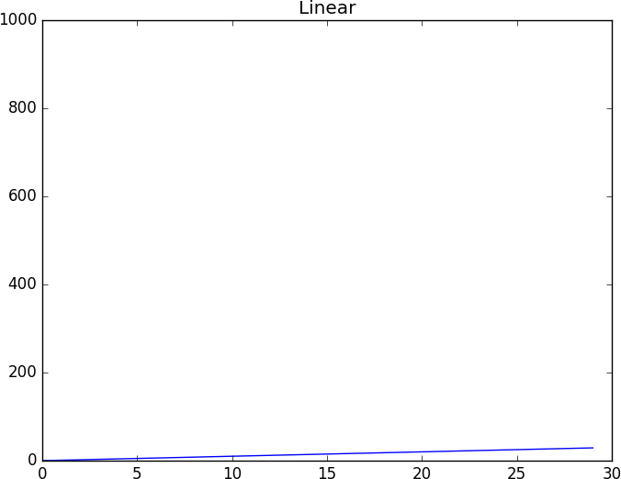
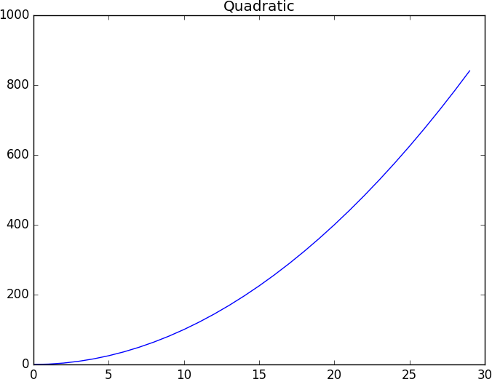
CHANGING LIMITS ON AXES

Slide 25
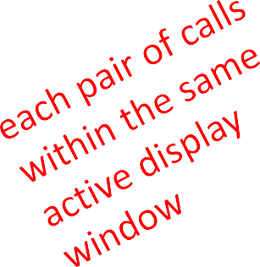

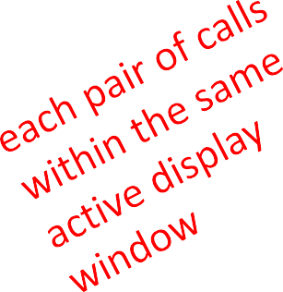

OVERLAYING PLOTS
plt.figure('lin quad') plt.clf()
plt.plot(mySamples, myLinear)
plt.plot(mySamples, myQuadratic)
plt.figure('cube exp')
plt.clf()
plt.plot(mySamples, myCubic) plt.plot(mySamples, myExponential)
plt.figure('lin quad') plt.title('Linear vs. Quadratic') plt.figure('cube exp') plt.title('Cubic vs. Exponential')

Slide 26
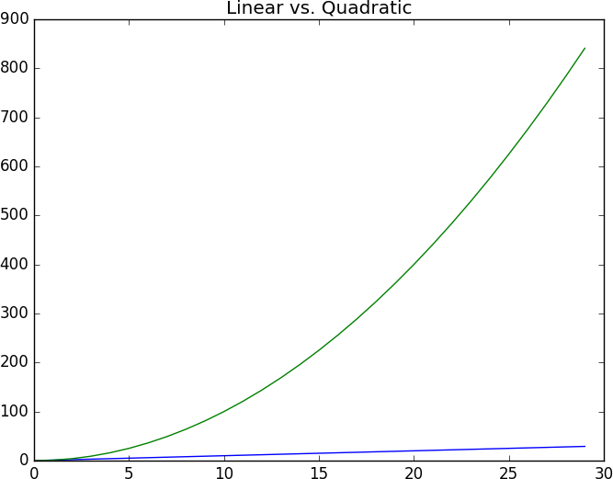
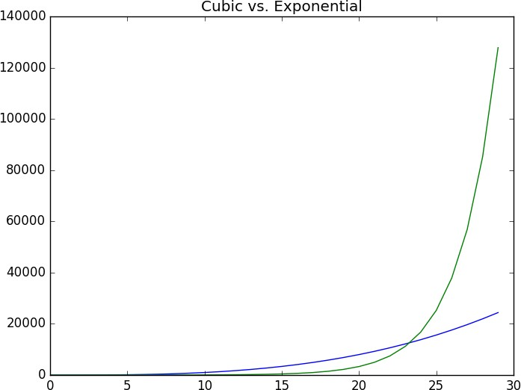
OVERLAYING PLOTS

Slide 27
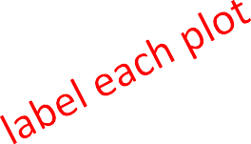



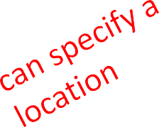




ADDING MORE DOCUMENTATION
can add a legend that identifies each plot
plt.figure('lin quad') plt.clf()
plt.plot(mySamples, myLinear,
label = 'linear' |  | )
 | label = 'quadratic'
plt.plot(mySamples, myQuadratic,
)
plt.legend(loc = 'upper left')
plt.title('Linear vs. Quadratic')
plt.figure('cube exp') plt.clf() plt.plot(mySamples, myCubic,
label = 'cubic')
plt.plot(mySamples, myExponential, label = 'exponential')
plt.legend()
plt.title('Cubic vs. Exponential')

Slide 28
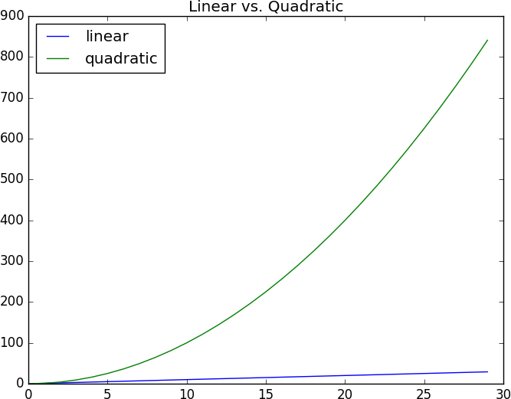
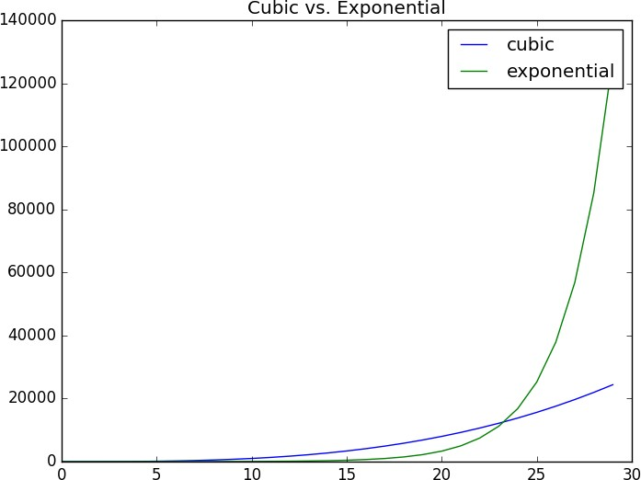
ADDING MORE DOCUMENTATION

Slide 30
CONTROLLING DISPLAY PARAMETERS
now suppose we want to control details of the displays themselves
examples:
changing color or style of data sets
changing width of lines or displays
using subplots

Slide 31





CHANGING DATA DISPLAY
plt.figure('lin quad') plt.clf()
plt.plot(mySamples, myLinear, 'b-', label = 'linear') plt.plot(mySamples, myQuadratic,'ro', label = 'quadratic') plt.legend(loc = 'upper left')
plt.title('Linear vs. Quadratic’)
plt.figure('cube exp') plt.clf()
plt.plot(mySamples, myCubic, 'g^', label = 'cubic')
plt.plot(mySamples, myExponential, 'r--',label = 'exponential') plt.legend()
plt.title('Cubic vs. Exponential')

Slide 32
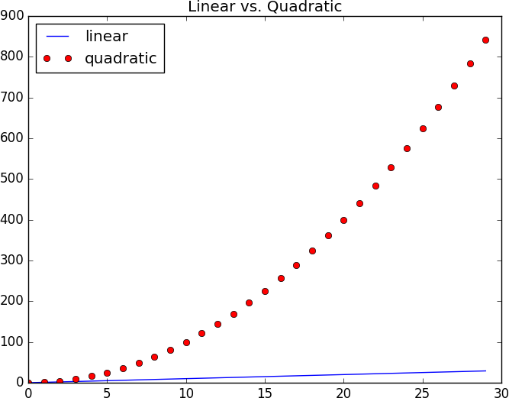
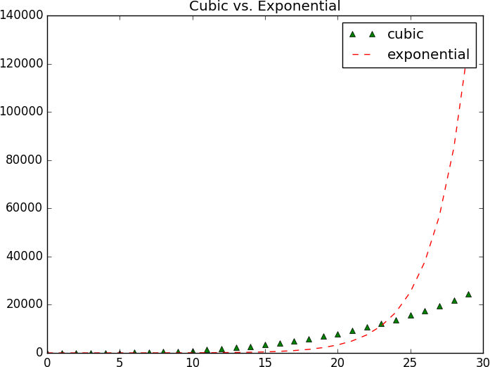
CHANGING DATA DISPLAY

Slide 33


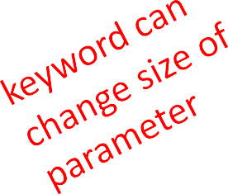


CHANGING DATA DISPLAY
plt.figure('lin quad') plt.clf()
plt.plot(mySamples, myLinear, 'b-', label = 'linear’,
linewidth = 2.0)
plt.plot(mySamples, myQuadratic,'r', label = 'quadratic’,
linewidth = 3.0)
plt.legend(loc = 'upper left') plt.title('Linear vs. Quadratic')
plt.figure('cube exp') plt.clf()
plt.plot(mySamples, myCubic, 'g--', label = 'cubic',
linewidth = 4.0)
plt.plot(mySamples, myExponential, 'r',label = 'exponential',
linewidth = 5.0)
plt.legend()
plt.title('Cubic vs. Exponential')

Slide 34
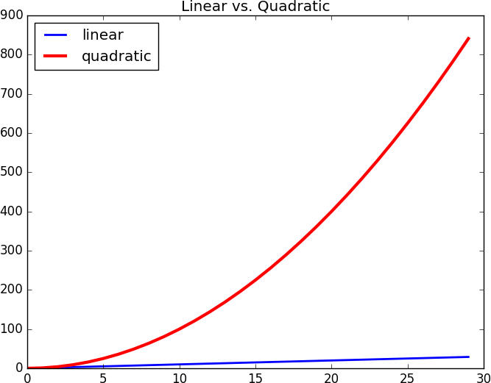
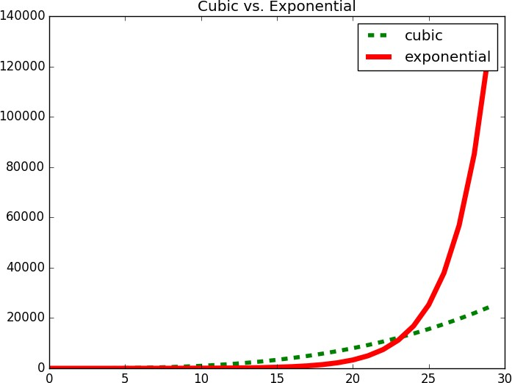
CHANGING DATA DISPLAY

Slide 35




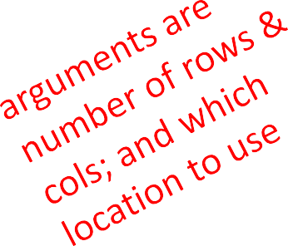
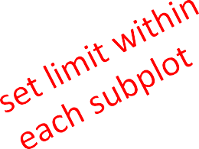



USING SUBPLOTS
plt.figure('lin quad') plt.clf() plt.subplot(211) plt.ylim(0,900)
plt.plot(mySamples, myLinear, 'b-', label = 'linear’, linewidth = 2.0) plt.subplot(212)
plt.ylim(0,900)
plt.plot(mySamples, myQuadratic, 'r', label = 'quadratic’, linewidth = 3.0) plt.legend(loc = 'upper left')
plt.title('Linear vs. Quadratic')
plt.figure('cube exp') plt.clf() plt.subplot(121) plt.ylim(0, 140000)
plt.plot(mySamples, myCubic, 'g--', label = 'cubic’, linewidth = 4.0) plt.subplot(122)
plt.ylim(0, 140000)
plt.plot(mySamples, myExponential, 'r',label = 'exponential’, linewidth = 5.0) plt.legend()
plt.title('Cubic vs. Exponential')

Slide 36
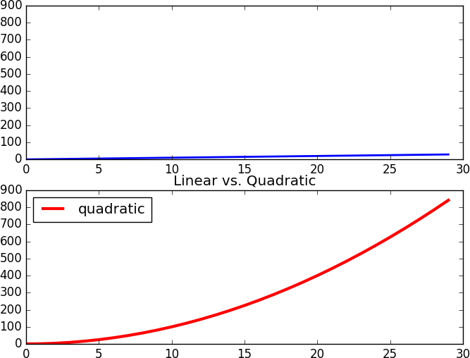
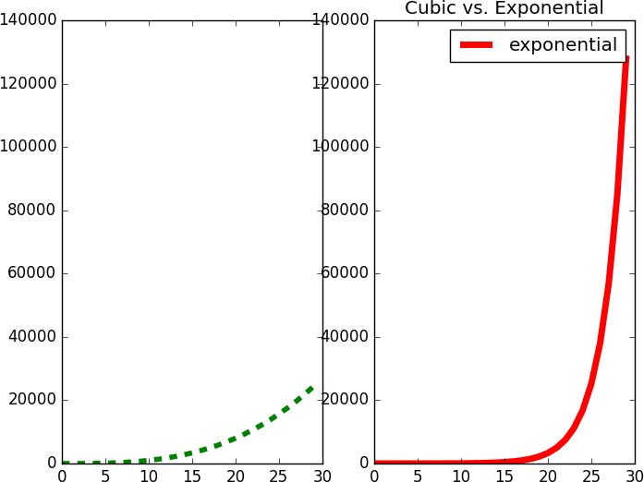
USING SUBPLOTS

Slide 37

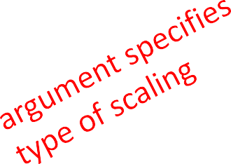
CHANGING SCALES
plt.figure('cube exp log')
plt.clf()
plt.plot(mySamples, myCubic, 'g--', label = 'cubic’, linewidth = 2.0)
plt.plot(mySamples, myExponential, 'r',label = 'exponential', linewidth | = | 4.0)
plt.yscale('log')
plt.legend() plt.title('Cubic vs. Exponential')
plt.figure('cube exp linear') plt.clf() plt.plot(mySamples, myCubic, 'g--', label = 'cubic’, linewidth = 2.0) plt.plot(mySamples, myExponential, 'r',label = 'exponential', linewidth | = | 4.0)
plt.legend() plt.title('Cubic vs. Exponential')

Slide 38
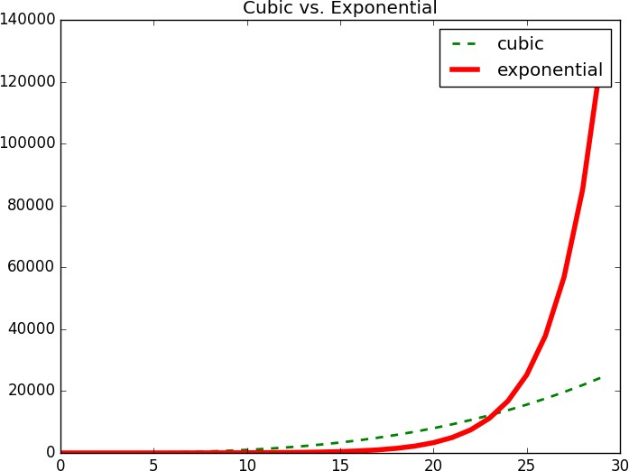
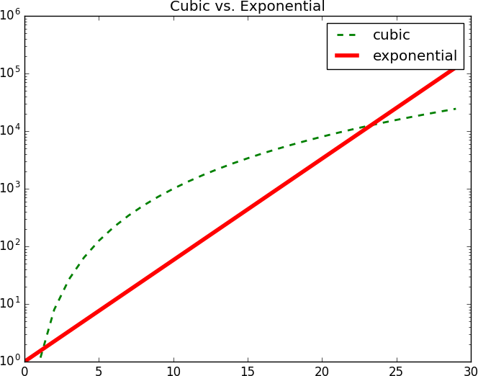
CHANGING SCALES

Slide 40
AN EXAMPLE
want to explore how ability to visualize results can help guide computation
simple example
planning for retirement
intend to save an amount m each month
expect to earn a percentage r
investments each month
want to explore how big a retirement fund will be compounded by time ready to retire
of income on

Slide 41
AN EXAMPLE: compound interest
def retire(monthly, rate, terms): savings = [0]
base = [0] mRate = rate/12
for i in range(terms):
base += [i]
savings += [savings[-1]*(1 + mRate) + monthly] return base, savings

Slide 42
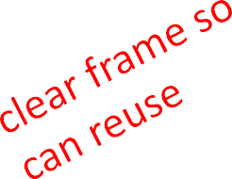


DISPLAYING RESULTS vs. MONTH
def displayRetireWMonthlies(monthlies, plt.figure('retireMonth') | rate, | terms):
plt.clf()
for monthly in monthlies: xvals, yvals = retire(monthly, | rate, | terms)
plt.plot(xvals, yvals,
label = 'retire:'+str(monthly))
plt.legend(loc = 'upper left')
displayRetireWMonthlies([500, 600, 700, 800, 900,
1000, 1100], .05, 40* 12)

Slide 43
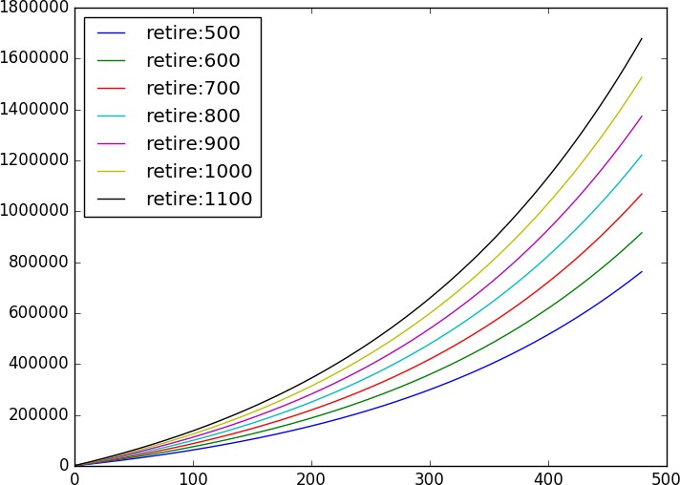
DISPLAYING RESULTS vs. MONTH

Slide 44
ANALYSIS vs. CONTRIBUTION
can see impact of increasing monthly contribution
ranges from about 750K to 1.67M, as monthly savings ranges from $500 to $1100
what is effect of rate of growth of investments?

Slide 45


DISPLAYING RESULTS vs. RATE
def displayRetireWRates(month, rates, terms): plt.figure('retireRate')
plt.clf()
for rate in rates:
xvals, yvals = retire(month, rate, terms)
plt.plot(xvals, yvals,
label = 'retire:'+str(month)+ ':' + \
str(int(rate*100)))
plt.legend(loc = 'upper left')
displayRetireWRates(800,[.03, .05, .07], 40*12)

Slide 46
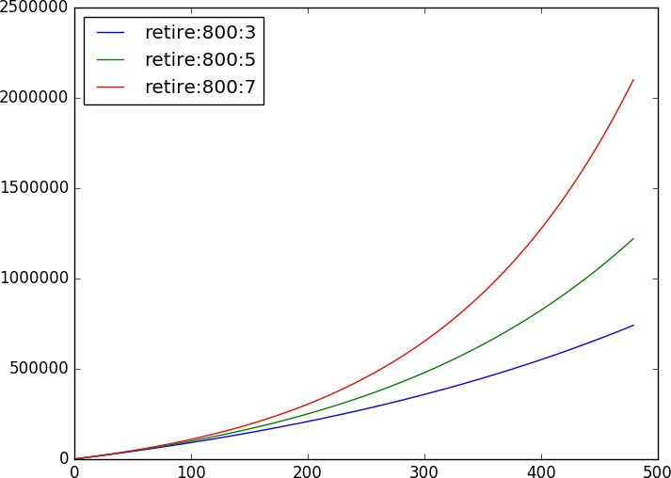
DISPLAYING RESULTS vs. RATE

Slide 47
ANALYSIS vs. RATE
can also see impact of increasing expected rate of return on investments
ranges from about 600K to 2.1M, as rate goes from 3% to 7%
what if we look at both effects together?

Slide 48




DISPLAYING RESULTS vs. BOTH
def displayRetireWMonthsAndRates(monthlies, rates, terms):
plt.figure('retireBoth')
plt.clf()
plt.xlim(30*12, 40*12)
for monthly in monthlies:
for rate in rates:
xvals, yvals = retire(monthly, rate, terms)
plt.plot(xvals, yvals,
label = 'retire:'+str(monthly)+ ':' \
+ str(int(rate*100)))
plt.legend(loc = 'upper left')
displayRetireWMonthsAndRates([500, 700, 900, 1100],
[.03, .05, .07], 40*12)

Slide 49
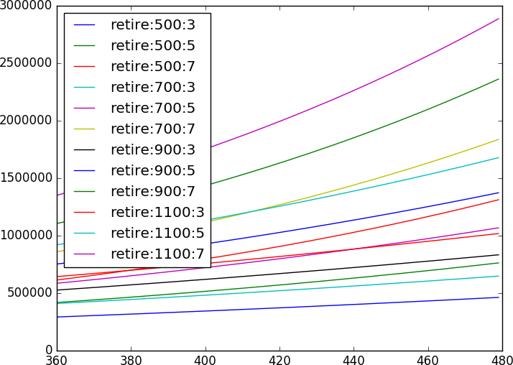
DISPLAYING RESULTS vs. BOTH

Slide 50
DISPLAYING RESULTS vs. BOTH
hard to distinguish because of overlap of many graphs
could just analyze separately
but can also try to visually separate effects

Slide 51
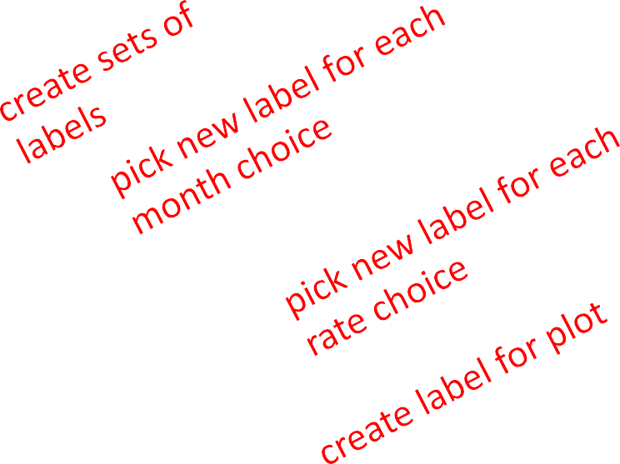


DISPLAYING RESULTS vs. BOTH
def displayRetireWMonthsAndRates(monthlies, rates, terms):
plt.figure('retireBoth') plt.clf() plt.xlim(30*12, 40*12)
monthLabels = ['r', ’b', ’g', ’k']
rateLabels = ['-', 'o', '—']
for i in range(len(monthlies)):
monthly = monthlies[i]
monthLabel = monthLabels[i%len(monthLabels)]
for j in range(len(rates)): rate = rates[j]
rateLabel = rateLabels[j%len(rateLabels)]
xvals, yvals = retire(monthly, rate, terms)
plt.plot(xvals, yvals,
monthLabel+rateLabel,
label = 'retire:'+str(monthly)+ ':' \
+ str(int(rate*100))) plt.legend(loc = 'upper left')
displayRetireWMonthsAndRates([500, 700, 900, 1100], [.03, .05, .07],
40*12)

Slide 52
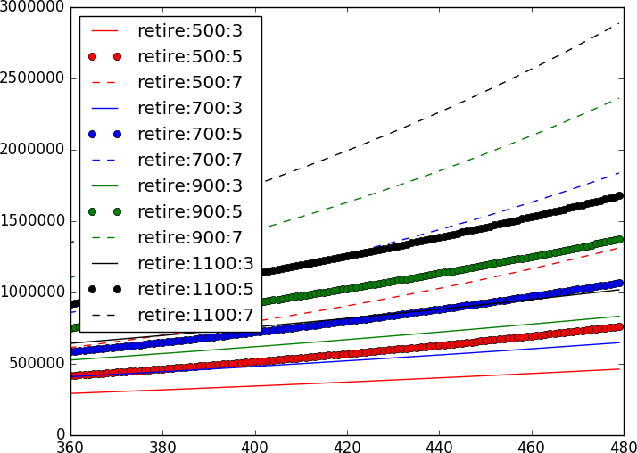
DISPLAYING RESULTS vs. BOTH

Slide 53
DISPLAYING RESULTS vs. BOTH
now easier to see grouping of plots
color encodes monthly contribute
format (solid, circle, dashed) encodes growth rate of investments
interaction with plotting routines and computations allows us to explore data
change display range to zero in on particular areas of interest
change sets of values and visualize effect – then guides new choice of values to explore
change display parameters to highlight clustering of plots by parameter

