Slide 1
高精度整数乘法
大整数整数解决方案分析讨论

Slide 2
问题定义
高精度整数乘法一般也叫大整数乘法，就是用低位的整数乘法， 实现超过该表示的整数的乘法； 具体上可以通过如下公式来表达（当然由于表示的方法不同，可能的表示也不同， 所以下面的表示只是这个问题的一种表达方式）

Slide 3
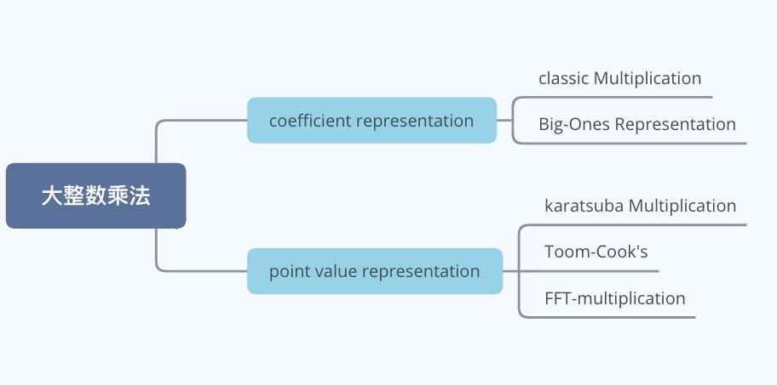
CPU 计算环境下解决方案

Slide 4
Cpu 计算环境的解决方案
算法流程主要分为两大范式：
1. coefficient representation: 一般用多项式来表示； 计算复杂度高， 但不需要特别复杂的前后处理；
2. point-value representation: 能降低计算复杂度， 但构建point-value representation 的过程一般比较复杂； 例如FFT 以及Toom-Cook's 的计算比较适合在特别大的整数时才会优于 classic Multiplication, 因为前处理的耗时比较高。

Slide 5
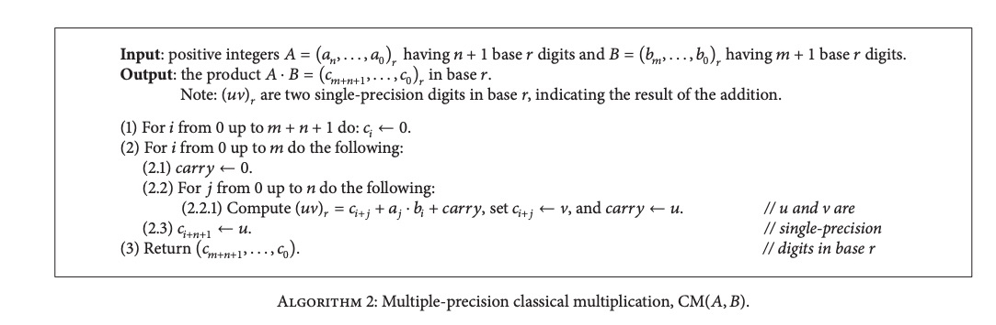
Classic Multiplication 算法

Slide 6
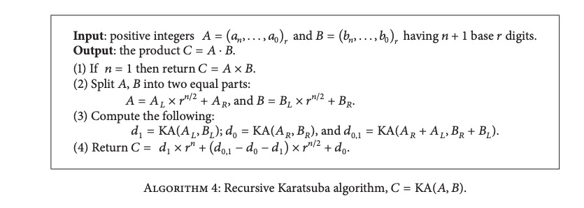
karatsuba Multiplication 算法

Slide 7
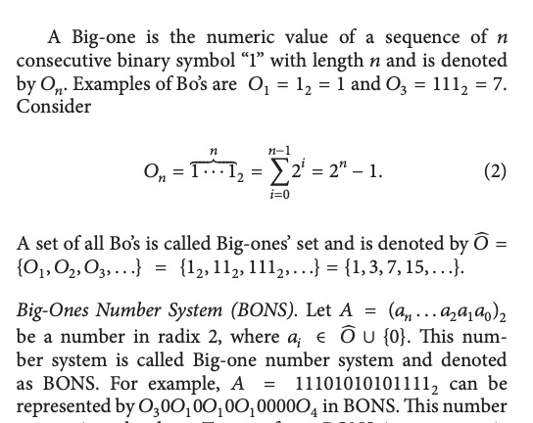
Big-Ones Representation 算法
思想：用类似hamming编码的方式，缩小表示的位数， 这样在计算时可以减少需要计算的复杂度， 从而提升计算性能

Slide 8
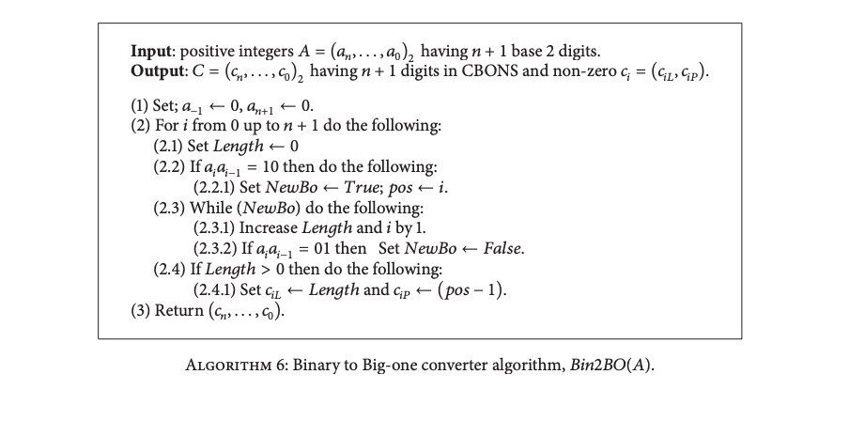
2进制表示转成Big- one 表示

Slide 9
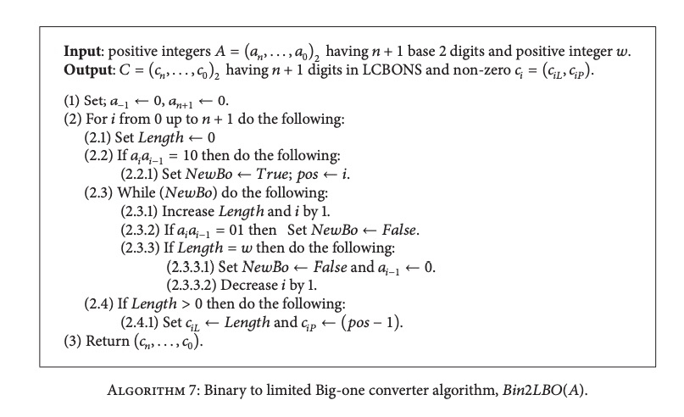
Limited Big-one 转换算法
由于后续Big-one乘法实现，需要用查表的方式进行（空间换时间），所以对编码的格式也做了限制, 就是说连续为为1的字符最多为5个

Slide 10
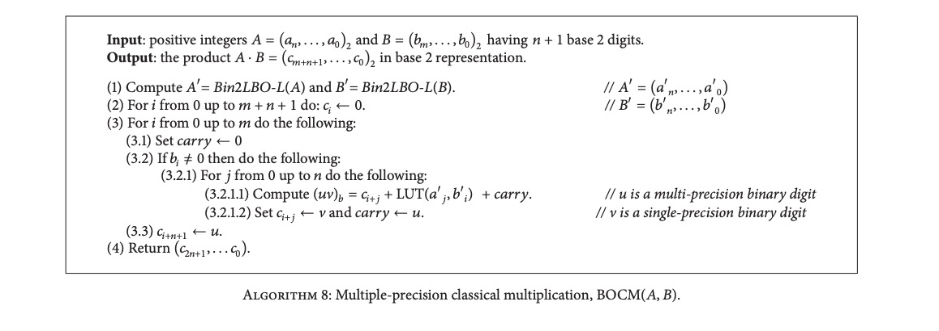
Big-one 乘法实现：
注意： 上面流程中的LUT 就是一个查表的过程， 就是说 所有的aj‘ * bi’ 是提前算好，放在内存里面；
内存占用： The size of LUT for the case of 𝑤=5 is 50 bytes (5×5×2 bytes) for squaring and multiplication.

Slide 11
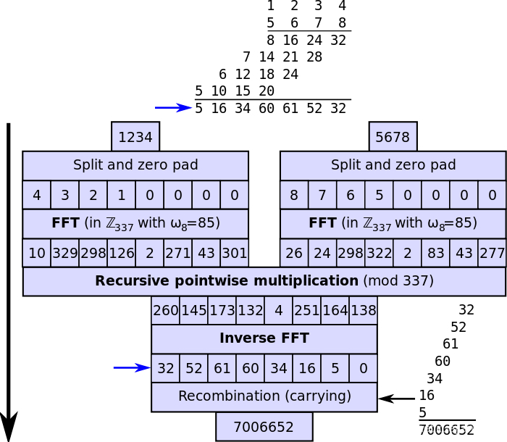
Strassen FFT 算法

Slide 12
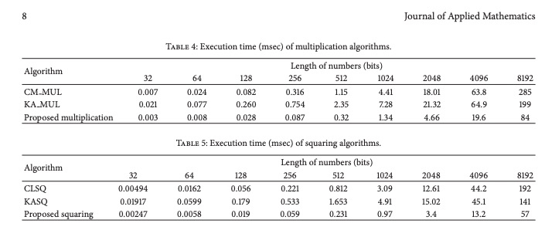
效果对比

Slide 13
效果结论
representatives include Karatsuba method Toom-Cook method 4- way method 5-way method and Strassen FFT multiplication Time complexities of these methods are O(n 1.585),O(n 1.465), O(n 1.404), and O(n 1.365) respectively n is the number of bits of a multiplicand and a multiplier
but in the study [5], Zuras compares implementation of these methods in C language and assembly language on HP-9000/720, and reports that the naive O(n 2 ) method is the best for small numbers and that all naive methods are faster than FFT multiplication which has advantage in time complexity for large numbers. Finally, Zuras concludes that FFT multiplication is not always the fastest even for extremely large numbers (> 37,000,000 bits).

Slide 14
基于GPU 算法
主要研究方向是利用gpu的并行度来提升计算速度
两个算法：
FFT multiplication on GPU
Product Digit Table on GPU

Slide 15
FFT multiplication on GPU
Parallel FFT algorithms are commonly based on the Stockham out-of-place FFT. Here use Bailey’s variation of this algorithm.
all data fetches and stores are performed solely with unit strides, hence, no bank conflicts occur. Roots of unity are still accessed with power-of-two strides but this can be alleviated by storing the roots in contiguous arrays for each FFT step.

Slide 16
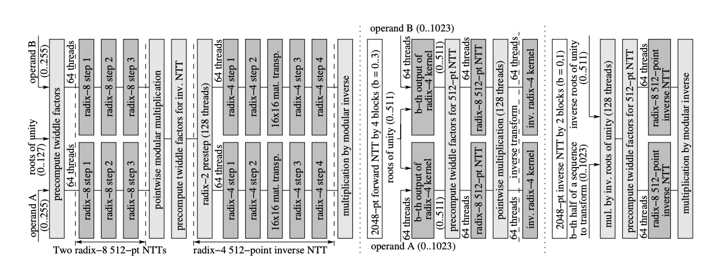
FFT multiplication on GPU

Slide 17
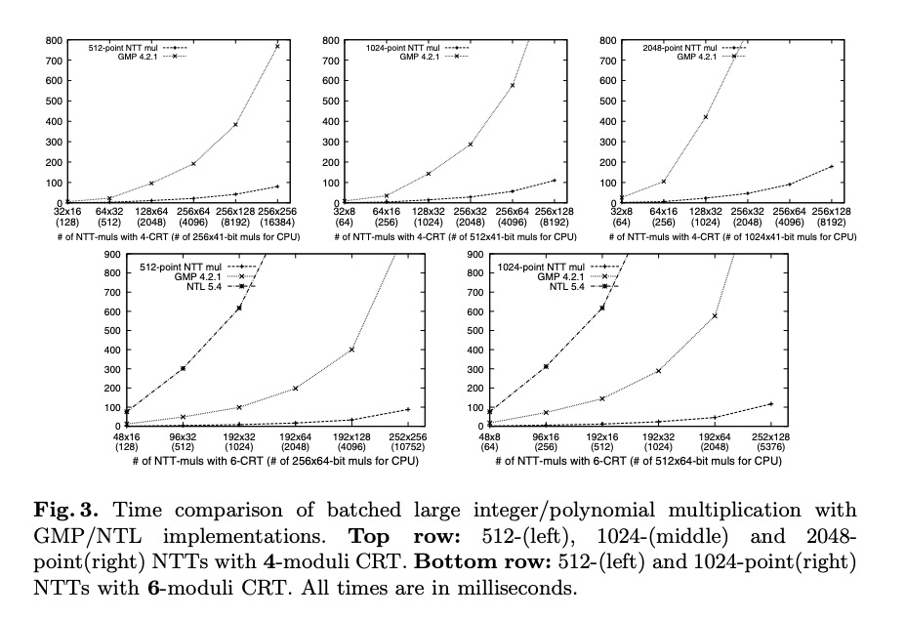
FFT ON GPU 效果

Slide 18
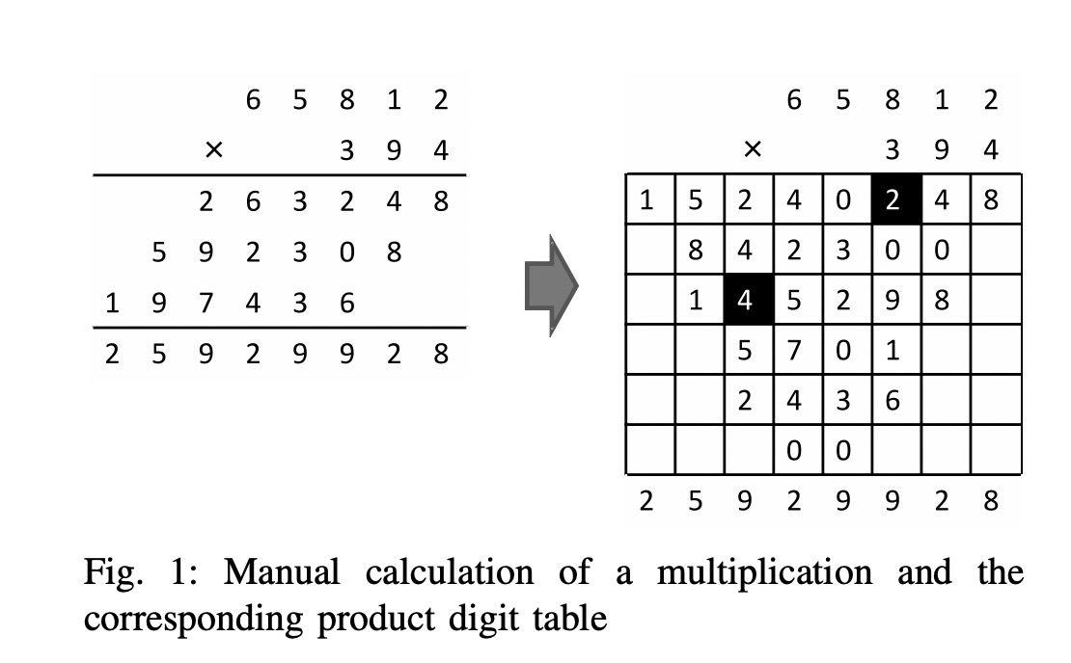
Product Digit Table 算法
A Product Digit Table 形式

Slide 19
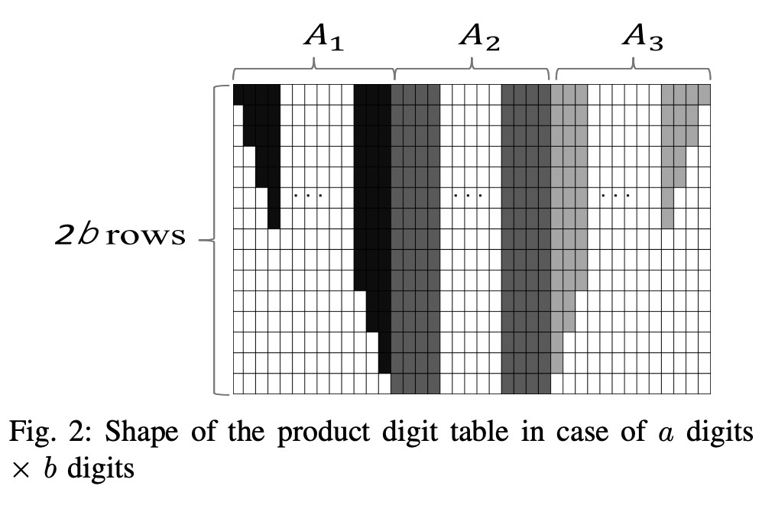
Table 形状
The number of the columns in A1(A3) is equal to b.
The number of the columns in A2 equals a−b,
and the number of the rows in A2 is exactly 2b.

Slide 20
Table 形状优化
In the proposed GPU algorithm, we basically allocate a thread to each column of a product digit table so that both summation computation for each column and carry propagation can be done in parallel
However, if we directly use a product digit table in Fig. 2, the amount of computation and memory access would be imbalanced among threads allocated to the columns in A1 or A3.

Slide 21
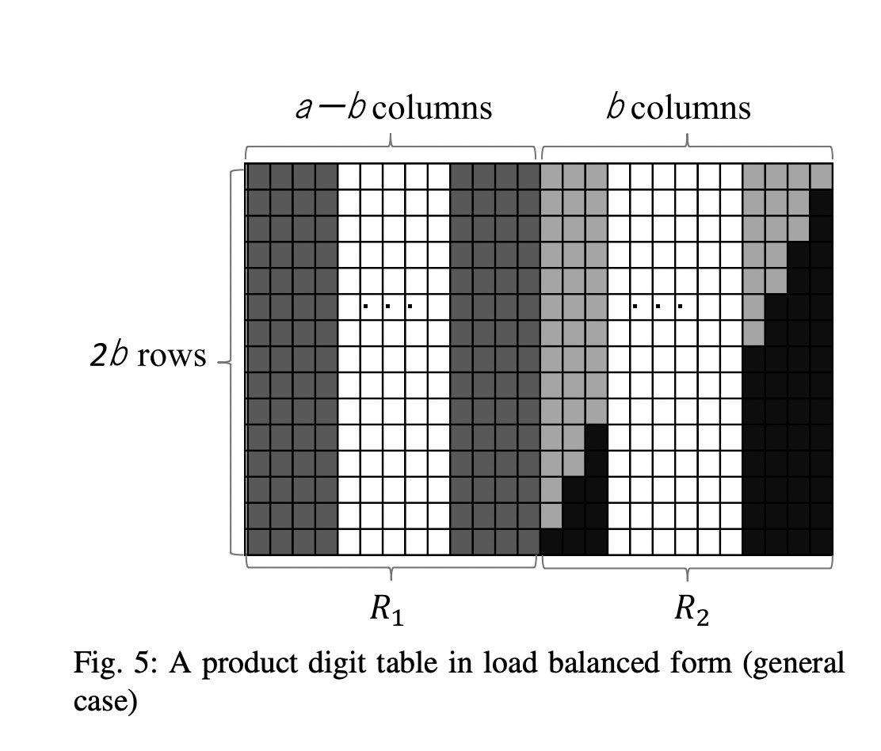
Table 形状优化

Slide 22
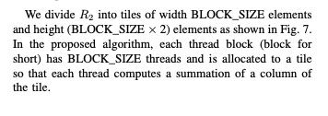
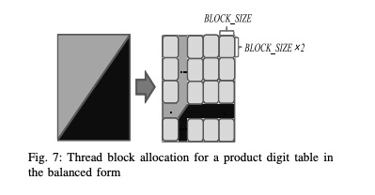
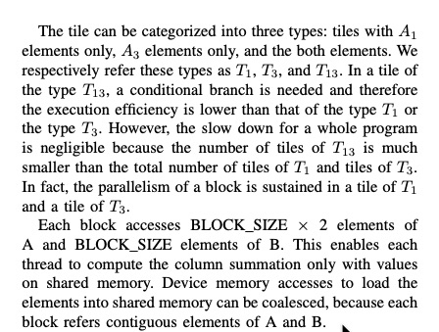
算法细节

Slide 23
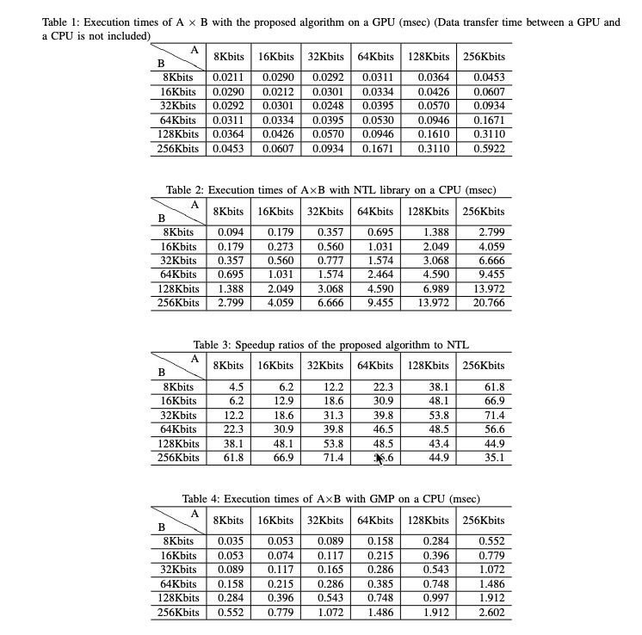
效果：

Slide 24
References
[1] S. Jahani, A. Samsudin, and K. G. Subramania "Efficient Big Integer Multiplication and Squaring Algorithms for Cryptographic Applications", Journal of Applied Mathematics Volume, 2014
[2] https://blog.csdn.net/xueyan0096/article/details/84862548
[3] http://worldcomp-proceedings.com/proc/p2014/PDP4208.pdf
[4] https://domino.mpi-inf.mpg.de/intranet/ag1/ag1publ.nsf/AuthorEditorIndividualView/ca00677497561c7ec125763c0044a41a/$FILE/gpgpu_mul.pdf?OpenElement
[5] Zhao, K. and Chu, X., "GPUMP: A Multiple-Precision Integer Library for GPUs," IEEE Int’l Conf. on Computer and Information Technology (CIT), pp.1164-1168, June 2010

