Slide 1

NLP for Finance
Cris Chai, Dhruva Iyer, Dristi Roy, Sean Wu, Legolas Zhang, Satvik Marthi
We used NLP to predict sentiments of stock market tweets, involving preprocessing and inputting them to train classification models. Sentiments can help predict changes in stock prices.

Slide 2
NLP pre-processing
Stemming
Tokenization
Remove prefixes and suffixes
Simplify the data
walking
Split the sentence
walked
walk
The stock will go up
walks
Some words can be incorrectly stemmed
The
stock
will
go
up
people
peopl
Notes:
Talk about tokenization and stemming, lemmatization can fix errors with stemming

Slide 3
Text Cleaning
Text cleaning is the process of simplifying a sentence
One way is by replacing characters such as , . ; “ ‘ with spaces
Sentences will have the same meaning
Unsimplified Sentence: I was surprised when the stock price increased.
Simplified Sentence: The stock price increased.

Slide 4
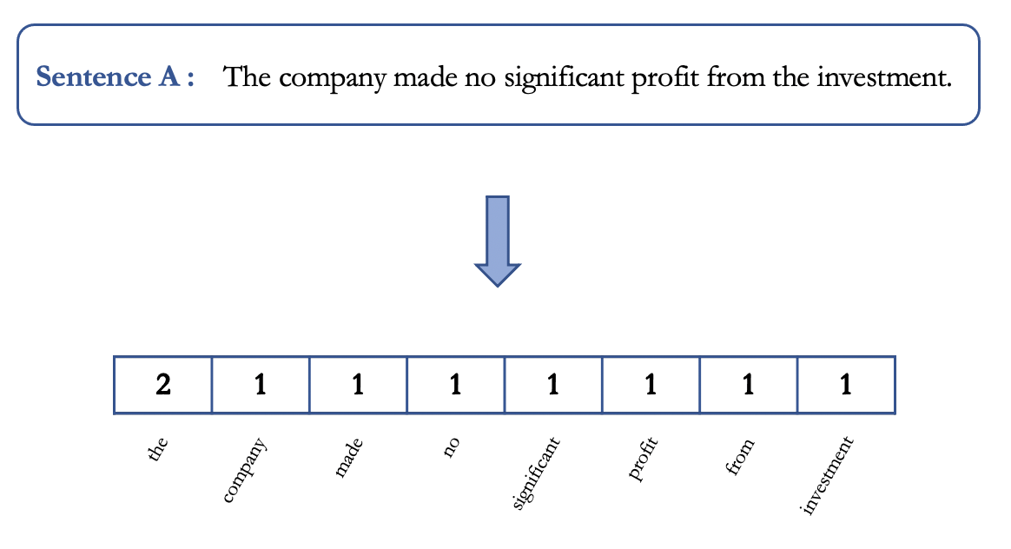
Stopword removal
Vectorization
The company is not good
The company is good
Remove stopwords like
there
is
the
and
company good
Converts a list of words into a vector of numbers
Notes:
Talk about stopword removal and vectorization

Slide 5
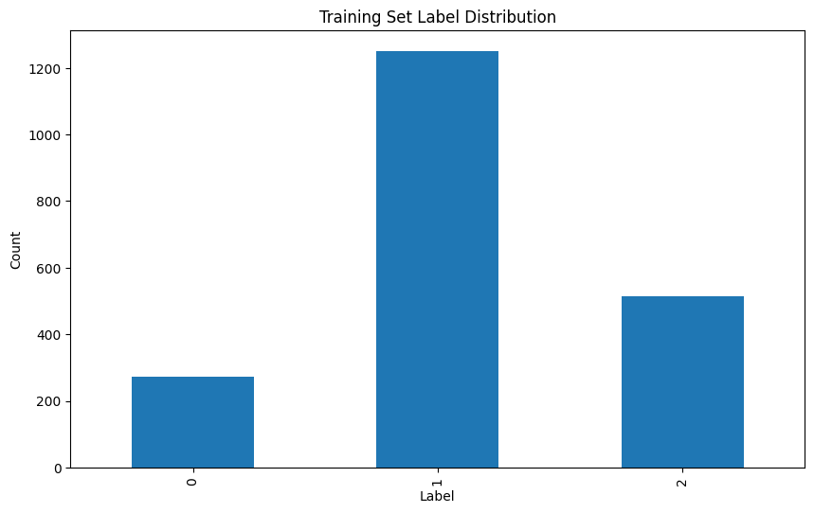
Data set balancing
Data is not balanced
Lots of neutral data
We did not address this, but we should if we do this again.
0 is negative
1 is neutral
2 is positive

Slide 6
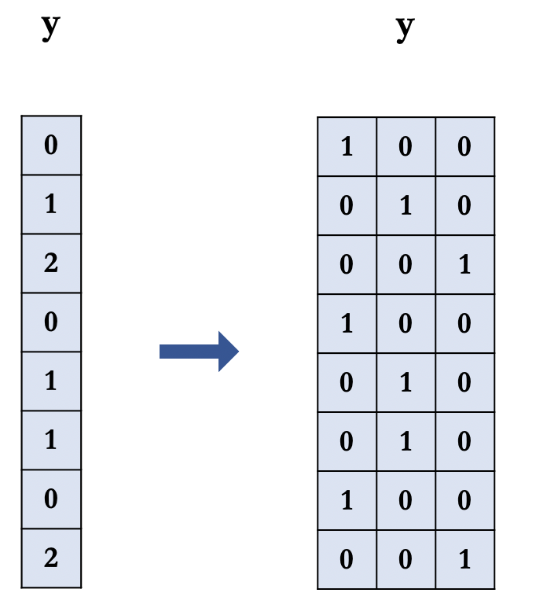
One Hot Encoding
One hot encoding is converting categorical data into numerical data
1 column per possible label
Easy to interpret model’s output
Before: 0: negative, 1: neutral, 2: positive
After: Col 1: negative, Col 2: neutral, Col 3: positive

Slide 7
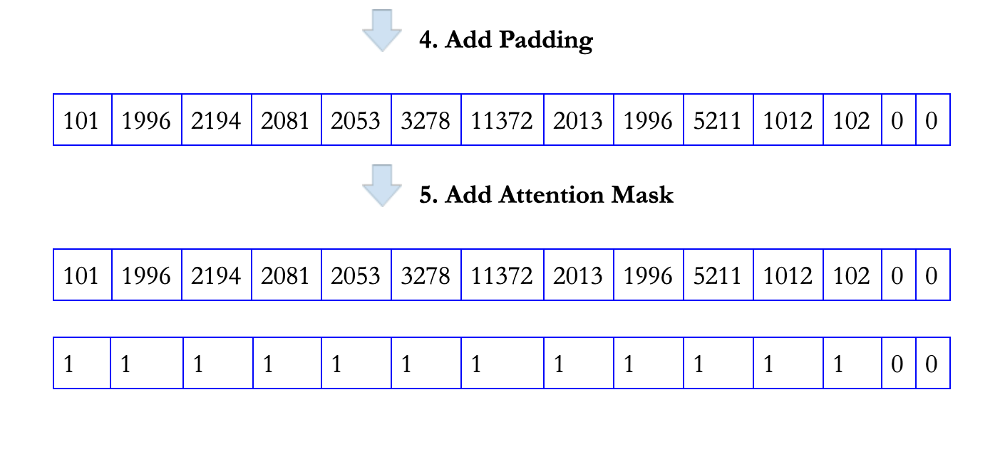
Padding and Attention Masks
Extends vectors with padding to have equal length inputs
Attention mask draws model attention away from padding

Slide 8
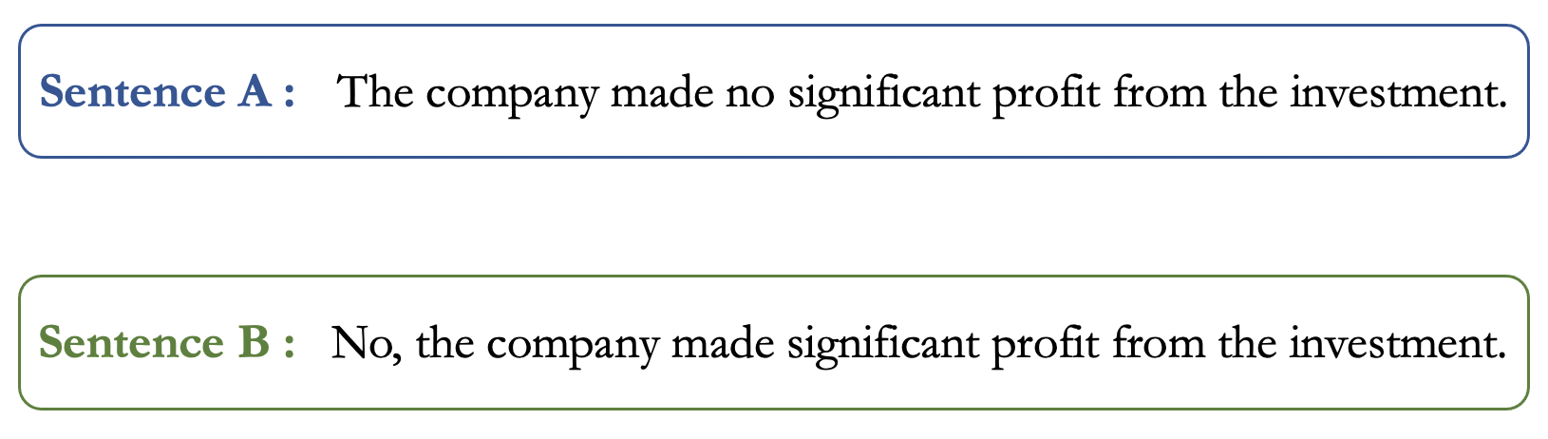
Word Order
Changes the meaning of a sentence
Very important

Slide 9
LSTM
LSTM stands for long short-term memory
It can help to solve word order issues
A sequence of words rather than bag

Slide 10
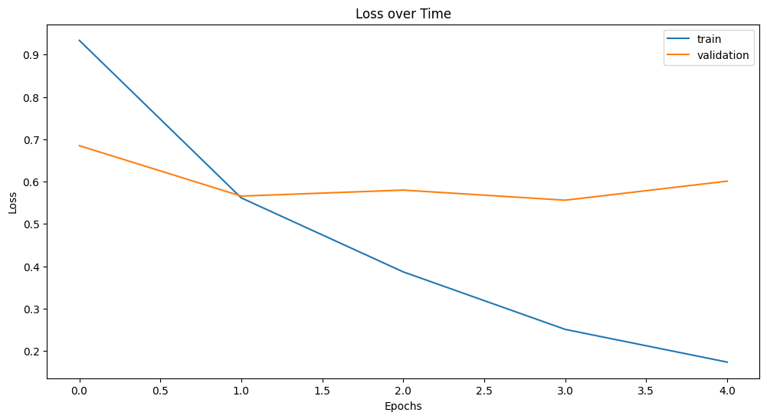
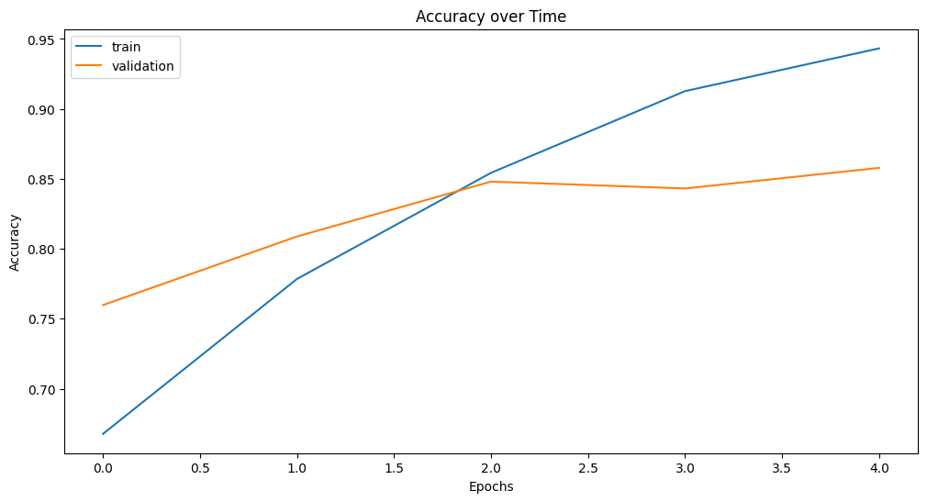
LSTM Result
83.70% Accuracy

Slide 11
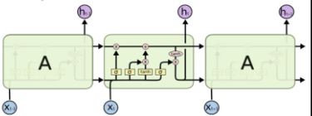
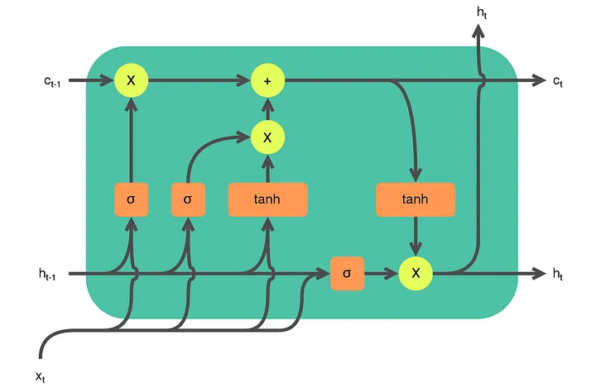
Model Architecture and Hyperparameters
Model layers
Embedding
Dropout
LSTM
Dense
Hyperparameters
Epochs
Max Sequence Length
Max NB Words
Notes:
Embedding Layer: Converts words into vectors of numbers, mapping similar words close together. This is how the model begins to understand relationship between words and and context.
Dropout Layer: Used to avoid overfitting. This technique randomly 'drops' or turns off some neurons during the training. Which prevents the model from becoming over-dependent any one neuron and helps it generalize to the data better.
LSTM Layer: LSTM stands for Long Short-Term Memory and is a type of Recurrent Neural Network that can essential remember important information for longer periods and forget what's not necessary. This is really helpful in tasks like text generation and language translation. Usually we think of LSTM as a whole model but here we think of it only as a part of our model architecture
Dense Layer: Finally, we have a Dense or fully connected layer. This is your normal MLP layer per say. It synthesizes the learned features to give a final output.
Hyperparameters
Epochs: should know what that is by now
Max Sequence Length: what length all the sentences will be padded to
Max NB words: model’s vocab size

Slide 12

BERT Pre-trained Model
BERT is a pre-trained model from Google
Very accurate
Needs less effort than new model
Speeds up training
Needs less data
Notes:
BERT is very accurate and easy to use because Google has already put in the effort in training it. We do still need to train to specialize BERT for what we’re doing, but this is faster than training an entirely new model from scratch. It also needs less data, since it already recognizes words, it just needs to know what to do with those words. The fast training is helpful if we ever need to retrain the model, for example new data appears or a new financial event happens

Slide 13
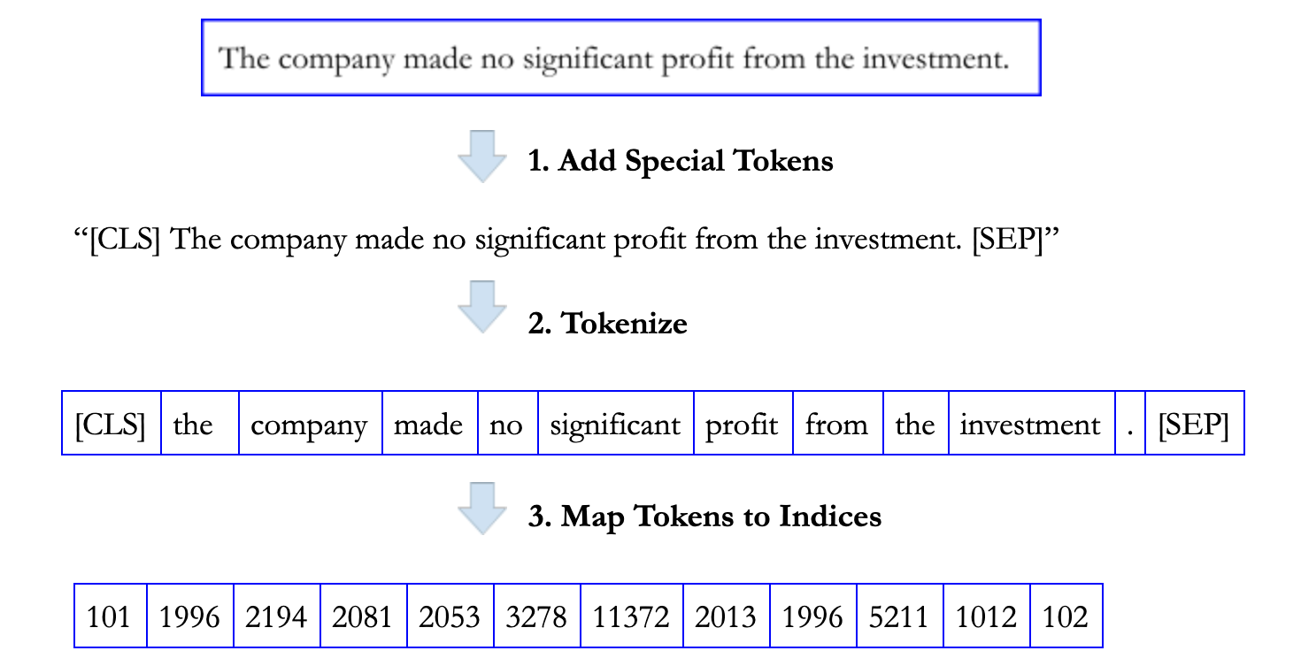
Setting Up BERT
Pre-processing steps
Add special tokens
Tokenize
Convert tokens to indexes
Add padding and attention mask
Using the model
Huggingface Pytorch has a BERT implementation
Add an output layer to BERT
Train like any other model
Notes:
Before we can use BERT, we need to preprocess the data and load BERT. BERT uses special tokens to recognize the beginning and end of a sentence, so we add them on. Tokenizing is necessary for any NLP model and makes it easier for the model to understand. Padding and an attention mask again make the sentence easier to understand.
After preprocessing, we load the huggingface Pytorch implementation of BERT. Then we add an output layer to BERT, to actually get results out of it. Finally, we train it like any other model.

Slide 14
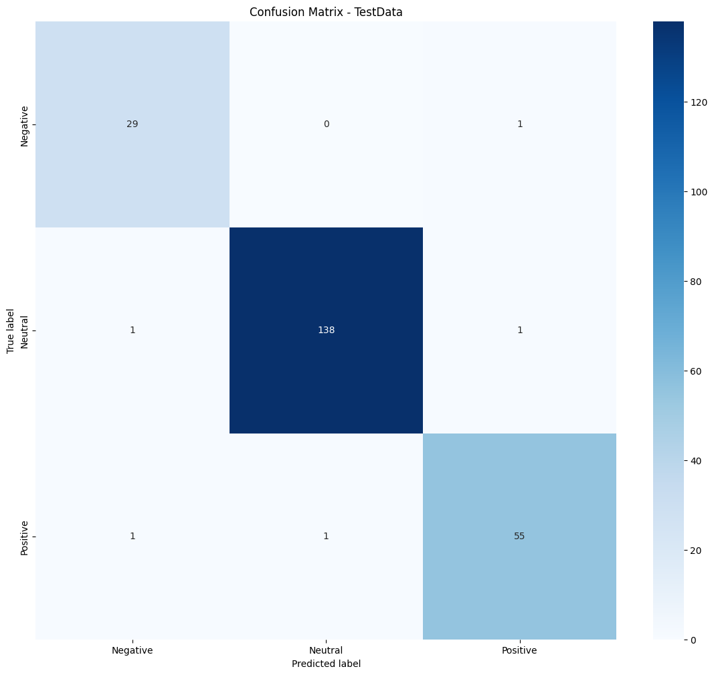
BERT Results
Highly accurate in testing with no hyperparameter optimization
Only 5/227 wrong answers (98% accuracy)
Notes:
As you can see in the confusion matrix, the vast majority of predictions are right. (point out data) If we had more data, this probably would be better, but this test really highlights BERT’s ability to be trained with less data than an entirely new model

Slide 15
Thank You
Notes:
Using preprocessing + Bert and LSTM, we successfully predicted tweet sentiments.

