Slide 1

Team 1
Edwin Rodriguez Omar Lewis Josh Miller Jason Perry

Slide 2
Break through your
and improve your creative writing skills.

Slide 3
Designed for novice writers looking to:
Test their critical thinking abilities and embrace their imagination through challenging exercises.
Fine tune their grammar, spelling, and analytical skills.
Improve their vocabulary and receive beneficial constructive criticism.

Slide 4


Slide 5
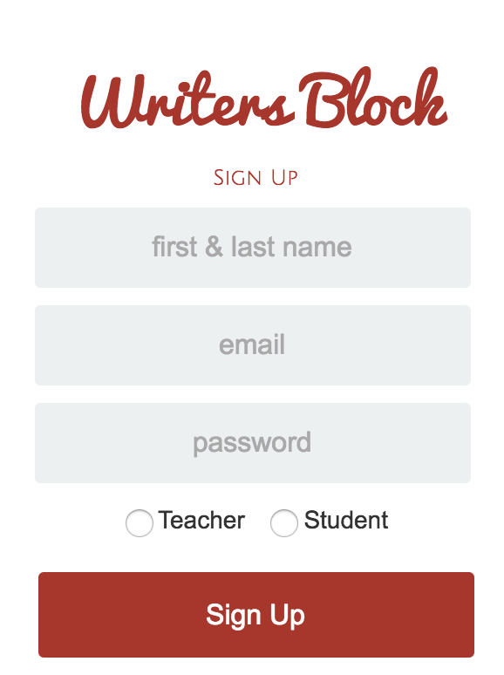

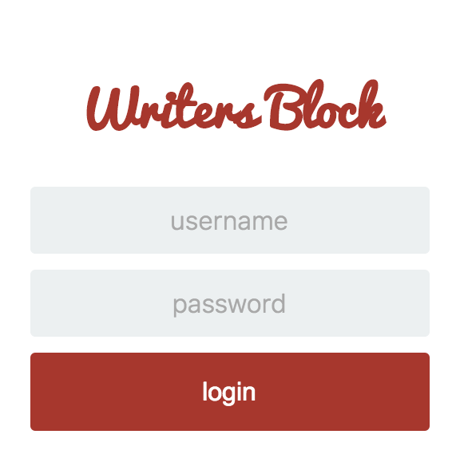

Slide 6
Demo

Slide 7
Technologies Used
Node.js / Express Server
Model View Controller (MVC)
Firebase for Authentication
MySQL Database
Sequelize

Slide 8
Future Enhancements
Ability to have student/mentor message box area for feedback and suggestions.
Specific topics to practice concepts for tests like FCAT, SAT, ACT, and more.
International support for various languages.
Charge for a subscription plan. PROFIT.

Slide 10
Instructions:
To begin, you'll be provided with a writing prompt in the form of an image.
Using the given writing prompt, you’ll be given only 20 minutes to develop a story of your choosing.
Once completed, our experienced mentors will provide you with constructive feedback to help you understand principles common to analytical writing, while preparing you for multi-genre projects that embrace academic thinking.

