Slide 1
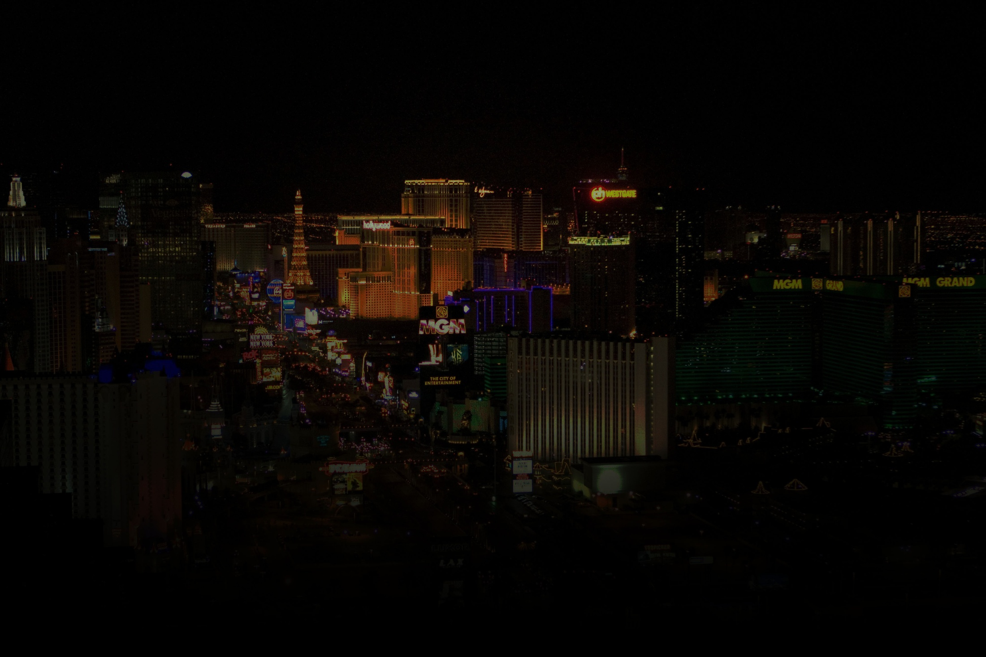


Team Two // Charles McCarthy, Edwin Rodriguez, Lauren Farrell
UCF Coding Bootcamp // Saturday, August 13, 2016

