Slide 1
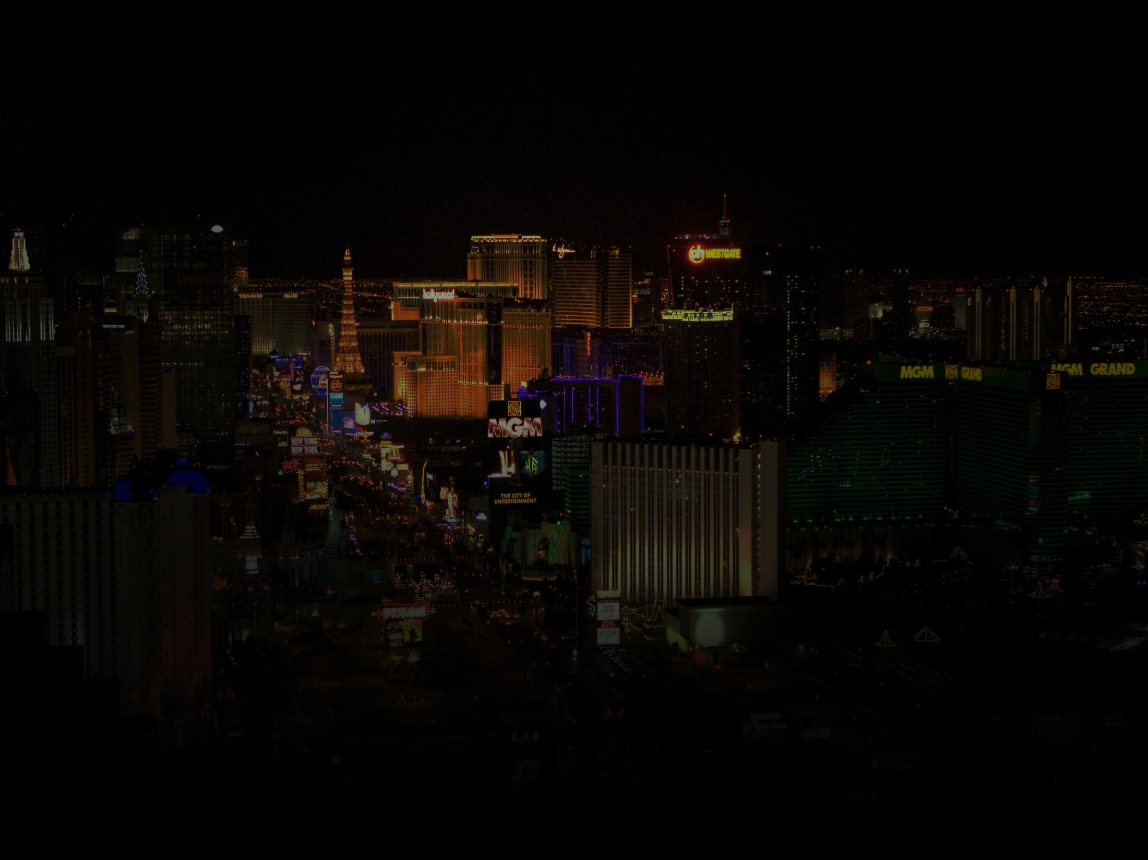


Team WHIPW-SIPW // Charles McCarthy, Edwin Rodriguez, Lauren Farrell
UCF Coding Bootcamp // Saturday, August 13, 2016
Notes:
Team Whipphl-Sippuhl (WHIPW-SIPW) “What happens in project week, stays in project week.”
Presents – Karaoke Roulette: “Let’s get embarrassed.”

Slide 2
APPLICATION CONCEPT
Make something…
Fun
Entertaining
Social
A “Plugin” app
Notes:
As a team we wanted to create an app that was fun, entertaining, and social. Instead of inventing a new game we wanted to come up with an app that was sort of a “plugin” to an already existing activity people do that they find fun, entertaining and social – something you can do at home or when out with friends.

Slide 3
APPLICATION CONCEPT
Karaoke… for short attention spans
Increased entertainment value (watching)
Incorporates live social media feed
Allows anon live voting
Notes:
So came the idea of Karaoke Roulette – an extreme version of Karaoke. Instead of getting on stage and singing one song you selected, you have to get on stage and sing about 15 to 30 seconds of a randomly generated song at a randomly selected point in the song. And you do that with three songs total. The lyrics are provided like regular karaoke but players really need to stay on their toes.
I know what you’re thinking. Lauren, this karaoke is totally out of control. But let me remind you how boring it can be on karaoke nights when the same person is singing the same songs they usually sing, because they sing them moderately decent. Your karaoke night NEEDS Karaoke Roulette.
To add to the entertainment and overall soul crushing embarrassment of karaoke roulette we have incorporate a live social media feed. So, while you are attempting to spit out Biggie lyrics before going into 20 seconds of Greased Lightening – there is a live twitter feed that anyone at the bar is free to comment on your performance. People at the bar don’t have a twitter? No problem. Users can thumbs up, thumbs down and even poultry leg you if they please.

Slide 4

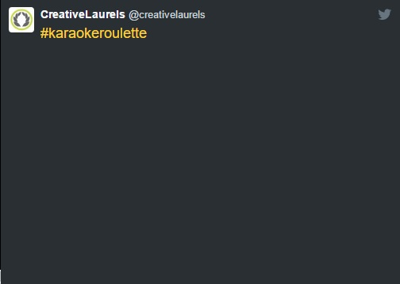

APPLICATION CONCEPT
Notes:
To add to the entertainment and overall soul crushing embarrassment of karaoke roulette we have incorporate a live social media feed. So, while you are attempting to spit out Biggie lyrics before going into 20 seconds of Greased Lightening – there is a live twitter feed that anyone at the bar is free to comment on your performance. People at the bar don’t have a twitter? No problem. Users can thumbs up, thumbs down and even poultry leg you if they please.
Why this is so great for the business owner is – this is a great tool to boost your social media presence. So Twitter users will include the hashtag karaoke roulette they will actually tweat @ business. Most businesses have twitter linked with their facebook and have a twitter feed like this on their webpage, so talk about a great way to show activity, and attract new customers, create a buzz.
And now to talk about the development of this fun, entertaining, social app please welcome Charles up to tell you about the magical world of the YouTube API.

Slide 5
DEVELOPMENT MOTIVATION
YouTube API…
Twitter Live Tweets
Notes:
Charles -
Using the YouTube API to randomly select songs, at random intervals.
Challenging included:
Videos with ads
Starting at random points
Originally we wanted to use the Slack API to create a live messaging feature paired with the ran

Slide 6
TECHNOLOGIES USED
YouTube API
Twitter API
HTML/CSS/Bootstrap
Firebase (emoji voting)
Notes:
YouTube API
Twitter API
HTML/CSS/Bootstrap
Firebase – emoji voting
User Validation Input with a email subscription form at the bottom

Slide 7
DESIGN PROCESS
Roulette – Vegas Feel
Nightlife
Low lighting
Modern

Slide 8
DEMONSTRATION
https://fathomless-lake-76819.herokuapp.com/

Slide 9
FUTURE DEVELOPMENT
Webcam
Gaming Platforms, Twitch
Incorporate existing karaoke music software

Slide 10
QUESTIONS & COMMENTS

