Slide 1
Why do some papulacandins survive serum?
A 10-phase computational dissection of the FKS1-inhibitor serum gap
Papulacandin / fusacandin serum-gap study · Phases 1–10 · generated from SYNTHESIS_phases1-10.md

Slide 2
Bottom line up front
• Serum POTENCY is governed by intrinsic potency × molecular size / lipophilicity
• Serum TOLERANCE (the free→serum MIC shift) has, at most, a weak association with
– exposing POLAR rather than HYDROPHOBIC surface
– |ρ| ≈ 0.30–0.33, p ≈ 0.13 — consistent across independent methods, never significant
• No computable descriptor or docking model predicts serum tolerance on this dataset
• The binding constraint is the DATA (n=24, 11/24 censored), not the methods

Slide 3
The dataset — the dependent variable
• 24 compounds with matched serum-free AND serum whole-cell MIC vs C. albicans
– Yeung-1996 fusacandin analogs 6a–6u + Fusacandin A/B + Papulacandin B
• 13/24 retain measurable serum activity; 11/24 serum MICs CENSORED at 100
– values tied on {12.5, 25, 50, 100} → this is the ceiling on every correlation
• Two endpoints used throughout:
– raw serum MIC — but it is ~potency-dominated (ρ=0.79 with serum-free MIC)
– serum SHIFT fold (serum/free) — the potency-independent measure of true tolerance

Slide 4
Approach — a multi-tier descriptor funnel
• Phases 1–4 : curate serum-gap table + interpretable 2D design-rule score
• Phase 5 : scaffold-constrained generative design → 12 novel candidates
• Phase 6 : QM funnel — CREST ensembles, in-house SASA, Gaussian DFT I/O
• Phases 7–8 : 3D shape retrospective (MMFF proxy → real CREST) + confound test
• Phase 9 : GFN2-xTB electronic / solvation descriptors
• Phase 10 : explicit human serum albumin docking
• Each tier asks: does THIS descriptor family predict the serum shift?

Slide 5
Phases 1–5 — 2D fails, and the chemotype is bRo5
• Best 2D predictor (rigid-aromatic + polar design score) vs serum MIC:
– Spearman ρ = 0.32, not significant
• Generative design cleaves/re-esterifies the C-6′ aromatic ester → 12 novel analogs
• Whole chemotype is beyond-Rule-of-5:
– QED ≈ 0.01–0.03, 0/30 pass Lipinski → 2D drug-likeness is uninformative
– → motivated the 3D / QM approach

Slide 6
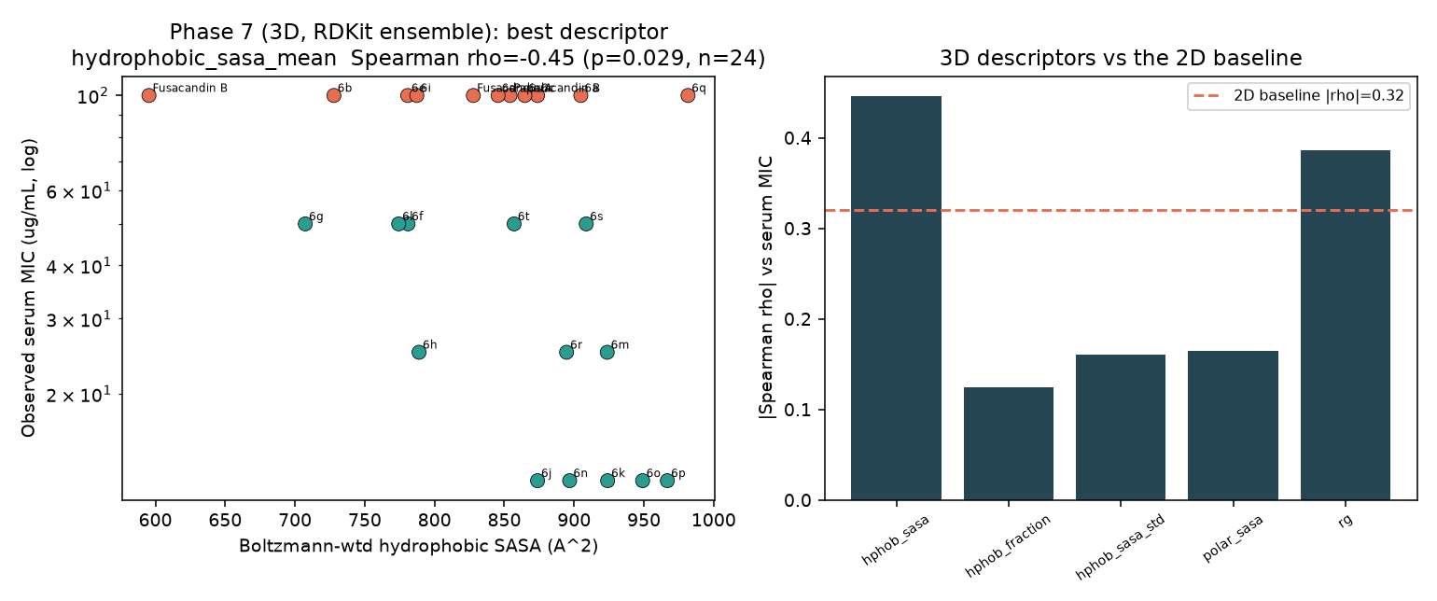
Phase 7 — a promising 3D lead (MMFF proxy)
• Fast RDKit-MMFF ensembles on the 24 knowns
• Hydrophobic SASA vs serum MIC:
– ρ = −0.45 (p = 0.029) — beats 2D
• Promising enough to justify real CREST
• Caveat: proxy ensembles, to be confirmed

Slide 7
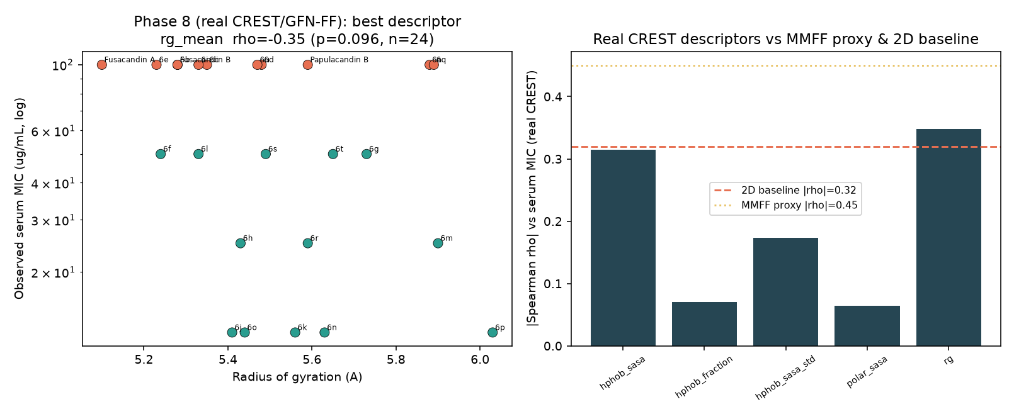
Phase 8 — real CREST overturns it: a potency artifact
• Real CREST/GFN-FF: signal shrinks to ρ=−0.31 (p=0.14)
• Decisive confound check:
– serum-free MIC alone → serum MIC ρ=0.79
– control potency → hydrophobic SASA ρ=0.02
• Rigidity hypothesis dies (shift ρ≈−0.1)
• Only coherent lead: polar SASA vs shift ρ=−0.33

Slide 8
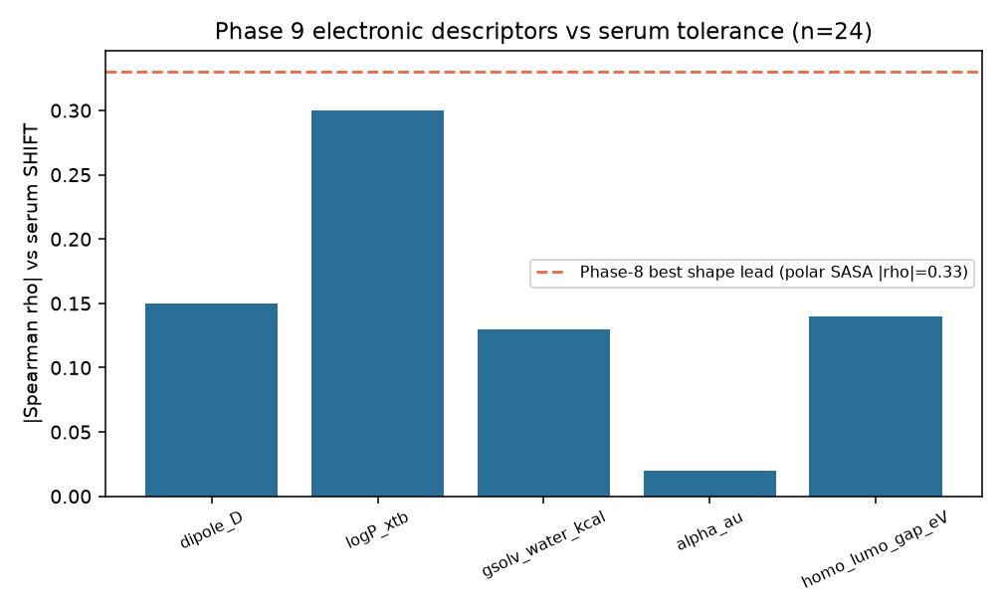
Phase 9 — electronics converge on the polar-surface lead
• GFN2-xTB: dipole, gap, polarizability, QM logP
• Polarizability ρ=−0.54 (p=0.01) — but a SIZE proxy
– shift ρ=−0.02; tracks Rg, potency
• QM logP ↔ hydrophobic SASA (ρ=+0.76);
– shift ρ=+0.30 — corroborates polar-surface lead
• Two descriptor families converge; neither significant

Slide 9
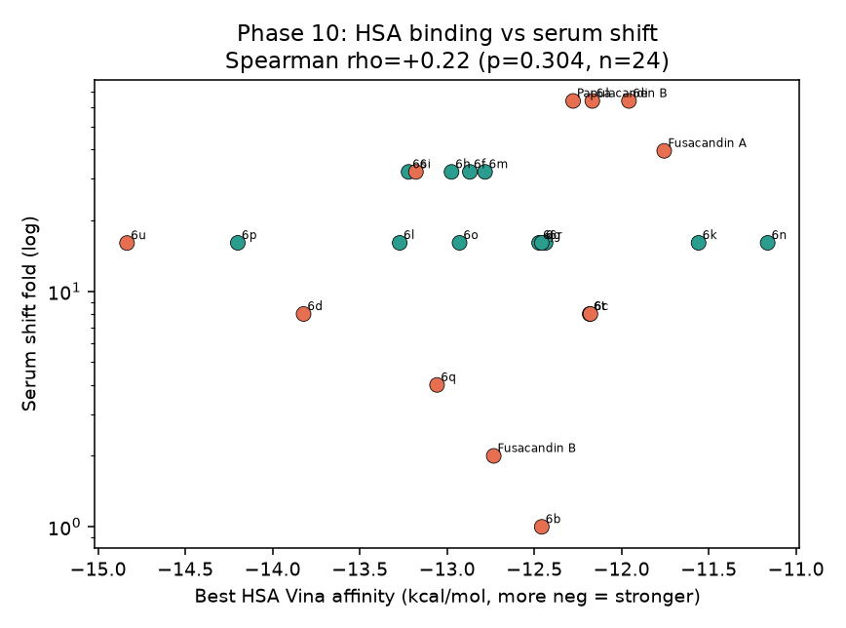
Phase 10 — explicit HSA docking is null
• Rigid ensemble surface docking (flexible = intractable at ~38 torsions)
• HSA binding vs serum shift:
– ρ = +0.22 (p=0.30) — sign OPPOSITE to sequestration
• Flat under potency- and size-controls
• Not a size proxy (ρ=−0.15 vs polarizability)
• Caveat: Vina unfit for 1200 Da amphiphiles → cannot EXCLUDE sequestration

Slide 10
The one convergent, defensible finding
• Three independent families agree on a single qualitative rule:
– 3D shape (polar SASA), QM solvation (logP), weakly the dipole
• “Among equipotent analogs, bias the exposed surface toward POLAR / H-bonding
• character to reduce serum loss.” |ρ| ≈ 0.30–0.33, p ≈ 0.13 — directional, not proven
• Rigorously established NEGATIVES:
– raw serum MIC is potency-dominated (ρ=0.79) — model the shift instead
– the rigidity hypothesis is not supported
– size / lipophilicity (clogP, Rg, polarizability) tracks potency, not tolerance
– explicit HSA drug-site docking carries no signal

Slide 11
Design output (carried forward, with caveats)
• 12 novel candidates taken through the full funnel; 3 finalists by multi-objective score:
– cand01 quinolinecarbonyl · cand02 naphthoyl-6-OH · cand03 pyridylphenyl
– GFN2-reranked ensembles + ready Gaussian DFT inputs
• Ranking unchanged, but the RATIONALE shifts after Phases 8–10:
– prefer added polar / H-bonding surface on the variable C-6′ group,
– not just rigid aromatic bulk — a hypothesis to test, not a validated predictor

Slide 12
Limitations → next steps are EXPERIMENTAL
• Limitations
– n=24, 11 censored, single chemotype/lab — caps achievable significance
– MMFF proxy OVERSTATED effects (−0.45→−0.31) — trust QM-ensemble numbers
– Vina unsuited to 1000–1200 Da amphiphiles — Phase-10 null can't exclude sequestration
• Recommended next steps
– 1. Acquire UNCENSORED serum MICs on more analogs / a fresh chemotype (biggest lever)
– 2. Direct HSA-binding assay (equilibrium dialysis / fluorescence displacement)
– 3. If in silico: model fatty-acid sites & other carriers; run finalist DFT (exploratory)

Slide 13
A clean, fully-documented stopping point
Computation mapped the serum gap and its limits; the lever is now experimental data
Per-phase write-ups: outputs/phase7–10_findings.md · full report: outputs/SYNTHESIS_phases1-10.md

