Slide 1
PROMOTION REVIEW · RESEARCH SUMMARY
Designing Serum-Tolerant Antifungal Candidates
An AI- and Quantum-Chemistry–Guided Drug Discovery Program
on the Papulacandin / Fusacandin class (β-1,3-glucan / FKS1 inhibitors)
Presenter: ______________________ Date: ____________
A complete, reproducible pipeline — from scattered literature to a ready-to-test design.
Notes:
[~30s] Good morning, and thank you for being here. Over the next fifteen minutes I'll walk you through a drug-discovery program that combines artificial intelligence with quantum chemistry to attack a stubborn problem in antifungal medicine. I'll keep the chemistry light and focus on the ideas and the reasoning. The one-sentence version is on the slide: we set out to design antifungal molecules that keep working in blood — and along the way we built a complete, reusable computational platform and learned exactly where AI can and cannot help. Let me start with why this matters.

Slide 2
BACKGROUND · THE PROBLEM
Invasive fungal infections: an urgent, under-served threat
Rising incidence
hundreds of thousands of deaths / year
Very few drug classes
limited options, serious side effects
Resistance spreading
existing drugs losing ground
The opportunity — and the catch
The papulacandin natural products block the enzyme that builds the fungal cell wall (β-1,3-glucan synthase / FKS1). Humans have no cell wall → an attractive, low-toxicity target.
❗ The catch: potent in a test tube, but activity is lost in blood serum — so they never became drugs.
If we understand and fix that, we revive an entire drug class.
2
Notes:
[~60s] Invasive fungal infections are a growing, under-appreciated threat — they kill hundreds of thousands of people a year, often patients whose immune systems are already compromised. Yet we have only a handful of antifungal drug classes, many with serious side effects, and resistance is spreading. So there is a real need for genuinely new structures. Our starting point is a natural-product family, the papulacandins. They hit a target that is attractive because it is in the fungus but not in us — the machinery that builds the fungal cell wall. The catch, in red: these molecules are potent in a test tube but lose activity in blood serum. That single flaw is why they never became drugs. If we can understand and fix it, we potentially revive an entire class.

Slide 3
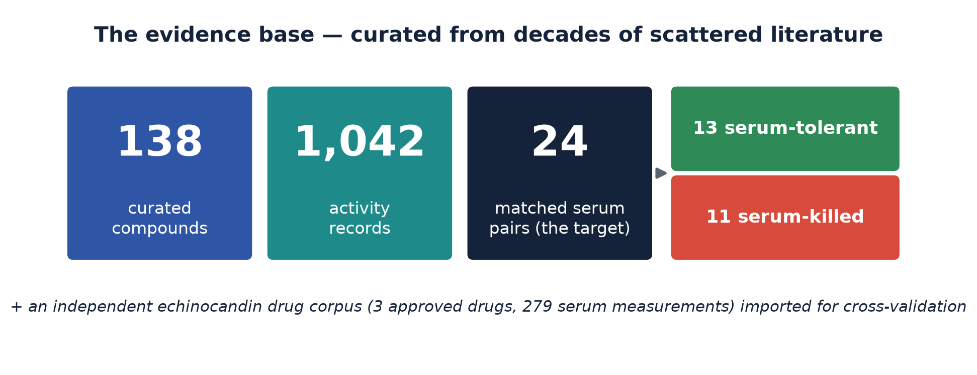
BACKGROUND · THE DATA
The evidence base: decades of scattered literature, curated
A clean, provenance-tracked benchmark — itself a lasting resource for the field.
3
Notes:
[~45s] Before any modeling we had to build the dataset. The results we needed were scattered across decades of old papers, so we hand-curated them into one clean, computer-readable database — 138 compounds and over a thousand activity measurements, each traceable to its source. The heart of it is the 24 compounds with the matched measurement we care about: activity with and without serum. Thirteen keep some activity; eleven are switched off completely. We later imported an independent set of data on approved drugs for cross-checking. I want to flag that this curated dataset is itself a lasting contribution — it is the benchmark everything else is measured against, and others can reuse it.

Slide 4
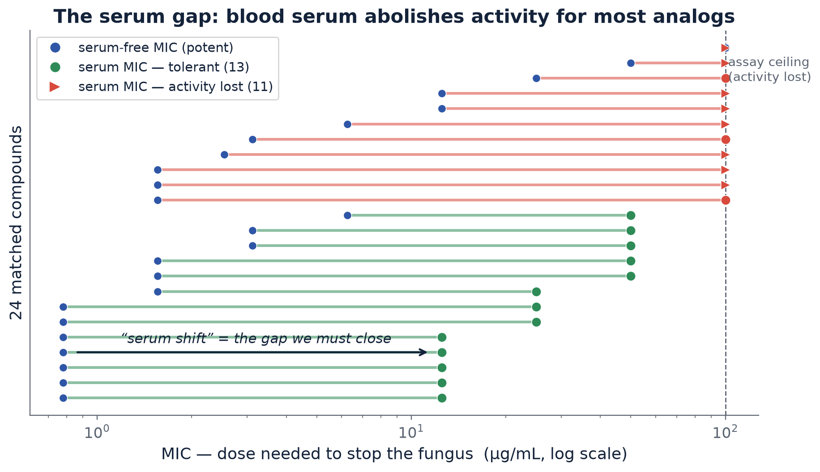
THE SCIENTIFIC QUESTION
The serum gap, quantified: blood switches most analogs off
“serum shift” = dose needed in serum ÷ dose needed in broth — the one number we set out to lower.
4
Notes:
[~50s] This is the problem in one picture. Every horizontal line is one compound. The blue dot on the left is the dose needed to stop the fungus in clean broth — low, meaning potent. Follow the line right to the dose needed in serum. Green compounds keep reasonable activity; the red arrows are compounds pushed past our detection ceiling — serum has essentially abolished them. The gap between the two ends is what we named the 'serum shift': serum dose divided by broth dose. A shift near one is ideal; a large shift is the clinical failure. Everything downstream is about lowering that shift without giving up potency. So the whole project reduces to one number we are trying to design down.

Slide 5
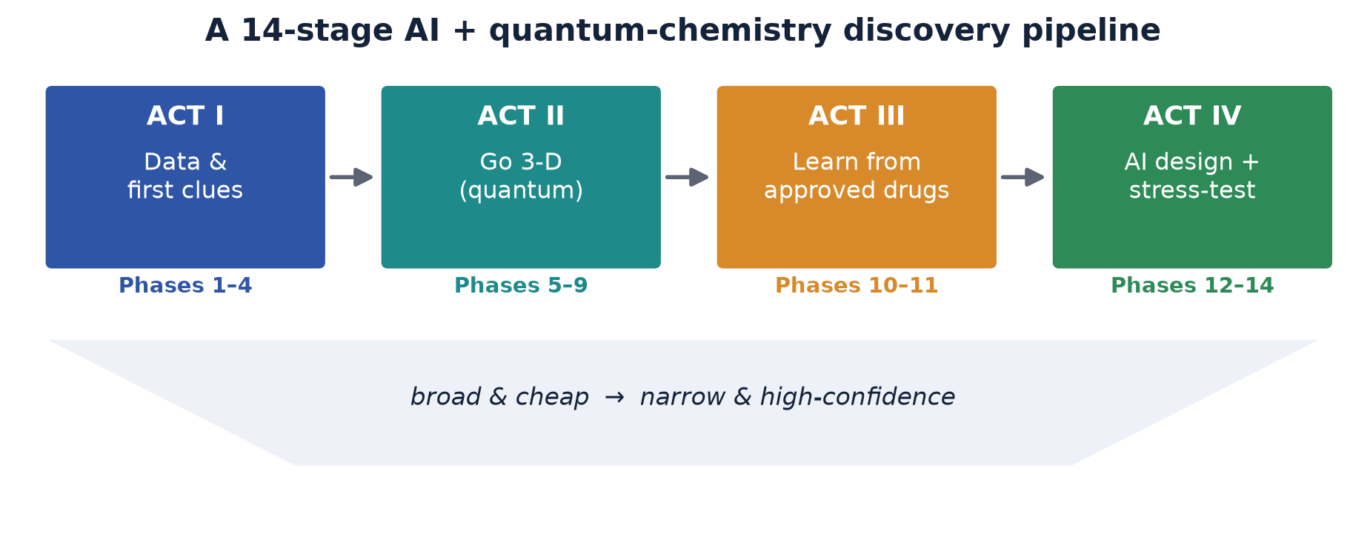
STRATEGY
A 14-stage funnel: start broad and cheap, narrow to confident designs
Each stage checks our reasoning before the next — and the whole platform is reusable.
5
Notes:
[~45s] Here is the overall strategy. Rather than one big experiment, we built a staged funnel across four acts and fourteen documented steps. We start broad and cheap — curating data and looking for simple patterns. Then we go three-dimensional with quantum chemistry. Then — and this turned out to be pivotal — we borrow lessons from approved drugs. And finally we let AI design molecules and stress-test them. The key discipline, shown by the narrowing shape, is that each stage checks our reasoning before we spend effort on the next. And because it is all documented and reproducible, the platform outlives this one question.

Slide 6
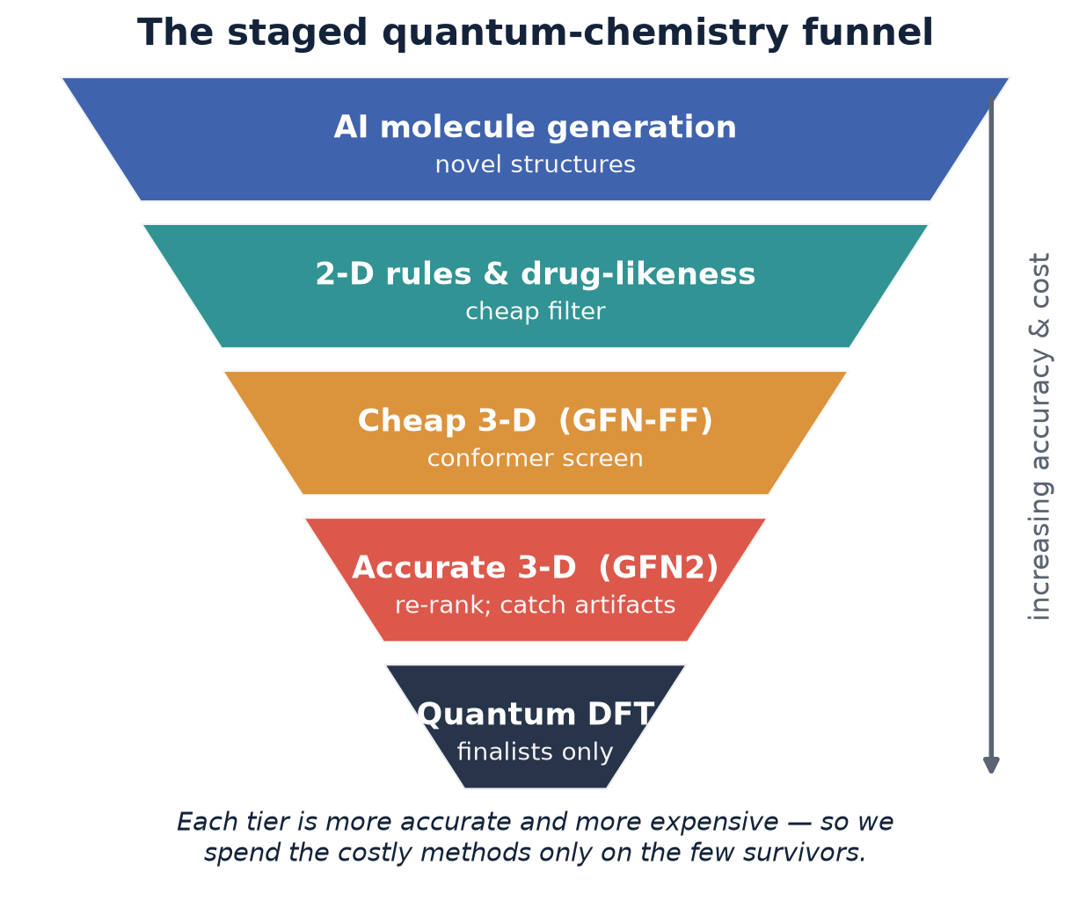
METHODS · THE ALGORITHM
The staged quantum-chemistry funnel
How it works
① AI invents novel molecules.
② Cheap filters remove the obvious losers.
③ Accurate quantum chemistry computes the real 3-D shapes — and re-checks the cheap results.
④ The costliest method (DFT) touches only the few survivors.
Same measurement engine at every tier → a fair, honest comparison.
6
Notes:
[~55s] This is the engine at the heart of Act Two — the 'algorithm', in plain terms. These molecules are floppy; think of a piece of cooked spaghetti that curls into many shapes. To judge them fairly we compute the real 3-D shapes they adopt in water and measure how much greasy versus water-friendly surface they expose. The trick is cost: each tier down the funnel is more accurate and more expensive. So we generate many molecules, filter cheaply, and spend the costly quantum methods only on the few survivors — using the same measurement engine at every tier so comparisons stay fair. This funnel is reusable infrastructure, not specific to this one question.

Slide 7
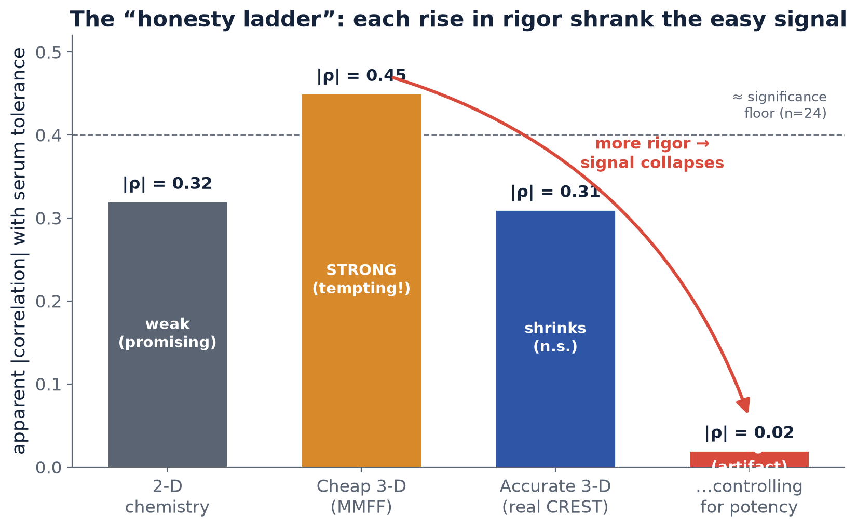
KEY METHODOLOGICAL RESULT
The “honesty ladder”: more rigor shrank the easy signal
A less careful analysis would have made a confident — and WRONG — claim at every rung. Knowing what is NOT true is a real, durable result.
7
Notes:
[~70s — the key slide] This is the most important methodological slide and the strongest evidence of how we work. The vertical axis is the strength of the apparent signal linking our 3-D descriptor to serum tolerance; read left to right as we increase rigor. Crude 2-D chemistry: weak. A cheap 3-D method: it looks strong — genuinely tempting, you could write a paper on that bar. But accurate quantum chemistry shrank it, and once we did the honest thing and controlled for plain potency, it collapsed to essentially zero. The exciting early result was largely an illusion. The message: at every rung, a less careful analysis would have made a confident and wrong claim. We climbed the whole ladder and reported what was actually there. Knowing precisely what is not true is a real, durable result — and it is what stops us wasting years chasing a mirage. [If asked 'so you found nothing?': we found what is NOT true — which saves years — plus one honest lead and a validated platform. Rigorously established negatives are results.]

Slide 8
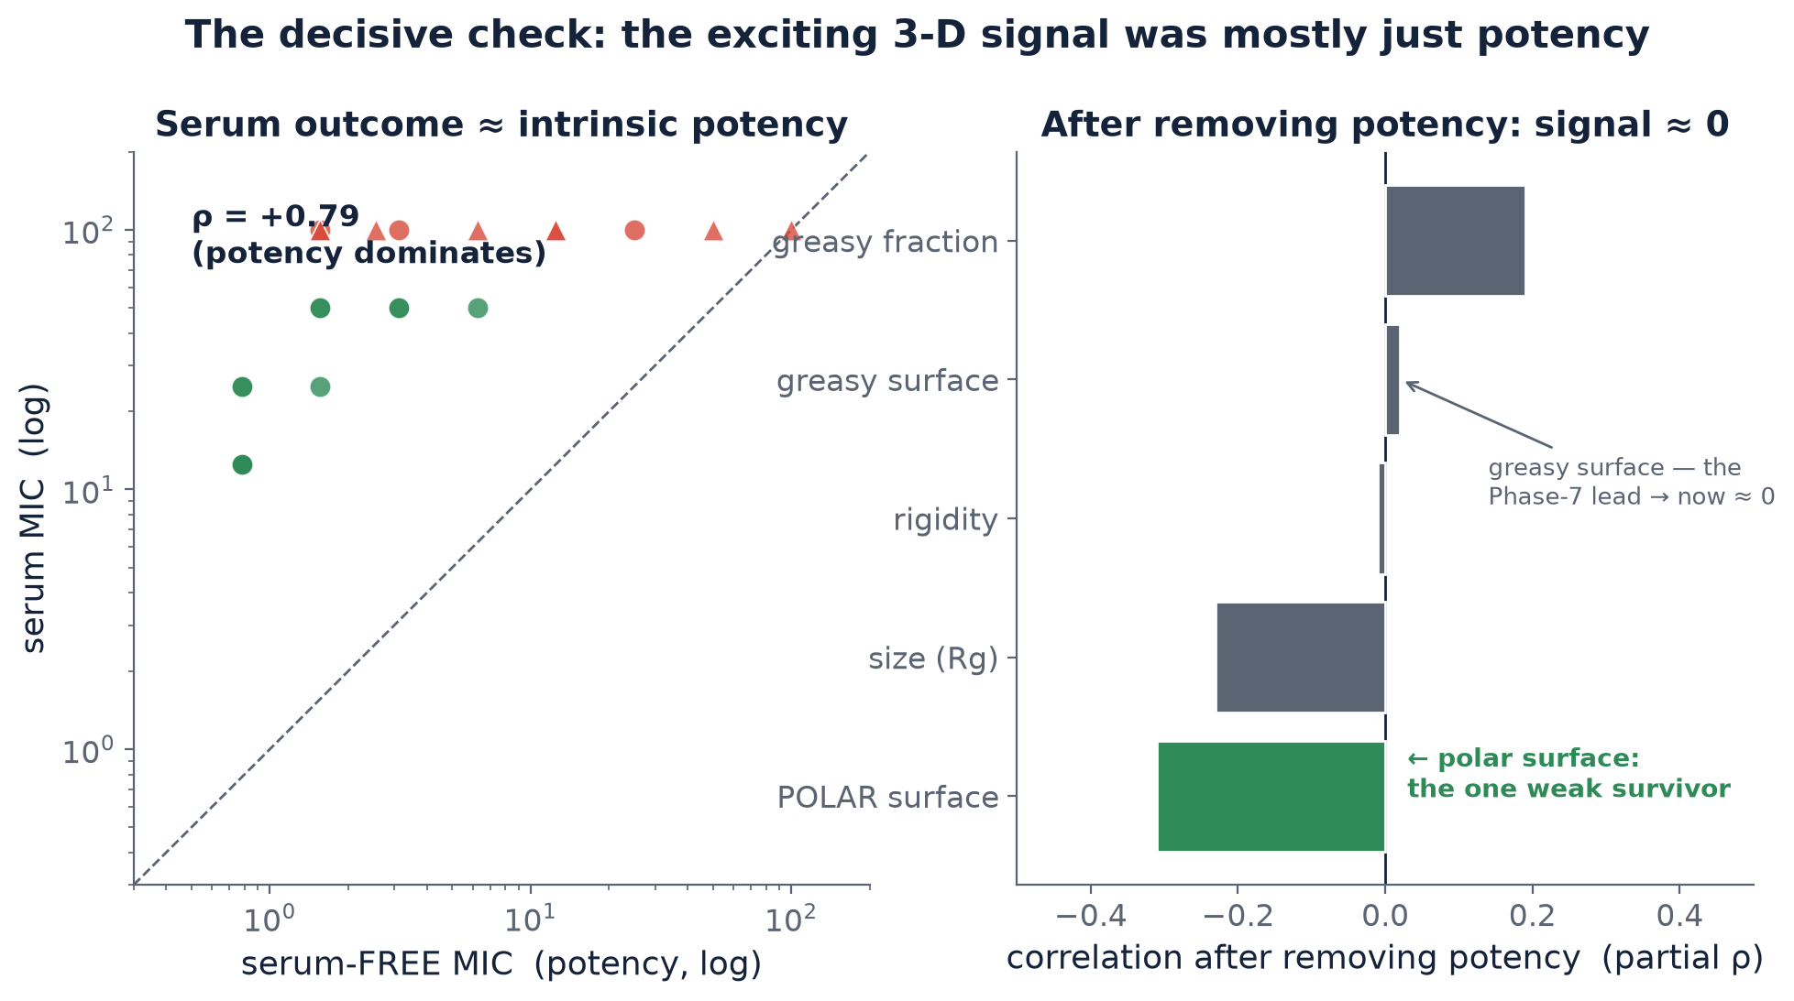
RESULT · THE DECISIVE CHECK
Why the exciting signal collapsed: it was mostly potency
Serum outcome is governed by intrinsic potency (ρ=0.79); remove it and the 3-D signal vanishes — so we model the potency-free SHIFT.
8
Notes:
[~55s] Here is the data behind that collapse — the decisive check. On the left, the dose needed in serum plotted against the dose needed in broth. They track together tightly, correlation 0.79. In plain terms, a compound's fate in serum is mostly explained by how potent it was to begin with, not by a special serum-resistance property. On the right, once we statistically remove that potency effect, the 3-D descriptor that looked so promising — the greasy-surface one — drops to essentially zero. Only one weak signal survives: exposing water-friendly rather than greasy surface. That survivor is faint, but it is the honest lead we carried forward. This is what separates a real effect from a potency artifact.

Slide 9
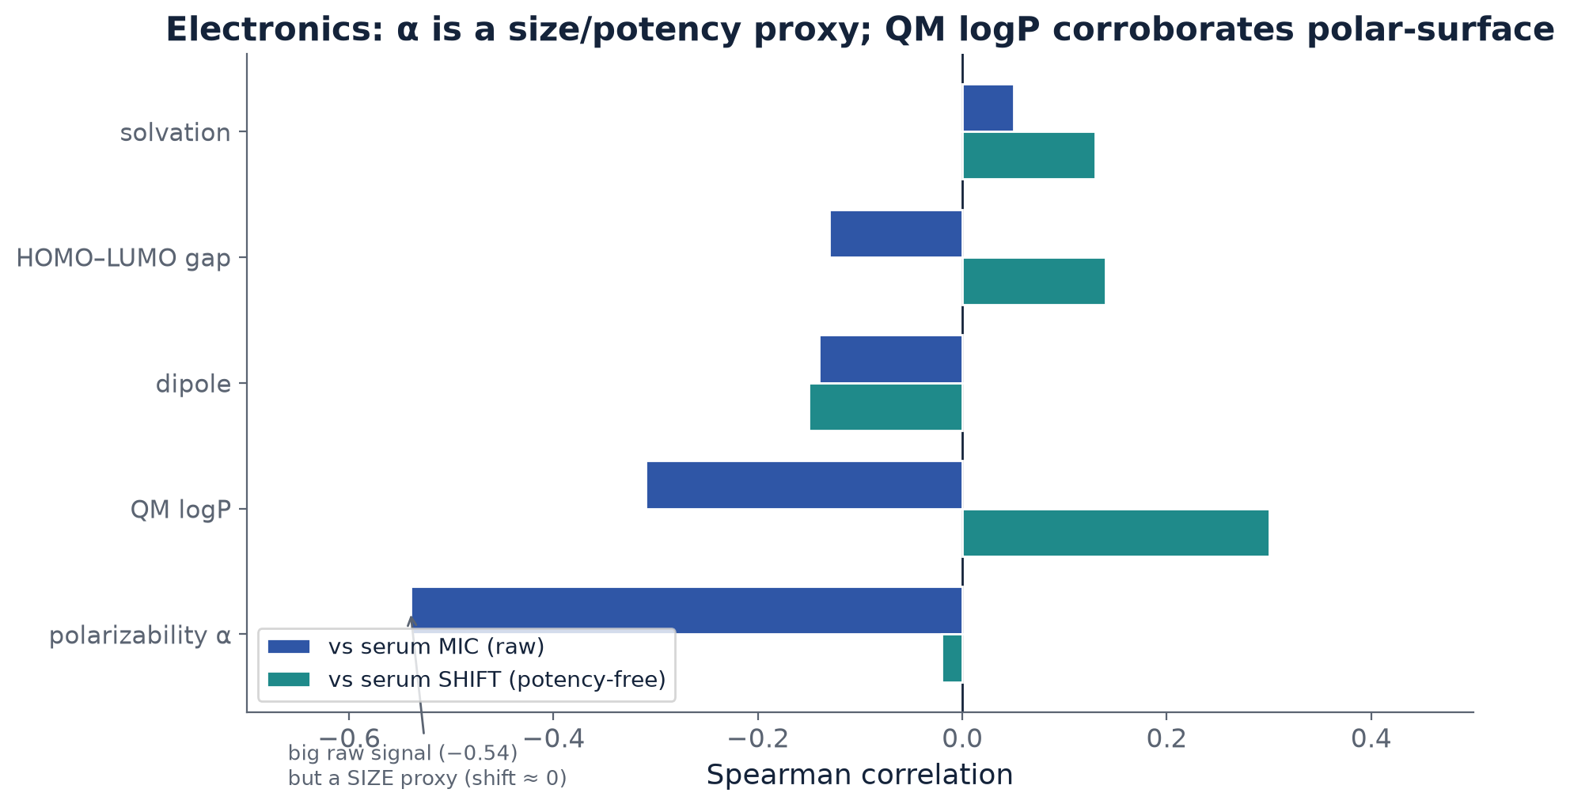
RESULT · INDEPENDENT CHECK
A different property (electronics) — the same honest story
What it shows
• Polarizability looks like the strongest signal — but it is a size / potency proxy (vanishes on the shift).
• QM logP independently corroborates the polar-surface lead (+0.30 on the shift).
Two unrelated descriptor families converge on the same weak, honest conclusion.
9
Notes:
[~45s] We didn't stop at shape. We also examined a completely different property — the molecules' electronic structure — as an independent check, and got the same story. The descriptor that looks strongest here, polarizability, turns out to be another stand-in for size and potency: it vanishes on the potency-free shift. But one quantity — a quantum-computed measure of water-versus-oil preference — independently points the same way as our surface lead. Two unrelated families of measurement converging on the same modest conclusion. When independent methods agree you trust the direction, even while being honest that the effect is small.

Slide 10
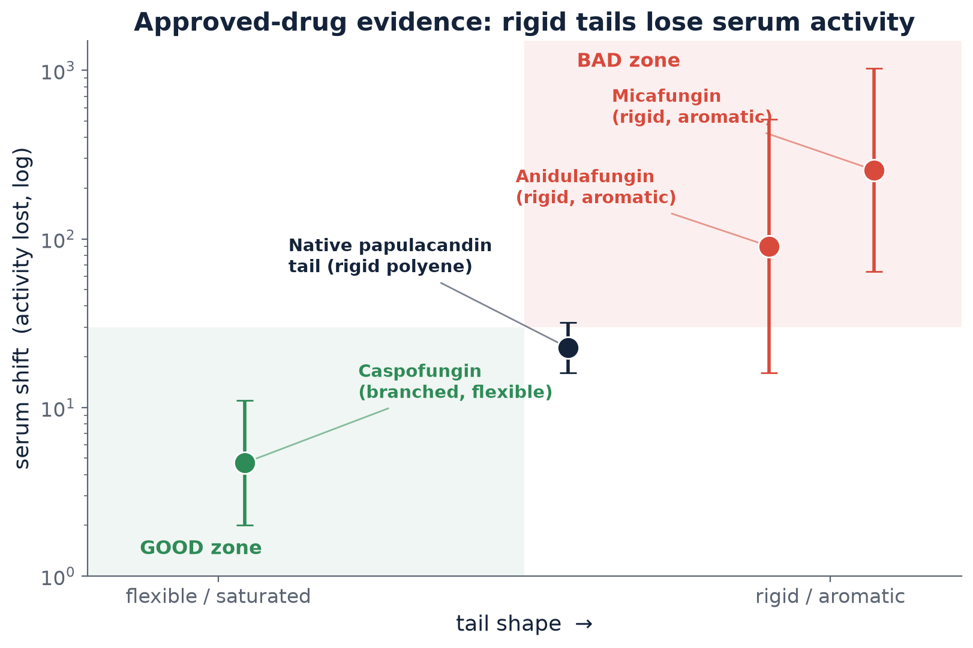
LEARNING FROM APPROVED DRUGS
Echinocandins: same target, real clinical data
Two lessons that redirected our design:
1. The tail is REQUIRED for potency
can’t just make it water-friendly or cut it off, or the drug stops working.
2. SHAPE matters more than greasiness
flexible tail = less serum loss. Our native tail is rigid & flat → the ‘bad’ zone.
10
Notes:
[~65s] Here is where borrowing from approved drugs pays off. The echinocandins are antifungals already on the market that hit the same target and carry the same kind of greasy tail, so their well-documented serum behavior is a natural second opinion. Two lessons. First: the tail is required for the drug to work at all — it anchors the molecule into the membrane — so we cannot simply make it water-friendly or cut it off. Second, and more useful: among drugs that keep their potency, the one with the smallest serum problem, caspofungin, has a flexible, branched tail, while the worst offenders have rigid, flat, aromatic tails — good zone lower-left, bad zone upper-right. Our native molecule's tail is a rigid, flat chain, sitting squarely in the bad zone. That single observation redirected our whole design.

Slide 11
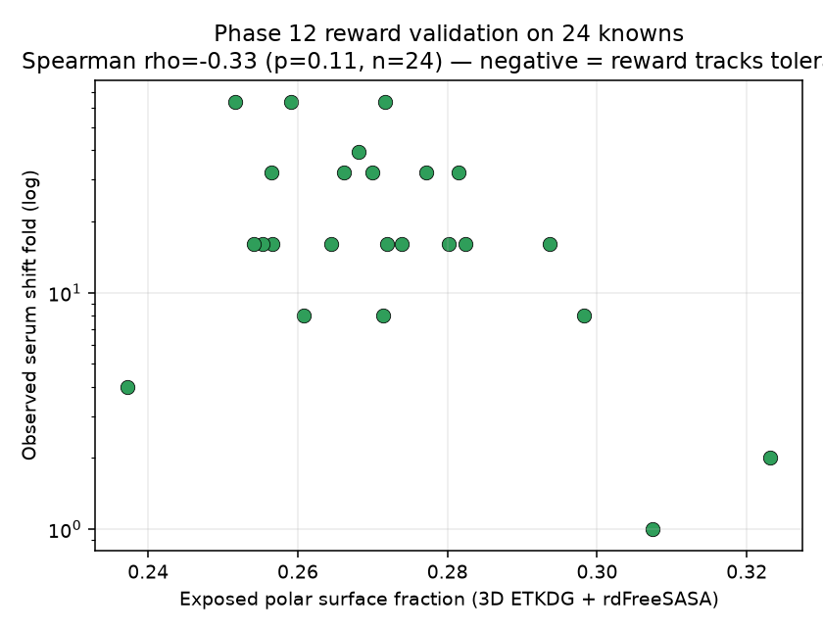
AI-GUIDED DESIGN
We built an AI generator — and validated its scoring on real data
The AI, done honestly
• An AI generator invents novel, on-scaffold molecules.
• Its ‘good design’ reward was checked against real measured data (left) before we trusted it.
• It is built to produce a discriminating series — molecules that TEST the idea, not just assume it.
Left: the reward tracks true serum tolerance on the 24 known compounds (a weak-but-real trend, honestly reported).
11
Notes:
[~55s] Now the AI. We built a generator that invents new molecules on our scaffold. But — discipline again — we did not let it optimize a made-up target. We first checked its scoring rule against real measured data; that is the plot on the left, showing the reward genuinely tracks serum tolerance across our known compounds, honestly reported as a weak-but-real trend. And we designed it to produce a spread of molecules that would test our idea, not just confirm it. So the AI here is not a black box making bold claims — it is a disciplined design tool whose scoring we validated before trusting. [If asked 'why not a bigger neural network?': with no measured labels yet, a bigger model just learns our unvalidated guess faster — garbage in. That is why the next step is the lab.]

Slide 12
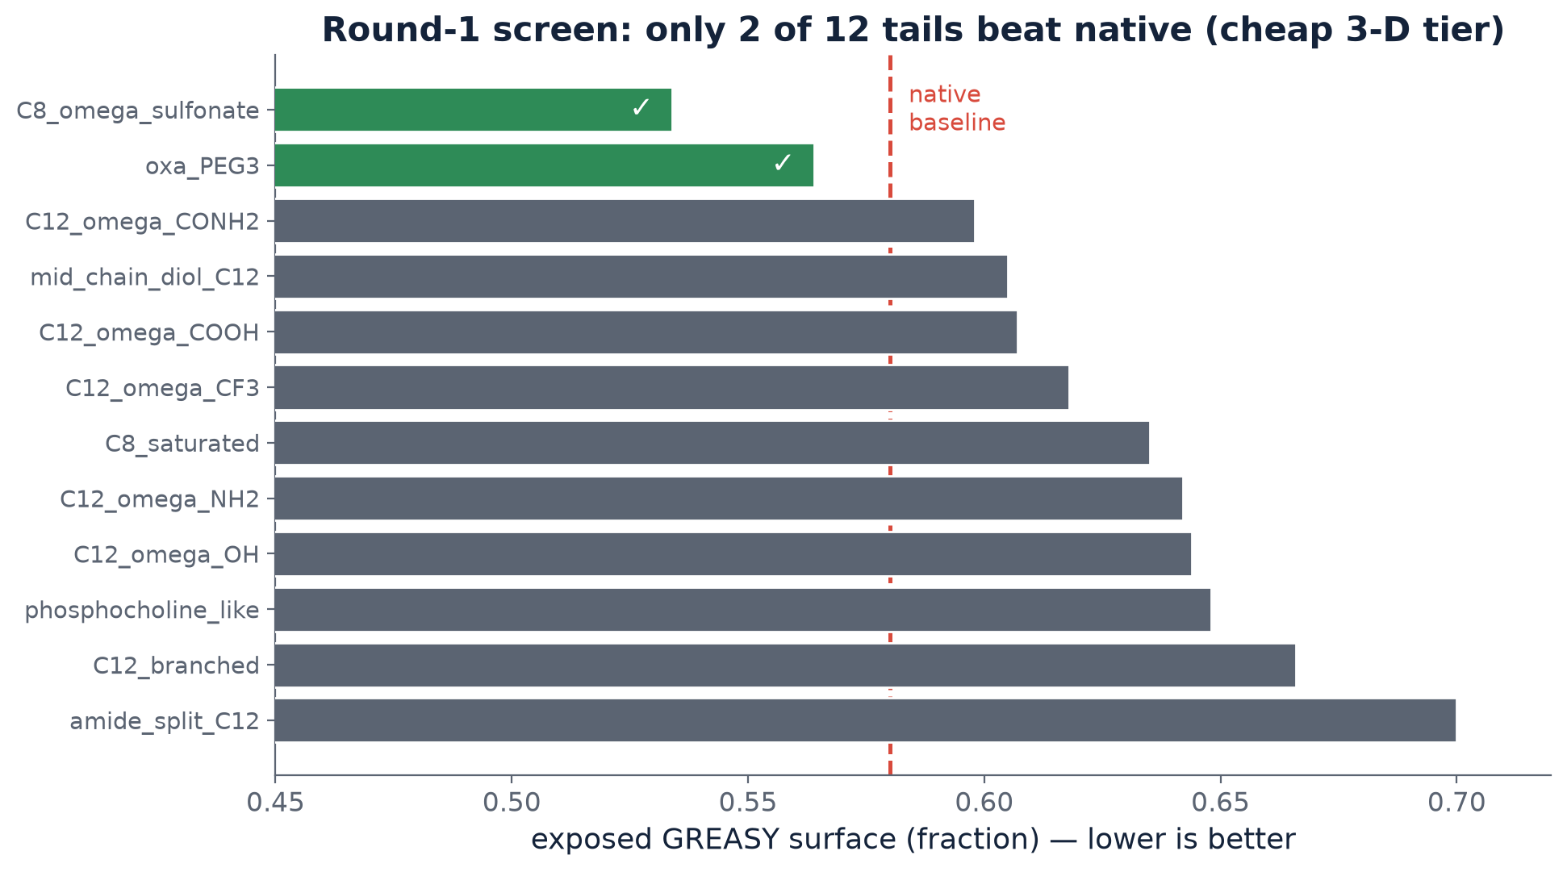
RESULT · ROUND 1 (DETAIL)
AI-designed tails, ranked by the cheap 3-D screen
Only 2 of 12 beat the native tail here — and the accurate re-check (next slide) removed even those.
12
Notes:
[~45s] Round one: we asked the AI to redesign just the greasy tail, keeping the rest of the molecule fixed — a clean, one-variable experiment. This shows all twelve designed tails ranked by how much greasy surface they expose, lower being better, against the native baseline in red. At this cheaper tier only two beat the native tail — the two green bars. Encouraging. But we had learned not to trust the cheap tier, so we did the accurate re-check — the next slide.

Slide 13
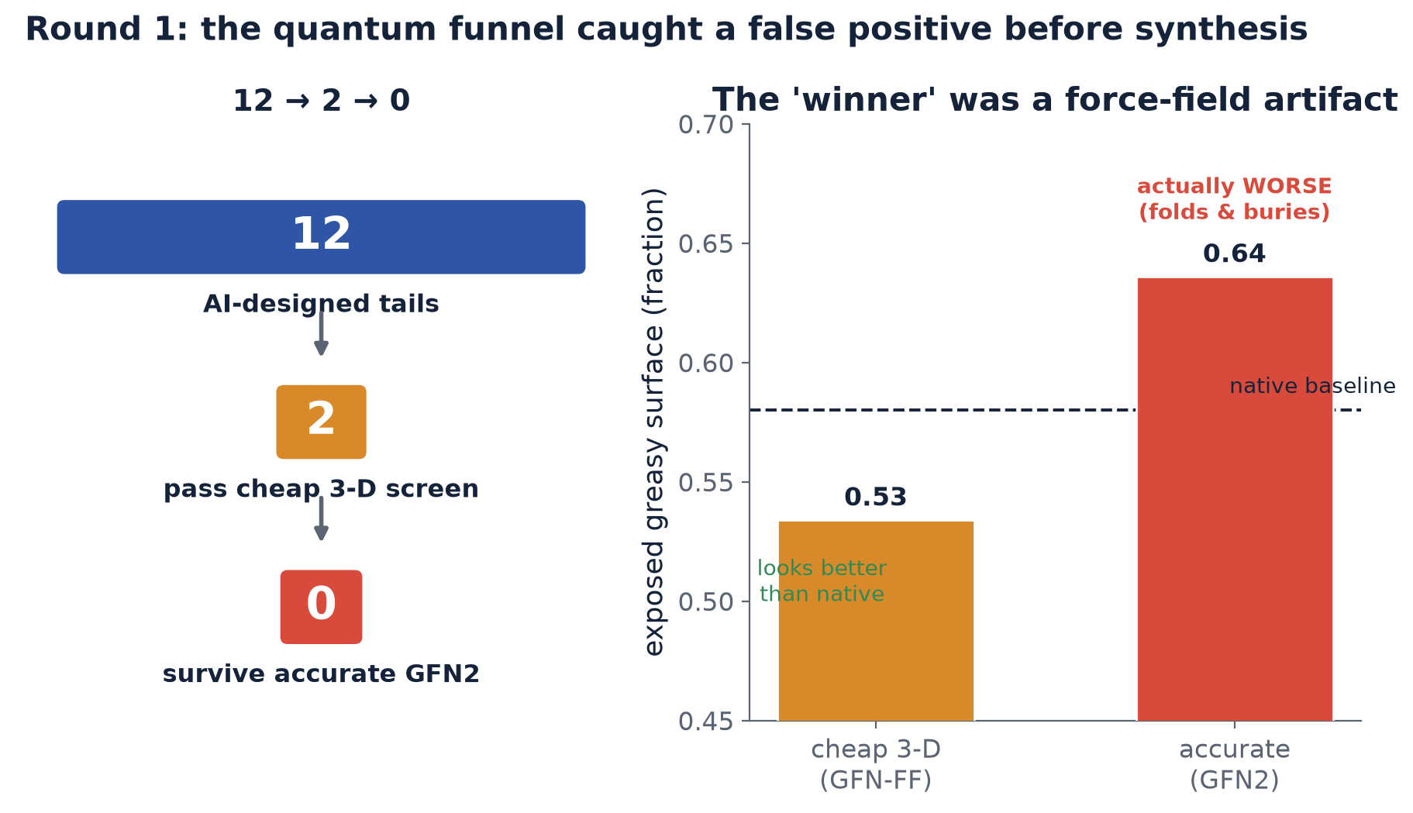
RESULT · ROUND 1
The quantum funnel caught a false positive before synthesis
The accurate method exposed the cheap method’s ‘winner’ as an artifact — caught before any lab time was spent.
13
Notes:
[~55s] And here is the payoff of the funnel discipline. On the left, twelve designs down to two, and then, at the most accurate quantum level, zero survivors. On the right is why. Our top candidate looked better than native with the cheaper method — but the accurate method showed its water-friendly group folds back and hides inside the molecule, leaving it actually worse than where we started. A computational artifact. The important part: we caught it before a single day of laboratory synthesis. That is exactly what the expensive quantum tier is for — cheap insurance against making the wrong molecule.

Slide 14
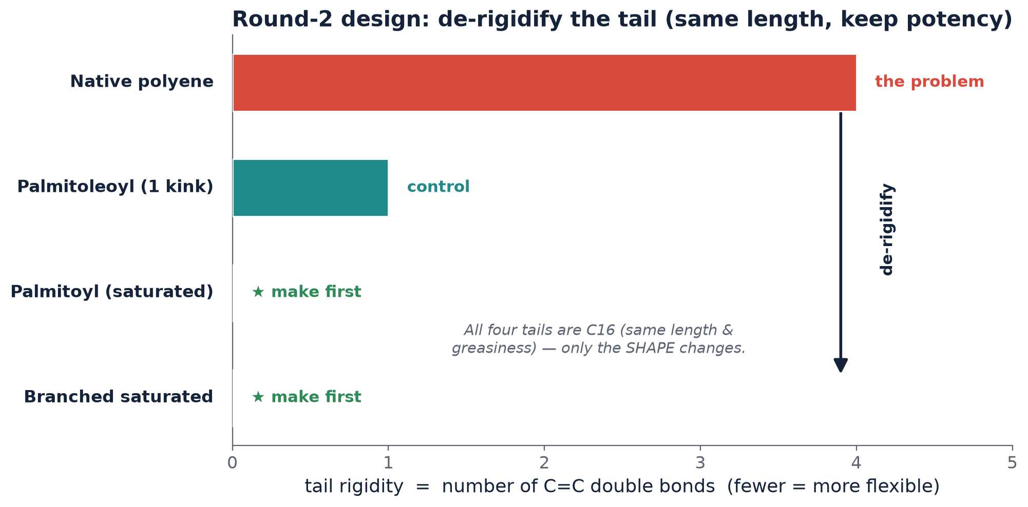
THE DELIVERABLE
A ranked, easy-to-make shortlist — redirected by the drug lesson
Make first (best bet):
Palmitoyl (saturated) · cleanest single test
Branched saturated · caspofungin-like
One-kink control · make second
Happy coincidence: these are also the EASIEST to synthesize — cheap fatty acids, one step. Best science = cheapest chemistry.
14
Notes:
[~55s] So computation told us the water-friendly route was a dead end — and the approved-drug lesson told us the right route instead: don't make the tail water-friendly, make it less rigid. This is our deliverable: a short, ranked set of molecules that keep the tail the same length — so potency is preserved — and change only its shape, from rigid to flexible. And here is the practical gift: these are also the easiest molecules to make — cheap, off-the-shelf building blocks, one step — unlike the original or the exotic designs. So the best scientific bet and the cheapest chemistry are the same molecules. We make the flexible ones first.

Slide 15
CONTRIBUTIONS
What this program delivered — a reusable platform, not a one-off
📊 Benchmark dataset
138 compounds, 1,042 records, full provenance — a field resource
🔬 Validated QM method
multi-tier quantum pipeline + in-house 3-D surface engine
🤖 AI molecule generator
novel-structure design with a reward checked against real data
💊 Cross-drug read-across
clinical echinocandin evidence imported into the design logic
⚙️ Reproducible engineering
14 documented stages, automated tests, cluster run protocols
🗺️ Roadmap + shortlist
the exact experiment that unlocks predictive AI
15
Notes:
[~50s] Stepping back, here is what the program delivered — and I want to stress it is a platform, not a one-off. A curated benchmark dataset that is a resource for the field. A validated quantum-chemistry method for these large, floppy natural products, which is genuinely hard. An AI generator with a scoring rule checked against real data. A framework for importing clinical drug knowledge into design. Reproducible engineering — documented stages, automated tests, run scripts — so anyone can rebuild it. And a clear roadmap with a concrete shortlist. Any one of these outlives the specific question we started with.

Slide 16
THE KEY LESSON & THE ROAD AHEAD
Where AI helps — and the loop that gets us there
This is NOT “AI failed.” It is a precise statement of the critical path:
AI drug design needs a measured ‘answer key’. Physics-based guesses alone were shown — rigorously — to mislead.
We now know exactly which few experiments unlock the AI — and the AI is already built to use them.
1. Synthesize the 4-molecule shortlist
2. Measure serum shift + protein binding
3. Train the AI on the results
4. AI designs round 2 (wider)
↻ A virtuous loop: each round of data makes the AI a better designer. The immediate next step needs no more computing.
16
Notes:
[~55s] I want to be direct about the honest conclusion, because it is often misunderstood. This is not 'AI failed.' It is a precise statement of the critical path: AI drug design needs a measured answer key to learn from, and we showed — rigorously — that physics-based guesses alone can mislead. The good news is we now know exactly which few experiments unlock the predictive AI, and the AI is already built to use them. The loop at the bottom is the path: synthesize the four-molecule shortlist, measure their serum behavior, feed that back to train the AI, and let it design the next, wider round. Each turn makes the AI a better designer — and the immediate next step needs no more computing, just a lab experiment.

Slide 17
SIGNIFICANCE
Why this matters — and the one-line takeaway
Revived a stalled, high-value drug class as a tractable design problem — urgent unmet clinical need
Built an end-to-end AI + quantum-chemistry discovery platform — reusable across programs
Demonstrated rigorous self-correction (the ‘honesty ladder’) — trustworthy, independent science
Integrated chemistry + machine learning + quantum physics + pharmacology — genuinely interdisciplinary
Defined the exact experiment that unlocks predictive AI — de-risks future investment
“We set out to teach a computer to design a serum-tolerant antifungal. We built the platform, curated the data, imported lessons from approved drugs, and — most importantly — learned to tell a real signal from a flattering illusion.
The computer is ready; it awaits one clean experiment, designed down to the exact four molecules.”
17
Notes:
[~55s] To summarize the significance. We took a stalled but high-value drug class and turned it into a tractable design problem. We built an end-to-end AI-plus-quantum-chemistry platform that is reusable. We demonstrated rigorous self-correction — the honesty ladder — which is really the hallmark of trustworthy science. The work spans chemistry, machine learning, quantum physics, and clinical pharmacology. And we defined the exact experiment that unlocks predictive AI, which de-risks future investment. If I leave you with one line: we set out to teach a computer to design a serum-tolerant antifungal — and along the way we learned to tell a real signal from a flattering illusion. The computer is ready; it is waiting for one clean experiment, narrowed to exactly four molecules.

Slide 18
Thank you
Questions & discussion welcome
Full technical detail, code, and reproducible reports: project repository (Phases 1–14).
Notes:
[~20s] Thank you. I am happy to take questions — about the biology, the computational methods, the AI, or where this goes next. All the detail, the code, and the reproducible reports live in the project repository, so anything I show can be independently checked.

