Slide 1
CS 325 – Asymptotic Analysis
Week 1 Part 1 Big-Oh, Omega, Theta

Slide 2
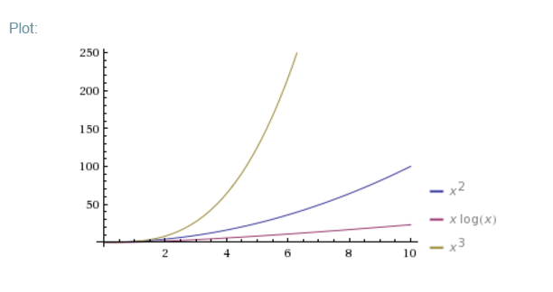
Problems vs Algorithms
For any given problem there are potentially many different types of algorithms to solve it.
Problem: Sorting a list of integers
Algorithms: Insertion Sort, Merge Sort, Naive Sort
Running time
Insertion Sort is O(n²)
Merge Sort is O(nlgn)
Naive Sort is O(n³)

Slide 3
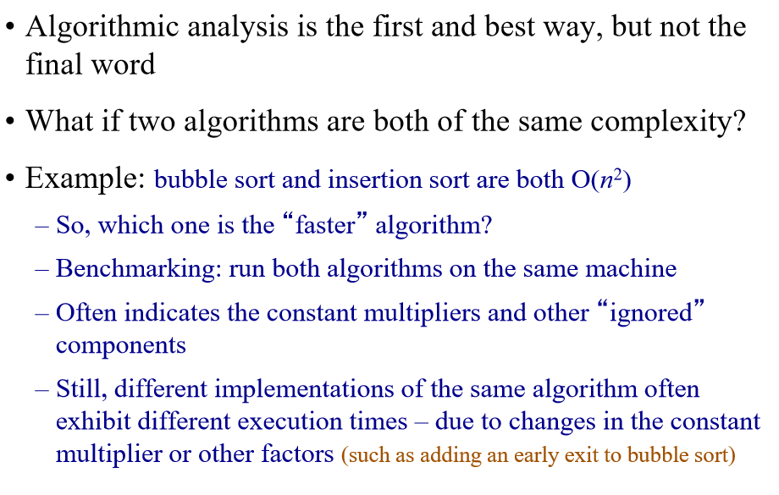
Benchmarking

Slide 4
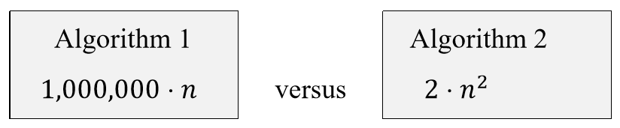
Constant factors and domination
Suppose we have two algorithms with exact running times of:
Is it reasonable to say that runtime of Algorithm 2 dominates (is worse) than Algorithm1?
NO for small values of n
Yes for large values of n

Slide 5
How do we compare algorithms?
We need to define a number of objective measures.
(1) Compare execution times?
Not good: times are specific to a particular computer and programming language!!
(2) Count the number of statements executed?
Not good: number of statements vary with the programming language as well as the style of the individual programmer.

Slide 6
Our Machine Model
Generic Random Access Machine (RAM)
Executes operations sequentially
Set of primitive operations:
Arithmetic. Logical, Comparisons, Function calls
Simplifying assumption: all ops cost 1 unit
Eliminates dependence on the speed of our computer, otherwise impossible to verify and to compare

Slide 7
Asymptotic Analysis
To compare two algorithms with running times f(n) and g(n), we need a rough measure that characterizes how fast each function grows.
Running time of an algorithm as a function of input size n for large n.
Compare functions in the limit, that is, asymptotically! (i.e., for large values of n)
Worst Case Analysis

Slide 8
Input Size
Express running time as a function of the input size n (i.e., f(n)).
size of an array
# of elements in a matrix
# of bits in the binary representation of the input
vertices and edges in a graph

Slide 9
Types of Analysis
Worst case
Provides an upper bound on running time
An absolute guarantee that the algorithm would not run longer, no matter what the inputs are
Best case
Provides a lower bound on running time
Input is the one for which the algorithm runs the fastest
Average case = Expected Value
Provides a prediction about the running time
Assumes that the input is random

Slide 10
Asymptotic performance
When n gets large enough, an n² algorithm always “beats” a n³ algorithm.
T(n)
n
n₀

Slide 11
Asymptotic Notation
Big-Oh - O notation: asymptotic “less than”:
f(n)=O(g(n)) implies: f(n) “≤” g(n)
Omega - Ω notation: asymptotic “greater than”:
f(n)= Ω (g(n)) implies: f(n) “≥” g(n)
Theta - Θ notation: asymptotic “equality”:
f(n)= Θ (g(n)) implies: f(n) “=” g(n)

Slide 12
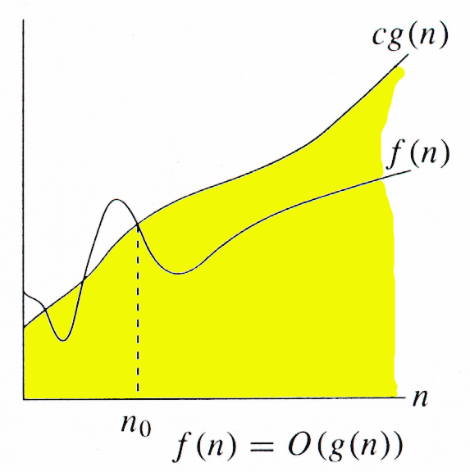
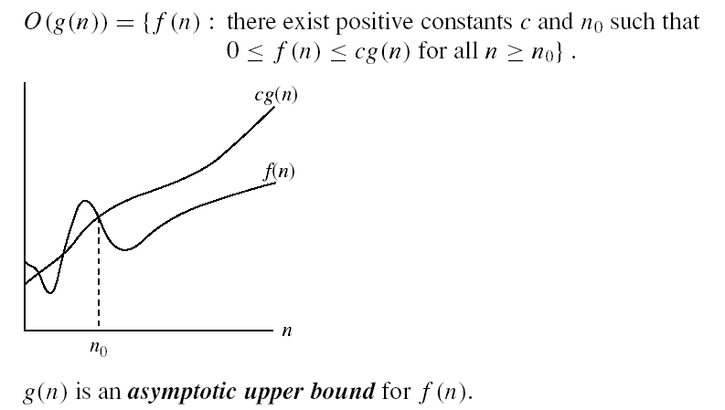
O-notation

Slide 13
Big-O example, graphically
Note 30n+8 isn’t less than n anywhere (n>0).
It isn’t even less than 31n everywhere.
But it is less than 31n everywhere to the right of n=8.
30n+8 is O(n)
cn = 31n
30n+8
Value of function →
n
n>n₀=8 →
Increasing n →

Slide 14
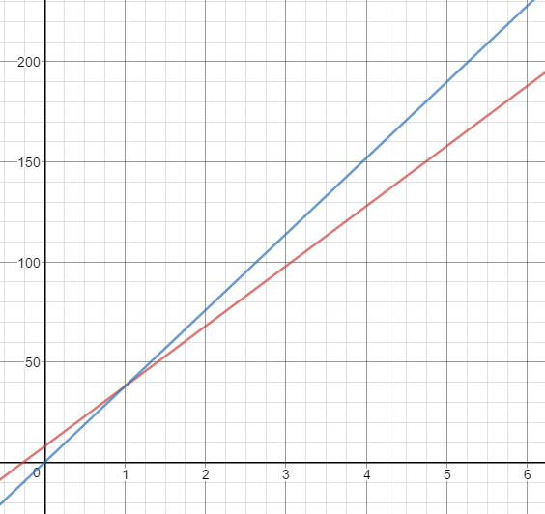
Not Unique - Example
Show that 30n+8 is O(n).
Show ∃c,n₀: 30n+8 ≤ cn, ∀n ≥ n₀ .
Let c=38, n₀=1. Assume n ≥ n₀=1.
Then cn = 38n = 30n + 8n ≥ 30n + 8, so
30n+8 ≤ 38n. when n ≥ 1
n ≥ 1
38n
30n+8

Slide 15
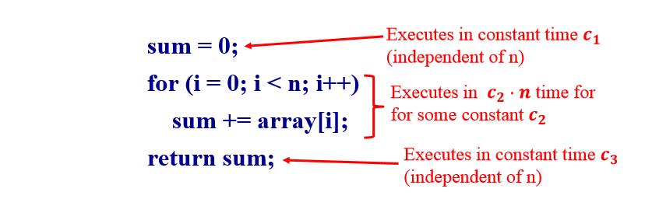
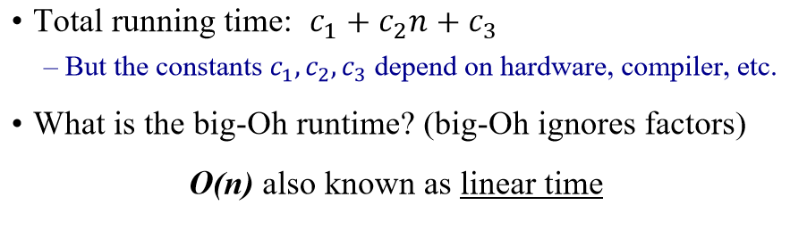
A Simple Code Example

Slide 16
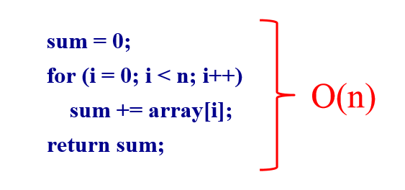
A Simple Example

Slide 17
Non-Linear Times
Consider the BubbleSort Algorithm
Let n be the size of the input list to be sorted
Runtime is O(n²), also known as quadratic time.
Suppose size doubles, what happens to execution time?
It goes up by a factor of 4. Why?

Slide 18
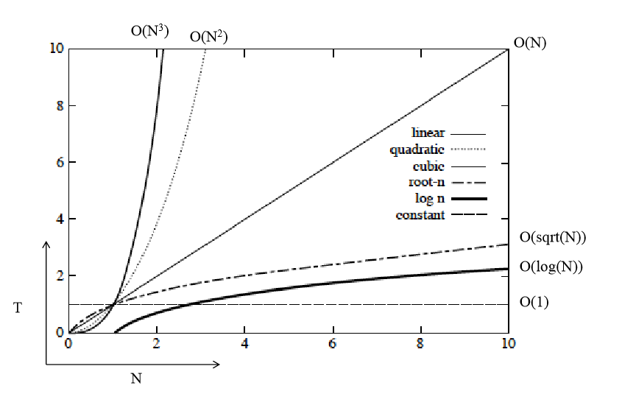
Orders of Growth

Slide 19
Big Oh Classes
Constant O(1)
Logarithmic O(log (n))
Linear O(n)
Quadratic O(n²)
Cubic O(n³)
Polynominal O(n^{k}) for any k>0
Exponential O(k^{n}), where k>1
Factorial O(n!)

Slide 20
Rank the following functions in increasing order of growth
10, logn, lg(2^{n}), 3n², n!

Slide 21
A polynomial of degree k is O(n^{k})
Recall: f(n) is O(g(n)) if there exist positive constants c and n₀ such that f(n) ≤ c ⋅ g(n) for all n ≥ n₀
Proof:
Suppose f(n) = b_{k}n^{k} + b_{k-1}n^{k-1} + … + b₁n + b₀
Let a_{i} = | b_{i} |
f(n) ≤ a_{k}n^{k} + a_{k-1}n^{k-1} + … + a₁n + a₀
Therefore all polynomial functions f(n) of degree k are O(n^{k}).

Slide 22
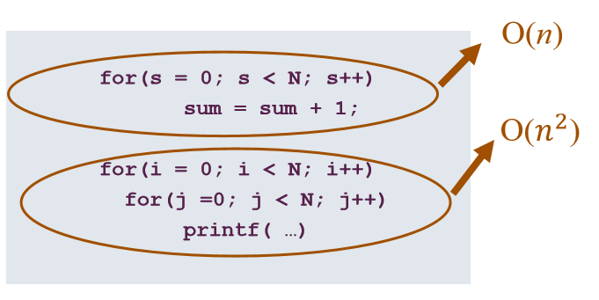
What does this mean in practice?
Total = O(n) + O(n²) = O(n + n²) = O(n²)

Slide 23
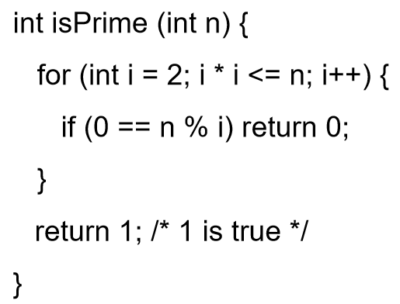
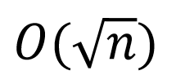
Code Example
What is the “Big-Oh” running time in terms of n?

Slide 24
Trouble with Big-Oh
Just an upper bound. Factually true but practically meaningless.
3n is O(n²)
3n is O(n⁴)
3n is O(n)
Many times only Big-Oh is reported but it is assumed a “tight” upper bound.

Slide 25
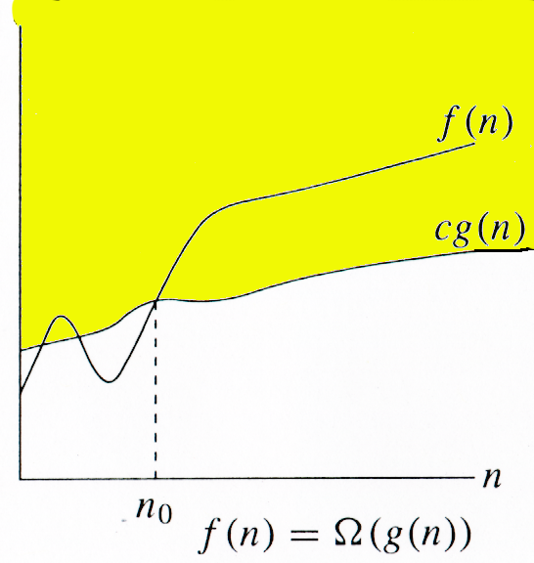
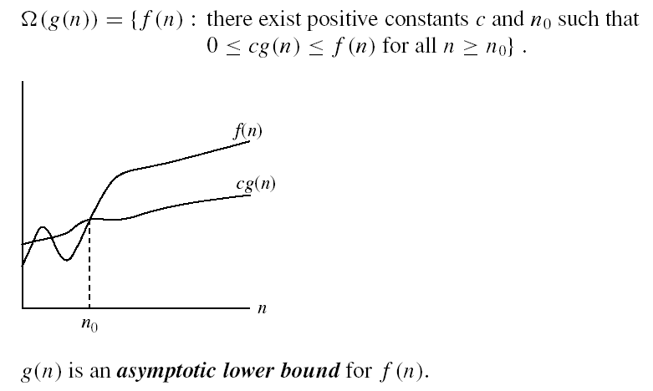
Omega Ω -notation
Ω(g(n)) is the set of functions with larger or same order of growth as g(n)

Slide 26
Omega Graphically
Note 30n+8 isn’t less than n anywhere (n>0).
30n+8 is Ω(n)
30n+8
Value of function →
n
n>0
Increasing n →

Slide 27
Examples
5n² = Ω(n)
5n²+10= Ω(n²)
∃ c, n₀ such that: 0 ≤ cn ≤ 5n²
⇒ cn ≤ 5n²
⇒ c = 5 and n₀ = 1
∃ c, n₀ such that: 0 ≤ cn² ≤ 5n²+10
5n²c ≤ 5n² +10
⇒ c = 1 and n₀ = 1

Slide 28
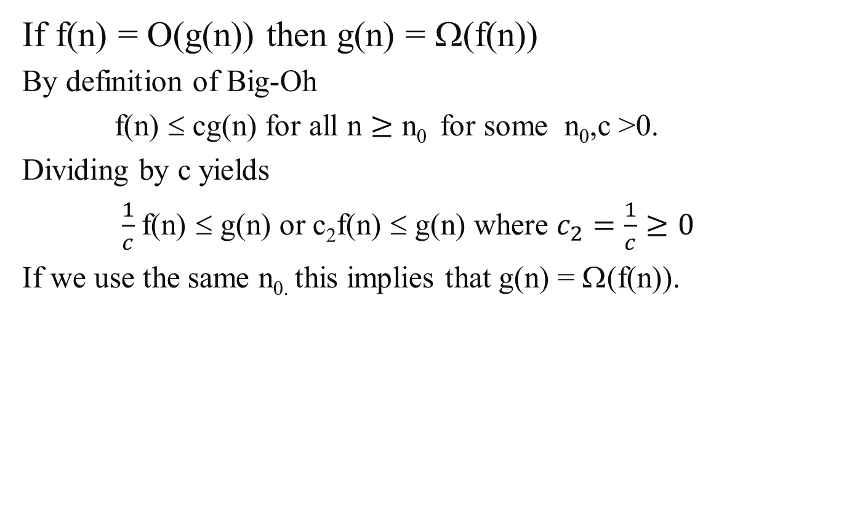
Property of Big-Oh and Omega
If f(n) = O(g(n)) then g(n) = Ω(f(n))
By definition of Big-Oh
f(n) ≤ cg(n) for all n $≥\text{n}\text{0 }$ for some n₀,c >0.
Dividing by c yields
$\frac{1}{c}$f(n) ≤ g(n) or c₂f(n) ≤ g(n) where $c_{2}=\frac{1}{c}≥0$
If we use the same n_{0.} this implies that g(n) = Ω(f(n)).

Slide 29
logn vs n
Show that n = Ω(logn) which will imply that logn = O(n)
Start with showing that 2^{n} = Ω(n).
Find c and n₀ such that cn ≤ 2^{n} for n ≥ n₀.
2n ≤ 2^{n} for n ≥ 2. (this could be proved by induction too)
So cn ≤ 2^{n} take the log of both sides
lg(cn) ≤ lg(2^{n})
lg(c) + lg(n) ≤ n so
1*lg(n) ≤ n for n ≥ 2
Therefore n = Ω(logn) and logn = O(n)

Slide 30
A non-negative polynomial of degree k is Ω(n^{k})
Proof:
Suppose f(n) = b_{k}n^{k} + b_{k-1}n^{k-1} + … + b₁n + b₀
For large n’s the fractions go to zero, so if we set n₀ large enough we can ignore all terms except b_{k} . Thus a value for n₀ must exist.
Therefore all polynomial functions f(n) of degree k are Ω(n^{k}).

Slide 31
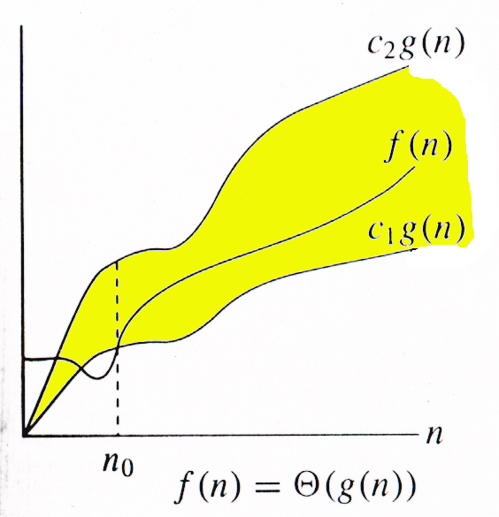

Θ-notation
Θ(g(n)) is the set of functions with the same order of growth as g(n)
g(n) is an asymptotically tight bound for f(n).

Slide 32
Big-Theta example, graphically
Note 30n+8 isn’t less than n anywhere (n>0).
It isn’t even less than 31n everywhere.
But it is less than 31n everywhere to the right of n=8.
30n+8 ∈ Θ(n)
cn = 31n
30n+8
Value of function →
n
n>n₀=8 →
Increasing n →

Slide 33
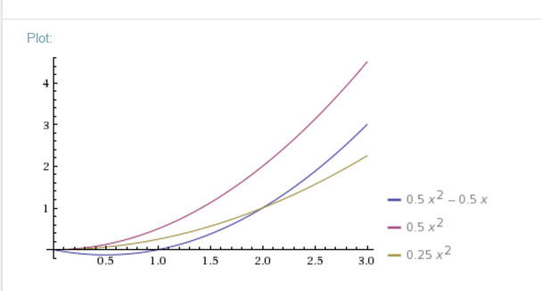
f(n) = ½ n² - ½n = Θ(n²)
Θ(g(n)) = { f (n) : there exist positive constants c₁, c₂, and n₀ such that 0 ≤ c₁ g(n) ≤ f (n) ≤ c₂ g(n) for all n ≥ n₀ }
Show f(n) = ½ n² - ½n = Θ(n²)
½ n² - ½ n ≤ ½ n² ∀n ≥ 0 ⇒ c₂= ½
½ n² - ½ n ≥ ½ n² - ½ n * ½ n ( ∀n ≥ 2 )
½ n² - ½ n ≥ ¼ n²
c₁= ¼
¼ n² ≤ ½ n² - ½ n ≤ ½ n² ∀n ≥ 2
Therefore, f(n) = ½ n² - ½n = Θ(n²)

Slide 34
A non-negative polynomial of degree k is Θ(n^{k})
Proof: From previous Big-Oh and Omega
f(n) = b_{k}n^{k} + b_{k-1}n^{k-1} + … + b₁n + b₀ is Θ(n^{k} )
Short-cut:
Drop low-order terms; ignore leading constants.
Example: 3n³ + 90n² – 5n + 6046 = Θ(n³)

Slide 35

For the functions f(n)=logn and g(n)=lgn. Which is true?
f(n) is O(g(n))
f(n) is Θ(g(n))
f(n) is Ω(g(n))
All of the above
lgn = log₂n = $\frac{logn}{log2}$ = c₁ logn
logn =log2(lgn) = c₂ lgn

Slide 36



Relations Between Θ, O, Ω

