Slide 1
CS 325 – Asymptotic Analysis
Week 1 Part 2: Limits

Slide 2
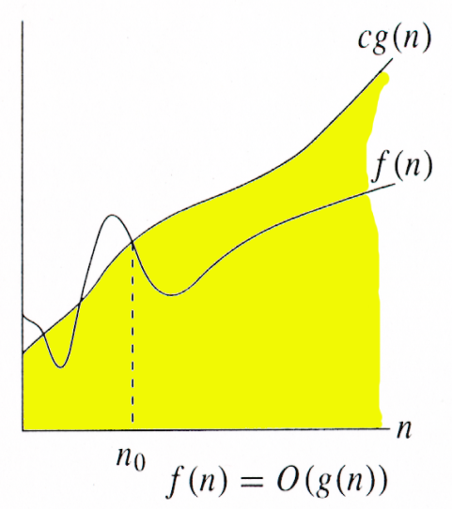
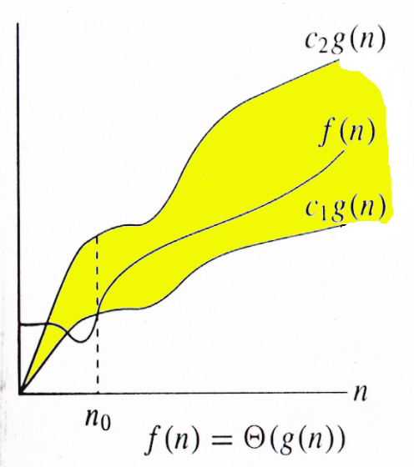
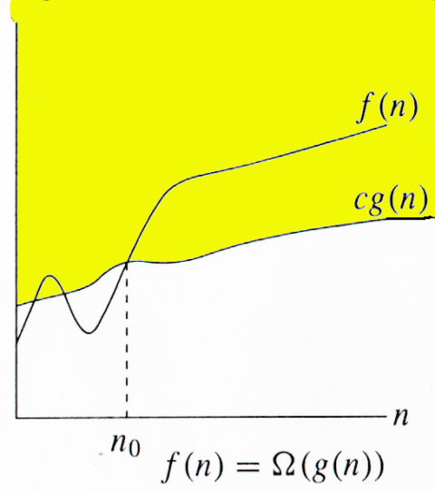
Relations Between Θ, O, Ω

Slide 3
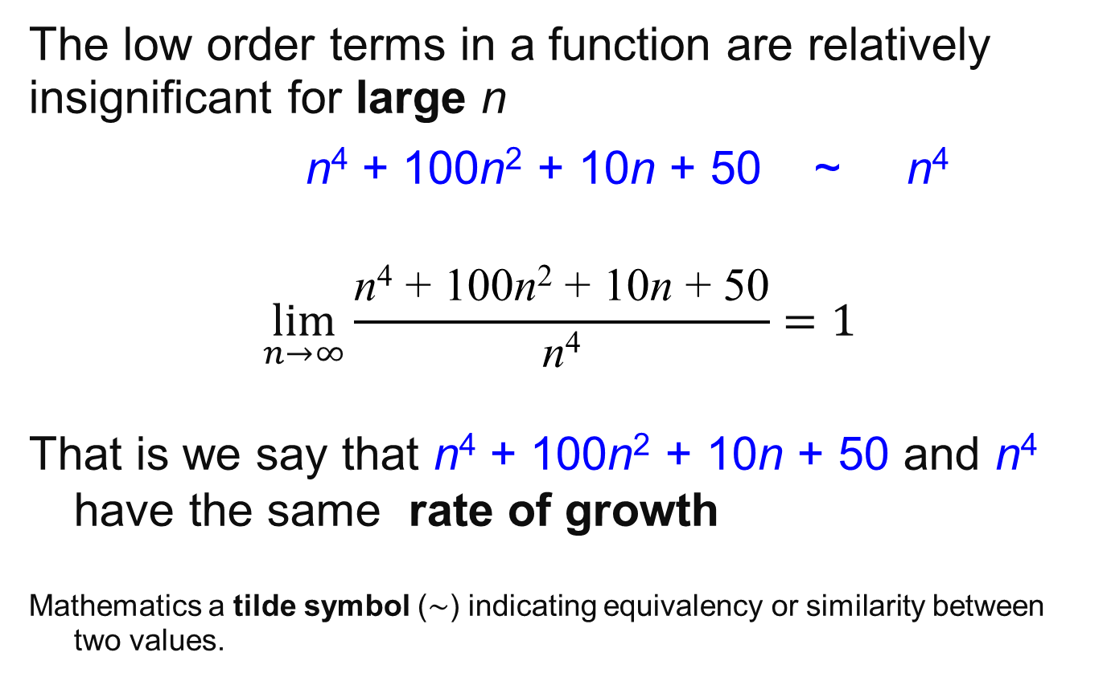
Rate of Growth
The low order terms in a function are relatively insignificant for large n
n⁴ + 100n² + 10n + 50 ~ n⁴
$$\lim_{n→∞}{\frac{\text{n}\text{4} \text{+ }\text{100}\text{n}\text{2} \text{+ }\text{10}\text{n}\text{ + }\text{50}}{\text{n}\text{4}}=1}$$
That is we say that n⁴ + 100n² + 10n + 50 and n⁴ have the same rate of growth
Mathematics a tilde symbol (∼) indicating equivalency or similarity between two values.

Slide 4
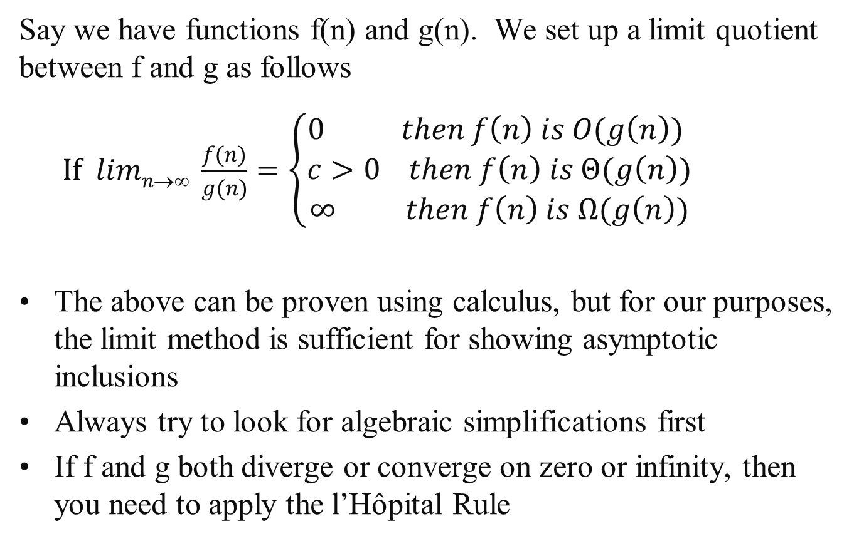
Limit Method: The Process
Say we have functions f(n) and g(n). We set up a limit quotient between f and g as follows
$If limn→∞ \frac{f(n)}{g(n)}=\left\{\begin{aligned}0 then f\left(n\right) is O(g\left(n\right)) \\ c>0 then f\left(n\right) is Θ(g\left(n\right)) \\ ∞ then f\left(n\right) is Ω(g\left(n\right))\end{aligned}\right.$
The above can be proven using calculus, but for our purposes, the limit method is sufficient for showing asymptotic inclusions
Always try to look for algebraic simplifications first
If f and g both diverge or converge on zero or infinity, then you need to apply the l’Hôpital Rule

Slide 5
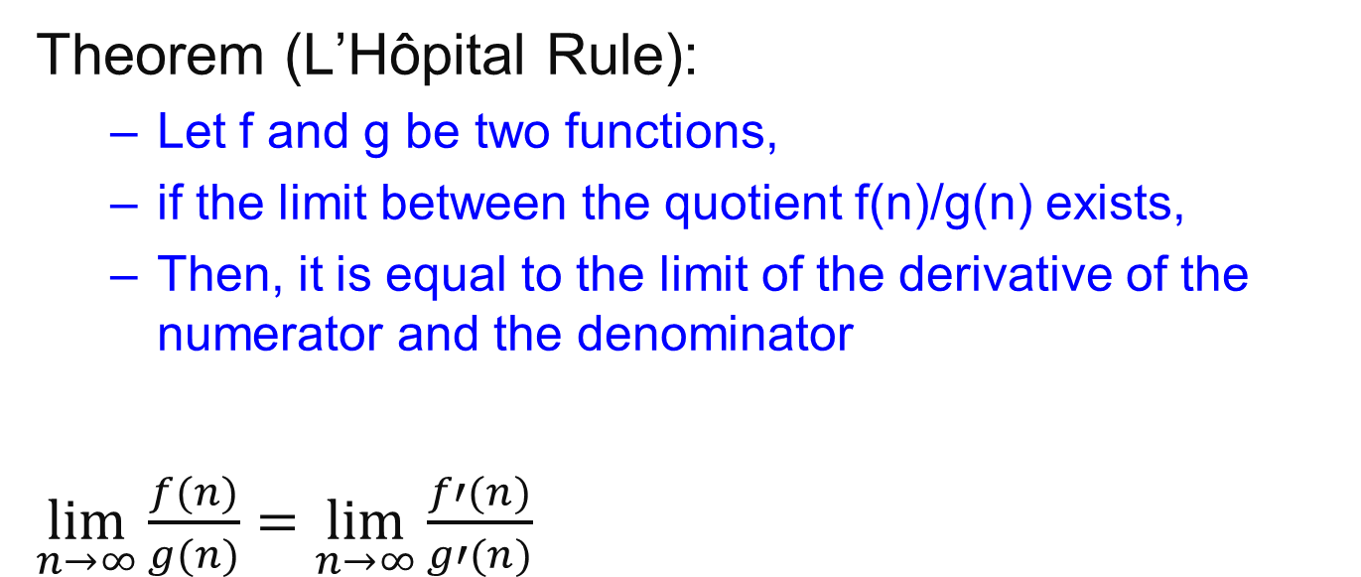
L’Hôpital Rule
Theorem (L’Hôpital Rule):
Let f and g be two functions,
if the limit between the quotient f(n)/g(n) exists,
Then, it is equal to the limit of the derivative of the numerator and the denominator
$\lim_{n→∞}{\frac{f(n)}{g(n)}=}$ $\lim_{n→∞}{\frac{f′(n)}{g′(n)}}$

Slide 6
Limit Method: Example 1
Example: Let f(n) =2^{n}, g(n)=3^{n}. Determine a tight inclusion of the form f(n) ∈ Δ (g(n))
What is your intuition in this case? Which function grows quicker?

Slide 7
Limit Method: Example1
Using algebra
lim_{n→∞} 2^{n}/3^{n} = lim_{n→∞} (2/3)^{n}
Now we use the following Theorem
 | 0 | if α < 1
lim_{n→∞} α^{n} = | 1 | if α = 1
 | ∞ | if α > 1
lim_{n→∞} 2^{n}/3^{n} = lim_{n→∞} (2/3)^{n}
= 0
Therefore we conclude that 2^{n} is O(3^{n})

Slide 8
Using Wolfram Alpha
https://www.wolframalpha.com/
lim(x->inf)(2^x/3^x)

Slide 9
Limit Method: Example 2
Example: Let f(n) =log₂n, g(n)=log₃n². Determine a tight inclusion of the form
f(n) ∈ Δ(g(n))
What is your intuition in this case?

Slide 10
Limit Method: Example 2
We set up our limit
lim_{n→∞} f(n)/g(n) = lim_{n→∞} log₂n/log₃n²
= lim_{n→∞} log₂n/(2log₃n)
Here we use the change of base formula for logarithms:
log₃n = log₂n / log₂3
lim_{n→∞} log₂n/(2log₃n) = lim_{n→∞} (log₂n log₂3) /(2log₂n)
= lim_{n→∞} (log₂3)/2
= (log₂3) /2
≈ 0.7924, a positive constant
So we conclude that f(n)∈Θ(g(n)) that is
log₂n ∈Θ(log₃n²) which implies that log₃n² ∈Θ(log₂n)

Slide 11
Important Result
All logs have the same asymptotic growth rate no what the base is.
In many CS algorithms the base is 2.
But we get sloppy since lg(n) is Θ(logn)

Slide 12
Properties

Slide 13
Properties
Theorem:
f(n) = Θ(g(n)) ⇔ f = O(g(n)) and f = Ω(g(n))
Transitivity:
f(n) = Θ(g(n)) and g(n) = Θ(h(n)) ⇒ f(n) = Θ(h(n))
Same for O and Ω
Reflexivity:
f(n) = Θ(f(n))
Same for O and Ω
Symmetry:
f(n) = Θ(g(n)) if and only if g(n) = Θ(f(n))
Transpose symmetry:
f(n) = O(g(n)) if and only if g(n) = Ω(f(n))

Slide 14
Let f, g and h be asymptotically positive functions. Prove or disprove each of the following conjectures.
Transitivity f(n) = Θ(g(n)) and g(n) = Θ(h(n)) ⇒ f(n) = Θ(h(n))
By definition f(n) = Θ(g(n)) implies there exist positive constants c₁, c₂, and n₀ such that 0 ≤ c₁ g(n) ≤ f (n) ≤ c₂ g(n) for all n ≥ n₀
2. By definition g(n) = Θ(h(n)) implies there exist positive constants c₃, c₄, and n₁ such that 0 ≤ c₃ h(n) ≤ g(n) ≤ c₄ h(n) for all n ≥ n₁
3. Show f(n) = Θ(h(n)) that is there exist positive constants c₅, c₆, and n₂ such that 0 ≤ c₅ h(n) ≤ f (n) ≤ c₆ h(n) for all n ≥ n₂
By combining 1 and 2: c₁c₃ h(n) ≤ c₁ g(n) ≤ f (n) let c₅ = c₁c₃ so c₅ h(n) ≤ f (n)
Again from 1 and 2: f (n) ≤ c₂ g(n) ≤ c₂ c₄ h(n) let c₆ = c₂c₄ so c₆ h(n) ≤ f (n)
And let n₂ = max {n₀ , n₁}

Slide 15
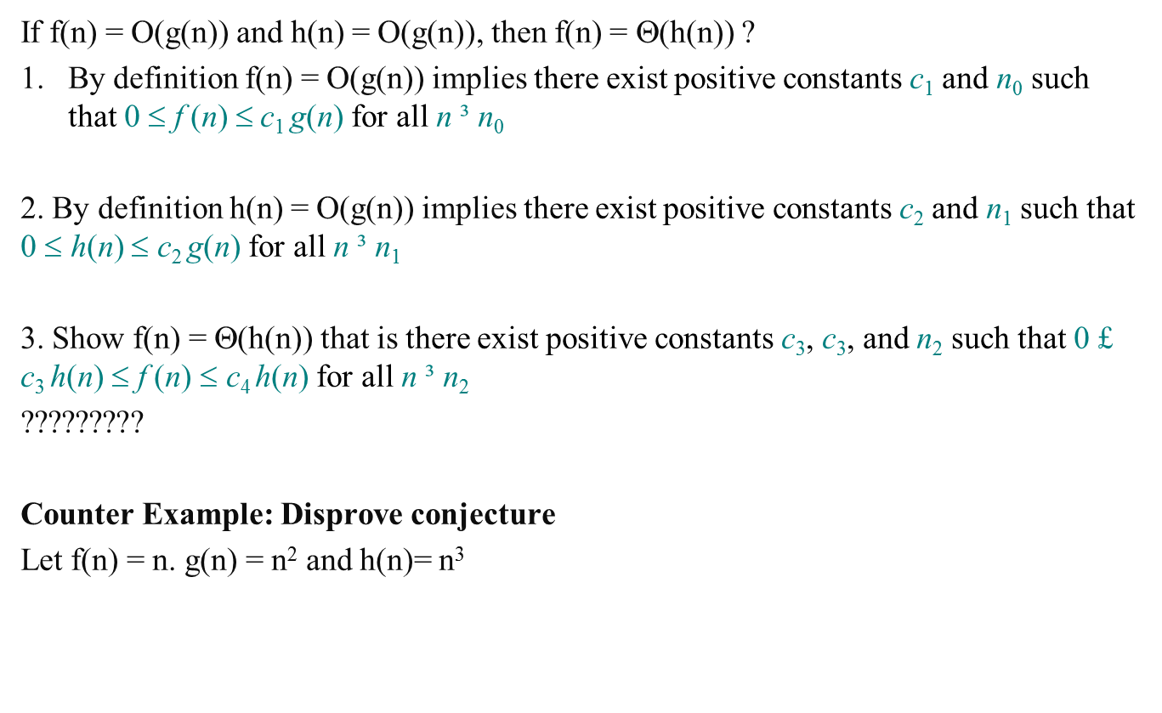
Let f, g and h be asymptotically positive functions. Prove or disprove each of the following conjectures.
If f(n) = O(g(n)) and h(n) = O(g(n)), then f(n) = Θ(h(n)) ?
By definition f(n) = O(g(n)) implies there exist positive constants c₁ and n₀ such that 0 $$ f (n) $$c₁ g(n) for all n ³ n₀
2. By definition h(n) = O(g(n)) implies there exist positive constants c₂ and n₁ such that 0 $$ h(n) $$ c₂ g(n) for all n ³ n₁
3. Show f(n) = Θ(h(n)) that is there exist positive constants c₃, c₃, and n₂ such that 0 £ c₃ h(n) $$ f (n) $$ c₄ h(n) for all n ³ n₂
?????????
Counter Example: Disprove conjecture
Let f(n) = n. g(n) = n² and h(n)= n³

