Slide 1
Graph Algorithms Part 1 BFS & DFS
CS 325

Slide 2
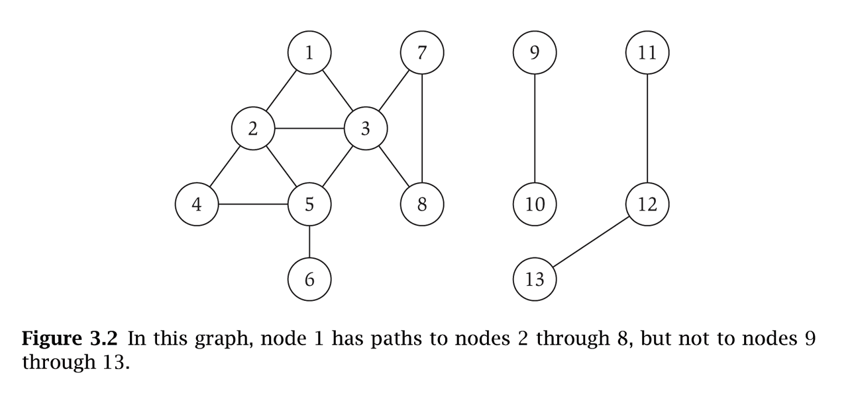
Introduction to graph theory
Graph – mathematical object consisting of a set of:
Denoted by G = (V, E).
V = nodes (vertices, points). V(G) and V_{G}
E = edges (links, arcs) between pairs of nodes. Also denoted by E(G) and E_{G} ; E ⊆ V x V
Graph size parameters: n = |V|, m = |E|.
V = { 1, 2, 3, 4, 5, 6, 7, 8 }
E = { (1,2), (1,3), (2,3), (2,4), (2,5), (3,5), (3,7), (3,8), (4,5), (5,6) } n = 8
m = 11

Slide 3
Introduction to graph theory
For graph G(V,E):
If edge e=(u,v) ∈ E(G), we say that u and v are adjacent or neighbors
u and v are incident with e
u and v are end-vertices of e
An edge where the two end vertices are the same is called a loop, or a self-loop
V = { 1, 2, 3, 4, 5, 6, 7, 8 }
E = { (1,2), (1,3), (2,3), (2,4), (2,5), (3,5), (3,7), (3,8), (4,5), (5,6) } n = 8
m = 11
3
3

Slide 4
Directed graph (digraph)
Directed edge
ordered pair of vertices (u,v)
Undirected edge
unordered pair of vertices (u,v)
A graph with directed edges is called a directed graph or digraph
A graph with undirected edges is an undirected graph or simply a graph

Slide 5
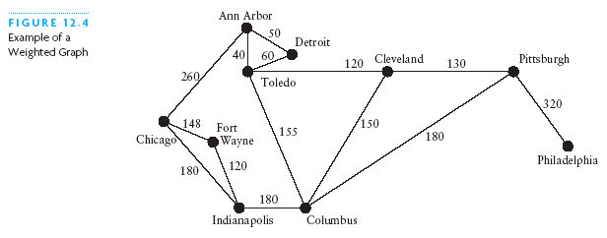
Weighted Graphs
The edges in a graph may have values associated with them known as their weights
A graph with weighted edges is known as a weighted graph

Slide 6
Terminology
End vertices (or endpoints) of an edge
U and V are the endpoints of a
Edges incident on a vertex
a, d, and b are incident on V
Adjacent vertices
U and V are adjacent
Degree of a vertex
X has degree 5
Self-loop
j is a self-loop
V
a
b
h
j
U
d
X
Z
c
e
i
W
g
f
Y

Slide 7
Terminology
A path in an undirected graph G = (V, E) is a sequence P of nodes v₁, v₂, …, v_{k-1}, v_{k} with the property that each consecutive pair v_{i}, v_{i+1} is joined by an edge in E. So, nodes can repeat, but edges do not.
A walk: a path in which edges/nodes can be repeated.
A path is simple if all nodes are distinct.
A cycle is a path in which the first and final vertices are the same
1
1
1
1
3
4
3
4
3
4
3
4
2
Walk:
(2,3), (3,1), (1,2), (2,3), (3,4)
Path:
(3,1), (1,2), (2,3), (3,4)
Simple Path:
(1,2), (2,3), (3,4)
Cycle

Slide 8
Terminology
Simple cycle: a cycle in which all vertices and edges are distinct
1-2-3-7-8-3-1 is not a simple cycle,
Cycles are denoted by C_{k}, where k is the number of nodes in the cycle
simple cycle C = 1-2-4-5-3-1
C₃
C₄
C₅

Slide 9
Subgraphs
A subgraph S of a graph G is a graph such that
The vertices of S are a subset of the vertices of G
The edges of S are a subset of the edges of G
A spanning subgraph of G is a subgraph that contains all the vertices of G
Subgraph
Spanning subgraph

Slide 10
Connectivity
A graph is connected if there is a path between every pair of vertices
A connected component of a graph G is a maximal connected subgraph of G
Connected graph
Non connected graph with two connected components

Slide 11
Trees and Forests
A tree is an undirected graph T such that
T is connected
T has no cycles
A forest is an undirected graph without cycles
The connected components of a forest are trees
Tree
Forest

Slide 12
DAG
A directed acyclic graph (DAG) is a digraph that has no directed cycles
D
E
B
C
A
DAG G

Slide 13
Spanning Trees and Forests
A spanning tree of a connected graph is a spanning subgraph that is a tree
A spanning tree is not unique unless the graph is a tree
Graph
Spanning tree

Slide 14
Representation of Graphs
Two standard ways:
Adjacency List
preferred for sparse graphs (|E| is much less than |V|^2)
Unless otherwise specified we will assume this representation
Adjacency Matrix
Preferred for dense graphs

Slide 15
Adjacency List
1
2
3
4
5
2
5
1
1
5
4
5
2
4
2
3
5
4
3
4
1
2
An array Adj of |V| lists, one per vertex
For each vertex u in V,
Adj[u] contains all vertices v such that there is an edge (u,v) in E (i.e. all the vertices adjacent to u)
Space required Θ(|V|+|E|) (Following CLRS, we will use V for |V| and E for |E|) thus Θ(V+E)

Slide 16
Adjacency Matrix
1
1 2 3 4 5
1
2
3
4
5
0 | 1 | 0 | 0 | 1
1 | 0 | 0 | 1 | 1
0 | 0 | 0 | 1 | 0
0 | 1 | 1 | 0 | 1
1 | 1 | 0 | 1 | 0
5
2
4
3

Slide 17
Graph Traversals
For solving most problems on graphs
Need to systematically visit all the vertices and edges of a graph
Two major traversals
Breadth-First Search (BFS)
Depth-First Search(DFS)

Slide 18
BFS
Starts at some source vertex s
Discover every vertex that is reachable from s
Also produces a BFS tree with root s and including all reachable vertices
Discovers vertices in increasing order of distance from s
Distance between v and s is the minimum number of edges on a path from s to v
i.e. discovers vertices in a series of layers

Slide 19
BFS : vertex colors stored in color[]
Initially all undiscovered: white
When first discovered: gray
They represent the frontier of vertices between discovered and undiscovered
Frontier vertices stored in a queue
Visits vertices across the entire breadth of this frontier
When processed: black

Slide 20
Review: Breadth-First Search
“Explore” a graph, turning it into a tree
One vertex at a time
Expand frontier of explored vertices across the breadth of the frontier
Builds a tree over the graph
Pick a source vertex to be the root
Find (“discover”) its children, then their children, etc.

Slide 21
Breadth-First Search
Again will associate vertex “colors” to guide the algorithm
White vertices have not been discovered
All vertices start out white
Grey vertices are discovered but not fully explored
They may be adjacent to white vertices
Black vertices are discovered and fully explored
They are adjacent only to black and gray vertices
Explore vertices by scanning adjacency list of grey vertices

Slide 22
Review: Breadth-First Search
BFS(G, s) {
initialize vertices;
Q = {s}; // Q is a queue initialize to s
while (Q not empty) {
u = DEQUEUE(Q);
for each v ∈ G.Adj[u] {
if (v.color == WHITE)
v.color = GREY;
v.d = u.d + 1;
v.p = u;
ENQUEUE(Q, v);
}
u.color = BLACK;
}
}

Slide 23
Breadth-First Search: Example
r
s
t
u
∞
∞
∞
∞
∞
∞
∞
∞
v
w
x
y

Slide 24
Breadth-First Search: Example
r
s
t
u
∞
0
∞
∞
∞
∞
∞
∞
v
w
x
y
Q:
s

Slide 25
Breadth-First Search: Example
r
s
t
u
1
0
∞
∞
∞
1
∞
∞
v
w
x
y
Q:
w
r

Slide 26
Breadth-First Search: Example
r
s
t
u
1
0
2
∞
∞
1
2
∞
v
w
x
y
Q:
r
t
x

Slide 27
Breadth-First Search: Example
r
s
t
u
1
0
2
∞
2
1
2
∞
v
w
x
y
Q:
t
x
v

Slide 28
Breadth-First Search: Example
r
s
t
u
1
0
2
3
2
1
2
∞
v
w
x
y
Q:
x
v
u

Slide 29
Breadth-First Search: Example
r
s
t
u
1
0
2
3
2
1
2
3
v
w
x
y
Q:
v
u
y

Slide 30
Breadth-First Search: Example
r
s
t
u
1
0
2
3
2
1
2
3
v
w
x
y
Q:
u
y

Slide 31
Breadth-First Search: Example
r
s
t
u
1
0
2
3
2
1
2
3
v
w
x
y
Q:
y

Slide 32
Breadth-First Search: Example
r
s
t
u
1
0
2
3
2
1
2
3
v
w
x
y
Q:
Ø

Slide 33
BFS: The Code Again
BFS(G, s) {
initialize vertices;
Q = {s}; // Q is a queue initialize to s
while (Q not empty) {
u = DEQUEUE(Q);
for each v ∈ G.Adj[u] {
if (v.color == WHITE)
v.color = GREY;
v.d = u.d + 1;
v.p = u;
ENQUEUE(Q, v);
}
u.color = BLACK;
}
}
Touch every vertex: O(V)
u = every vertex, but only once
So v = every vertex that appears in some other vert’s adjacency list
What will be the running time?
Total running time: O(V+E)

Slide 34
Breadth-First Search: Properties
BFS calculates the shortest-path distance to the source node
Shortest-path distance δ(s,v) = minimum number of edges from s to v, or ∞ if v not reachable from s
BFS builds breadth-first tree, in which paths to root represent shortest paths in G
Thus can use BFS to calculate shortest path from one vertex to another in O(V+E) time

Slide 35
Analysis
Each vertex is enqueued once and dequeued once : O(V)
Each adjacency list is traversed once:
Total: O(V+E)

Slide 36
BFS and shortest paths
Theorem: Let G=(V,E) be a directed or undirected graph, and suppose BFS is run on G starting from vertex s. During its execution BFS discovers every vertex v in V that is reachable from s. Let δ(s,v) denote the number of edges on the shortest path form s to v. Upon termination of BFS, d[v] = δ(s,v) for all v in V.

Slide 37
Depth-First Search
Depth-first search is another strategy for exploring a graph
Explore “deeper” in the graph whenever possible
Edges are explored out of the most recently discovered vertex v that still has unexplored edges
When all of v’s edges have been explored, backtrack to the vertex from which v was discovered
recursive

Slide 38
Time stamps, color[u] and pred[u] as before
We store two time stamps:
d[u] or u.d: the time vertex u is first discovered (discovery time)
f[u] or u.f: the time we finish processing vertex u (finish time)
color[u] or u.color
Undiscovered: white
Discovered but not finished processing: gray
Finished: black
pred[u] or u.π
Pointer to the vertex that first discovered u

Slide 39
Depth-First Search: The Code
DFS(G)
{
for each vertex u ∈ G.V
{
u.color = WHITE;
}
time = 0;
for each vertex u ∈ G.V
{
if (u.color == WHITE)
DFS_Visit(G,u);
}
}
DFS_Visit(G, u)
{
u.color = GREY;
time = time+1;
u.d = time;
for each v ∈ G.Adj[u]
{
if (v.color == WHITE)
DFS_Visit(G,v);
}
u.color = BLACK;
time = time+1;
u.f = time;
}
Running time: Θ(V+E) = Θ(V²) because call DFS_Visit on each vertex, and the loop over Adj[] can run as many as |V| times

Slide 40
DFS Example
source vertex

Slide 41
DFS Example
source vertex
d f
1 |
|
|
|
|
|
|
|

Slide 42
DFS Example
source vertex
d f
1 |
|
|
2 |
|
|
|
|

Slide 43
DFS Example
source vertex
d f
1 |
|
|
2 |
|
3 |
|
|

Slide 44
DFS Example
source vertex
d f
1 |
|
|
2 |
|
3 | 4
|
|

Slide 45
DFS Example
source vertex
d f
1 |
|
|
2 |
|
3 | 4
5 |
|

Slide 46
DFS Example
source vertex
d f
1 |
|
|
2 |
|
3 | 4
5 | 6
|

Slide 47
DFS Example
source vertex
d f
1 |
8 |
|
2 | 7
|
3 | 4
5 | 6
|

Slide 48
DFS Example
source vertex
d f
1 |
8 |
|
2 | 7
|
3 | 4
5 | 6
|

Slide 49
DFS Example
source vertex
d f
1 |
8 |
|
2 | 7
9 |
3 | 4
5 | 6
|
What is the structure of the grey vertices? What do they represent?

Slide 50
DFS Example
source vertex
d f
1 |
8 |
|
2 | 7
9 |10
3 | 4
5 | 6
|

Slide 51
DFS Example
source vertex
d f
1 |
8 |11
|
2 | 7
9 |10
3 | 4
5 | 6
|

Slide 52
DFS Example
source vertex
d f
1 |12
8 |11
|
2 | 7
9 |10
3 | 4
5 | 6
|

Slide 53
DFS Example
source vertex
d f
1 |12
8 |11
13|
2 | 7
9 |10
3 | 4
5 | 6
|

Slide 54
DFS Example
source vertex
d f
1 |12
8 |11
13|
2 | 7
9 |10
3 | 4
5 | 6
14|

Slide 55
DFS Example
source vertex
d f
1 |12
8 |11
13|
2 | 7
9 |10
3 | 4
5 | 6
14|15

Slide 56
DFS Example
source vertex
d f
1 |12
8 |11
13|16
2 | 7
9 |10
3 | 4
5 | 6
14|15

Slide 57
DFS Example
source vertex
d f
1 |12
8 |11
13|16
2 | 7
9 |10
3 | 4
5 | 6
14|15
Tree edges

Slide 58
DFS Example
source vertex
d f
1 |12
8 |11
13|16
2 | 7
9 |10
3 | 4
5 | 6
14|15
Tree edges
Back edges

Slide 59
DFS Example
source vertex
d f
1 |12
8 |11
13|16
2 | 7
9 |10
3 | 4
5 | 6
14|15
Tree edges
Back edges
Forward edges

Slide 60
DFS: Kinds of edges
DFS introduces an important distinction among edges in the original graph:
Tree edge: encounter new (white) vertex
Back edge: from descendent to ancestor
Forward edge: from ancestor to descendent
Cross edge: between a tree or subtrees
Note: tree & back edges are important; most algorithms don’t distinguish forward & cross

Slide 61
DFS Example
source vertex
d f
1 |12
8 |11
13|16
2 | 7
9 |10
3 | 4
5 | 6
14|15
Tree edges
Back edges
Forward edges
Cross edges

Slide 62
DFS And Graph Cycles
Thm: An undirected graph is acyclic iff a DFS yields no back edges
If acyclic, no back edges (because a back edge implies a cycle
If no back edges, acyclic
No back edges implies only tree edges Only tree edges implies we have a tree or a forest
Which by definition is acyclic
Thus, can run DFS to find whether a graph has a cycle

Slide 63
DFS And Cycles
Θ(V+E)
We can actually determine if cycles exist in Θ(V) time:
In an undirected acyclic forest, |E| ≤ |V| - 1
So count the edges: if ever see |V| distinct edges, must have seen a back edge along the way

Slide 64
Directed Acyclic Graphs
A directed acyclic graph or DAG is a directed graph with no directed cycles:
directed graph G is acyclic iff a DFS of G yields no back edges:

Slide 65
Topological Sort
Topological sort of a DAG:
Linear ordering of all vertices in graph G such that vertex u comes before vertex v if edge (u, v) ∈ G
Real-world example: getting dressed

Slide 66

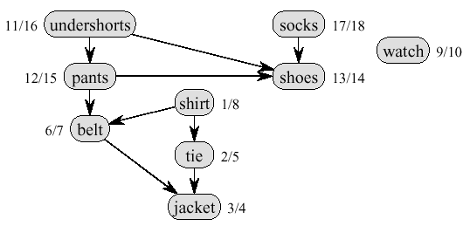
Topological Sort Example
Precedence relations: an edge from x to y means one must be done with x before one can do y
Intuition: can schedule task only when all of its subtasks have been scheduled

Slide 67
Topological Sort Algorithm
Topological-Sort()
{
Run DFS
When a vertex is finished, output it
Vertices are output in reverse topological order
}
Time: Θ(V+E)

Slide 68
Topological Example
Call DFS(G) to compute the finishing times f[v]
Time = 1
Time = 2
d = ∞
f = ∞
Let’s say we start the DFS from the vertex c
a
d = 1
f = ∞
Next we discover the vertex d
d = ∞
f = ∞
b
c
c
d = ∞
f = ∞
d = ∞
f = ∞
d
e
d = ∞
f = ∞
f

Slide 69
Topological sort
Call DFS(G) to compute the finishing times f[v]
Time = 2
Time = 3
d = ∞
f = ∞
Let’s say we start the DFS from the vertex c
a
d = 1
f = ∞
Next we discover the vertex d
d = ∞
f = ∞
b
c
c
d = ∞
f = ∞
d = 2
f = ∞
d
d
e
d = ∞
f = ∞
f

Slide 70
Topological sort
Call DFS(G) to compute the finishing times f[v]
Time = 3
Time = 4
as each vertex is finished, insert it onto the front of a linked list
d = ∞
f = ∞
Let’s say we start the DFS from the vertex c
a
d = 1
f = ∞
Next we discover the vertex d
d = ∞
f = ∞
b
c
c
Next we discover the vertex f
d = 2
f = ∞
d = ∞
f = ∞
f is done, move back to d
d
d
e
f
d = 3
f = 4
f
f

Slide 71
Topological sort
Call DFS(G) to compute the finishing times f[v]
Time = 4
Time = 5
d = ∞
f = ∞
Let’s say we start the DFS from the vertex c
a
d = 1
f = ∞
Next we discover the vertex d
d = ∞
f = ∞
b
c
c
Next we discover the vertex f
d = 2
f = 5
d = ∞
f = ∞
f is done, move back to d
d
d
e
d is done, move back to c
d = 3
f = 4
f
f
d
f

Slide 72
Topological sort
Call DFS(G) to compute the finishing times f[v]
Time = 5
Time = 6
d = ∞
f = ∞
Let’s say we start the DFS from the vertex c
a
d = 1
f = ∞
Next we discover the vertex d
d = ∞
f = ∞
b
c
c
Next we discover the vertex f
d = 2
f = 5
d = ∞
f = ∞
f is done, move back to d
d
d
e
d is done, move back to c
d = 3
f = 4
f
Next we discover the vertex e
f
d
f

Slide 73
Topological sort
Call DFS(G) to compute the finishing times f[v]
Time = 6
Time = 7
d = ∞
f = ∞
Let’s say we start the DFS from the vertex c
a
d = 1
f = ∞
Next we discover the vertex d
d = ∞
f = ∞
b
c
Next we discover the vertex f
Both edges from e are cross edges
d = 2
f = 5
d = 6
f = ∞
f is done, move back to d
d
d
e
e
d is done, move back to c
d = 3
f = 4
f
Next we discover the vertex e
f
e is done, move back to c
e
d
f

Slide 74
Topological sort
Call DFS(G) to compute the finishing times f[v]
Time = 7
Time = 8
d = ∞
f = ∞
Let’s say we start the DFS from the vertex c
a
Just a note: If there was (c,f) edge in the graph, it would be classified as a forward edge
(in this particular DFS run)
d = 1
f = ∞
Next we discover the vertex d
d = ∞
f = ∞
b
c
Next we discover the vertex f
d = 2
f = 5
d = 6
f = 7
f is done, move back to d
d
d
e
e
d is done, move back to c
d = 3
f = 4
f
Next we discover the vertex e
f
e is done, move back to c
c
e
d
f
c is done as well

Slide 75
Topological sort
Call DFS(G) to compute the finishing times f[v]
Time = 9
Time = 10
d = ∞
f = ∞
Let’s now call DFS visit from the vertex a
d = 9
f = ∞
a
a
d = 1
f = 8
Next we discover the vertex c,
but c was already processed => (a,c) is a cross edge
d = ∞
f = ∞
b
c
d = 2
f = 5
d = 6
f = 7
Next we discover the vertex b
d
d
e
e
d = 3
f = 4
f
f
c
e
d
f

Slide 76
Topological sort
Call DFS(G) to compute the finishing times f[v]
Time = 10
Time = 11
d = 9
f = ∞
Let’s now call DFS visit from the vertex a
a
a
d = 1
f = 8
Next we discover the vertex c,
but c was already processed => (a,c) is a cross edge
d = 10
f = ∞
d = 10
f = 11
b
b
c
d = 2
f = 5
d = 6
f = 7
Next we discover the vertex b
d
d
e
e
b is done as (b,d) is a cross edge => now move back to c
d = 3
f = 4
f
f
b
c
e
d
f

Slide 77
Topological sort
Call DFS(G) to compute the finishing times f[v]
Time = 11
Time = 12
d = 9
f = ∞
Let’s now call DFS visit from the vertex a
a
a
d = 1
f = 8
Next we discover the vertex c,
but c was already processed => (a,c) is a cross edge
d = 10
f = 11
b
b
c
d = 2
f = 5
d = 6
f = 7
Next we discover the vertex b
d
d
e
e
b is done as (b,d) is a cross edge => now move back to c
d = 3
f = 4
f
f
a is done as well
b
c
e
d
f

Slide 78
Topological sort
Call DFS(G) to compute the finishing times f[v]
Time = 11
Time = 13
d = 9
f = 12
Let’s now call DFS visit from the vertex a
WE HAVE THE RESULT!
return the linked list of vertices
a
a
d = 1
f = 8
Next we discover the vertex c,
but c was already processed => (a,c) is a cross edge
d = 10
f = 11
b
b
c
d = 2
f = 5
d = 6
f = 7
Next we discover the vertex b
d
d
e
e
b is done as (b,d) is a cross edge => now move back to c
d = 3
f = 4
f
f
a is done as well
a
b
c
e
d
f

Slide 79
Topological sort
Time = 11
Time = 13
The linked list is sorted in decreasing order of finishing times f[]
d = 9
f = 12
a
a
d = 10
f = 11
d = 1
f = 8
b
Try yourself with different vertex order for DFS visit
b
c
d = 2
f = 5
d = 6
f = 7
d
d
e
e
Note: If you redraw the graph so that all vertices are in a line ordered by a valid topological sort, then all edges point „from left to right“
d = 3
f = 4
f
f
a
b
c
e
d
f

