Slide 1
Graph Algorithms Part 2 MST
CS 325

Slide 2
Ch 23 Spanning Trees
Weighted Graphs
Minimum Spanning Trees
Greedy Choice Theorem
Kruskal’s Algorithm
Prim’s Algorithm

Slide 3
Minimum Spanning Tree
Problem: given a connected, undirected, weighted graph:
6
4
5
9
14
2
10
15
3
8

Slide 4
Minimum Spanning Tree
Problem: given a connected, undirected, weighted graph, find a spanning tree using edges that minimize the total weight
6
4
5
9
14
2
10
15
3
8

Slide 5
Minimum Spanning Tree
Which edges form the minimum spanning tree (MST) of the below graph?
A
6
4
H
5
B
9
C
14
2
10
G
E
15
D
3
8
F

Slide 6
Minimum Spanning Tree
Answer:
A
6
4
H
5
B
9
C
14
2
10
G
E
15
D
3
8
F

Slide 7
Greedy Algorithms for Minimum Spanning Tree
[Prim] Extend a tree by including the cheapest out going edge
[Kruskal] Add the cheapest edge that joins disjoint components
4
b
c
20
5
11
8
a
d
7
22
e

Slide 8
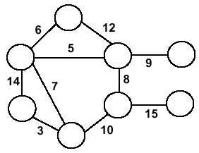
Minimum Spanning Trees
Undirected, connected graph G = (V,E)
Weight function W: E → R (assigning cost or length or other values to edges)
Spanning tree: tree that connects all the vertices (above?)
Minimum spanning tree: tree that connects all the vertices and minimizes

Slide 9
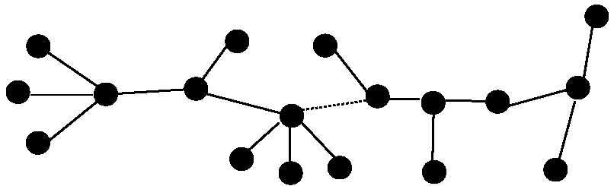
Optimal Substructure
T₂
MST T
Removing the edge (u,v) partitions T into T₁ and T₂
We claim that T₁ is the MST of G₁=(V₁,E₁), the subgraph of G induced by vertices in T₁
Also, T₂ is the MST of G₂
T₁

Slide 10
Greedy Choice
Greedy choice property: locally optimal (greedy) choice yields a globally optimal solution
Theorem
Let G=(V, E), and let S ⊆ V and
let (u,v) be min-weight edge in G connecting S to V – S
Then (u,v) ∈ T – some MST of G

Slide 11
Greedy Choice (2)
Proof
suppose (u,v) ∉ T
look at path from u to v in T
swap (x, y) – the first edge on path from u to v in T that crosses from S to V – S
this improves T – contradiction (T supposed to be MST)
V-S
S
y
x
u
v

Slide 12
Prim’s Algorithm
Vertex based algorithm
Grows one tree T, one vertex at a time
A cloud covering the portion of T already computed
Label the vertices v outside the cloud with key[v] – the minimum weigth of an edge connecting v to a vertex in the cloud, key[v] = ∞, if no such edge exists

Slide 13
Prim’s Algorithm
MST-Prim(G, w, r)
Q = V[G];
for each u ∈ Q
key[u] = ∞;
key[r] = 0;
p[r] = NULL;
while (Q not empty)
u = ExtractMin(Q);
for each v ∈ Adj[u]
if (v ∈ Q and w(u,v) < key[v])
p[v] = u;
key[v] = w(u,v);

Slide 14
Prim’s Algorithm
6
4
MST-Prim(G, w, r)
Q = V[G];
for each u ∈ Q
key[u] = ∞;
key[r] = 0;
p[r] = NULL;
while (Q not empty)
u = ExtractMin(Q);
for each v ∈ Adj[u]
if (v ∈ Q and w(u,v) < key[v])
p[v] = u;
key[v] = w(u,v);
5
9
14
2
10
15
3
8
Run on example graph

Slide 15
Prim’s Algorithm
6
∞
4
MST-Prim(G, w, r)
Q = V[G];
for each u ∈ Q
key[u] = ∞;
key[r] = 0;
p[r] = NULL;
while (Q not empty)
u = ExtractMin(Q);
for each v ∈ Adj[u]
if (v ∈ Q and w(u,v) < key[v])
p[v] = u;
key[v] = w(u,v);
5
9
∞
∞
∞
14
2
10
15
∞
∞
∞
3
∞
8
Run on example graph

Slide 16
Prim’s Algorithm
6
∞
4
MST-Prim(G, w, r)
Q = V[G];
for each u ∈ Q
key[u] = ∞;
key[r] = 0;
p[r] = NULL;
while (Q not empty)
u = ExtractMin(Q);
for each v ∈ Adj[u]
if (v ∈ Q and w(u,v) < key[v])
p[v] = u;
key[v] = w(u,v);
5
9
∞
∞
∞
14
2
10
15
r
0
∞
∞
3
∞
8
Pick a start vertex r

Slide 17
Prim’s Algorithm
6
∞
4
MST-Prim(G, w, r)
Q = V[G];
for each u ∈ Q
key[u] = ∞;
key[r] = 0;
p[r] = NULL;
while (Q not empty)
u = ExtractMin(Q);
for each v ∈ Adj[u]
if (v ∈ Q and w(u,v) < key[v])
p[v] = u;
key[v] = w(u,v);
5
9
∞
∞
∞
14
2
10
15
u
0
∞
∞
3
∞
8
Grey vertices have been removed from Q

Slide 18
Prim’s Algorithm
6
∞
4
MST-Prim(G, w, r)
Q = V[G];
for each u ∈ Q
key[u] = ∞;
key[r] = 0;
p[r] = NULL;
while (Q not empty)
u = ExtractMin(Q);
for each v ∈ Adj[u]
if (v ∈ Q and w(u,v) < key[v])
p[v] = u;
key[v] = w(u,v);
5
9
∞
∞
∞
14
2
10
15
u
0
∞
∞
3
3
8
v
Grey arrows indicate parent pointers

Slide 19
Prim’s Algorithm
v
6
∞
4
MST-Prim(G, w, r)
Q = V[G];
for each u ∈ Q
key[u] = ∞;
key[r] = 0;
p[r] = NULL;
while (Q not empty)
u = ExtractMin(Q);
for each v ∈ Adj[u]
if (v ∈ Q and w(u,v) < key[v])
p[v] = u;
key[v] = w(u,v);
5
9
14
∞
∞
14
2
10
15
u
0
∞
∞
3
3
8

Slide 20
Prim’s Algorithm
6
∞
4
MST-Prim(G, w, r)
Q = V[G];
for each u ∈ Q
key[u] = ∞;
key[r] = 0;
p[r] = NULL;
while (Q not empty)
u = ExtractMin(Q);
for each v ∈ Adj[u]
if (v ∈ Q and w(u,v) < key[v])
p[v] = u;
key[v] = w(u,v);
5
9
14
∞
∞
14
2
10
15
0
∞
∞
3
3
8
u

Slide 21
Prim’s Algorithm
6
∞
4
MST-Prim(G, w, r)
Q = V[G];
for each u ∈ Q
key[u] = ∞;
key[r] = 0;
p[r] = NULL;
while (Q not empty)
u = ExtractMin(Q);
for each v ∈ Adj[u]
if (v ∈ Q and w(u,v) < key[v])
p[v] = u;
key[v] = w(u,v);
5
9
14
∞
∞
14
2
10
15
0
8
∞
3
3
8
v
u

Slide 22
Prim’s Algorithm
v
6
∞
4
MST-Prim(G, w, r)
Q = V[G];
for each u ∈ Q
key[u] = ∞;
key[r] = 0;
p[r] = NULL;
while (Q not empty)
u = ExtractMin(Q);
for each v ∈ Adj[u]
if (v ∈ Q and w(u,v) < key[v])
p[v] = u;
key[v] = w(u,v);
5
9
10
∞
∞
14
2
10
15
0
8
∞
3
3
8
u

Slide 23
Prim’s Algorithm
6
∞
4
MST-Prim(G, w, r)
Q = V[G];
for each u ∈ Q
key[u] = ∞;
key[r] = 0;
p[r] = NULL;
while (Q not empty)
u = ExtractMin(Q);
for each v ∈ Adj[u]
if (v ∈ Q and w(u,v) < key[v])
p[v] = u;
key[v] = w(u,v);
5
9
10
∞
∞
14
2
10
15
0
8
∞
3
3
8
u

Slide 24
Prim’s Algorithm
6
∞
4
v
MST-Prim(G, w, r)
Q = V[G];
for each u ∈ Q
key[u] = ∞;
key[r] = 0;
p[r] = NULL;
while (Q not empty)
u = ExtractMin(Q);
for each v ∈ Adj[u]
if (v ∈ Q and w(u,v) < key[v])
p[v] = u;
key[v] = w(u,v);
5
9
10
2
∞
14
2
10
15
0
8
∞
3
3
8
u

Slide 25
Prim’s Algorithm
6
∞
4
MST-Prim(G, w, r)
Q = V[G];
for each u ∈ Q
key[u] = ∞;
key[r] = 0;
p[r] = NULL;
while (Q not empty)
u = ExtractMin(Q);
for each v ∈ Adj[u]
if (v ∈ Q and w(u,v) < key[v])
p[v] = u;
key[v] = w(u,v);
5
9
10
2
∞
14
2
10
15
0
8
15
3
8
v
3
u

Slide 26
Prim’s Algorithm
∞
u
6
4
MST-Prim(G, w, r)
Q = V[G];
for each u ∈ Q
key[u] = ∞;
key[r] = 0;
p[r] = NULL;
while (Q not empty)
u = ExtractMin(Q);
for each v ∈ Adj[u]
if (v ∈ Q and w(u,v) < key[v])
p[v] = u;
key[v] = w(u,v);
5
9
10
2
∞
14
2
10
15
0
8
15
3
3
8

Slide 27
Prim’s Algorithm
∞
u
6
4
v
MST-Prim(G, w, r)
Q = V[G];
for each u ∈ Q
key[u] = ∞;
key[r] = 0;
p[r] = NULL;
while (Q not empty)
u = ExtractMin(Q);
for each v ∈ Adj[u]
if (v ∈ Q and w(u,v) < key[v])
p[v] = u;
key[v] = w(u,v);
5
9
10
2
9
14
2
10
15
0
8
15
3
3
8

Slide 28
Prim’s Algorithm
v
4
u
6
4
MST-Prim(G, w, r)
Q = V[G];
for each u ∈ Q
key[u] = ∞;
key[r] = 0;
p[r] = NULL;
while (Q not empty)
u = ExtractMin(Q);
for each v ∈ Adj[u]
if (v ∈ Q and w(u,v) < key[v])
p[v] = u;
key[v] = w(u,v);
5
9
10
2
9
14
2
10
15
0
8
15
3
3
8

Slide 29
Prim’s Algorithm
4
u
v
6
4
MST-Prim(G, w, r)
Q = V[G];
for each u ∈ Q
key[u] = ∞;
key[r] = 0;
p[r] = NULL;
while (Q not empty)
u = ExtractMin(Q);
for each v ∈ Adj[u]
if (v ∈ Q and w(u,v) < key[v])
p[v] = u;
key[v] = w(u,v);
5
9
5
2
9
14
2
10
15
0
8
15
3
3
8

Slide 30
Prim’s Algorithm
u
6
4
4
MST-Prim(G, w, r)
Q = V[G];
for each u ∈ Q
key[u] = ∞;
key[r] = 0;
p[r] = NULL;
while (Q not empty)
u = ExtractMin(Q);
for each v ∈ Adj[u]
if (v ∈ Q and w(u,v) < key[v])
p[v] = u;
key[v] = w(u,v);
5
9
5
2
9
14
2
10
15
0
8
15
3
3
8

Slide 31
Prim’s Algorithm
u
4
6
4
MST-Prim(G, w, r)
Q = V[G];
for each u ∈ Q
key[u] = ∞;
key[r] = 0;
p[r] = NULL;
while (Q not empty)
u = ExtractMin(Q);
for each v ∈ Adj[u]
if (v ∈ Q and w(u,v) < key[v])
p[v] = u;
key[v] = w(u,v);
5
9
5
2
9
14
2
10
15
0
8
15
3
3
8

Slide 32
Prim’s Algorithm
u
6
4
4
MST-Prim(G, w, r)
Q = V[G];
for each u ∈ Q
key[u] = ∞;
key[r] = 0;
p[r] = NULL;
while (Q not empty)
u = ExtractMin(Q);
for each v ∈ Adj[u]
if (v ∈ Q and w(u,v) < key[v])
p[v] = u;
key[v] = w(u,v);
5
9
5
2
9
14
2
10
15
0
8
15
3
3
8

Slide 33
Prim’s Algorithm
6
4
4
MST-Prim(G, w, r)
Q = V[G];
for each u ∈ Q
key[u] = ∞;
key[r] = 0;
p[r] = NULL;
while (Q not empty)
u = ExtractMin(Q);
for each v ∈ Adj[u]
if (v ∈ Q and w(u,v) < key[v])
p[v] = u;
key[v] = w(u,v);
5
9
5
2
9
14
2
u
10
15
0
8
15
3
3
8

Slide 34
Analysis of Prim’s Algorithm
MST-Prim(G, w, r)
Q = V[G];
for each u ∈ Q
key[u] = ∞;
key[r] = 0;
p[r] = NULL;
while (Q not empty)
u = ExtractMin(Q);
for each v ∈ Adj[u]
if (v ∈ Q and w(u,v) < key[v])
p[v] = u;
key[v] = w(u,v);

Slide 35
Analysis of Prim’s Algorithm
MST-Prim(G, w, r)
Q = V[G];
for each u ∈ Q
key[u] = ∞;
key[r] = 0;
p[r] = NULL;
while (Q not empty)
u = ExtractMin(Q);
for each v ∈ Adj[u]
if (v ∈ Q and w(u,v) < key[v])
p[v] = u;
DecreaseKey(v, w(u,v));

Slide 36
Analysis of Prim’s Algorithm
MST-Prim(G, w, r)
Q = V[G];
for each u ∈ Q
key[u] = ∞;
key[r] = 0;
p[r] = NULL;
while (Q not empty)
u = ExtractMin(Q);
for each v ∈ Adj[u]
if (v ∈ Q and w(u,v) < key[v])
p[v] = u;
DecreaseKey(v, w(u,v));
How often is ExtractMin() called?
How often is DecreaseKey() called?

Slide 37
Prim’s Algorithm
MST-Prim(G, w, r)
Q = V[G];
for each u ∈ Q
key[u] = ∞;
key[r] = 0;
p[r] = NULL;
while (Q not empty)
u = ExtractMin(Q);
for each v ∈ Adj[u]
if (v ∈ Q and w(u,v) < key[v])
p[v] = u;
key[v] = w(u,v);
What will be the running time? A: Depends on queue binary heap: O(E lg V) Fibonacci heap: O(V lg V + E)

Slide 38
Prim’s Running Time
Time = |V|T(ExtractMin) + O(E)T(ModifyKey)
Time = O(V lgV + E lgV) = O(E lgV)
Q | T(ExtractMin) | T(DecreaseKey) | Total
array | O(V) | O(1) | O(V ²)
binary heap | O(lg V) | O(lg V) | O(E lgV )
Fibonacci heap | O(lg V) | O(1) amortized | O(V lgV +E )

Slide 39
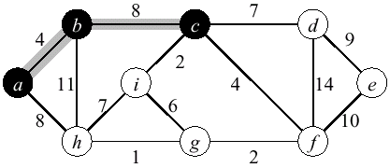
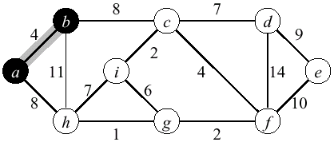
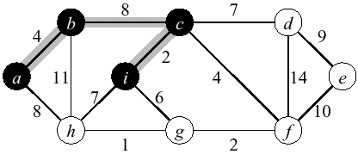
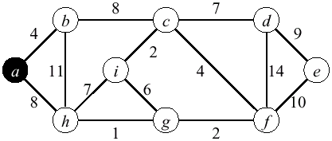
Prim’s Example (2)

Slide 40
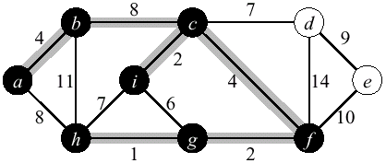
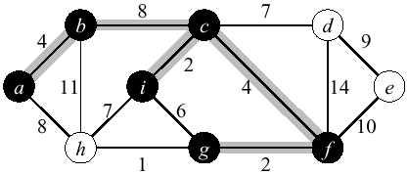
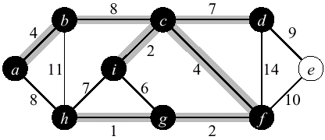
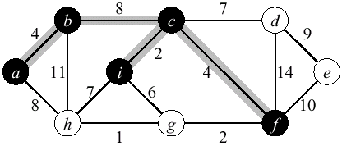
Prim’s Example (2)

Slide 41
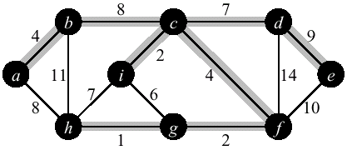
Prim’s Example (2)

Slide 42
Kruskal's Algorithm
Edge based algorithm
Add the edges one at a time, in increasing weight order
The algorithm maintains A – a forest of trees. An edge is accepted it if connects vertices of distinct trees
We need an Abstract Data Type (ADT) that maintains a partition, i.e.,a collection of disjoint sets
MakeSet(S,x): S ← S ∪ {{x}}
Union(S_{i},S_{j}): S ← S – {S_{i},S_{j}} ∪ {S_{i} ∪ S_{j}}
FindSet(S, x): returns unique S_{i} ∈ S, where x ∈ S_{i}

Slide 43
Kruskal’s Algorithm
Kruskal()
{
A = ∅;
for each v ∈ V
MakeSet(v);
sort E by increasing edge weight w
for each (u,v) ∈ E (in sorted order)
if FindSet(u) ≠ FindSet(v)
A = A U {{u,v}};
Union(FindSet(u), FindSet(v));
}

Slide 44
Kruskal’s Algorithm
Run the algorithm:
2
19
Kruskal()
{
A = ∅;
for each v ∈ V
MakeSet(v);
sort E by increasing edge weight w
for each (u,v) ∈ E (in sorted order)
if FindSet(u) ≠ FindSet(v)
A = A U {{u,v}};
Union(FindSet(u), FindSet(v));
}
9
14
17
8
25
5
21
13
1

Slide 45
Kruskal’s Algorithm
Run the algorithm:
2
19
Kruskal()
{
A = ∅;
for each v ∈ V
MakeSet(v);
sort E by increasing edge weight w
for each (u,v) ∈ E (in sorted order)
if FindSet(u) ≠ FindSet(v)
A = A U {{u,v}};
Union(FindSet(u), FindSet(v));
}
9
14
17
8
25
5
21
13
1

Slide 46
Kruskal’s Algorithm
Run the algorithm:
2
19
Kruskal()
{
A = ∅;
for each v ∈ V
MakeSet(v);
sort E by increasing edge weight w
for each (u,v) ∈ E (in sorted order)
if FindSet(u) ≠ FindSet(v)
A = A U {{u,v}};
Union(FindSet(u), FindSet(v));
}
9
14
17
8
25
5
21
13
1

Slide 47
Kruskal’s Algorithm
Run the algorithm:
2
19
Kruskal()
{
A = ∅;
for each v ∈ V
MakeSet(v);
sort E by increasing edge weight w
for each (u,v) ∈ E (in sorted order)
if FindSet(u) ≠ FindSet(v)
A = A U {{u,v}};
Union(FindSet(u), FindSet(v));
}
9
14
17
8
25
5
21
13
1?

Slide 48
Kruskal’s Algorithm
Run the algorithm:
2
19
Kruskal()
{
A = ∅;
for each v ∈ V
MakeSet(v);
sort E by increasing edge weight w
for each (u,v) ∈ E (in sorted order)
if FindSet(u) ≠ FindSet(v)
A = A U {{u,v}};
Union(FindSet(u), FindSet(v));
}
9
14
17
8
25
5
21
13
1

Slide 49
Kruskal’s Algorithm
Run the algorithm:
2?
19
Kruskal()
{
A = ∅;
for each v ∈ V
MakeSet(v);
sort E by increasing edge weight w
for each (u,v) ∈ E (in sorted order)
if FindSet(u) ≠ FindSet(v)
A = A U {{u,v}};
Union(FindSet(u), FindSet(v));
}
9
14
17
8
25
5
21
13
1

Slide 50
Kruskal’s Algorithm
Run the algorithm:
2
19
Kruskal()
{
A = ∅;
for each v ∈ V
MakeSet(v);
sort E by increasing edge weight w
for each (u,v) ∈ E (in sorted order)
if FindSet(u) ≠ FindSet(v)
A = A U {{u,v}};
Union(FindSet(u), FindSet(v));
}
9
14
17
8
25
5
21
13
1

Slide 51
Kruskal’s Algorithm
Run the algorithm:
2
19
Kruskal()
{
A = ∅;
for each v ∈ V
MakeSet(v);
sort E by increasing edge weight w
for each (u,v) ∈ E (in sorted order)
if FindSet(u) ≠ FindSet(v)
A = A U {{u,v}};
Union(FindSet(u), FindSet(v));
}
9
14
17
8
25
5?
21
13
1

Slide 52
Kruskal’s Algorithm
Run the algorithm:
2
19
Kruskal()
{
A = ∅;
for each v ∈ V
MakeSet(v);
sort E by increasing edge weight w
for each (u,v) ∈ E (in sorted order)
if FindSet(u) ≠ FindSet(v)
A = A U {{u,v}};
Union(FindSet(u), FindSet(v));
}
9
14
17
8
25
5
21
13
1

Slide 53
Kruskal’s Algorithm
Run the algorithm:
2
19
Kruskal()
{
A = ∅;
for each v ∈ V
MakeSet(v);
sort E by increasing edge weight w
for each (u,v) ∈ E (in sorted order)
if FindSet(u) ≠ FindSet(v)
A = A U {{u,v}};
Union(FindSet(u), FindSet(v));
}
9
14
17
8?
25
5
21
13
1

Slide 54
Kruskal’s Algorithm
Run the algorithm:
2
19
Kruskal()
{
A = ∅;
for each v ∈ V
MakeSet(v);
sort E by increasing edge weight w
for each (u,v) ∈ E (in sorted order)
if FindSet(u) ≠ FindSet(v)
A = A U {{u,v}};
Union(FindSet(u), FindSet(v));
}
9
14
17
8
25
5
21
13
1

Slide 55
Kruskal’s Algorithm
Run the algorithm:
2
19
Kruskal()
{
A = ∅;
for each v ∈ V
MakeSet(v);
sort E by increasing edge weight w
for each (u,v) ∈ E (in sorted order)
if FindSet(u) ≠ FindSet(v)
A = A U {{u,v}};
Union(FindSet(u), FindSet(v));
}
9?
14
17
8
25
5
21
13
1

Slide 56
Kruskal’s Algorithm
Run the algorithm:
2
19
Kruskal()
{
A = ∅;
for each v ∈ V
MakeSet(v);
sort E by increasing edge weight w
for each (u,v) ∈ E (in sorted order)
if FindSet(u) ≠ FindSet(v)
A = A U {{u,v}};
Union(FindSet(u), FindSet(v));
}
9
14
17
8
25
5
21
13
1

Slide 57
Kruskal’s Algorithm
Run the algorithm:
2
19
Kruskal()
{
A = ∅;
for each v ∈ V
MakeSet(v);
sort E by increasing edge weight w
for each (u,v) ∈ E (in sorted order)
if FindSet(u) ≠ FindSet(v)
A = A U {{u,v}};
Union(FindSet(u), FindSet(v));
}
9
14
17
8
25
5
21
13?
1

Slide 58
Kruskal’s Algorithm
Run the algorithm:
2
19
Kruskal()
{
A = ∅;
for each v ∈ V
MakeSet(v);
sort E by increasing edge weight w
for each (u,v) ∈ E (in sorted order)
if FindSet(u) ≠ FindSet(v)
A = A U {{u,v}};
Union(FindSet(u), FindSet(v));
}
9
14
17
8
25
5
21
13
1

Slide 59
Kruskal’s Algorithm
Run the algorithm:
2
19
Kruskal()
{
A = ∅;
for each v ∈ V
MakeSet(v);
sort E by increasing edge weight w
for each (u,v) ∈ E (in sorted order)
if FindSet(u) ≠ FindSet(v)
A = A U {{u,v}};
Union(FindSet(u), FindSet(v));
}
9
14?
17
8
25
5
21
13
1

Slide 60
Kruskal’s Algorithm
Run the algorithm:
2
19
Kruskal()
{
A = ∅;
for each v ∈ V
MakeSet(v);
sort E by increasing edge weight w
for each (u,v) ∈ E (in sorted order)
if FindSet(u) ≠ FindSet(v)
A = A U {{u,v}};
Union(FindSet(u), FindSet(v));
}
9
14
17
8
25
5
21
13
1

Slide 61
Kruskal’s Algorithm
Run the algorithm:
2
19
Kruskal()
{
A = ∅;
for each v ∈ V
MakeSet(v);
sort E by increasing edge weight w
for each (u,v) ∈ E (in sorted order)
if FindSet(u) ≠ FindSet(v)
A = A U {{u,v}};
Union(FindSet(u), FindSet(v));
}
9
14
17?
8
25
5
21
13
1

Slide 62
Kruskal’s Algorithm
Run the algorithm:
2
19?
Kruskal()
{
A = ∅;
for each v ∈ V
MakeSet(v);
sort E by increasing edge weight w
for each (u,v) ∈ E (in sorted order)
if FindSet(u) ≠ FindSet(v)
A = A U {{u,v}};
Union(FindSet(u), FindSet(v));
}
9
14
17
8
25
5
21
13
1

Slide 63
Kruskal’s Algorithm
Run the algorithm:
2
19
Kruskal()
{
A = ∅;
for each v ∈ V
MakeSet(v);
sort E by increasing edge weight w
for each (u,v) ∈ E (in sorted order)
if FindSet(u) ≠ FindSet(v)
A = A U {{u,v}};
Union(FindSet(u), FindSet(v));
}
9
14
17
8
25
5
21?
13
1

Slide 64
Kruskal’s Algorithm
Run the algorithm:
2
19
Kruskal()
{
A = ∅;
for each v ∈ V
MakeSet(v);
sort E by increasing edge weight w
for each (u,v) ∈ E (in sorted order)
if FindSet(u) ≠ FindSet(v)
A = A U {{u,v}};
Union(FindSet(u), FindSet(v));
}
9
14
17
8
25?
5
21
13
1

Slide 65
Kruskal’s Algorithm
Run the algorithm:
2
19
Kruskal()
{
A = ∅;
for each v ∈ V
MakeSet(v);
sort E by increasing edge weight w
for each (u,v) ∈ E (in sorted order)
if FindSet(u) ≠ FindSet(v)
A = A U {{u,v}};
Union(FindSet(u), FindSet(v));
}
9
14
17
8
25
5
21
13
1

Slide 66
Kruskal’s Algorithm
Run the algorithm:
2
19
Kruskal()
{
A = ∅;
for each v ∈ V
MakeSet(v);
sort E by increasing edge weight w
for each (u,v) ∈ E (in sorted order)
if FindSet(u) ≠ FindSet(v)
A = A U {{u,v}};
Union(FindSet(u), FindSet(v));
}
9
14
17
8
25
5
21
13
1

Slide 67
Correctness Of Kruskal’s Algorithm
Sketch of a proof that this algorithm produces an MST for T:
Assume algorithm is wrong: result is not an MST
Then algorithm adds a wrong edge at some point
If it adds a wrong edge, there must be a lower weight edge (cut and paste argument)
But algorithm chooses lowest weight edge at each step. Contradiction
Again, important to be comfortable with cut and paste arguments

Slide 68
Kruskal’s Algorithm
What will affect the running time?
Kruskal()
{
A = ∅;
for each v ∈ V
MakeSet(v);
sort E by increasing edge weight w
for each (u,v) ∈ E (in sorted order)
if FindSet(u) ≠ FindSet(v)
A = A U {{u,v}};
Union(FindSet(u), FindSet(v));
}

Slide 69
Kruskal’s Algorithm
What will affect the running time?
1 Sort
O(V) MakeSet() calls
O(E) FindSet() calls O(E) Union() calls
Kruskal()
{
A = ∅;
for each v ∈ V
MakeSet(v);
sort E by increasing edge weight w
for each (u,v) ∈ E (in sorted order)
if FindSet(u) ≠ FindSet(v)
A = A U {{u,v}};
Union(FindSet(u), FindSet(v));
}

Slide 70
Kruskal’s Algorithm: Running Time
To summarize:
Sort edges: O(E lg E)
O(V) MakeSet()’s
O(E) FindSet()’s
O(E) Union()’s
Upshot:
Best disjoint-set union algorithm makes above 3 operations take O(E⋅α(E,V)), α almost constant
Overall thus O(E lg E) = O(E lgV) since E < V²

Slide 71
Kruskal Running Time
Initialization O(V) time
Sorting the edges Θ(E lg E) = Θ(E lg V)
O(E) calls to FindSet
Union costs
Let t(v) – the number of times v is moved to a new cluster
Each time a vertex is moved to a new cluster the size of the cluster containing the vertex at least doubles: t(v) ≤ log V
Total time spent doing Union
Total time: O(E lg V)

