Slide 1
Introduction to Linear Programming

Slide 2
LP Model Formulation
A Maximization Example
Resource 40 hrs of labor per day
Availability: 120 lbs of clay
Decision x₁ = number of bowls to produce per day
Variables: x₂ = number of mugs to produce per day
Objective Maximize Z = $40x₁ + $50x₂
Function: Where Z = profit per day
Resource 1x₁ + 2x₂ ≤ 40 hours of labor
Constraints: 4x₁ + 3x₂ ≤ 120 pounds of clay
Non-Negativity x₁ ≥ 0; x₂ ≥ 0
Constraints:

Slide 3
LP Model Formulation
A Maximization Example
Complete Linear Programming Model:
Maximize Z = $40x₁ + $50x₂
subject to: 1x₁ + 2x₂ ≤ 40
4x₁ + 3x₂ ≤ 120
x₁, x₂ ≥ 0

Slide 4
Feasible Solutions
A feasible solution does not violate any of the constraints:
Example: x₁ = 5 bowls
x₂ = 10 mugs
Z = $40x₁ + $50x₂ = $700
Labor constraint check: 1(5) + 2(10) = 25 < 40 hours
Clay constraint check: 4(5) + 3(10) = 50 < 120 pounds

Slide 5
Infeasible Solutions
An infeasible solution violates at least one of the constraints:
Example: x₁ = 10 bowls
x₂ = 20 mugs
Z = $40x₁ + $50x₂ = $1400
Labor constraint check: 1(10) + 2(20) = 50 > 40 hours

Slide 6
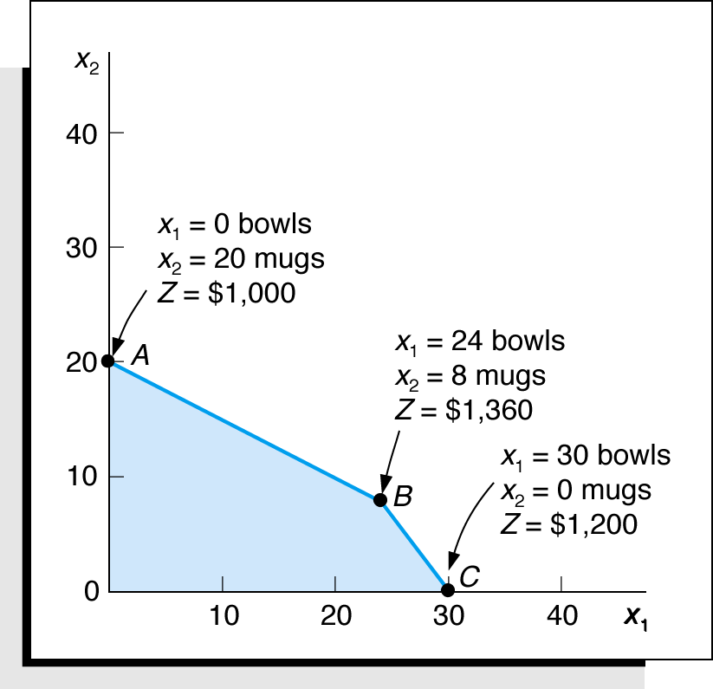
Extreme (Corner) Point Solutions
Graphical Solution of Maximization Model
Maximize Z = $40x₁ + $50x₂
subject to: 1x₁ + 2x₂ ≤ 40
4x₁ + 3x₂ ≤ 120
x₁, x₂ ≥ 0
feasible
Solutions at All Corner Points

Slide 7
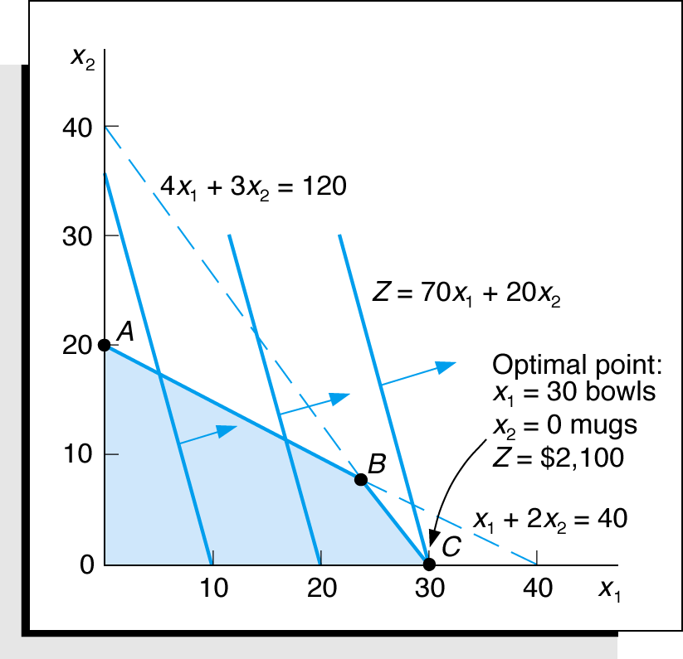
Optimal Solution for New Objective Function
Graphical Solution of Maximization Model
Maximize Z = $70x₁ + $20x₂
subject to: 1x₁ + 2x₂ ≤ 40
4x₁ + 3x₂ ≤ 120
x₁, x₂ ≥ 0
feasible
Optimal Solution with Z = 70x₁ + 20x₂

Slide 8
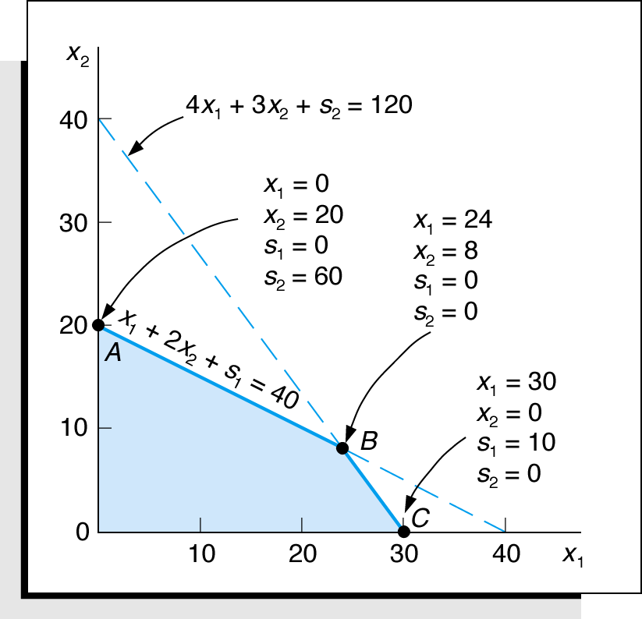
Linear Programming Model: Standard Form
Max Z = 40x₁ + 50x₂ + 0s₁ + 0s₂
subject to:1x₁ + 2x₂ + s₁ = 40
4x₁ + 3x₂ + s₂ = 120
x₁, x₂, s₁, s₂ ≥ 0
Where:
x₁ = number of bowls
x₂ = number of mugs
s₁, s₂ are slack variables
feasible
Solution Points A, B, and C with Slack

Slide 9
What if we add a plate and 5 hours of labor?
Profit $30
Labor = 0.5 hours, clay = 2 lbs
Maximize Z = $40x₁ + $50x₂+$30x₃
subject to: 1x₁ + 2x₂ + 0.5x₃ ≤ 45
4x₁ + 3x₂ + 2x₃ ≤ 120
x₁, x₂ ≥ 0

Slide 10
max 40x1 + 50x2 + 30x3
ST
x1 + 2x2 + 0.5x3 <= 45
4x1 + 3x2 + 2x3 <= 120
x1 >= 0
x2 >= 0
x3 >= 0
OBJECTIVE FUNCTION VALUE
1) 1860.000
VARIABLE VALUE REDUCED COST
X1 0.000000 20.000000
X2 12.000000 0.000000
X3 42.000000 0.000000
ROW SLACK OR SURPLUS DUAL PRICES
2) 0.000000 4.000000
3) 0.000000 14.000000
4) 0.000000 0.000000
5) 12.000000 0.000000
6) 42.000000 0.000000

Slide 11
Reduced Cost
is the amount by which an objective function coefficient would have to improve (so increase for maximization problem, decrease for minimization problem) before it would be possible for a corresponding variable to assume a positive value in the optimal solution.
Only positive for decision variables with a value of 0.

Slide 12
What if mugs had a profit of $60?
OBJECTIVE FUNCTION VALUE max 40x1 + 50x2 + 30x3
1) 1860.000
VARIABLE VALUE REDUCED COST
X1 0.000000 20.000000
X2 12.000000 0.000000
X3 42.000000 0.000000
ROW SLACK OR SURPLUS DUAL PRICES
2) 0.000000 4.000000
3) 0.000000 14.000000
4) 0.000000 0.000000
5) 12.000000 0.000000
6) 42.000000 0.000000
OBJECTIVE FUNCTION VALUE max 60x1 + 50x2 + 30x3
1) 1860.000
VARIABLE VALUE REDUCED COST
X1 21.000000 0.000000
X2 12.000000 0.000000
X3 0.000000 0.000000
ROW SLACK OR SURPLUS DUAL PRICES
2) 0.000000 4.000000
3) 0.000000 14.000000
4) 21.000000 0.000000
5) 12.000000 0.000000
6) 0.000000 0.000000

Slide 13
Dual Price / Shadow Price
is the instantaneous change, per unit of the constraint, in the objective value of the optimal solution obtained by relaxing the constraint.
In other words, it is the marginal utility of relaxing the constraint, or, equivalently, the marginal cost of strengthening the constraint.

Slide 14
What if we add 5 hours of labor? The objective increases by 5*4 = $20.
OBJECTIVE FUNCTION VALUE max 40x1 + 50x2 + 30x3
1) 1860.000
VARIABLE VALUE REDUCED COST
X1 0.000000 20.000000
X2 12.000000 0.000000
X3 42.000000 0.000000
ROW SLACK OR SURPLUS DUAL PRICES
2) 0.000000 4.000000
3) 0.000000 14.000000
4) 0.000000 0.000000
5) 12.000000 0.000000
6) 42.000000 0.000000
OBJECTIVE FUNCTION VALUE max 40x1 + 50x2 + 30x3
1) 1880.000
VARIABLE VALUE REDUCED COST
X1 0.000000 20.000000
X2 16.000000 0.000000
X3 36.000000 0.000000
ROW SLACK OR SURPLUS DUAL PRICES
2) 0.000000 4.000000
3) 0.000000 14.000000
4) 0.000000 0.000000
5) 16.000000 0.000000
6) 36.000000 0.000000

Slide 15
LP Model Formulation – Minimization
Decision Variables: x₁ = bags of Super-gro
x₂ = bags of Crop-quick
The Objective Function:
Minimize Z = $6x₁ + 3x₂
Where: $6x₁ = cost of bags of Super-Gro
$3x₂ = cost of bags of Crop-Quick
Model Constraints:
2x₁ + 4x₂ ≥ 16 lb (nitrogen constraint)
4x₁ + 3x₂ ≥ 24 lb (phosphate constraint)
x₁, x₂ ≥ 0 (non-negativity constraint)

Slide 16
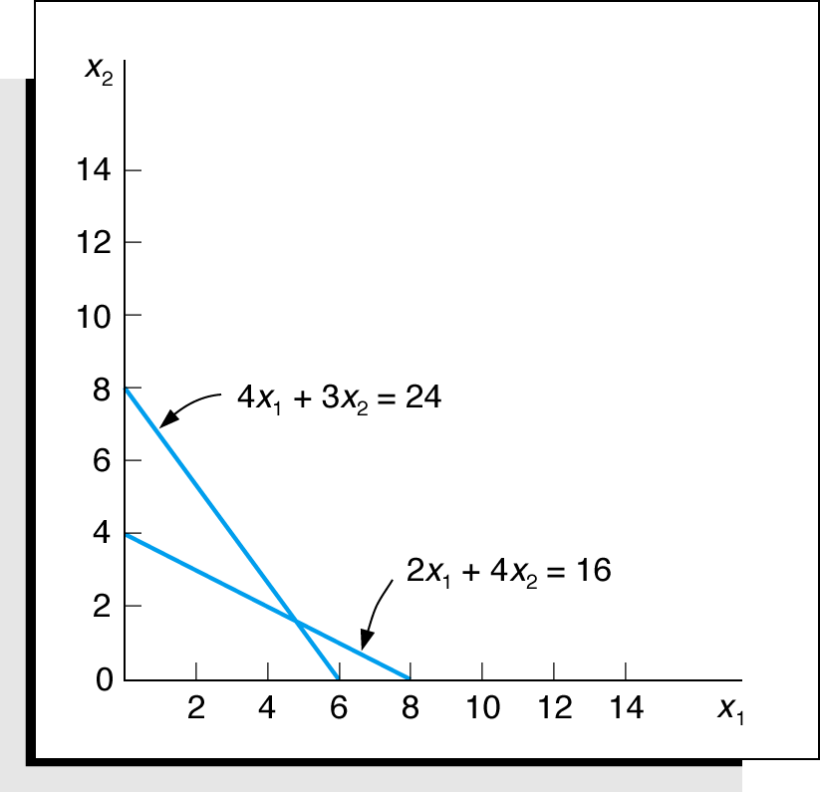
Constraint Graph – Minimization
Minimize Z = $6x₁ + $3x₂
subject to: 2x₁ + 4x₂ ≥ 16
4x₁ + 3x₂ ≥ 24
x₁, x₂ ≥ 0
Graph of Both Model Constraints

Slide 17
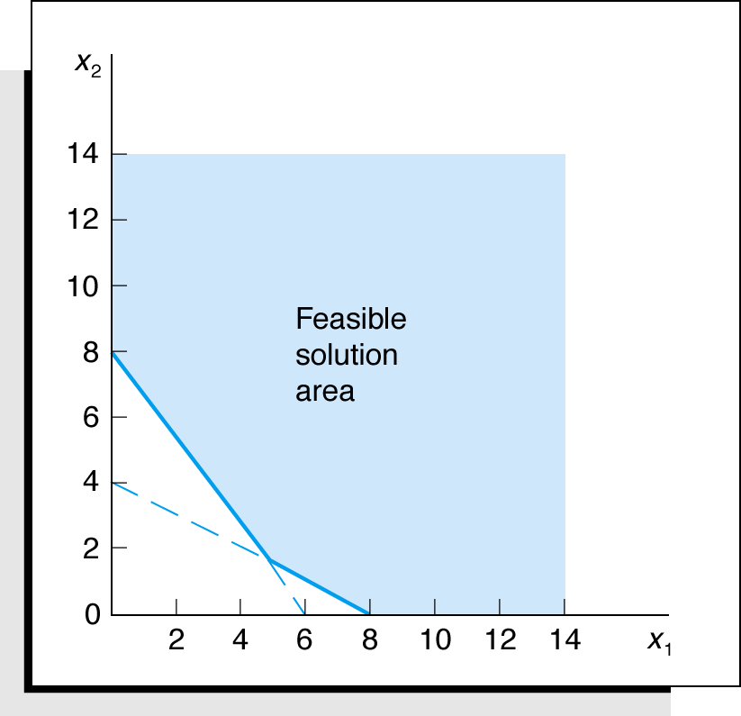
Feasible Region– Minimization
Minimize Z = $6x₁ + $3x₂
subject to: 2x₁ + 4x₂ ≥ 16
4x₁ + 3x₂ ≥ 24
x₁, x₂ ≥ 0
Feasible Solution Area

Slide 18
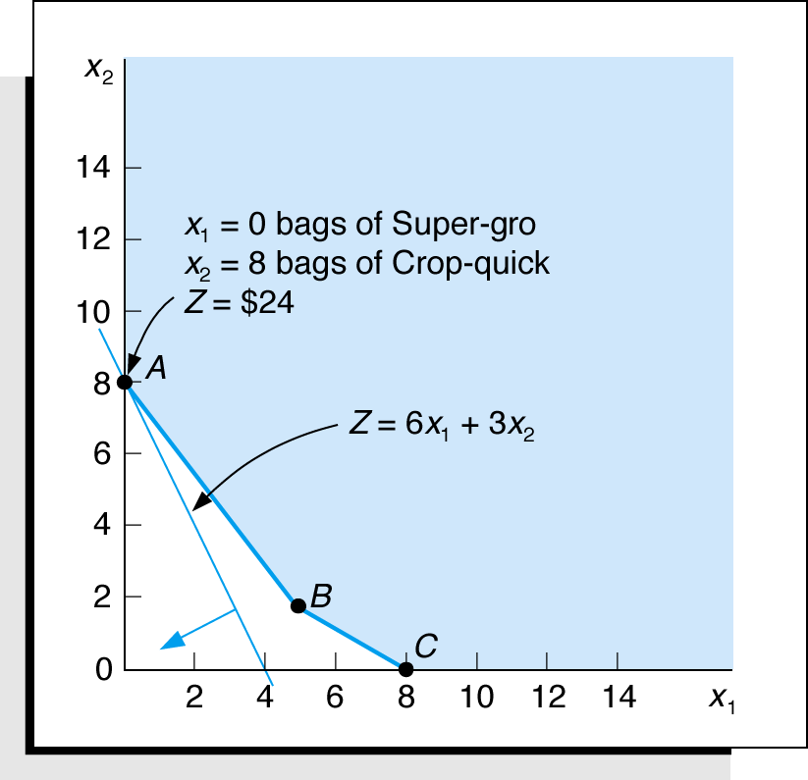
Optimal Solution Point – Minimization
feasible
Minimize Z = $6x₁ + $3x₂
subject to: 2x₁ + 4x₂ ≥ 16
4x₁ + 3x₂ ≥ 24
x₁, x₂ ≥ 0
Optimum Solution Point

Slide 19
Surplus Variables – Minimization
A surplus variable is subtracted from a ≥ constraint to convert it to an equation (=).
A surplus variable represents an excess above a constraint requirement level.
A surplus variable contributes nothing to the calculated value of the objective function.
Subtracting surplus variables in the farmer problem constraints:
2x₁ + 4x₂ - s₁ = 16 (nitrogen)
4x₁ + 3x₂ - s₂ = 24 (phosphate)

Slide 20
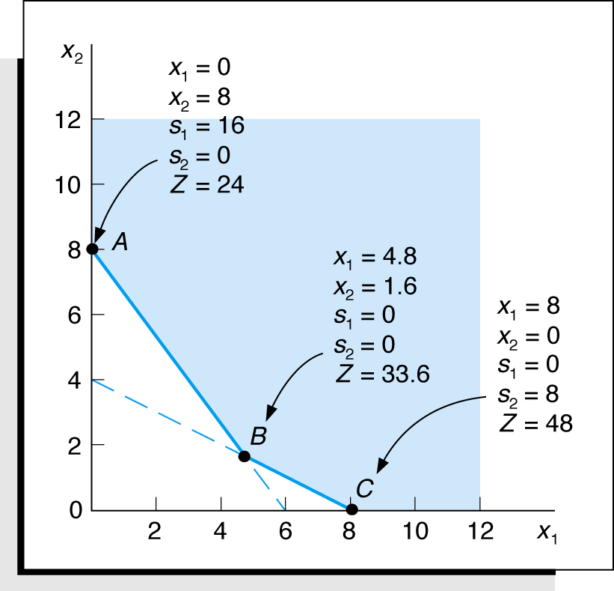
Graphical Solutions – Minimization
feasible
Minimize Z = $6x₁ + $3x₂ + 0s₁ + 0s₂
subject to: 2x₁ + 4x₂ – s₁ = 16
4x₁ + 3x₂ – s₂ = 24
x₁, x₂, s₁, s₂ ≥ 0
Graph of Fertilizer Example

Slide 21
Irregular Types of Linear Programming Problems
For some linear programming models, the general rules do not apply.
Special types of problems include those with:
Multiple optimal solutions
Infeasible solutions
Unbounded solutions

Slide 22
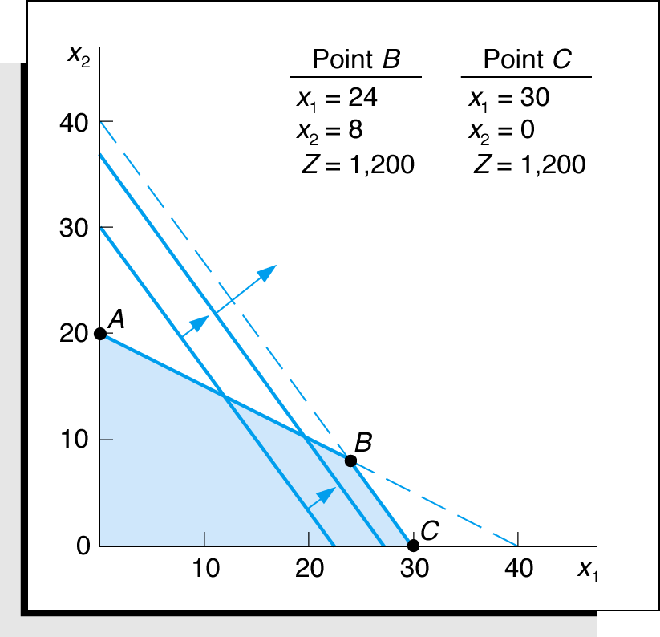
Multiple Optimal Solutions Beaver Creek Pottery
The objective function is
parallel to a constraint line.
Maximize Z=$40x₁ + 30x₂
subject to: 1x₁ + 2x₂ ≤ 40
4x₁ + 3x₂ ≤ 120
x₁, x₂ ≥ 0
Where:
x₁ = number of bowls
x₂ = number of mugs
feasible
Example with Multiple Optimal Solutions

Slide 23
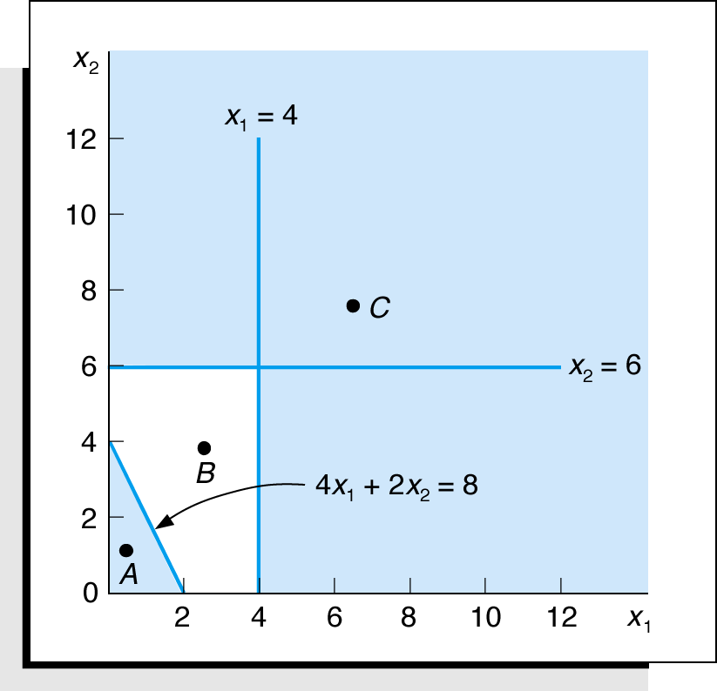
An Infeasible Problem
Every possible solution
violates at least one constraint:
Maximize Z = 5x₁ + 3x₂
subject to: 4x₁ + 2x₂ ≤ 8
x₁ ≥ 4
x₂ ≥ 6
x₁, x₂ ≥ 0
feasible
feasible
Graph of an Infeasible Problem

Slide 25
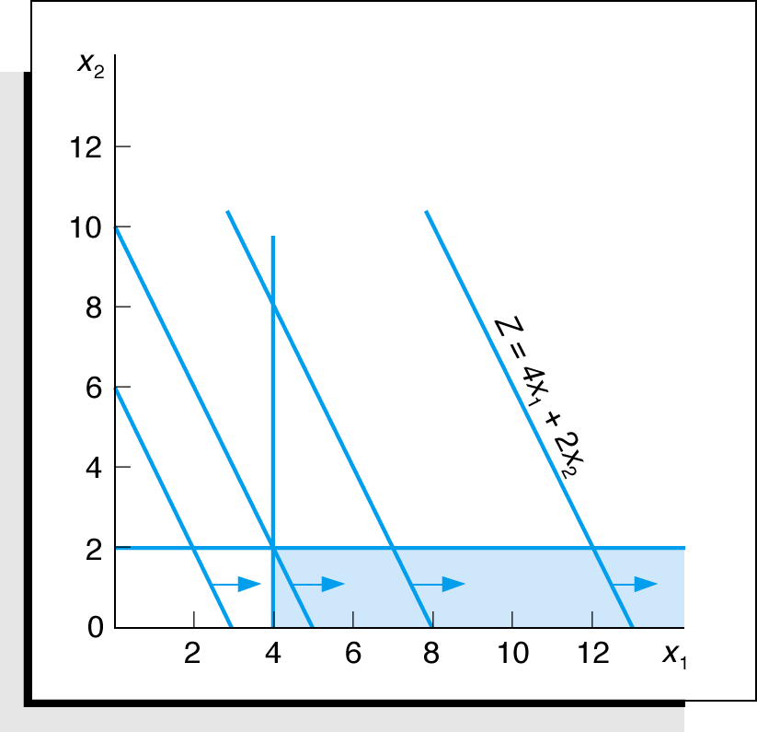
An Unbounded Problem
Value of the objective
function increases indefinitely:
Maximize Z = 4x₁ + 2x₂
subject to: x₁ ≥ 4
x₂ ≤ 2
x₁, x₂ ≥ 0
Graph of an Unbounded Problem

Slide 26
Simplex Method
A large variety of Simplex-based algorithms exist to solve LP problems.
Other (polynomial time) algorithms have been developed for solving LP problems:
Khachian algorithm (1979)
Kamarkar algorithm (AT&T Bell Labs, mid 80s)
See Section 4.10
BUT,
none of these algorithms have been able to beat Simplex in actual practical applications.
HENCE,
Simplex (in its various forms) is and will most likely remain the most dominant LP algorithm for at least the near future

Slide 27
Extreme point theorem:
If the maximum or minimum value of a linear function defined over a polygonal convex region exists, then it is to be found at the boundary of the region.
Convex set:
A set (or region) is convex if, for any two points (say, x₁ and x₂) in that set, the line segment joining these points lies entirely within the set.
A point is by definition convex.

Slide 28
What does the extreme point theorem imply?
A finite number of extreme points implies a finite number of solutions!
Hence, search is reduced to a finite set of points
However, a finite set can still be too large for practical purposes
Simplex method provides an efficient systematic search guaranteed to converge in a finite number of steps.

Slide 29
Formulations
There are many ways to formulate linear programs:
objective (or cost) function maximize c^{T}x, or minimize c^{T}x, or find any feasible solution
(in)equalities Ax ≤ b, or Ax ≥ b, or Ax = b, or any combination
nonnegative variables x ≥ 0, or not
Fortunately it is pretty easy to convert among forms

Slide 30
Formulations
The two most common formulations:
Canonical form
Standard form
minimize c^{T}x
subject to Ax ≥ b
x ≥ 0
slack
variables
minimize c^{T}x
subject to Ax = b
x ≥ 0
e.g.
7x₁ + 5x₂ ≥ 7
x₁, x₂ ≥ 0
y₁
7x₁ + 5x₂ - y₁ = 7
x₁, x₂, y₁ ≥ 0

Slide 31
Geometric View of Canonical Form
A polytope in n-dimensional space
Each inequality corresponds to a half-space.
The “feasible set” is the intersection of the half-spaces
This corresponds to a polytope
Polytopes are convex: if x,y is in the polytope, so is the line segment joining them.
The optimal solution is at a vertex (i.e., a corner).

Slide 32
Geometric View of Canonical Form
x₂
minimize:
 | z = -2x₁ - 3x₂
subject to:
 | x₁ – 2x₂ | ≤ 4
 | 2x₁ + x₂ | ≤ 18
 | x₂ | ≤ 10
 | x₁, x₂ ≥ 0
x₂ ≤ 10
Feasible Set
Direction
of “Goodness”
Corners
Objective
Function
-2x₁ – 3x₂
An intersection of 5 halfspaces
x₁
x₁ – 2x₂ ≤ 4
2x₁ + x₂ ≤ 18
Notes:
Is there necessarily any feasible set?

Slide 33
Geometric View of Canonical Form
A polytope in n-dimensional space
Each inequality corresponds to a half-space.
The “feasible set” is the intersection of the half-spaces.
This corresponds to a polytope
The optimal solution is at a corner.
Simplex moves around on the surface of the polytope
Interior-Point methods move within the polytope

Slide 34
The Simple Essense of Simplex
Polytope P
Input: min f(x) = cx
s.t. x in P = {x: Ax ≤ b, x ≥ 0}
Consider Polytope P from canonical form as a graph G = (V,E) with
V = polytope vertices,
E = polytope edges.
Find any vertex v of P.
While there exists a neighbor u of v in G with
f(u) < f(v), update v to u.
3) Output v.
Choice of neighbor if several u have f(u) < f(v)?

Slide 35
Basic Steps of Simplex
1. Begin the search at an extreme point (i.e., a basic feasible solution).
2. Determine if the movement to an adjacent extreme can improve on the optimization of the objective function. If not, the current solution is optimal. If, however, improvement is possible, then proceed to the next step.
3. Move to the adjacent extreme point which offers (or, perhaps, appears to offer) the most improvement in the objective function.
4. Continue steps 2 and 3 until the optimal solution is found or it can be shown that the problem is either unbounded or infeasible.

Slide 36
Simplex Running Time
For dense matrices, takes O(n(n+m)) time per iteration
Can take an exponential number of iterations.
In practice, sparse methods are used for the iterations.

Slide 37
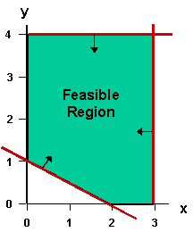
Linear Programming in 2 dimensions
Name | Vars | Constraints | Objective
linear programming (LP) | real | linear inequalities | linear function
y ≤ 4
2 variables: feasible region is a convex polygon
x ≥ 0
x ≤ 3
boundary of feasible region comes from the constraints
x+2y ≥ 2
y ≥ 0

Slide 38
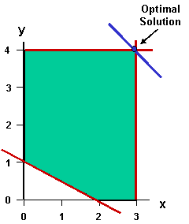
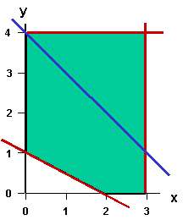
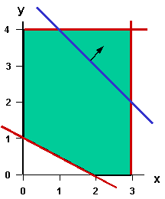
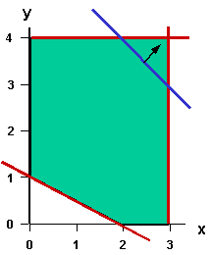
Linear Programming in 2 dimensions
Name | Vars | Constraints | Objective
linear programming (LP) | real | linear inequalities | linear function
“level sets” of the objective x+y (sets where it takes a certain value)
x+y = 4
x+y = 5
x+y = 6
x+y = 7

Slide 39
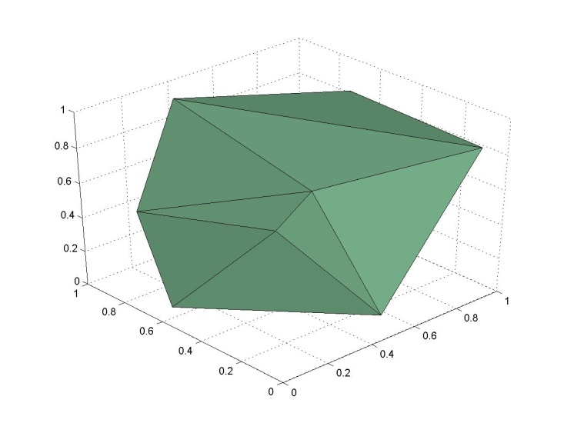
Linear Programming in n dimensions
Name | Vars | Constraints | Objective
linear programming (LP) | real | linear inequalities | linear function
3 variables: feasible region is a convex polyhedron

Slide 40
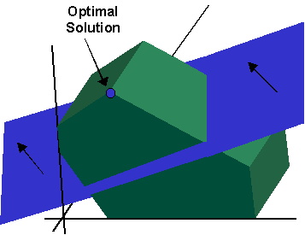
Linear Programming in n dimensions
Name | Vars | Constraints | Objective
linear programming (LP) | real | linear inequalities | linear function
here level set is a plane (in general, a hyperplane)
If an LP optimum is finite, it can always be achieved at a corner (“vertex”) of the feasible region.
(Can there be infinite solutions? Multiple solutions?)

Slide 41
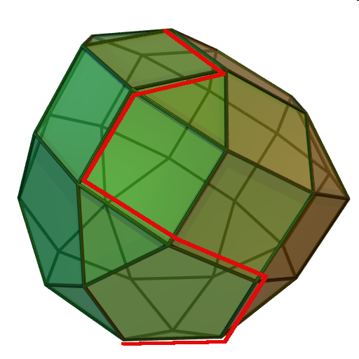
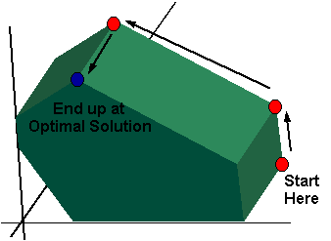
Simplex Method for Solving an LP
At every step, move to an adjacent vertex that improves the objective.

Slide 42
Trail Mix Problem
Acme Snacks produces three different trail mix blends by mixing the following raw ingredients: peanuts, raisins, soynuts, and pretzels.
These ingredients contain the following nutrients: vitamins, protein, calcium, and fat in the following quantities:
Nutrient, k
Vitamins
Protein
Calcium
Crude Fat
Ingredient, i
peanuts
8
10
6
8
raisins
6
5
10
6
soynuts
10
12
6
6
pretzels
4
18
6
9
Let a_{ik} = quantity of nutrient k per kg of ingredient i

Slide 43
Constraints
The company contracts for the following demands.
Demand (kg)
Mix 1
Mix 2
Mix 3
d_{j}
10,000
6,000
8,000
There are limited availabilities of the raw ingredients.
Supply (kg)
peanuts
raisins
soynuts
pretzels
s_{i}
6,000
10,000
4,000
5,000
The different mixes have “quality” bounds per kilogram.
Vitamins
Protein
Calcium
Crude fat
min max
min max
min max
min max
Mix 1
6 --
6 --
7 --
4 8
Mix 2
6 --
6 --
6 --
4 8
Mix 3
4 6
6 --
6 --
4 8
The above values represent bounds: l_{jk} and u_{jk}

Slide 44
Costs and Notation
Cost per kg of the raw ingredients is as follows:
peanuts
raisins
soynuts
pretzels
cost/kg, c_{i}
20¢
12¢
24¢
12¢
Formulate problem as a linear program whose solution yields desired trail mix production levels at minimum cost.
Indices/sets
i ∈ I
ingredients { peanuts, raisins, soynuts, pretzels }
j ∈ J
products { mix 1, mix 2, mix 3}
k ∈ K
nutrients { vitamins, protein, calcium, crude fat }

Slide 45
Data
d_{j}
demand for product j (kg)
s_{i}
supply of ingredient i (kg)
l_{jk}
lower bound on number of nutrients of type k per kg of product j
u_{jk}
upper bound on number of nutrients of type k per kg of product j
c_{i}
cost per kg of ingredient i
a_{ik}
number of nutrients k per kg of ingredient i
Decision Variables
x_{ij}
amount (kg) of ingredient i used in producing product j

Slide 46
LP Formulation of Mix Problem
∑
∑
c_{i}x_{ij}
min
i∈I
j∈J
∑
x_{ij} = d_{j}
∀ j ∈ J
s.t.
i∈I
∑
x_{ij} ≤ s_{i}
∀ i ∈ I
j∈J
∑
a_{ik}x_{ij} ≥ l_{jk} d_{j}
∀ j ∈ J, k∈K
i∈I
∑
a_{ik}x_{ij} ≤ u_{jk}d_{j}
∀ j ∈ J, k∈K
i∈I
x_{ij} ≥ 0
∀ i ∈ I, j ∈ J

Slide 48
LP:Labor Planning
Addresses staffing needs over a specific time period.
Hong Kong Bank of Commerce:
12 Full time workers available, but may fire some.
Use part time workers who has to work for 4 consequtive hours in a day.
Luch time is one hour between 11a.m. and 1p.m. shared by full time workers.
Total part time hours is less than 50% of the day’s total requirement.
Part-timers earn $4/hr (=$16/day) and full timers earn $50/day.

Slide 49
LP:Labor Planning (Cont’d.)
Time Period | Minimum labor required
9a.m.-10a.m. | 10
10a.m.-11a.m. | 12
11a.m.-noon | 14
Noon-1p.m. | 16
1p.m.-2p.m. | 18
2p.m.-3p.m. | 17
3p.m.-4p.m. | 15
4p.m.-5p.m. | 10

Slide 50
LP:Labor Planning (cont’d.)

Slide 51
Applications of LP:Transportation Models
Sporting goods company
Capacity Plants
Warehouses Demand
Frankfurt
100
300
200
Juarez
150
100
200
150
Seoul
NY
Tel Aviv
Phoenx
Yokohama

Slide 52
LP:Transportation Models (cont’d.)
What are the optimal shipping quantities from the
plants to the warehouses, if the demand has to be met
by limited capacities while the shipping cost is minimized?
Shipping Costs per pair of skis
From Plant | Destination
 | Frankfurt | NY | Phoenix | Yokohama
Juarez | $19 | $7 | $3 | $21
Seoul | 15 | 21 | 18 | 6
Tel Aviv | 11 | 14 | 15 | 22

Slide 53
LP:Transportation Models (cont’d.)
X_{ij}: Number of units shipped from plant i to warehouse j. i=1,2,3 and j=1,2,3,4.
Minimize shipping costs=19X₁₁+7X₁₂+3X₁₃+21X₁₄
+15X₂₁+21X₂₂+18X₂₃+6X₂₄
+11X₃₁+14X₃₂+15X₃₃+22X₃₄
From Plant | Destination |  |  |  | Capacity
 | Frankfurt | NY | Phoenix | Yokohama
Juarez | X11 | X12 | X13 | X14 | 100
Seoul | X21 | X22 | X23 | X24 | 300
Tel Aviv | X31 | X32 | X33 | X34 | 200
Demand | 150 | 100 | 200 | 150 | 600

Slide 54
LP:Transportation Models (cont’d.)
subject to
#shipped from a plant can not exceed the capacity:
X₁₁+X₁₂+X₁₃+X₁₄≤100 (Juarez Plant)
X₂₁+X₂₂+X₂₃+X₂₄≤300 (Seoul Plant)
X₃₁+X₃₂+X₃₃+X₃₄≤200 (Tel Aviv Plant)
#shipped to a warehouse can not be less than the demand:
X₁₁+X₂₁+X₃₁≥150 (Frankfurt)
X₁₂+X₂₂+X₃₂≥100 (NY)
X₁₃+X₂₃+X₃₃≥200 (Phoenix)
X₁₄+X₂₄+X₃₄≥150 (Yokohama)
Nonnegativity
X_{ij} ≥0 for all i,j.

Slide 55
LP:Transportation Models (cont’d.)
Optimal Solution: Optimal cost=$6,250
Capacity Plants
Warehouses Demand
Frankfurt
100
300
200
Juarez
50
150
100
200
150
100
Seoul
NY
100
100
Tel Aviv
Phoenx
100
150
Yokohama

Slide 57
Decision Problem
min(max (x1, x2, x3))
ST 3x1 + 2x2 – 5x3 <= 8

Slide 58
Decision Problem
min(max (x1, x2, x3))
ST 3x1 + 2x2 – 5x3 <= 8
min = t
ST 3x₁+2x₂- 5x₃ <=8
x₁<=t x1 – t <= 0
x₂<=t x2 – t <= 0
x₃<=t x3 – t <= 0

Slide 59
Decision Problem
min = t
ST 3x₁+2x₂- 5x₃ <=8
x₁<=t x1 – t <= 0
x₂<=t x2 – t <= 0
x₃<=t x3 – t <= 0
Unbounded: x’s can keep getting smaller

Slide 60
 | min (max(x1, x2, x3))
 |  |  |  |  | max | 3x1+2x2- 5x3 | <= 8
 |  | x1 | x2 | x3 | 0 | constraint | met
 |  | 2 | 1 | 5 | 5 | -17 | TRUE
 |  | -2 | -3 | 8 | 8 | -52 | TRUE
 |  | 3 | -2 | 2 | 3 | -5 | TRUE
 |  | -10 | -20 | -7 | -7 | -35 | TRUE
 |  | -10 | -20 | -8 | -8 | -30 | TRUE
 |  | -10 | -20 | -9 | -9 | -25 | TRUE
 |  | -12 | -22 | -10 | -10 | -30 | TRUE
 |  | -14 | -24 | -11 | -11 | -35 | TRUE
 |  | -16 | -26 | -12 | -12 | -40 | TRUE
 |  | -18 | -28 | -13 | -13 | -45 | TRUE
 |  | -20 | -30 | -14 | -14 | -50 | TRUE
 |  | -22 | -32 | -15 | -15 | -55 | TRUE
 |  | -24 | -34 | -16 | -16 | -60 | TRUE
 |  | -26 | -36 | -17 | -17 | -65 | TRUE
 |  | -28 | -38 | -18 | -18 | -70 | TRUE
 |  | -30 | -40 | -19 | -19 | -75 | TRUE
 |  | -32 | -42 | -20 | -20 | -80 | TRUE
 |  | -34 | -44 | -21 | -21 | -85 | TRUE
 |  | -36 | -46 | -22 | -22 | -90 | TRUE
 |  | -38 | -48 | -23 | -23 | -95 | TRUE
 |  | -40 | -50 | -24 | -24 | -100 | TRUE
 |  | -42 | -52 | -25 | -25 | -105 | TRUE
 |  |  |  | min | -25

Slide 61
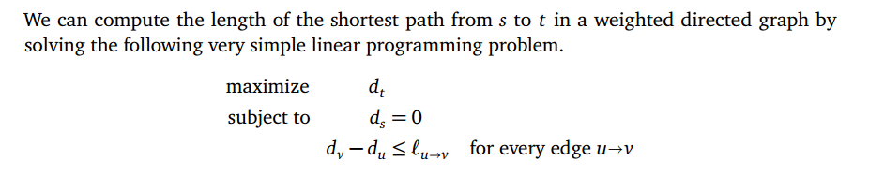
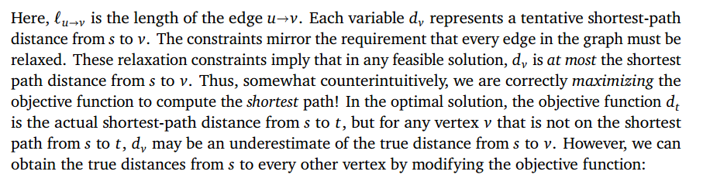
Shortest Paths

Slide 62
Variations
Integer Programming
Mixed Integer Programming

Slide 63
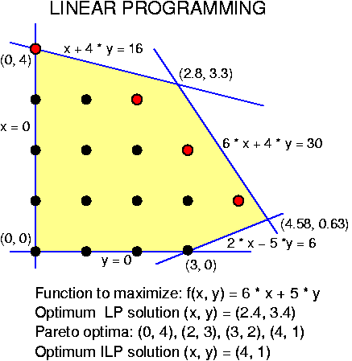
Integer Linear Programming (ILP)
Name | Vars | Constraints | Objective
integer linear prog. (ILP) | integer | linear inequalities | linear function
round to nearest int (3,3)? No, infeasible.
round to nearest feasible int (2,3) or (3,2)? No, suboptimal.
round to nearest integer vertex (0,4)? No, suboptimal.

Slide 64
Mixed Integer Programming (MIP)
Name | Vars | Constraints | Objective
linear programming (LP) | real | linear inequalities | linear function
integer linear prog. (ILP) | integer | linear inequalities | linear function
mixed integer prog. (MIP) | int&real | linear inequalities | linear function
We’ll be studying
MIP solvers.
SCIP mainly does MIP though it goes a bit farther.
x still integer
but y is now real

Slide 65
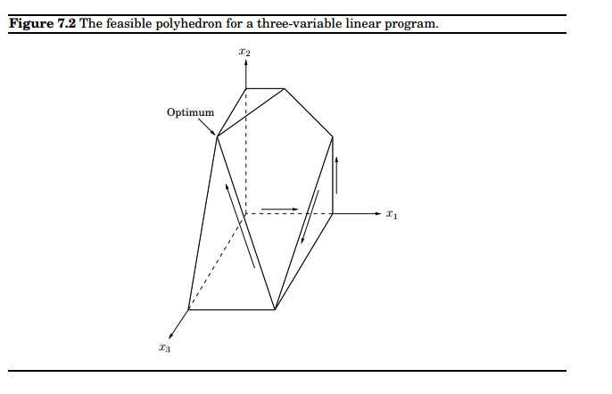
6
7
3
2
1
4
5

